Slide 1

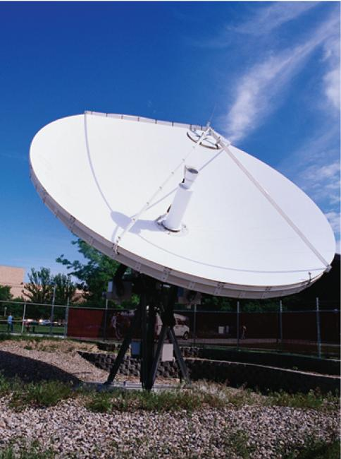
12
Vectors and the Geometry
of Space
Copyright © Cengage Learning. All rights reserved.

Slide 2

12.4
The Cross Product
Copyright © Cengage Learning. All rights reserved.

Slide 3


The Cross Product
Given two nonzero vectors a = ⟨a₁, a₂, a₃⟩ and
b = ⟨b₁, b₂, b₃⟩, it is very useful to be able to find a nonzero vector c that is perpendicular to both a and b.
If c = ⟨c₁, c₂, c₃⟩ is such a vector, then a  c = 0 and
b  c = 0 and so
a₁c₁ + a₂c₂ + a₃c₃ = 0
b₁c₁ + b₂c₂ + b₃c₃ = 0

Slide 4




The Cross Product
To eliminate c₃ we multiply by b₃ and by a₃ and subtract:
(a₁b₃ – a₃b₁)c₁ + (a₂b₃ – a₃b₂)c₂ = 0
Equation 3 has the form pc₁ + qc₂ = 0, for which an obvious solution is c₁ = q and c₂ = –p. So a solution of is
c₁ = a₂b₃ – a₃b₂ c₂ = a₃b₁ – a₁b₃

Slide 5
The Cross Product
Substituting these values into and , we then get
c₃ = a₁b₂ – a₂b₁
This means that a vector perpendicular to both a and b is
⟨c₁, c₂, c₃⟩ = ⟨a₂b₃ – a₃b₂, a₃b₁ – a₁b₃, a₁b₂ – a₂b₁⟩
The resulting vector is called the cross product of a and b and is denoted by a × b.

Slide 6
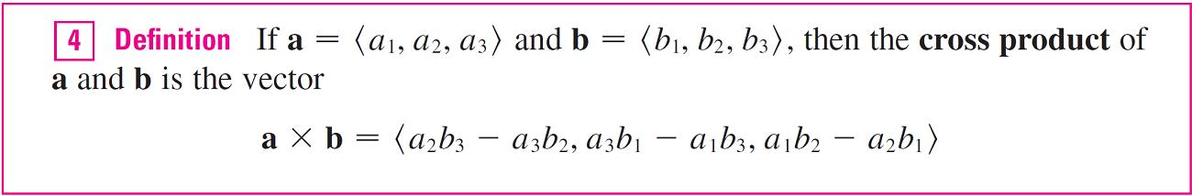
The Cross Product
Notice that the cross product a × b of two vectors a and b, unlike the dot product, is a vector. For this reason it is also called the vector product.
Note that a × b is defined only when a and b are
three-dimensional vectors.

Slide 7
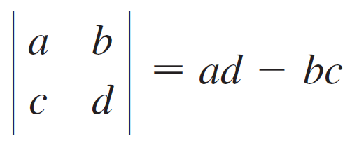
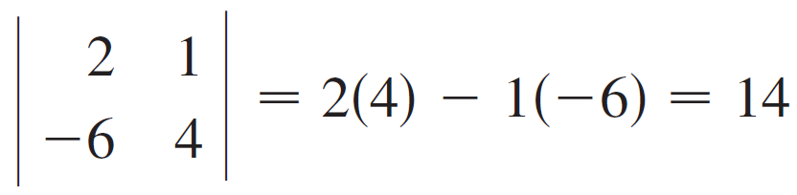
The Cross Product
In order to make Definition 4 easier to remember, we use the notation of determinants.
A determinant of order 2 is defined by
For example,

Slide 8
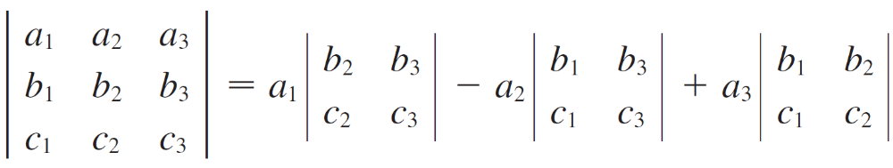

The Cross Product
A determinant of order 3 can be defined in terms of second-order determinants as follows:
Observe that each term on the right side of Equation 5 involves a number a_{i} in the first row of the determinant, and a_{i} is multiplied by the second-order determinant obtained from the left side by deleting the row and column in which a_{i} appears.

Slide 9
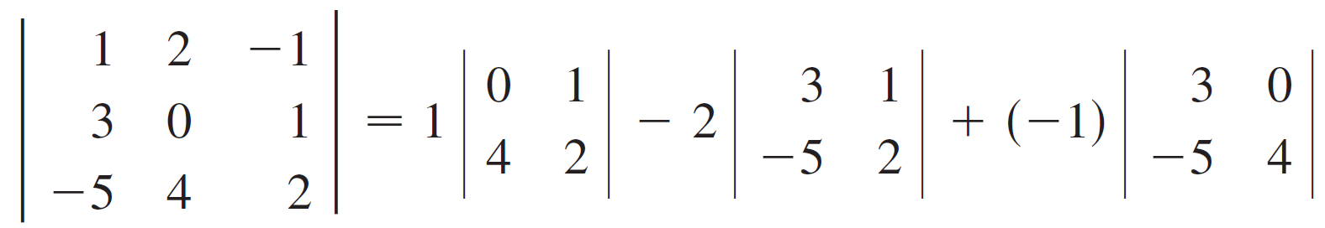
The Cross Product
Notice also the minus sign in the second term. For example,
= 1(0 – 4) – 2(6 + 5) + (–1)(12 – 0)
= –38

Slide 10
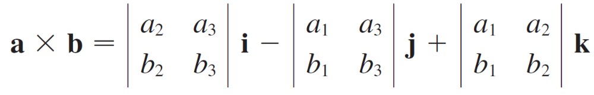

The Cross Product
If we now rewrite Definition 4 using second-order determinants and the standard basis vectors i, j, and k, we see that the cross product of the vectors
a = a₁ i + a₂ j + a₃ k and b = b₁ i + b₂ j + b₃ k is

Slide 11
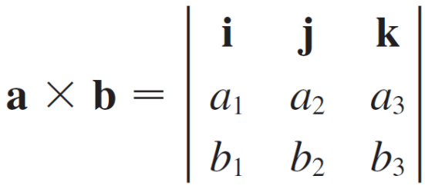

The Cross Product
In view of the similarity between Equations 5 and 6, we often write
Although the first row of the symbolic determinant in Equation 7 consists of vectors, if we expand it as if it were an ordinary determinant using the rule in Equation 5, we obtain Equation 6.
The symbolic formula in Equation 7 is probably the easiest way of remembering and computing cross products.

Slide 12
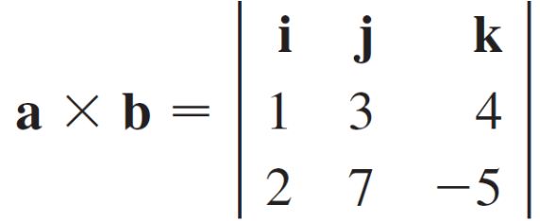
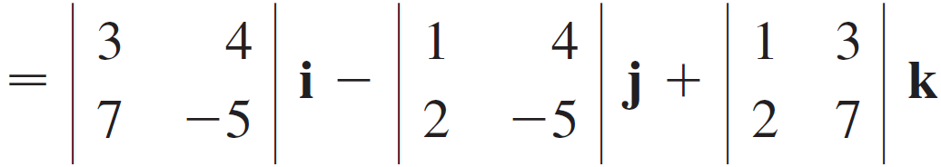
Example 1
If a = ⟨1, 3, 4⟩ and b = ⟨2, 7, –5⟩, then
= (–15 – 28)i – (–5 – 8)j + (7 – 6)k
= –43i + 13j + k

Slide 13
The Cross Product
We constructed the cross product a × b so that it would be perpendicular to both a and b. This is one of the most important properties of a cross product.

Slide 14
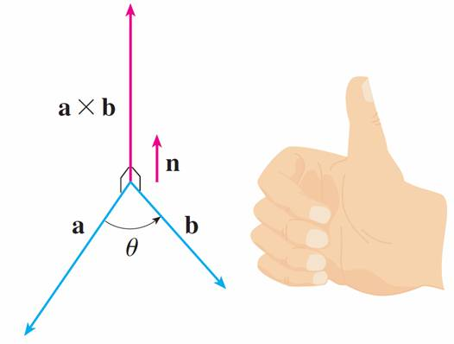
The Cross Product
If a and b are represented by directed line segments with the same initial point (as in Figure 1), then Theorem 8 says that the cross product a × b points in a direction perpendicular to the plane through a and b.
The right-hand rule gives the direction of a × b.
Figure 1

Slide 15
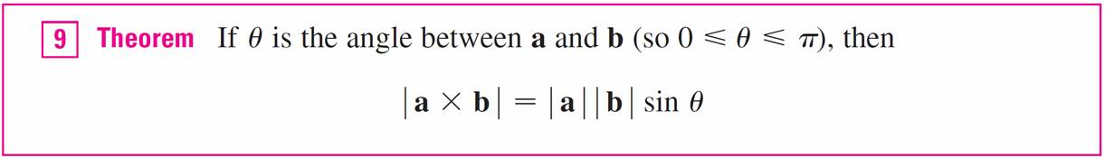
The Cross Product
It turns out that the direction of a × b is given by the
right-hand rule: If the fingers of your right hand curl in the direction of a rotation (through an angle less than 180°) from to a to b, then your thumb points in the direction of
a × b.
Now that we know the direction of the vector a × b, the remaining thing we need to complete its geometric description is its length | a × b |. This is given by the following theorem.

Slide 16
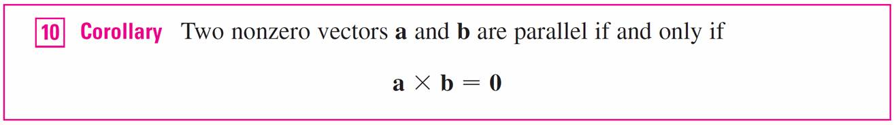
The Cross Product
Since a vector is completely determined by its magnitude and direction, we can now say that a × b is the vector that is perpendicular to both a and b, whose orientation is determined by the right-hand rule, and whose length is
| a | | b |sin θ. In fact, that is exactly how physicists
define a × b.

Slide 17
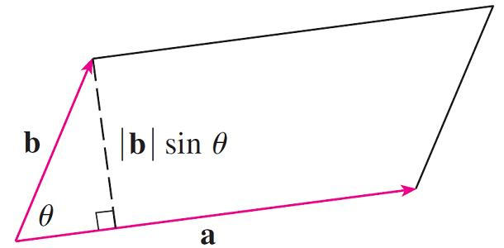
The Cross Product
The geometric interpretation of Theorem 9 can be seen by looking at Figure 2.
Figure 2

Slide 18
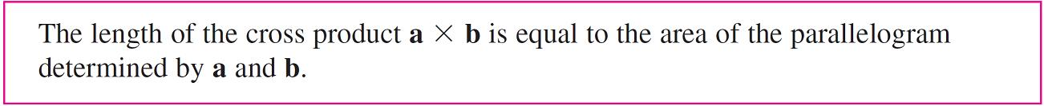
The Cross Product
If a and b are represented by directed line segments with the same initial point, then they determine a parallelogram with base | a |, altitude | b |sin θ, and area
A = | a |(| b |sin θ) = | a × b |
Thus we have the following way of interpreting the magnitude of a cross product.

Slide 19
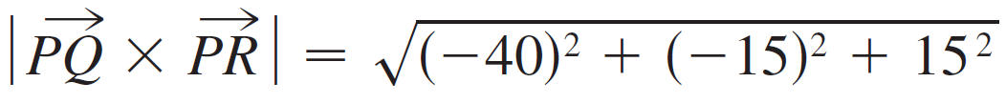


Example 4
Find the area of the triangle with vertices P (1, 4, 6),
Q (–2, 5, –1), and R (1, –1, 1).
Solution:
In Example 3 we computed that PQ × PR = ⟨–40, –15, 15⟩. The area of the parallelogram with adjacent sides PQ and PR is the length of this cross product:
The area A of the triangle PQR is half the area of this parallelogram, that is, .

Slide 20
The Cross Product
If we apply Theorems 8 and 9 to the standard basis vectors i, j, and k using θ = π /2, we obtain
i × j = k j × k = i k × i = j
j × i = –k k × j = –i i × k = –j
Observe that
i × j ≠ j × i

Slide 21
The Cross Product
Thus the cross product is not commutative. Also
i × (i × j) = i × k = –j
whereas
(i × i) × j = 0 × j = 0
So the associative law for multiplication does not usually
hold; that is, in general,
(a × b) × c ≠ a × (b × c)
However, some of the usual laws of algebra do hold for cross products.

Slide 22
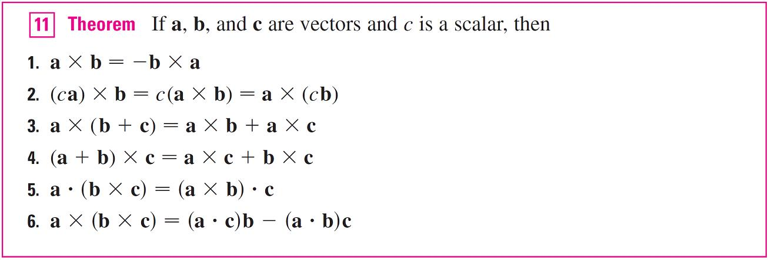
The Cross Product
The following theorem summarizes the properties of vector products.

Slide 23

The Cross Product
These properties can be proved by writing the vectors in terms of their components and using the definition of a cross product.
If a = ⟨a₁, a₂, a₃⟩, b = ⟨b₁, b₂, b₃⟩, and c = ⟨c₁, c₂, c₃⟩, then
a  (b × c) = a₁(b₂c₃ – b₃c₂) + a₂(b₃c₁ – b₁c₃)
+ a₃(b₁c₂ – b₂c₁)

Slide 24
Triple Products

Slide 25
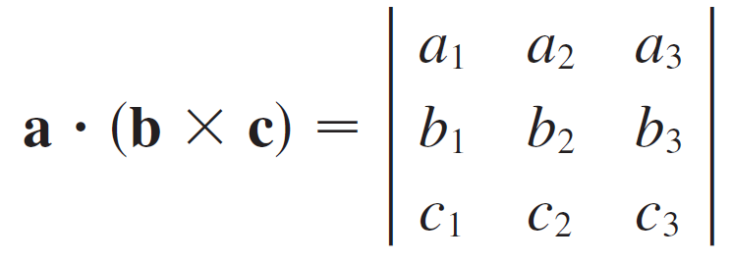

Triple Products
The product a  (b × c) that occurs in Property 5 is called the scalar triple product of the vectors a, b, and c. Notice from Equation 12 that we can write the scalar triple product as a determinant:

Slide 26
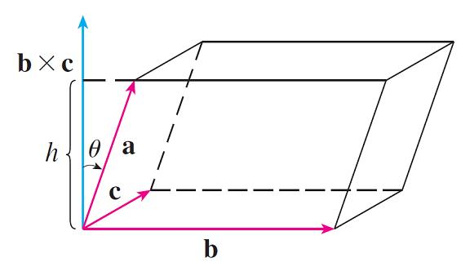
Triple Products
The geometric significance of the scalar triple product can be seen by considering the parallelepiped determined by the vectors a, b, and c. (See Figure 3.)
The area of the base parallelogram is A = | b × c |.
Figure 3

Slide 27
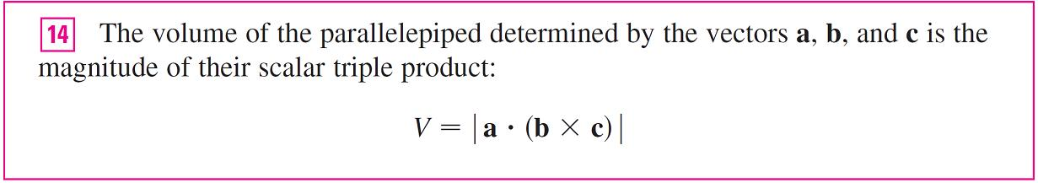
Triple Products
If θ is the angle between a and b × c, then the height h of the parallelepiped is h = | a || cos θ |. (We must use | cos θ | instead of cos θ in case θ > π/2.) Therefore the volume of the parallelepiped is
V = Ah = | b × c || a || cos θ | = | a  (b × c) |
Thus we have proved the following formula.

Slide 28

Triple Products
If we use the formula in and discover that the volume of the parallelepiped determined by a, b, and c is 0, then the vectors must lie in the same plane; that is, they are coplanar.

Slide 29
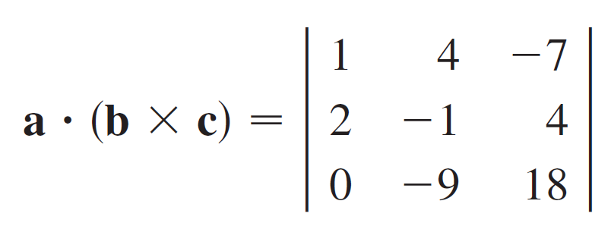
Example 5
Use the scalar triple product to show that the vectors
a = ⟨1, 4, –7⟩, b = ⟨2, –1, 4⟩, and c = ⟨0, –9, 18⟩ are coplanar.
Solution:
We use Equation 13 to compute their scalar triple product:

Slide 30
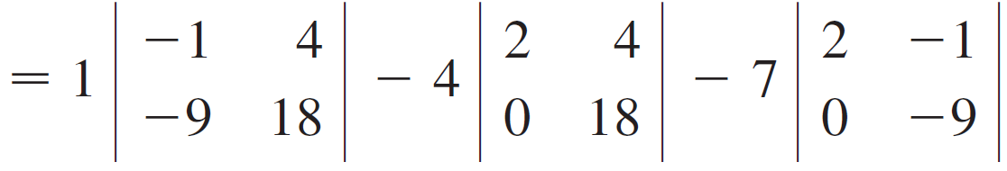

Example 5 – Solution
cont’d
= 1(18) – 4(36) – 7(–18)
= 0
Therefore, by , the volume of the parallelepiped determined by a, b, and c is 0. This means that a, b, and c are coplanar.

Slide 31
Triple Products
The product a × (b × c) that occurs in Property 6 is called the vector triple product of a, b, and c.

Slide 32
Torque

Slide 33
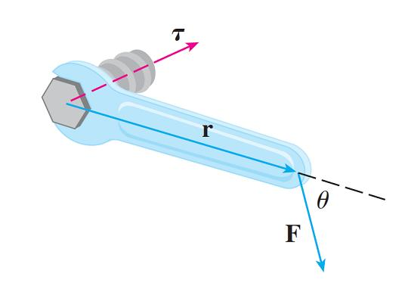
Torque
The idea of a cross product occurs often in physics.
In particular, we consider a force F acting on a rigid body at a point given by a position vector r. (For instance, if we tighten a bolt by applying a force to a wrench as in
Figure 4, we produce a turning effect.)
Figure 4

Slide 34
Torque
The torque τ (relative to the origin) is defined to be the cross product of the position and force vectors
τ = r × F
and measures the tendency of the body to rotate about the origin. The direction of the torque vector indicates the axis of rotation.

Slide 35
Torque
According to Theorem 9, the magnitude of the torque vector is
| τ | = | r × F | = | r || F | sin θ
where θ is the angle between the position and force vectors. Observe that the only component of F that can cause a rotation is the one perpendicular to r, that is,
|F| sin θ.
The magnitude of the torque is equal to the area of the parallelogram determined by r and F.

Slide 36
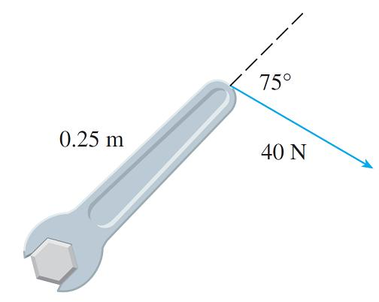
Example 6
A bolt is tightened by applying a 40-N force to a 0.25-m wrench as shown in Figure 5.
Find the magnitude of the torque about the center of the bolt.
Figure 5

Slide 37
Example 6 – Solution
The magnitude of the torque vector is
| τ | = | r × F | = | r || F | sin 75°
= (0.25)(40) sin 75°
= 10 sin 75° ≈ 9.66 Nm
If the bolt is right-threaded, then the torque vector itself is
τ = | τ | n ≈ 9.66 n
where n is a unit vector directed down into the page.

