Slide 1

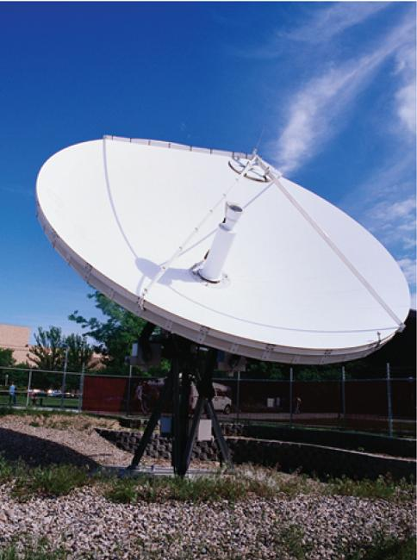
12
Vectors and the Geometry
of Space
Copyright © Cengage Learning. All rights reserved.

Slide 2

12.6
Cylinders and Quadric Surfaces
Copyright © Cengage Learning. All rights reserved.

Slide 3
Cylinders and Quadric Surfaces
We have already looked at two special types of surfaces: planes and spheres.
Here we investigate two other types of surfaces: cylinders and quadric surfaces.
In order to sketch the graph of a surface, it is useful to determine the curves of intersection of the surface with planes parallel to the coordinate planes.
These curves are called traces (or cross-sections) of the surface.

Slide 4
Cylinders

Slide 5
Cylinders
A cylinder is a surface that consists of all lines
(called rulings) that are parallel to a given line and pass through a given plane curve.

Slide 6
Example 1
Sketch the graph of the surface z = x².
Solution:
Notice that the equation of the graph, z = x², doesn’t involve y.
This means that any vertical plane with equation
y = k (parallel to the xz-plane) intersects the graph in a curve with equation z = x².
So these vertical traces are parabolas.

Slide 7
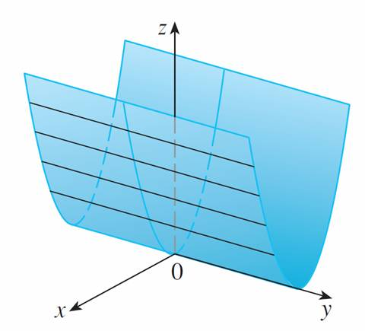
Example 1 – Solution
cont’d
Figure 1 shows how the graph is formed by taking the parabola z = x² in the xz-plane and moving it in the direction of the y-axis.
The surface z = x² is a parabolic cylinder.
Figure 1

Slide 8
Example 1 – Solution
cont’d
The graph is a surface, called a parabolic cylinder, made up of infinitely many shifted copies of the same parabola. Here the rulings of the cylinder are parallel to the y-axis.

Slide 9
Cylinders
We noticed that the variable y is missing from the equation of the cylinder in Example 1. This is typical of a surface whose rulings are parallel to one of the coordinate axes.
If one of the variables x, y or z is missing from the equation
of a surface, then the surface is a cylinder.
Note:
When you are dealing with surfaces, it is important to
recognize that an equation like x² + y² = 1 represents a
cylinder and not a circle. The trace of the cylinder
x² + y² = 1 in the xy-plane is the circle with equations
x² + y² = 1, z = 0.

Slide 10
Quadric Surfaces

Slide 11
Quadric Surfaces
A quadric surface is the graph of a second-degree equation in three variables x, y, and z. The most general such equation is
Where A,B,C,…, J are constants, but by translation and rotation it can be brought into one of the two standard forms
Ax² + By² + Cz² + J = 0 or Ax² + By² + Iz = 0
Quadric surfaces are the counterparts in three dimensions of the conic sections in the plane.

Slide 12
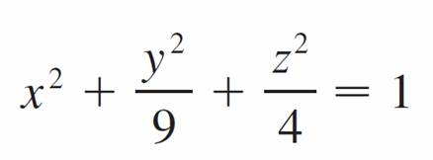
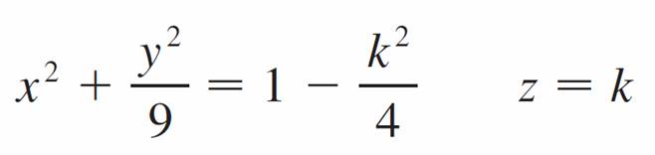
Example 3
Use traces to sketch the quadric surface with equation
Solution:
By substituting z = 0, we find that the trace in the xy-plane is x² + y²/9 = 1, which we recognize as an equation of an ellipse. In general, the horizontal trace in the plane z = k is
which is an ellipse, provided that k² < 4, that is, –2 < k < 2.

Slide 13
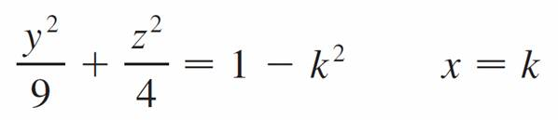
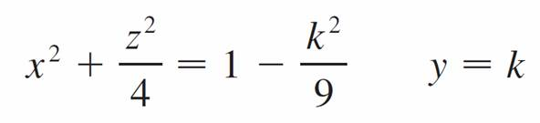
Example 3 – Solution
cont’d
Similarly, the vertical traces are also ellipses:
(if –1 < k < 1)
(if –3 < k < 3)

Slide 14
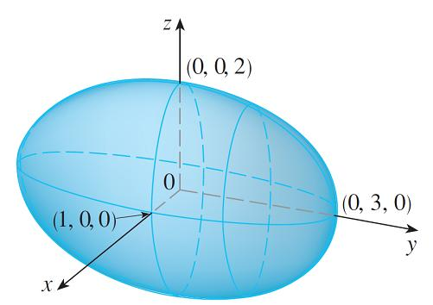
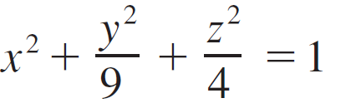
Example 3 – Solution
cont’d
Figure 4 shows how drawing some traces indicates the shape of the surface.
The ellipsoid
Figure 4

Slide 15
Example 3 – Solution
cont’d
It’s called an ellipsoid because all of its traces are ellipses. Notice that it is symmetric with respect to each coordinate plane; this is a reflection of the fact that its equation involves only even powers of x, y, and z.

Slide 16
Example 4
Use traces to sketch the surface z = 4x² + y².
Solution:
If we put x = 0, we get z = y², so the yz-plane intersects the surface in a parabola. If we put x = k (a constant), we get
z = y² + 4k².
This means that if we slice the graph with any plane parallel to the yz-plane, we obtain a parabola that opens upward.
Similarly, if y = k, the trace is z = 4x² + k², which is again a parabola that opens upward.

Slide 17
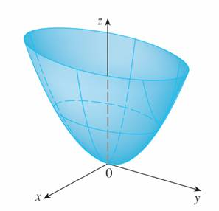
Example 4 – Solution
cont’d
If we put z = k, we get the horizontal traces 4x² + y² = k,
which we recognize as a family of ellipses. Knowing the shapes of the traces, we can sketch the graph in Figure 5.
Because of the elliptical and parabolic traces, the quadric surface z = 4x² + y² is called an elliptic paraboloid.
The surface z = 4x² + y² is an elliptic paraboloid. Horizontal
traces are ellipses; vertical traces are parabolas.
Figure 5

Slide 18
Example 5
Sketch the surface z = y² – x².
Solution:
The traces in the vertical planes x = k are the parabolas
z = y² – k², which open upward. The traces in y = k are the parabolas z = –x² + k², which open downward.
The horizontal traces are y² – x² = k, a family of hyperbolas.

Slide 19
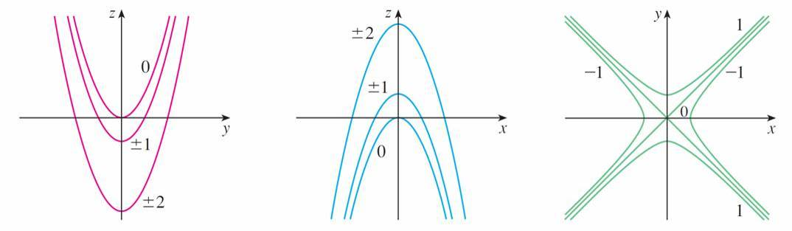
Example 5 – Solution
cont’d
We draw the families of traces in Figure 6, and we show
how the traces appear when placed in their correct planes in Figure 7.
Traces in x = k are z = y² – k²
Traces in y = k
are z = –x² + k²
Traces in z = k
are y² – x² = k
Vertical traces are parabolas; horizontal traces are
hyperbolas. All traces are labeled with the value of k.
Figure 6

Slide 20
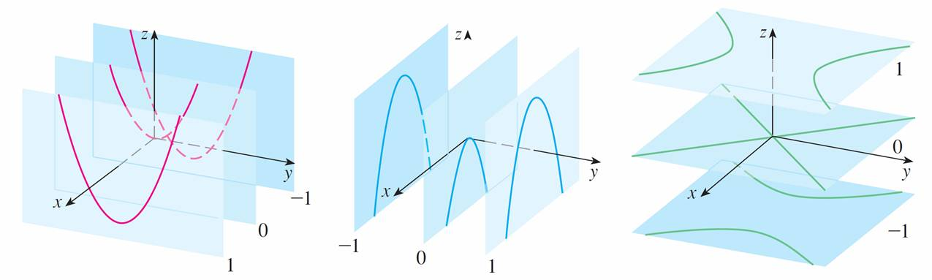
Example 5 – Solution
cont’d
Traces in x = k
Traces in y = k
Traces in z = k
Traces moved to their correct planes
Figure 7

Slide 21
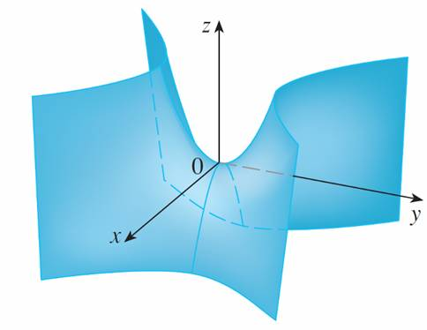
Example 5 – Solution
cont’d
In Figure 8 we fit together the traces from Figure 7 to form the surface z = y² – x², a hyperbolic paraboloid.
Notice that the shape of the surface near the origin resembles that of a saddle.
The surface z = y² – x² is a hyperbolic paraboloid.
Figure 8

Slide 22
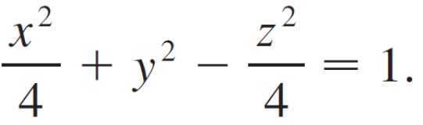
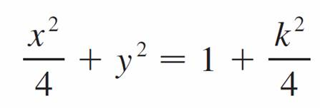
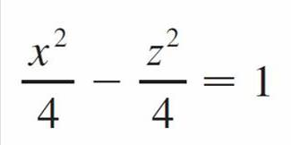
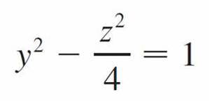
Example 6
Sketch the surface
Solution:
The trace in any horizontal plane z = k is the ellipse
z = k
but the traces in the xz- and yz-planes are the hyperbolas
y = 0 and x = 0

Slide 23
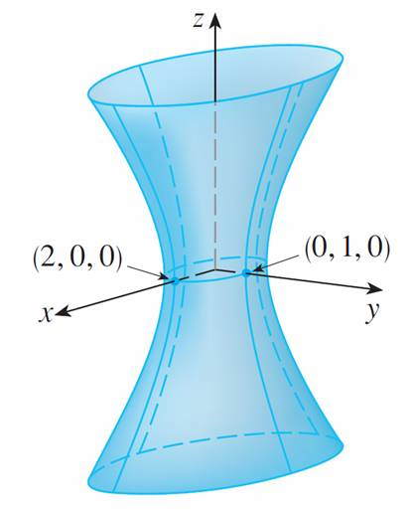
Example 6 – Solution
cont’d
This surface is called a hyperboloid of one sheet and is sketched in Figure 9.
Figure 9

Slide 24
Quadric Surfaces
The idea of using traces to draw a surface is employed in three-dimensional graphing software for computers.
In most such software, traces in the vertical planes x = k
and y = k are drawn for equally spaced values of k, and parts of the graph are eliminated using hidden line removal.

Slide 25
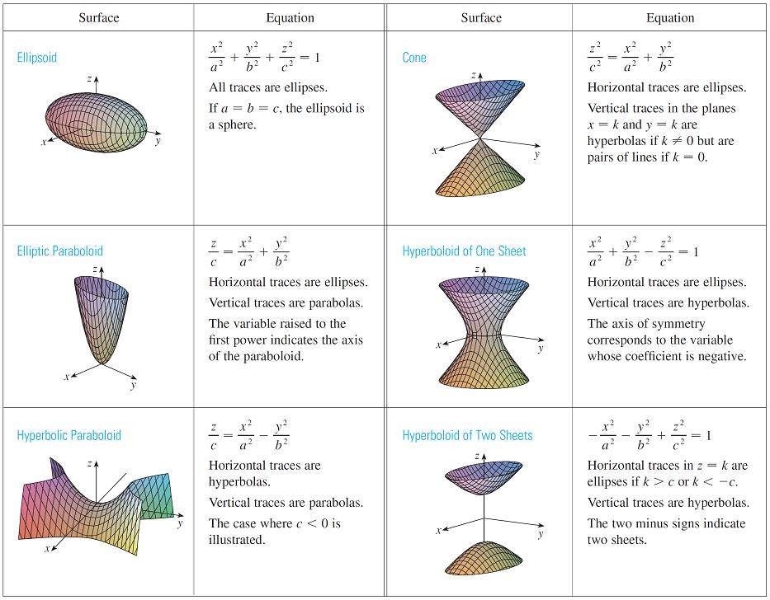
Quadric Surfaces
Table 1 shows
computer-drawn
graphs of the six
basic types of
quadric surfaces
in standard form.
Graphs of quadric surfaces
Table 1

Slide 26
Quadric Surfaces
All surfaces are symmetric with respect to the z-axis. If a quadric surface is symmetric about a different axis, its equation changes accordingly.

Slide 27
Applications of Quadric Surfaces

Slide 28
Applications of Quadric Surfaces
Examples of quadric surfaces can be found in the world around us. In fact, the world itself is a good example.
Although the earth is commonly modeled as a sphere, a more accurate model is an ellipsoid because the earth’s rotation has caused a flattening at the poles.
Circular paraboloids, obtained by rotating a parabola about its axis, are used to collect and reflect light, sound, and radio and television signals.

Slide 29
Applications of Quadric Surfaces
In a radio telescope, for instance, signals from distant stars that strike the bowl are all reflected to the receiver at the focus and are therefore amplified.
The same principle applies to microphones and satellite dishes in the shape of paraboloids.
Cooling towers for nuclear reactors are usually designed in the shape of hyperboloids of one sheet for reasons of structural stability.
Pairs of hyperboloids are used to transmit rotational motion between skew axes.

