Slide 1

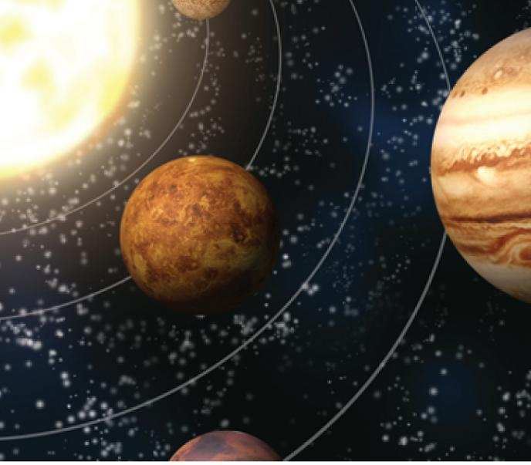
13
Vector Functions
Copyright © Cengage Learning. All rights reserved.

Slide 2

13.1
Vector Functions and Space Curves
Copyright © Cengage Learning. All rights reserved.

Slide 3
Vector Functions and Space Curves
In general, a function is a rule that assigns to each element in the domain an element in the range.
A vector-valued function, or vector function, is simply a function whose domain is a set of real numbers and whose range is a set of vectors.
We are most interested in vector functions r whose values are three-dimensional vectors.
This means that for every number t in the domain of r there is a unique vector in V₃ denoted by r(t).

Slide 4
Vector Functions and Space Curves
If f (t), g(t), and h(t) are the components of the vector r(t), then f, g, and h are real-valued functions called the component functions of r and we can write
r(t) = ⟨f (t), g(t), h(t)⟩ = f (t)i + g(t)j + h(t)k
We use the letter t to denote the independent variable because it represents time in most applications of vector functions.

Slide 5

Example 1
If r(t) = ⟨t ³, ln(3 – t), ⟩
then the component functions are
f (t) = t ³ g(t) = ln(3 – t) h(t) =
By our usual convention, the domain of r consists of all values of t for which the expression for r(t) is defined.
The expressions t ³, ln(3 – t), and are all defined when
3 – t > 0 and t ≥ 0.
Therefore the domain of r is the interval [0, 3).

Slide 6
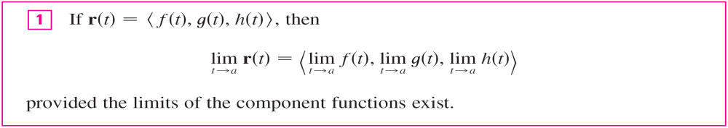
Vector Functions and Space Curves
The limit of a vector function r is defined by taking the limits of its component functions as follows.
Limits of vector functions obey the same rules as limits of real-valued functions.

Slide 7

Vector Functions and Space Curves
A vector function r is continuous at a if
In view of Definition 1, we see that r is continuous at a if and only if its component functions f, g, and h are continuous at a.
There is a close connection between continuous vector functions and space curves.

Slide 8


Vector Functions and Space Curves
Suppose that f, g, and h are continuous real-valued functions on an interval I.
Then the set C of all points (x, y, z) in space, where
x = f (t) y = g(t) z = h(t)
and t varies throughout the interval I, is called a space curve.
The equations in are called parametric equations of C and t is called a parameter.
We can think of C as being traced out by a moving particle whose position at time t is (f (t), g(t), h(t)).

Slide 9
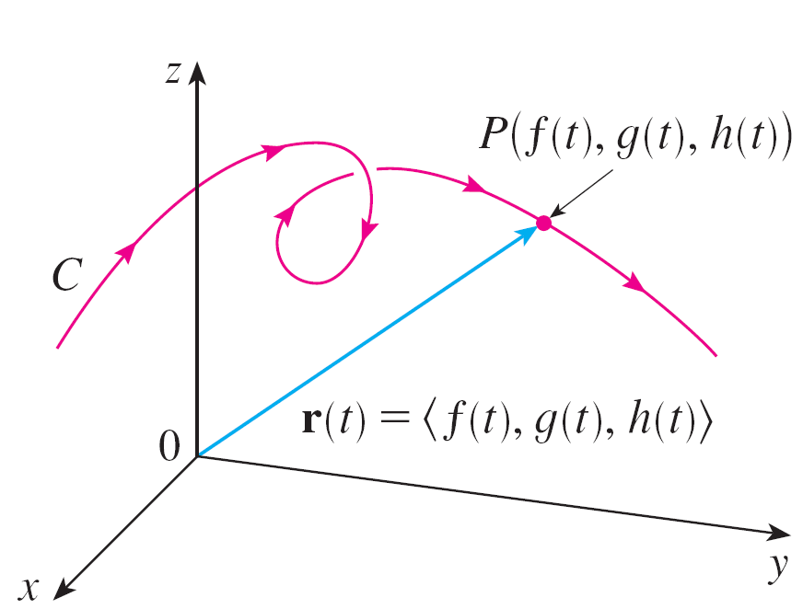
Vector Functions and Space Curves
If we now consider the vector function r(t) = ⟨f (t), g(t), h(t)⟩, then r(t) is the position vector of the point P(f (t), g(t), h(t))
on C.
Thus any continuous vector
function r defines a space
curve C that is traced out by
the tip of the moving vector
r(t), as shown in Figure 1.
Figure 1
C is traced out by the tip of a moving position vector r(t).

Slide 10
Example 4
Sketch the curve whose vector equation is
r(t) = cos t i + sin t j + t k
Solution:
The parametric equations for this curve are
x = cos t y = sin t z = t
Since x² + y² = cos²t + sin²t = 1, the curve must lie on the circular cylinder x² + y² = 1.
The point (x, y, z) lies directly above the point (x, y, 0), which moves counterclockwise around the circle x² + y² = 1 in the xy-plane. (The projection of the curve onto the xy-plane has vector equation r(t) = ⟨cos t, sin t, 0⟩.)

Slide 11
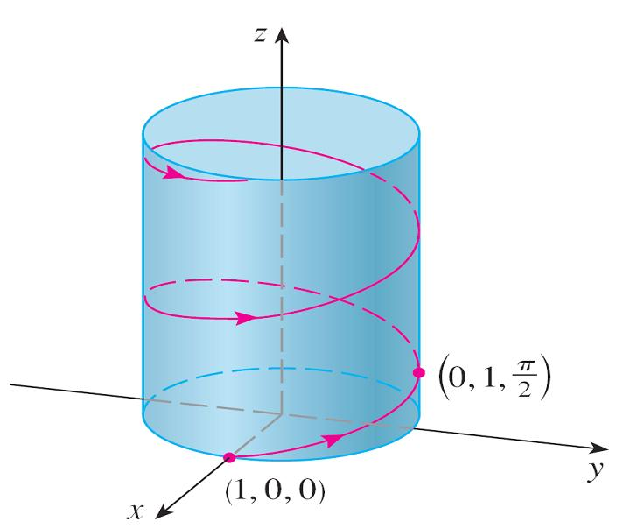
Example 4 – Solution
cont’d
Since z = t, the curve spirals upward around the cylinder as t increases. The curve, shown in Figure 2, is called a helix.
Figure 2

Slide 12

Vector Functions and Space Curves
The corkscrew shape of the helix in Example 4 is familiar from its occurrence in coiled springs.
It also occurs in the model of DNA (deoxyribonucleic acid, the genetic material of living cells).
In 1953 James Watson and
Francis Crick showed that
the structure of the DNA
molecule is that of two linked,
parallel helixes that are
intertwined as in Figure 3.
Figure 3
A double helix

Slide 13
Using Computers to Draw
Space Curves

Slide 14
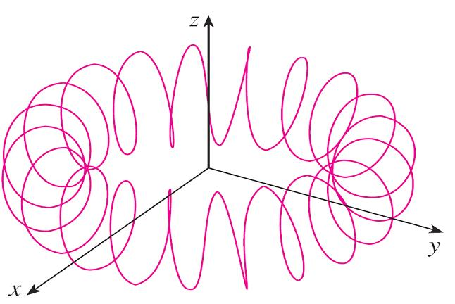
Using Computers to Draw Space Curves
Space curves are inherently more difficult to draw by hand than plane curves; for an accurate representation we need to use technology.
For instance, Figure 7 shows
a computer-generated graph
of the curve with parametric
equations
x = (4 + sin 20t) cos t
y = (4 + sin 20t) sin t
z = cos 20t
It’s called a toroidal spiral because it lies on a torus.
Figure 7
A toroidal spiral

Slide 15
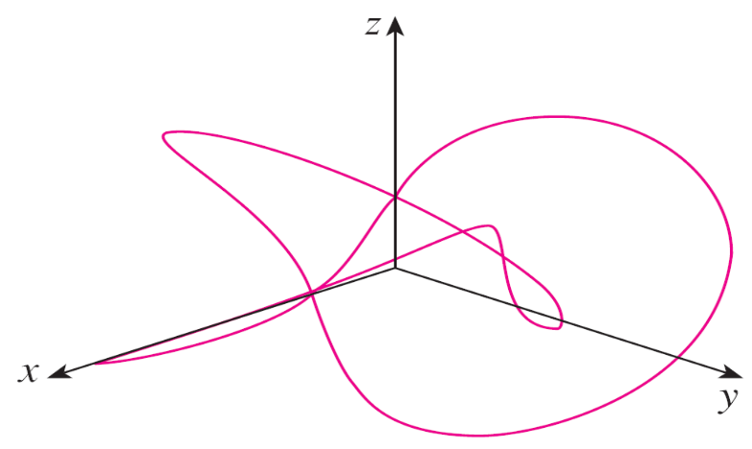
Using Computers to Draw Space Curves
Another interesting curve, the trefoil knot, with equations
x = (2 + cos 1.5t) cos t
y = (2 + cos 1.5t) sin t
z = sin 1.5t
is graphed in Figure 8. It wouldn’t be easy to plot either of these curves by hand.
Figure 8
A trefoil knot

Slide 16
Using Computers to Draw Space Curves
Even when a computer is used to draw a space curve, optical illusions make it difficult to get a good impression of what the curve really looks like. (This is especially true in Figure 8.)
The next example shows how to cope with this problem.

Slide 17
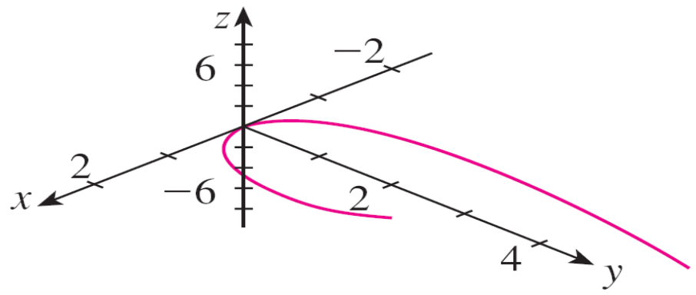
Example 7
Use a computer to draw the curve with vector equation
r(t) = ⟨t, t², t³⟩. This curve is called a twisted cubic.
Solution:
We start by using the computer to plot the curve with parametric equations x = t, y = t², z = t³ for –2 ≤ t ≤ 2.
The result is shown in
Figure 9(a), but it’s hard
to see the true nature of
the curve from that graph
alone.
Figure 9(a)
View of the twisted cubic

Slide 18
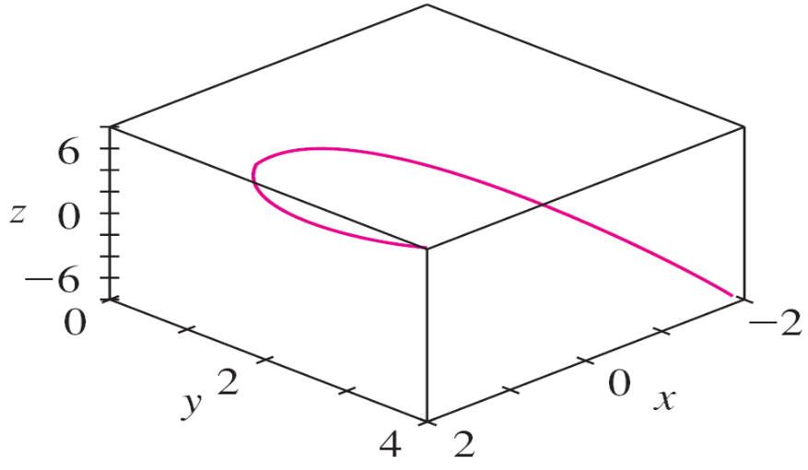
Example 7 – Solution
cont’d
Most three-dimensional computer graphing programs allow the user to enclose a curve or surface in a box instead of displaying the coordinate axes.
When we look at the same curve in a box in Figure 9(b), we
have a much clearer picture of the curve.
Figure 9(b)
View of the twisted cubic

Slide 19
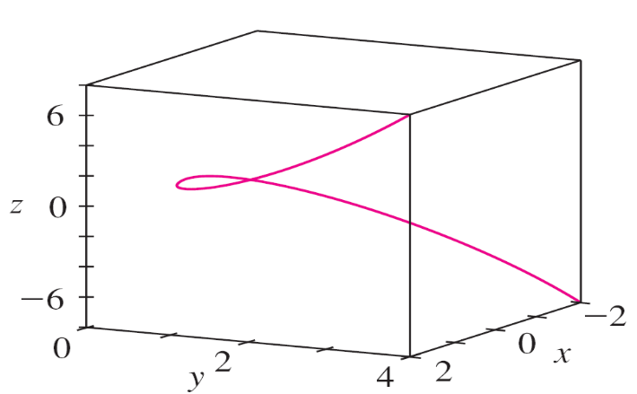
Example 7 – Solution
cont’d
We can see that it climbs from a lower corner of the box to the upper corner nearest us, and it twists as it climbs.
We get an even better idea of the curve when we view it from different vantage points.
Figure 9(c) shows the result of rotating the box to give another viewpoint.
Figure 9(c)
View of the twisted cubic

Slide 20
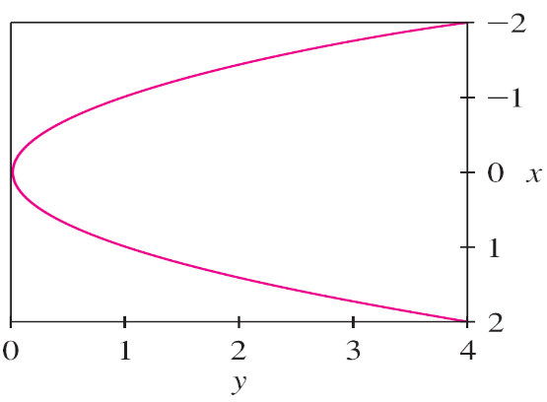
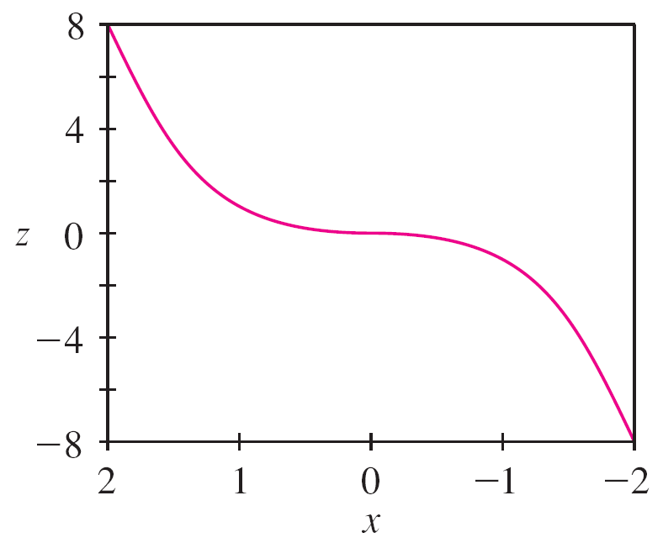
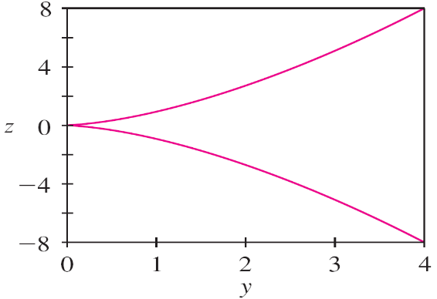
Example 7 – Solution
cont’d
Figures 9(d), 9(e), and 9(f) show the views we get when we look directly at a face of the box.
In particular, Figure 9(d) shows the view from directly above the box.
Figure 9(d)
Figure 9(e)
Figure 9(f)
Views of the twisted cubic

Slide 21
Example 7 – Solution
cont’d
It is the projection of the curve on the xy-plane, namely, the parabola y = x².
Figure 9(e) shows the projection on the xz-plane, the cubic curve z = x³.
It’s now obvious why the given curve is called a twisted cubic.

Slide 22
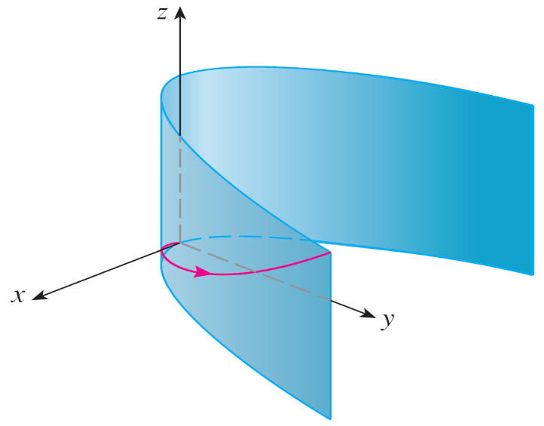
Using Computers to Draw Space Curves
Another method of visualizing a space curve is to draw it on a surface.
For instance, the twisted cubic in Example 7 lies on the parabolic cylinder y = x². (Eliminate the parameter from the first two parametric equations, x = t and y = t².)
Figure 10 shows both the
cylinder and the twisted cubic,
and we see that the curve
moves upward from the origin
along the surface of the cylinder.
Figure 10

Slide 23
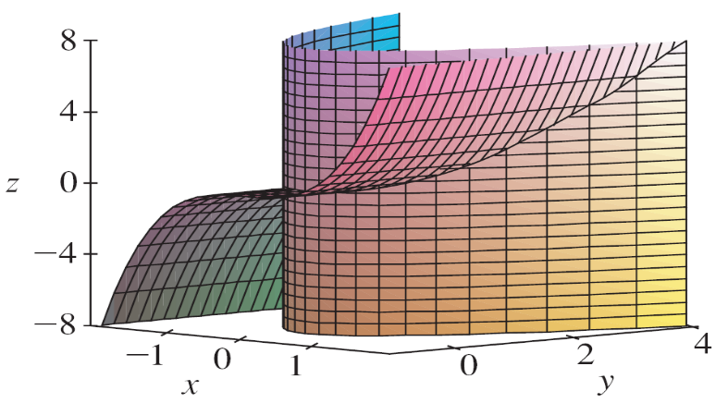
Using Computers to Draw Space Curves
We also used this method in Example 4 to visualize the helix lying on the circular cylinder.
A third method for visualizing the twisted cubic is to realize that it also lies on the cylinder z = x³.
So it can be viewed as the curve of intersection of the
cylinders y = x² and z = x³. (See Figure 11.)
Figure 11

Slide 24
Using Computers to Draw Space Curves
We have seen that an interesting space curve, the helix, occurs in the model of DNA.
Another notable example of a space curve in science is the trajectory of a positively charged particle in orthogonally oriented electric and magnetic fields E and B.

Slide 25
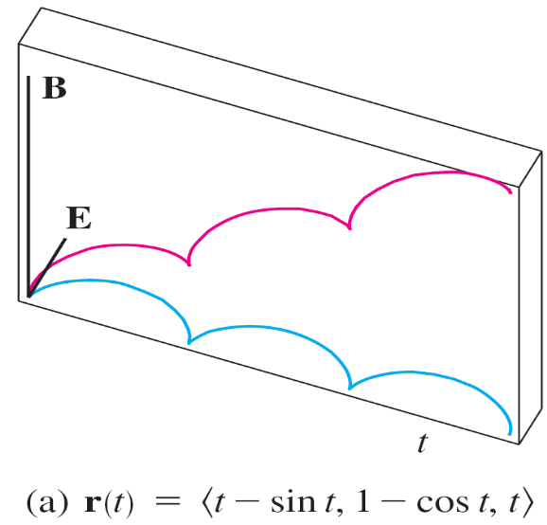
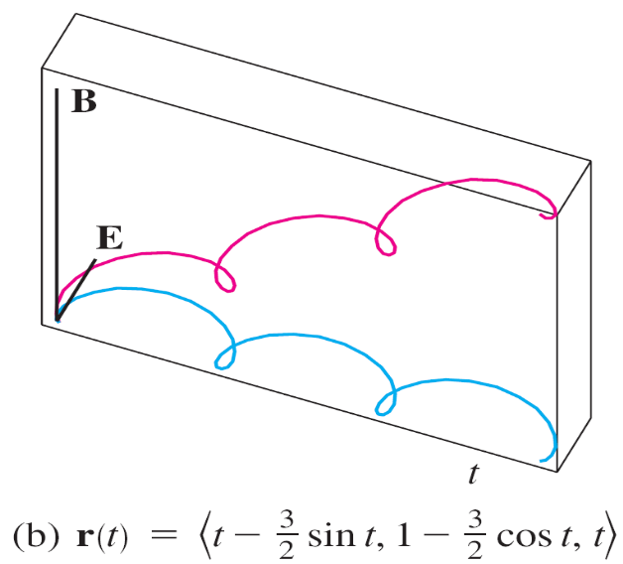
Using Computers to Draw Space Curves
Depending on the initial velocity given the particle at the origin, the path of the particle is either a space curve whose projection on the horizontal plane is the cycloid
[Figure 12(a)] or a curve whose projection is the trochoid [Figure 12(b)].
Figure 12
Motion of a charged particle in orthogonally oriented electric and magnetic fields

