Slide 1

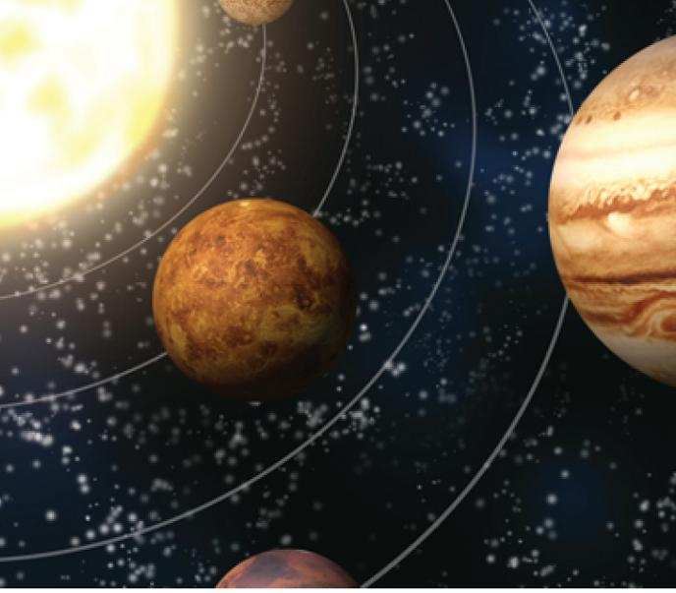
13
Vector Functions
Copyright © Cengage Learning. All rights reserved.

Slide 2

Motion in Space: Velocity and Acceleration
13.4
Copyright © Cengage Learning. All rights reserved.

Slide 3
Motion in Space: Velocity and Acceleration
In this section we show how the ideas of tangent and normal vectors and curvature can be used in physics to study the motion of an object, including its velocity and acceleration, along a space curve.
In particular, we follow in the footsteps of Newton by using these methods to derive Kepler’s First Law of planetary motion.

Slide 4
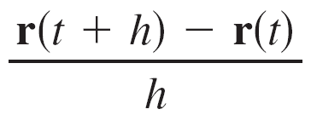
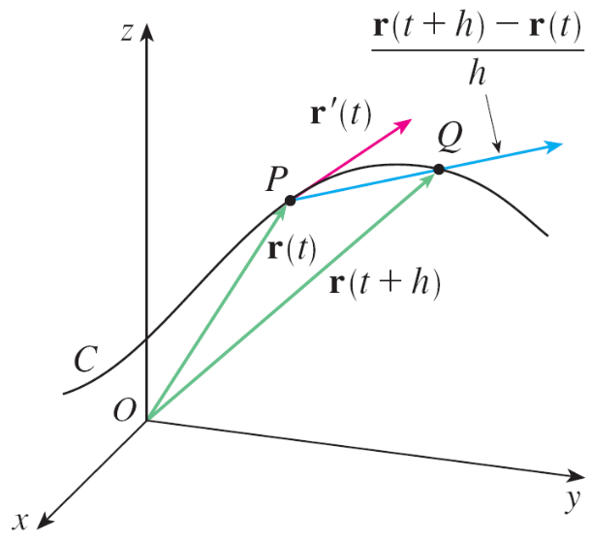

Motion in Space: Velocity and Acceleration
Suppose a particle moves through space so that its position vector at time t is r(t). Notice from Figure 1 that, for small values of h, the vector
approximates the direction of
the particle moving along
the curve r(t).
Its magnitude measures the size
of the displacement vector per
unit time.
Figure 1

Slide 5
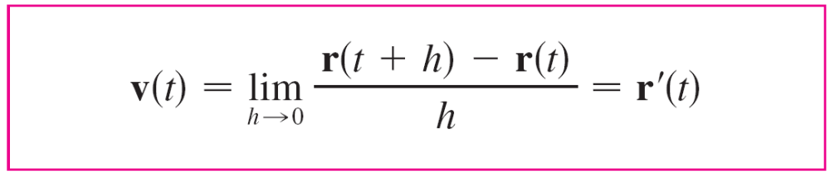

Motion in Space: Velocity and Acceleration
The vector (1) gives the average velocity over a time interval of length h and its limit is the velocity vector v(t) at time t:
Thus the velocity vector is also the tangent vector and points in the direction of the tangent line.
The speed of the particle at time t is the magnitude of the velocity vector, that is, | v(t) |.

Slide 6

Motion in Space: Velocity and Acceleration
This is appropriate because, from (2), we have
| v(t) | = | r ′(t) | = = rate of change of distance with
respect to time
As in the case of one-dimensional motion, the acceleration of the particle is defined as the derivative of the velocity:
a(t) = v ′(t) = r ′′(t)

Slide 7
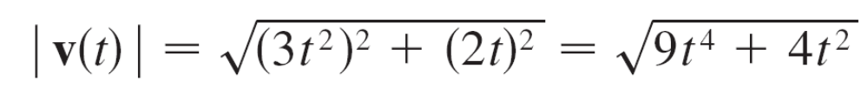
Example 1
The position vector of an object moving in a plane is given by r(t) = t³ i + t² j. Find its velocity, speed, and acceleration when t = 1 and illustrate geometrically.
Solution:
The velocity and acceleration at time t are
v(t) = r ′(t) = 3t² i + 2t j
a(t) = r ′′(t) = 6t i + 2 j
and the speed is

Slide 8

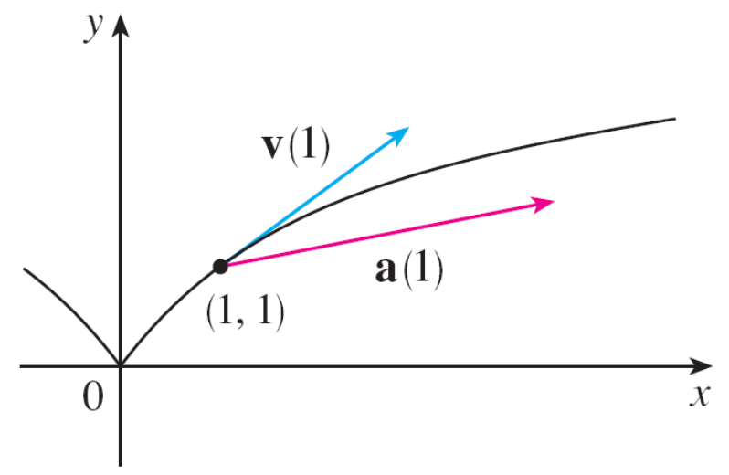
Example 1 – Solution
cont’d
When t = 1, we have
v(1) = 3 i + 2 j a(1) = 6 i + 2 j | v(1) | =
These velocity and acceleration vectors are shown in
Figure 2.
Figure 2

Slide 9
Motion in Space: Velocity and Acceleration
In general, vector integrals allow us to recover velocity when acceleration is known and position when velocity is known:
If the force that acts on a particle is known, then the acceleration can be found from Newton’s Second Law of Motion.
The vector version of this law states that if, at any time t, a force F(t) acts on an object of mass m producing an acceleration a(t), then
F(t) = ma(t)

Slide 10
Tangential and Normal Components of Acceleration

Slide 11
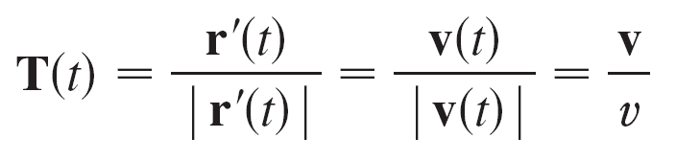

Tangential and Normal Components of Acceleration
When we study the motion of a particle, it is often useful to resolve the acceleration into two components, one in the direction of the tangent and the other in the direction of the normal.
If we write v = | v | for the speed of the particle, then
and so v = vT
If we differentiate both sides of this equation with respect to t, we get
a = v ′ = v ′T + vT ′

Slide 12
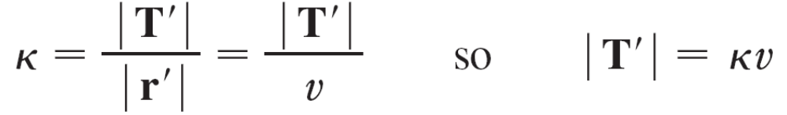




Tangential and Normal Components of Acceleration
If we use the expression for the curvature, then we have
The unit normal vector was defined in the preceding section as N = T ′/| T ′ |, so (6) gives
T ′ = | T ′ |N = vN
and Equation 5 becomes

Slide 13

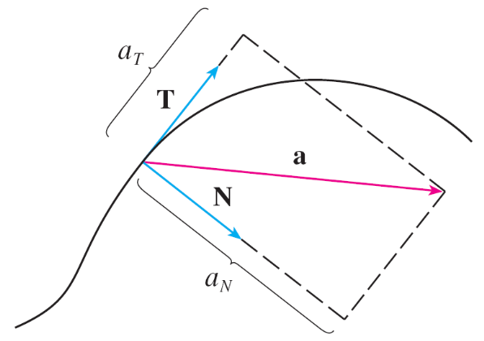
Tangential and Normal Components of Acceleration
Writing a_{T} and a_{N} for the tangential and normal components of acceleration, we have
a = a_{T} T + a_{N} N
where
a_{T} = v ′ and a_{N} = v²
This resolution is illustrated
in Figure 7.
Figure 7

Slide 14

Tangential and Normal Components of Acceleration
Let’s look at what Formula 7 says. The first thing to notice is that the binormal vector B is absent.
No matter how an object moves through space, its acceleration always lies in the plane of T and N (the osculating plane). (Recall that T gives the direction of motion and N points in the direction the curve is turning.)
Next we notice that the tangential component of acceleration is v ', the rate of change of speed, and the normal component of acceleration is v², the curvature times the square of the speed.

Slide 15
Tangential and Normal Components of Acceleration
This makes sense if we think of a passenger in a car—a sharp turn in a road means a large value of the curvature , so the component of the acceleration perpendicular to the motion is large and the passenger is thrown against a car door.
High speed around the turn has the same effect; in fact, if you double your speed, a_{N} is increased by a factor of 4. Although we have expressions for the tangential and normal components of acceleration in Equations 8, it’s desirable to have expressions that depend only on r, r ′, and r ′′.

Slide 16
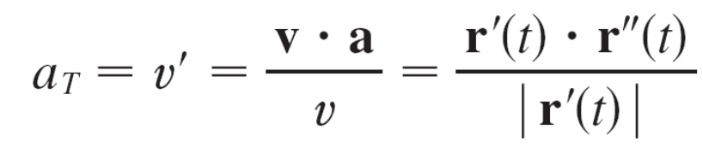

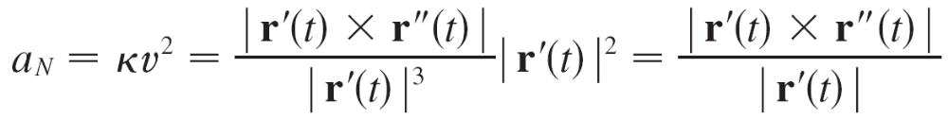

Tangential and Normal Components of Acceleration
To this end we take the dot product of v = vT with a as given by Equation 7:
v  a = vT  (v ′T + v²N)
= vv ′T  T + v³T  N
= vv ′
Therefore
Using the formula for curvature, we have
(since T  T = 1 and T  N = 0)

Slide 17

Example 7
A particle moves with position function r(t) = ⟨t², t², t³⟩. Find the tangential and normal components of acceleration.
Solution:
r(t) = t² i + t² j + t³ k
r′(t) = 2t i + 2t j + 3t² k
r′′(t) = 2 i + 2 j + 6t k
| r′(t) | =

Slide 18
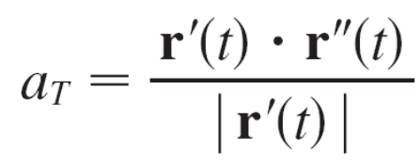
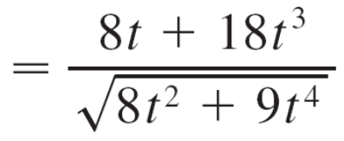
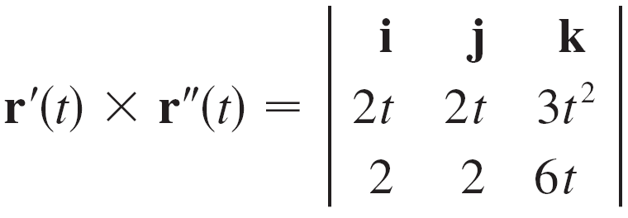

Example 7 – Solution
cont’d
Therefore Equation 9 gives the tangential component as
Since

Slide 19
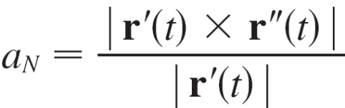
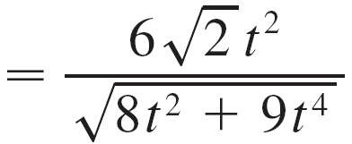
Example 7 – Solution
cont’d
Equation 10 gives the normal component as

Slide 20
Kepler’s Laws of Planetary Motion

Slide 21
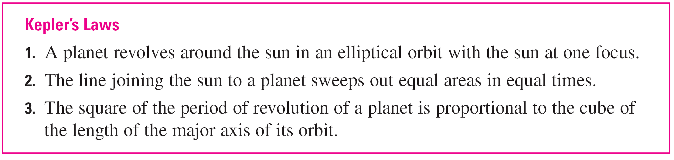
Kepler’s Laws of Planetary Motion
Since the gravitational force of the sun on a planet is so much larger than the forces exerted by other celestial bodies, we can safely ignore all bodies in the universe except the sun and one planet revolving about it.
We use a coordinate system with the sun at the origin and we let r = r(t) be the position vector of the planet. (Equally well, r could be the position vector of the moon or a satellite moving around the earth or a comet moving around a star.)

Slide 22
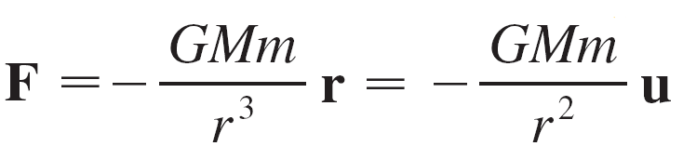
Kepler’s Laws of Planetary Motion
The velocity vector is v = r′ and the acceleration vector is a = r″.
We use the following laws of Newton:
Second Law of Motion: F = ma
Law of Gravitation:
where F is the gravitational force on the planet, m and M are the masses of the planet and the sun, G is the gravitational constant, r = | r |, and u = (1/r)r is the unit vector in the direction of r.

Slide 23
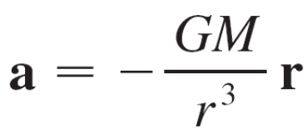
Kepler’s Laws of Planetary Motion
We first show that the planet moves in one plane.
By equating the expressions for F in Newton’s two laws, we find that
and so a is parallel to r.
It follows that r × a = 0.

Slide 24
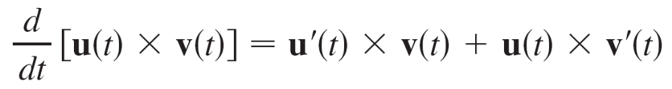

Kepler’s Laws of Planetary Motion
We use the formula
to write
(r × v) = r ′ × v + r × v ′
= v × v + r × a
= 0 + 0
= 0

Slide 25
Kepler’s Laws of Planetary Motion
Therefore
r × v = h
where h is a constant vector. (We may assume that h ≠ 0; that is, r and v are not parallel.)
This means that the vector r = r(t) is perpendicular to h for all values of t, so the planet always lies in the plane through the origin perpendicular to h.
Thus the orbit of the planet is a plane curve.

Slide 26
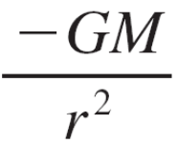
Kepler’s Laws of Planetary Motion
To prove Kepler’s First Law we rewrite the vector h as follows:
h = r × v = r × r ′ = ru × (ru)′
= ru × (ru ′ + r ′u) = r²(u × u ′) + rr ′(u × u)
= r²(u × u ′)
Then
a × h = u × (r²u × u ′) = –GM u × (u × u ′)
= –GM [(u  u ′)u – (u  u)u ′]
by Formula
a × (b × c) = (a  c)b – (a  b)c

Slide 27
Kepler’s Laws of Planetary Motion
But u  u = | u |² = 1 and, since | u(t) | = 1, it follows that u  u′ = 0.
Therefore
a × h = GM u′
and so (v × h)′ = v′ × h
= a × h
= GM u′

Slide 28

Kepler’s Laws of Planetary Motion
Integrating both sides of this equation, we get
v × h = GM u + c
where c is a constant vector.
At this point it is convenient to choose the coordinate axes so that the standard basis vector k points in the direction of the vector h.
Then the planet moves in the xy-plane. Since both v × h and u are perpendicular to h, Equation 11 shows that c lies in the xy-plane.

Slide 29
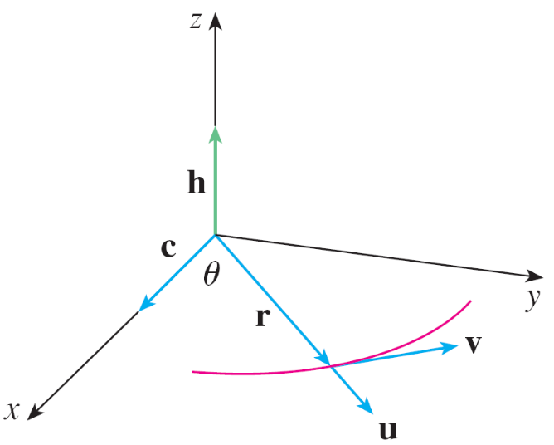
Kepler’s Laws of Planetary Motion
This means that we can choose the x- and y-axes so that the vector i lies in the direction of c, as shown in Figure 8.
Figure 8

Slide 30
Kepler’s Laws of Planetary Motion
If θ is the angle between c and r, then (r, θ ) are polar coordinates of the planet.
From Equation 11 we have
r  (v × h) = r  (GM u + c) = GM r  u + r  c
= GMr u  u + | r | | c | cos θ
= GMr + rc cos θ
where c = | c |.

Slide 31
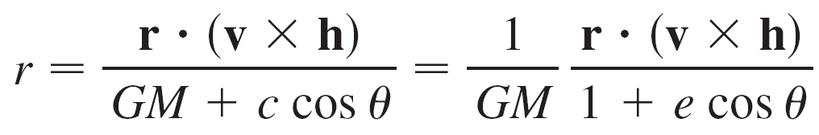
Kepler’s Laws of Planetary Motion
Then
where e = c/(GM).
But
r  (v × h) = (r × v)  h = h  h = | h |² = h²
where h = | h |.

Slide 32
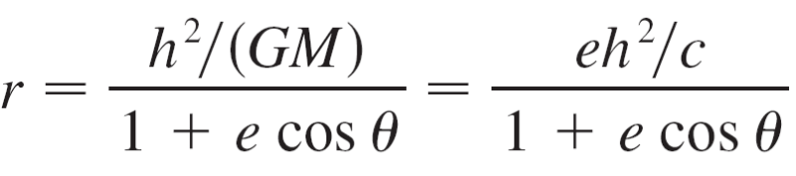
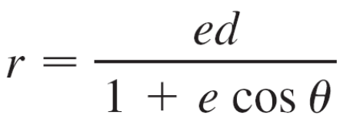

Kepler’s Laws of Planetary Motion
So
Writing d = h²/c, we obtain the equation
It is shown that Equation 12 is the polar equation of a conic section with focus at the origin and eccentricity e. We know that the orbit of a planet is a closed curve and so the conic must be an ellipse.

