Slide 1


14
Partial Derivatives
Copyright © Cengage Learning. All rights reserved.

Slide 2

14.1
Functions of Several Variables
Copyright © Cengage Learning. All rights reserved.

Slide 3
Functions of Several Variables
In this section we study functions of two or more variables from four points of view:
verbally (by a description in words)
numerically (by a table of values)
algebraically (by an explicit formula)
visually (by a graph or level curves)
Recall that a function f of two variables is a rule that assigns to each ordered pair (x, y) of real numbers in its domain a unique real number denoted by f (x, y).

Slide 4
Functions of Two Variables

Slide 5
Functions of Several Variables
The temperature T at a point on the surface of the earth at any given time depends on the longitude x and latitude y of the point.
We can think of T as being a function of the two variables x and y , or as a function of the pair (x, y). We indicate this functional dependence by writing T = f (x, y).
The volume of V a circular cylinder depends on its radius r and its height h. In fact, we know that V = π r²h. We say that V is a function of r and h, and we write V( r, h) = π r²h.

Slide 6
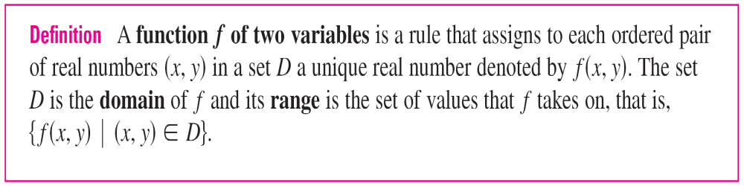
Functions of Several Variables
We often write z = f(x, y) to make explicit the value taken on by f at the general point (x, y). The variables x and y are independent variables and z is the dependent variable.
[Compare this with the notation y = f (x) for functions of a single variable.]

Slide 7
Example 2
In regions with severe winter weather, the wind-chill index is often used to describe the apparent severity of the cold.
This index W is a subjective temperature that depends on the actual temperature T and the wind speed v.
So W is a function of T and v, and we can write W = f (T, v).

Slide 8
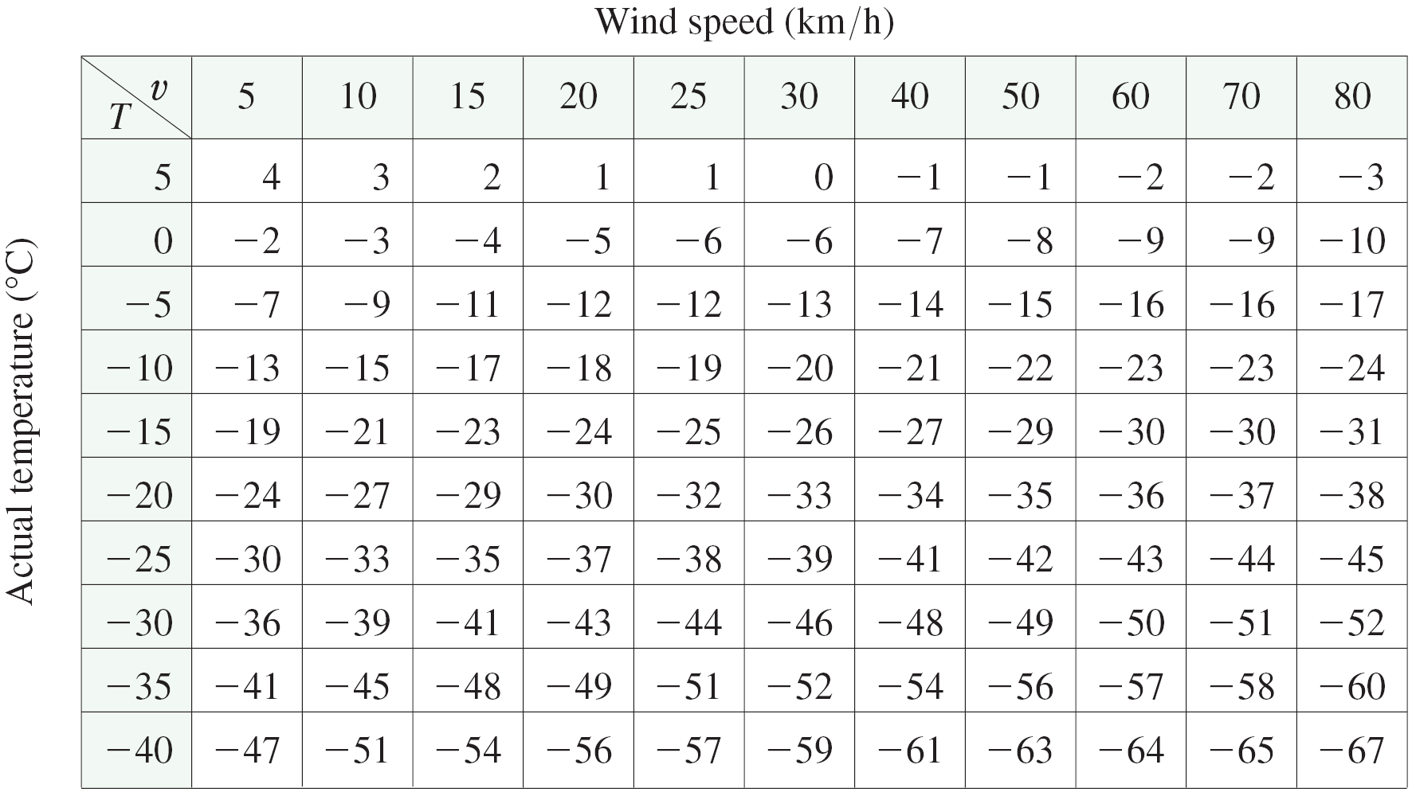
Example 2
cont’d
Table 1 records values of W compiled by the National Weather Service of the US and the Meteorological Service of Canada.
Table 1
Wind-chill index as a function of air temperature and wind speed

Slide 9
Example 2
cont’d
For instance, the table shows that if the temperature is
–5°C and the wind speed is 50 km/h, then subjectively it would feel as cold as a temperature of about –15°C with no wind.
So
f (–5, 50) = –15

Slide 10
Example 3
In 1928 Charles Cobb and Paul Douglas published a study in which they modeled the growth of the American economy during the period 1899–1922.
They considered a simplified view of the economy in which production output is determined by the amount of labor involved and the amount of capital invested.
While there are many other factors affecting economic performance, their model proved to be remarkably accurate.

Slide 11

Example 3
cont’d
The function they used to model production was of the form
P(L, K) = bL^{α}K^{1 – α}
where P is the total production (the monetary value of all goods produced in a year), L is the amount of labor (the total number of person-hours worked in a year), and K is the amount of capital invested (the monetary worth of all machinery, equipment, and buildings).

Slide 12
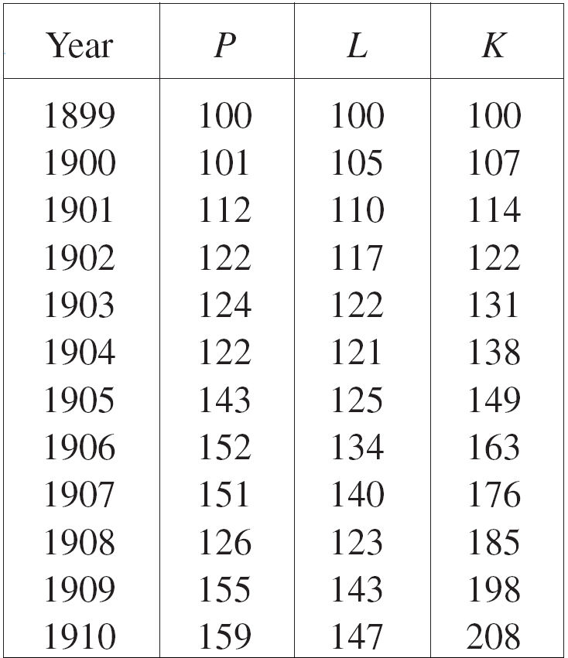
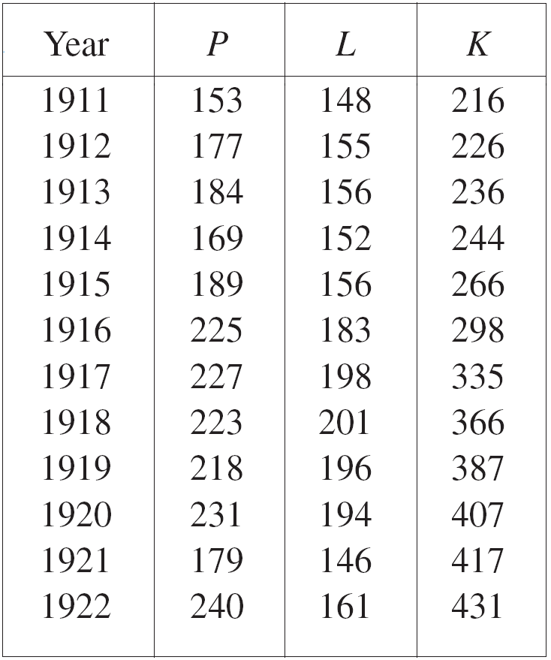
Example 3
cont’d
Cobb and Douglas used economic data published by the government to obtain Table 2.
Table 2

Slide 13

Example 3
cont’d
They took the year 1899 as a baseline and P, L, and K for 1899 were each assigned the value 100.
The values for other years were expressed as percentages of the 1899 figures.
Cobb and Douglas used the method of least squares to fit the data of Table 2 to the function
P(L, K) = 1.01L^{0.75}K ^{0.25}

Slide 14
Example 3
cont’d
If we use the model given by the function in Equation 2 to compute the production in the years 1910 and 1920, we get the values
P(147, 208) = 1.01(147)^{0.75}(208)^{0.25} ≈ 161.9
P(194, 407) = 1.01(194)^{0.75}(407)^{0.25} ≈ 235.8
which are quite close to the actual values, 159 and 231.
The production function (1) has subsequently been used in many settings, ranging from individual firms to global economics. It has become known as the Cobb-Douglas production function.

Slide 15
Graphs

Slide 16
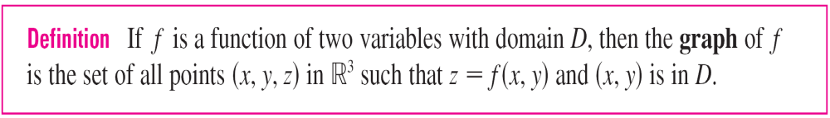
Graphs
Another way of visualizing the behavior of a function of two variables is to consider its graph.
Just as the graph of a function f of one variable is a curve c with equation y = f(x), so the graph of a function f of two variables is a surface S with equation z = f(x, y) .

Slide 17
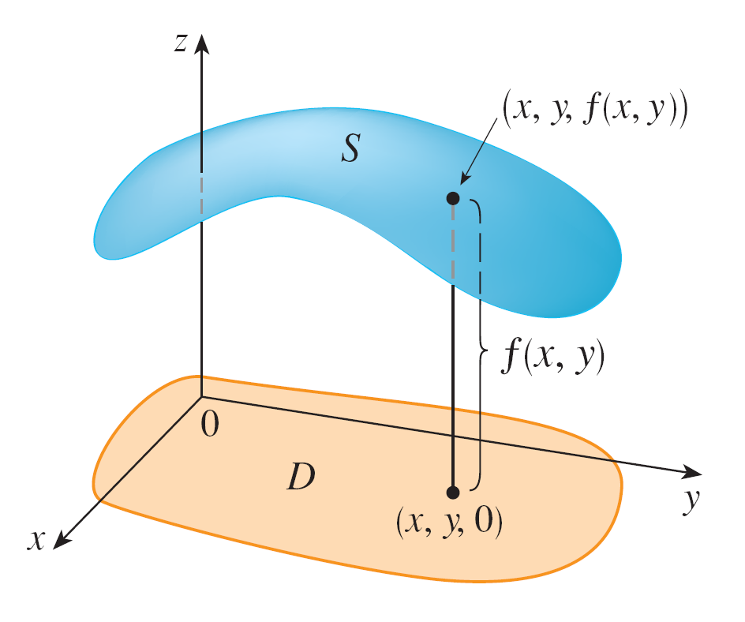
Graphs
We can visualize the graph S of f as lying directly above or below its domain D in the xy-plane (see Figure 5).
Figure 5

Slide 18


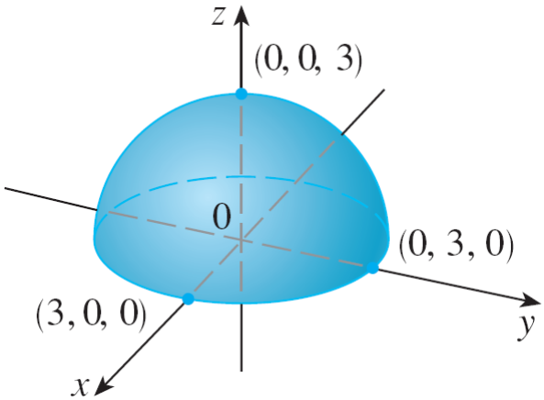

Example 6
Sketch the graph of
Solution:
The graph has equation We square both sides of this equation to obtain z² = 9 – x² – y², or x² + y² + z² = 9, which we recognize as an equation of the sphere with center the origin and radius 3.
But, since z ≥ 0, the graph of
g is just the top half of this
sphere (see Figure 7).
Figure 7
Graph of

Slide 19
Graphs
The function f(x, y) = ax + by + c is called as a linear function.
The graph of such a function has the equation
z = ax + by + c or ax + by – z + c = 0
so it is a plane. In much the same way that linear functions of one variable are important in single-variable calculus, we will see that linear functions of two variables play a central role in multivariable calculus.

Slide 20
Level Curves

Slide 21
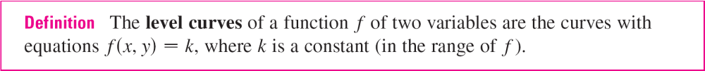
Level Curves
So far we have two methods for visualizing functions: arrow diagrams and graphs. A third method, borrowed from mapmakers, is a contour map on which points of constant elevation are joined to form contour lines, or level curves.
A level curve f (x, y) = k is the set of all points in the domain of f at which f takes on a given value k.
In other words, it shows where the graph of f has height k.

Slide 22
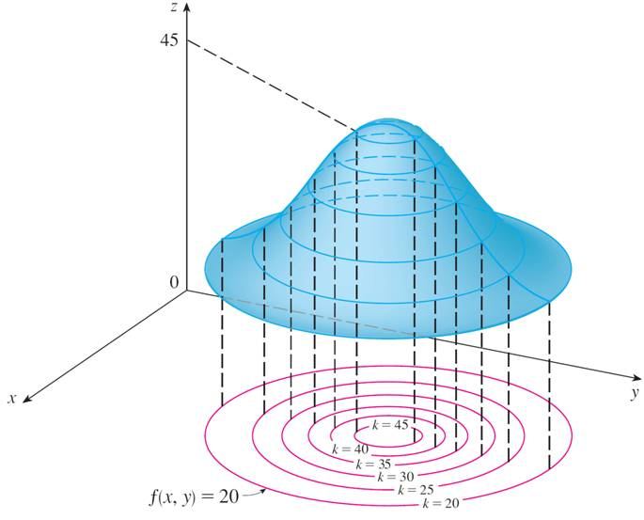
Level Curves
You can see from Figure 11 the relation between level curves and horizontal traces.
Figure 11

Slide 23
Level Curves
The level curves f (x, y) = k are just the traces of the graph of f in the horizontal plane z = k projected down to the
xy-plane.
So if you draw the level curves of a function and visualize them being lifted up to the surface at the indicated height, then you can mentally piece together a picture of the graph.
The surface is steep where the level curves are close together. It is somewhat flatter where they are farther apart.

Slide 24
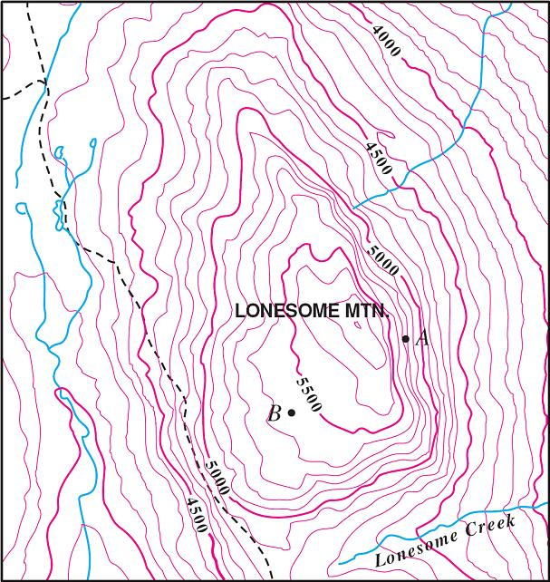
Level Curves
One common example of level curves occurs in topographic maps of mountainous regions, such as the map in Figure 12.
Figure 12

Slide 25
Level Curves
The level curves are curves of constant elevation above sea level.
If you walk along one of these contour lines, you neither ascend nor descend.
Another common example is the temperature at locations
(x, y) with longitude x and latitude y.
Here the level curves are called isothermals and join locations with the same temperature.

Slide 26
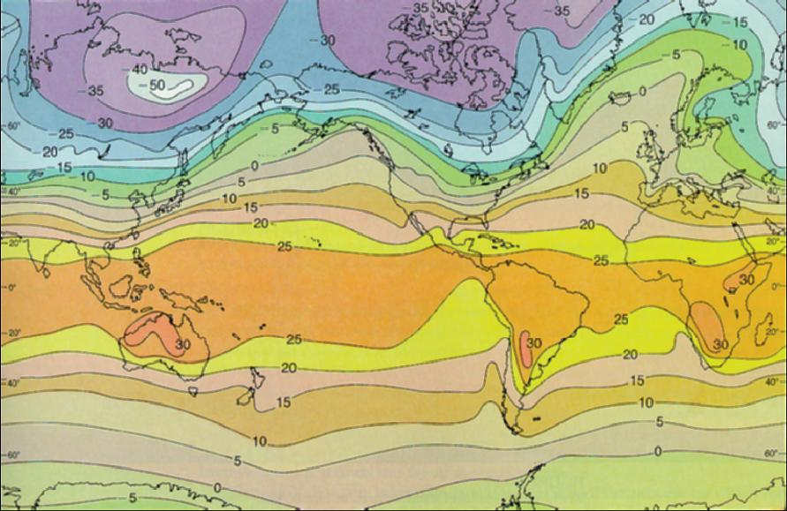
Level Curves
Figure 13 shows a weather map of the world indicating the average January temperatures. The isothermals are the curves that separate the colored bands.
Figure 13
World mean sea-level temperatures
in January in degrees Celsius

Slide 27
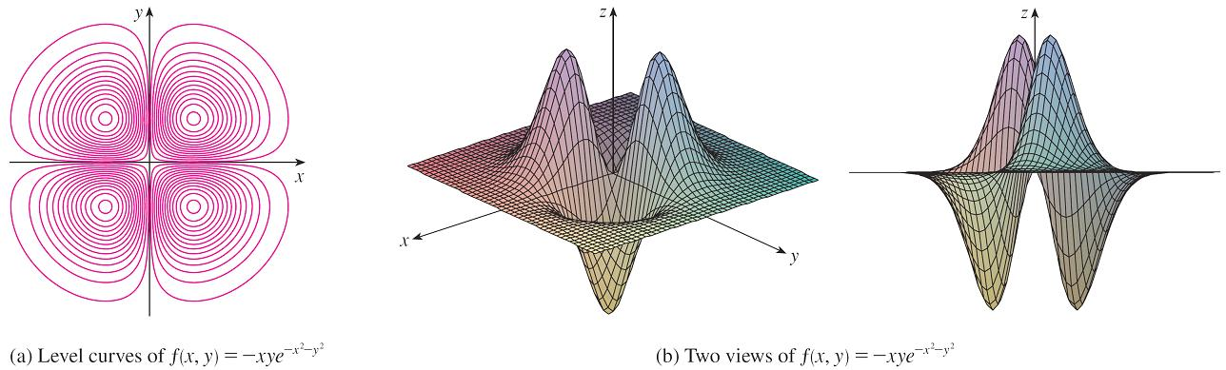
Level Curves
For some purposes, a contour map is more useful than a graph. It is true in estimating function values. Figure 19 shows some computer-generated level curves together with the corresponding computer-generated graphs.
Figure 19

Slide 28
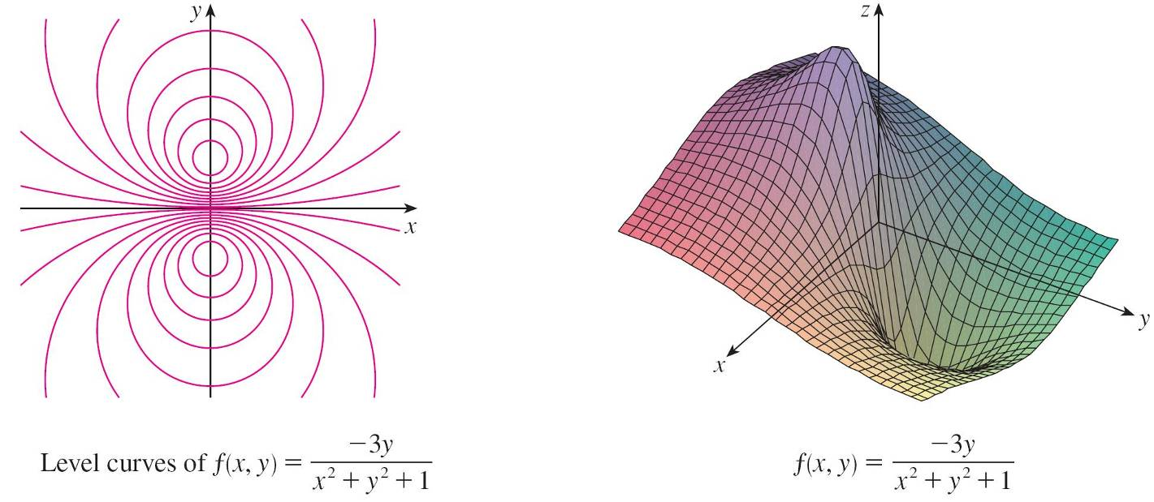
Level Curves
Notice that the level curves in Figure 19(c) crowd together near the origin. That corresponds to the fact that the graph in Figure 19(d) is very steep near the origin.
Figure 19(c)
Figure 19(d)

Slide 29
Functions of Three or More Variables

Slide 30

Functions of Three or More Variables
A function of three variables, f, is a rule that assigns to each ordered triple (x, y, z) in a domain a unique real number denoted by f (x, y, z).
For instance, the temperature T at a point on the surface of the earth depends on the longitude x and latitude y of the point and on the time t, so we could write T = f (x, y, t).

Slide 31

Example 14
Find the domain of f if
f (x, y, z) = ln(z – y) + xy sin z
Solution:
The expression for f (x, y, z) is defined as long as z – y > 0, so the domain of f is
D = {(x, y, z) ∈ | z > y}
This is a half-space consisting of all points that lie above the plane z = y.

Slide 32

Functions of Three or More Variables
It’s very difficult to visualize a function f of three variables by its graph, since that would lie in a four-dimensional space.
However, we do gain some insight into f by examining its level surfaces, which are the surfaces with equations
f (x, y, z) = k, where k is a constant. If the point (x, y, z) moves along a level surface, the value of f (x, y, z) remains fixed.
Functions of any number of variables can be considered.
A function of n variables is a rule that assigns a number
z = f (x₁, x₂,…, x_{n}) to an n-tuple (x₁, x₂,…, x_{n}) of real numbers. We denote by the set of all such n-tuples.

Slide 33

Functions of Three or More Variables
For example, if a company uses n different ingredients in making a food product, c_{i} is the cost per unit of the i th ingredient, and x_{i} units of the i th ingredient are used, then the total cost C of the ingredients is a function of the n variables x₁, x₂, . . . , x_{n}:
C = f (x₁, x₂, . . . , x_{n}) = c₁x₁ + c₂x₂ + . . . + c_{n} x_{n}
The function f is a real-valued function whose domain is a subset of .

Slide 34
Functions of Three or More Variables
Sometimes we will use vector notation to write such functions more compactly: If x = ⟨x₁, x₂, . . . , x_{n}⟩, we often write f (x) in place of f (x₁, x₂, . . . , x_{n}).
With this notation we can rewrite the function defined in Equation 3 as
f (x) = c  x
where c = ⟨c₁, c₂, . . . , c_{n}⟩ and c  x denotes the dot product of the vectors c and x in V_{n}.

Slide 35
Functions of Three or More Variables
In view of the one-to-one correspondence between points
(x₁, x₂, . . . , x_{n}) in and their position vectors
x = ⟨x₁, x₂, . . . , x_{n}⟩ in V_{n}, we have three ways of looking at a function f defined on a subset of :
1. As a function of n real variables x₁, x₂, . . . , x_{n}
2. As a function of a single point variable (x₁, x₂, . . . , x_{n})
3. As a function of a single vector variable x = ⟨x₁, x₂, . . . , x_{n}⟩

