Slide 1
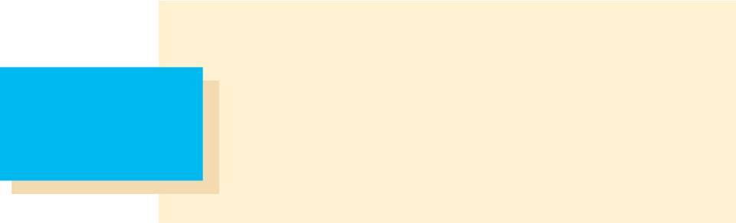

14
Partial Derivatives
Copyright © Cengage Learning. All rights reserved.

Slide 2
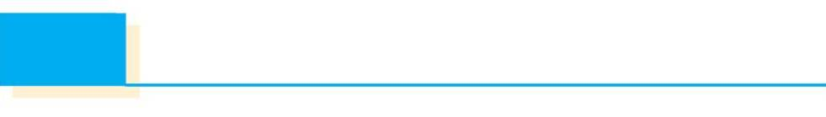
14.2
Limits and Continuity
Copyright © Cengage Learning. All rights reserved.

Slide 3
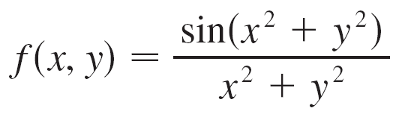
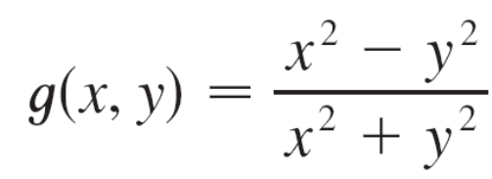
Limits and Continuity
Let’s compare the behavior of the functions
and
as x and y both approach 0 [and therefore the point (x, y) approaches the origin].

Slide 4
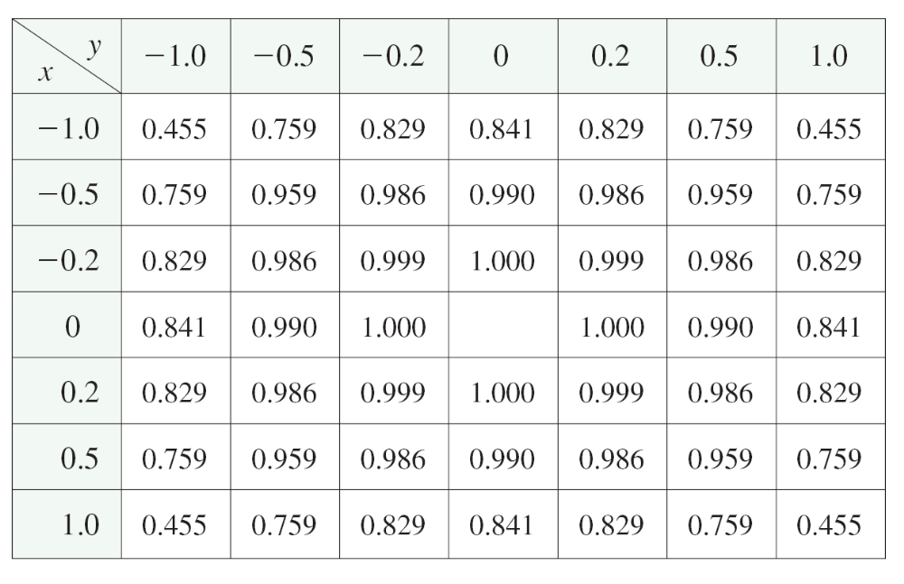
Limits and Continuity
Tables 1 and 2 show values of f (x, y) and g (x, y), correct to three decimal places, for points (x, y) near the origin. (Notice that neither function is defined at the origin.)
Values of f (x, y)
Table 1

Slide 5
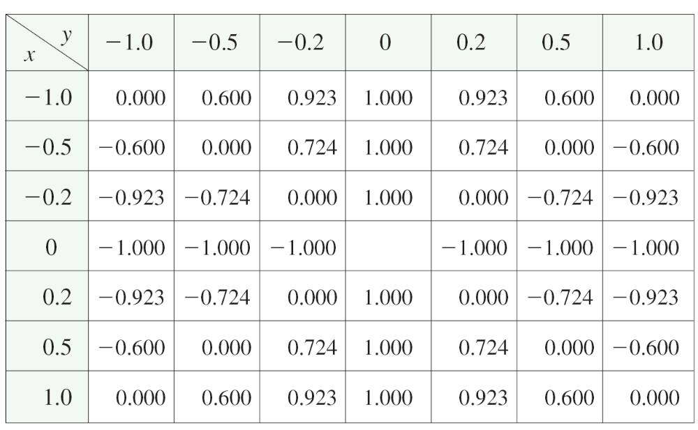
Limits and Continuity
cont’d
Values of g(x, y)
Table 2

Slide 6
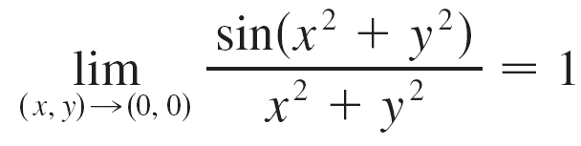
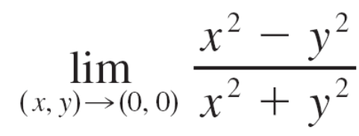
Limits and Continuity
It appears that as (x, y) approaches (0, 0), the values of f (x, y) are approaching 1 whereas the values of g (x, y) aren’t approaching any number. It turns out that these guesses based on numerical evidence are correct, and we write
and
does not exist.

Slide 7
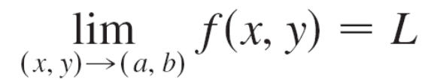
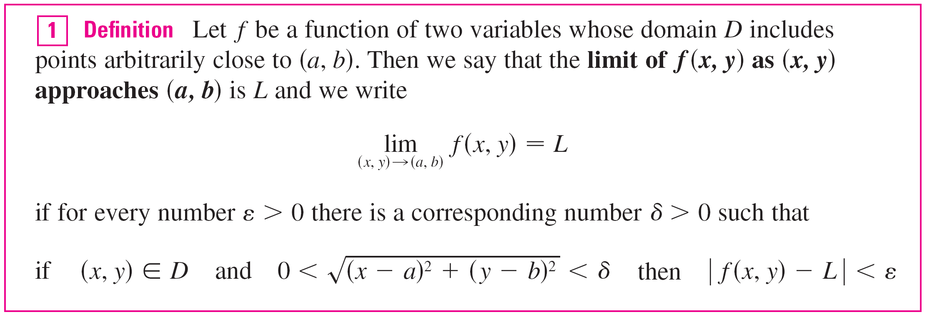
Limits and Continuity
In general, we use the notation
to indicate that the values of f (x, y) approach the number L as the point (x, y) approaches the point (a, b) along any path that stays within the domain of f.

Slide 8
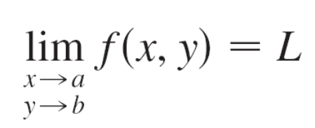
Limits and Continuity
Other notations for the limit in Definition 1 are
and f (x, y) → L as (x, y) → (a, b)
For functions of a single variable, when we let x approach a, there are only two possible directions of approach, from the left or from the right.
We recall that if lim_{x→a}- f (x) ≠ lim_{x→a}+ f (x), then lim_{x→a} f (x) does not exist.

Slide 9
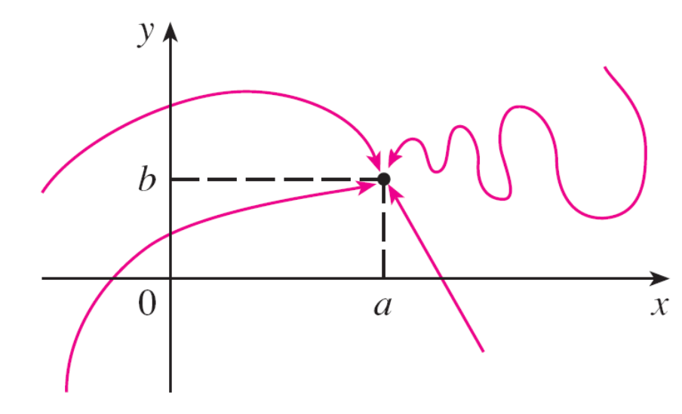
Limits and Continuity
For functions of two variables the situation is not as simple because we can let (x, y) approach (a, b) from an infinite number of directions in any manner whatsoever
(see Figure 3) as long as (x, y) stays within the domain of f.
Figure 3

Slide 10
Limits and Continuity
Definition 1 says that the distance between f (x, y) and L can be made arbitrarily small by making the distance from (x, y) to (a, b) sufficiently small (but not 0).
The definition refers only to the distance between (x, y) and (a, b). It does not refer to the direction of approach.
Therefore, if the limit exists, then f (x, y) must approach the same limit no matter how (x, y) approaches (a, b).

Slide 11
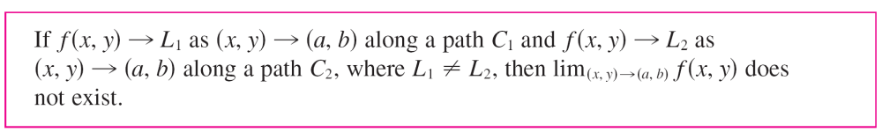
Limits and Continuity
Thus, if we can find two different paths of approach along which the function f (x, y) has different limits, then it follows that lim_{(x, y) → (a, b)} f (x, y) does not exist.

Slide 12
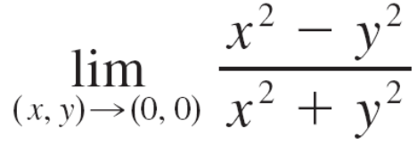
Example 1
Show that does not exist.
Solution:
Let f (x, y) = (x² – y²)/(x² + y²).
First let’s approach (0, 0) along the x-axis.
Then y = 0 gives f (x, 0) = x²/x² = 1 for all x ≠ 0, so
f (x, y) → 1 as (x, y) → (0, 0) along the x-axis

Slide 13
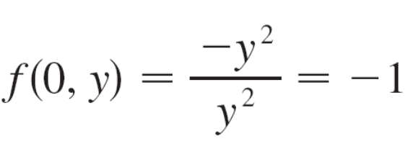
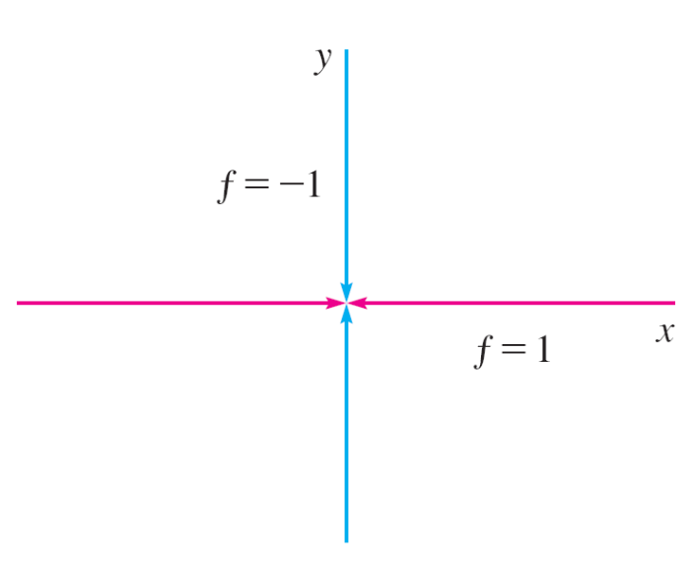
Example 1 – Solution
cont’d
We now approach along the y-axis by putting x = 0.
Then for all y ≠ 0, so
f (x, y) → –1 as (x, y) → (0, 0) along the y-axis
(See Figure 4.)
Figure 4

Slide 14
Example 1 – Solution
cont’d
Since f has two different limits along two different lines, the given limit does not exist. (This confirms the conjecture we made on the basis of numerical evidence at the beginning of this section.)

Slide 15

Limits and Continuity
Now let’s look at limits that do exist. Just as for functions of one variable, the calculation of limits for functions of two variables can be greatly simplified by the use of properties of limits.
The Limit Laws can be extended to functions of two variables: The limit of a sum is the sum of the limits, the limit of a product is the product of the limits, and so on.
In particular, the following equations are true.
The Squeeze Theorem also holds.

Slide 16
Continuity

Slide 17
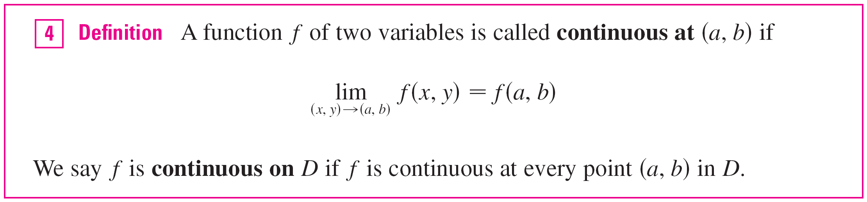
Continuity
Recall that evaluating limits of continuous functions of a single variable is easy.
It can be accomplished by direct substitution because the defining property of a continuous function is lim_{x→a} f (x) = f (a).
Continuous functions of two variables are also defined by the direct substitution property.

Slide 18
Continuity
The intuitive meaning of continuity is that if the point (x, y) changes by a small amount, then the value of f (x, y) changes by a small amount.
This means that a surface that is the graph of a continuous function has no hole or break.
Using the properties of limits, you can see that sums, differences, products, and quotients of continuous functions are continuous on their domains.
Let’s use this fact to give examples of continuous functions.

Slide 19
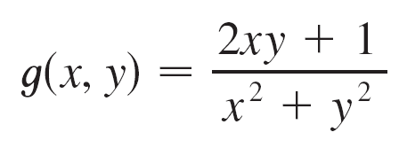
Continuity
A polynomial function of two variables (or polynomial, for short) is a sum of terms of the form cx^{m}y^{n}, where c is a constant and m and n are nonnegative integers.
A rational function is a ratio of polynomials.
For instance,
f (x, y) = x⁴ + 5x³y² + 6xy⁴ – 7y + 6
is a polynomial, whereas
is a rational function.

Slide 20


Continuity
The limits in show that the functions f (x, y) = x, g(x, y) = y, and h(x, y) = c are continuous.
Since any polynomial can be built up out of the simple functions f, g, and h by multiplication and addition, it follows that all polynomials are continuous on .
Likewise, any rational function is continuous on its domain because it is a quotient of continuous functions.

Slide 21
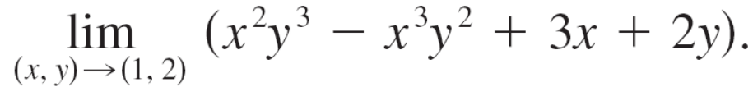

Example 5
Evaluate
Solution:
Since f (x, y) = x²y³ – x³y² + 3x + 2y is a polynomial, it is continuous everywhere, so we can find the limit by direct substitution:

Slide 22
Continuity
Just as for functions of one variable, composition is another way of combining two continuous functions to get a third.
In fact, it can be shown that if f is a continuous function of two variables and g is a continuous function of a single variable that is defined on the range of f, then the composite function h = g ° f defined by h (x, y) = g (f (x, y)) is also a continuous function.

Slide 23
Functions of Three or More Variables

Slide 24
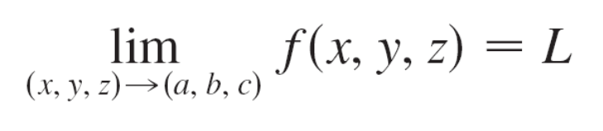
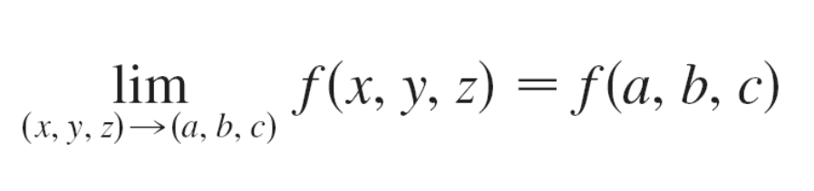
Functions of Three or More Variables
Everything that we have done in this section can be extended to functions of three or more variables.
The notation
means that the values of f (x, y, z) approach the number L as the point (x, y, z) approaches the point (a, b, c) along any path in the domain of f.
The function f is continuous at (a, b, c) if

Slide 25
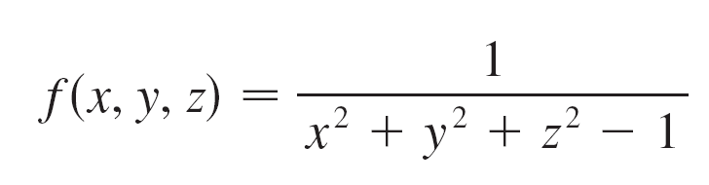

Functions of Three or More Variables
For instance, the function
is a rational function of three variables and so is continuous at every point in except where x² + y² + z² = 1.
In other words, it is discontinuous on the sphere with center the origin and radius 1.

Slide 26
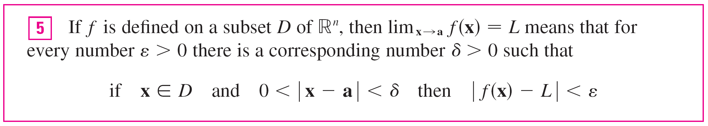
Functions of Three or More Variables
We can write the definitions of a limit for functions of two or three variables in a single compact form as follows.

