Slide 1


14
Partial Derivatives
Copyright © Cengage Learning. All rights reserved.

Slide 2

14.5
The Chain Rule
Copyright © Cengage Learning. All rights reserved.

Slide 3
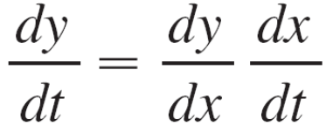

The Chain Rule
Recall that the Chain Rule for functions of a single variable gives the rule for differentiating a composite function:
If y = f (x) and x = g(t), where f and g are differentiable functions, then y is indirectly a differentiable function of t and
For functions of more than one variable, the Chain Rule has several versions, each of them giving a rule for differentiating a composite function.

Slide 4
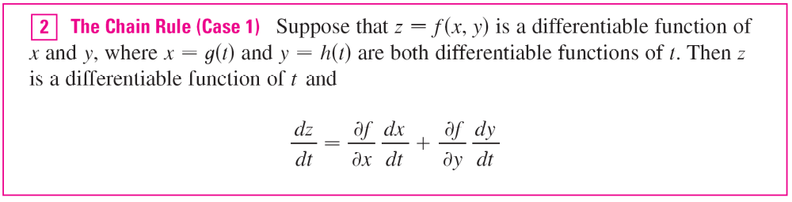
The Chain Rule
The first version (Theorem 2) deals with the case where z = f (x, y) and each of the variables x and y is, in turn, a function of a variable t.
This means that z is indirectly a function of t,
z = f (g(t), h(t)), and the Chain Rule gives a formula for differentiating z as a function of t.

Slide 5
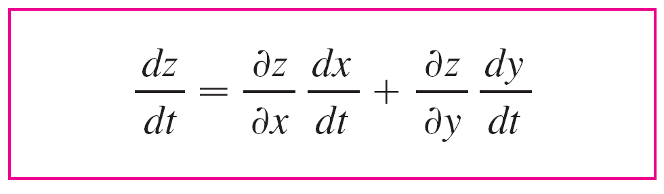
The Chain Rule
We assume that f is differentiable. Recall that this is the case when f_{x} and f_{y} are continuous.
Since we often write ∂z/∂x in place of ∂f/∂x, we can rewrite
the Chain Rule in the form

Slide 6
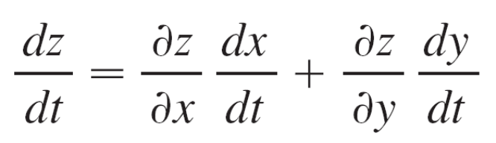
Example 1
If z = x²y + 3xy⁴, where x = sin 2t and y = cos t, find dz/dt when t = 0.
Solution:
The Chain Rule gives
= (2xy + 3y⁴)(2 cos 2t) + (x² + 12xy³)(–sin t)
It’s not necessary to substitute the expressions for x and y in terms of t.

Slide 7
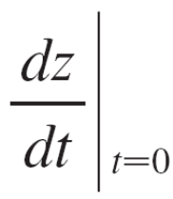
Example 1 – Solution
cont’d
We simply observe that when t = 0, we have x = sin 0 = 0 and y = cos 0 = 1.
Therefore
= (0 + 3)(2 cos 0) + (0 + 0)(–sin 0)
= 6

Slide 8
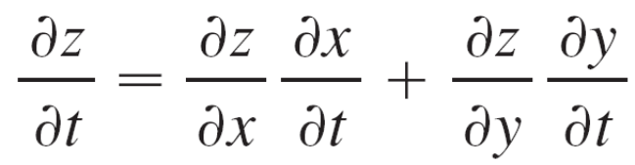
The Chain Rule
We now consider the situation where z = f (x, y) but each of x and y is a function of two variables s and t:
x = g(s, t), y = h(s, t).
Then z is indirectly a function of s and t and we wish to find ∂z/∂s and ∂z/∂t .
Recall that in computing ∂z/∂t we hold s fixed and compute the ordinary derivative of z with respect to t.
Therefore we can apply Theorem 2 to obtain

Slide 9
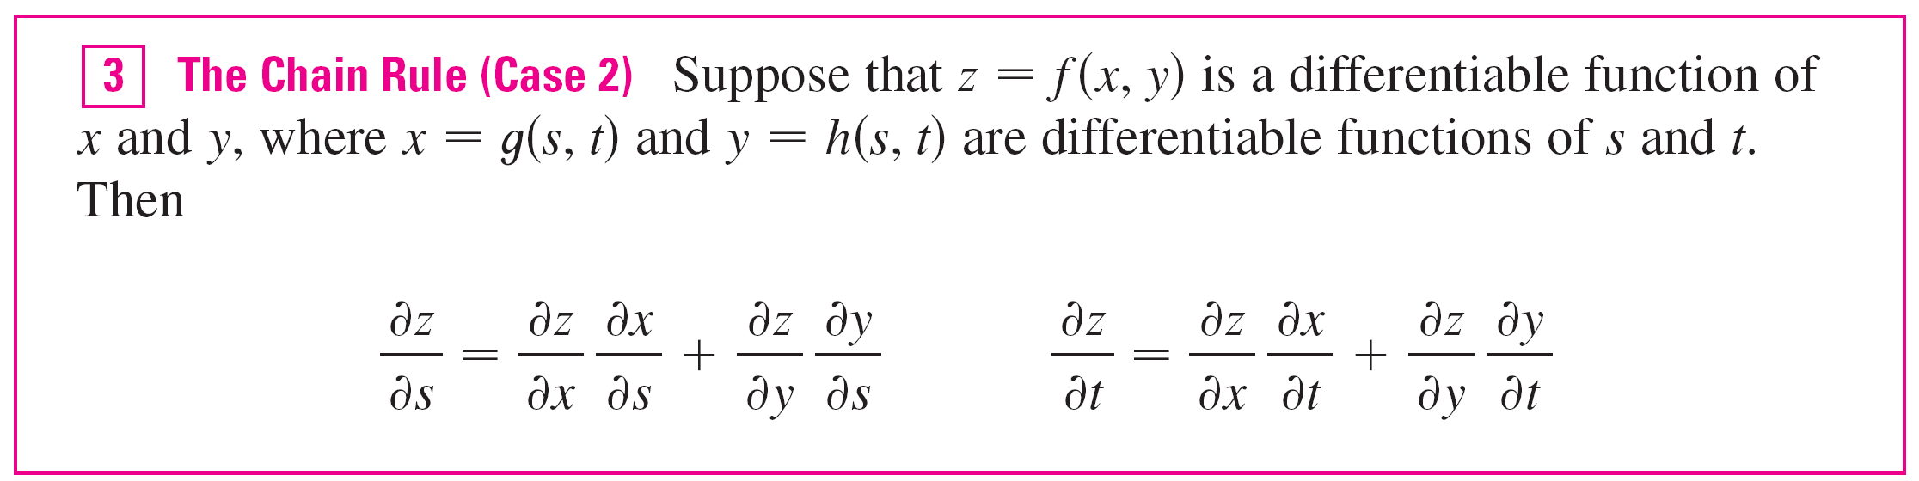
The Chain Rule
A similar argument holds for ∂z/∂s and so we have proved the following version of the Chain Rule.
Case 2 of the Chain Rule contains three types of variables: s and t are independent variables, x and y are called intermediate variables, and z is the dependent variable.

Slide 10
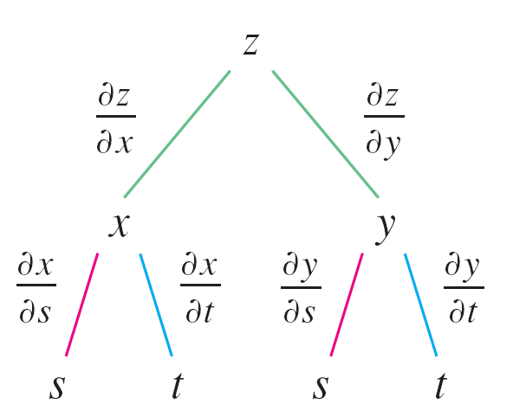
The Chain Rule
Notice that Theorem 3 has one term for each intermediate variable and each of these terms resembles the one-dimensional Chain Rule in Equation 1.
To remember the Chain Rule, it’s helpful to draw the tree diagram in Figure 2.
Figure 2

Slide 11
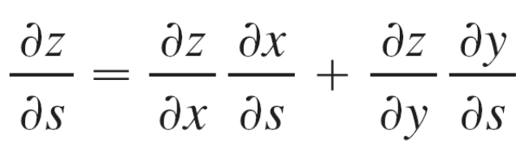
The Chain Rule
We draw branches from the dependent variable z to the intermediate variables x and y to indicate that z is a function of x and y. Then we draw branches from x and y to the independent variables s and t.
On each branch we write the corresponding partial derivative. To find ∂z/∂s, we find the product of the partial derivatives along each path from z to s and then add these products:

Slide 12
The Chain Rule
Similarly, we find ∂z/∂t by using the paths from z to t.
Now we consider the general situation in which a dependent variable u is a function of n intermediate variables x₁, …, x_{n}, each of which is, in turn, a function of m independent variables t₁,…, t_{m}.
Notice that there are n terms, one for each intermediate variable.

Slide 13
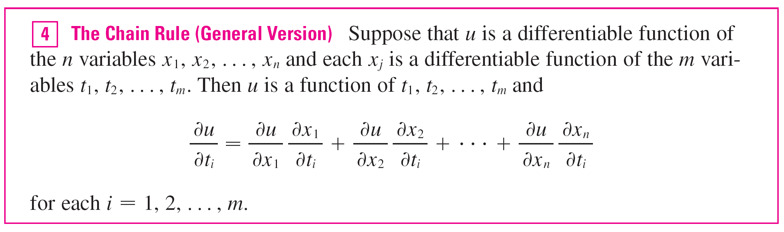
The Chain Rule

Slide 14
Implicit Differentiation

Slide 15
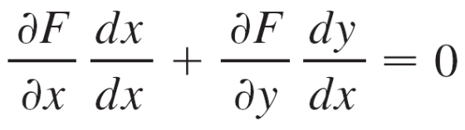
Implicit Differentiation
The Chain Rule can be used to give a more complete description of the process of implicit differentiation. We suppose that an equation of the form F (x, y) = 0 defines y implicitly as a differentiable function of x, that is, y = f (x), where F (x, f (x)) = 0 for all x in the domain of f.
If F is differentiable, we can apply Case 1 of the Chain Rule to differentiate both sides of the equation F (x, y) = 0 with respect to x.
Since both x and y are functions of x, we obtain

Slide 16
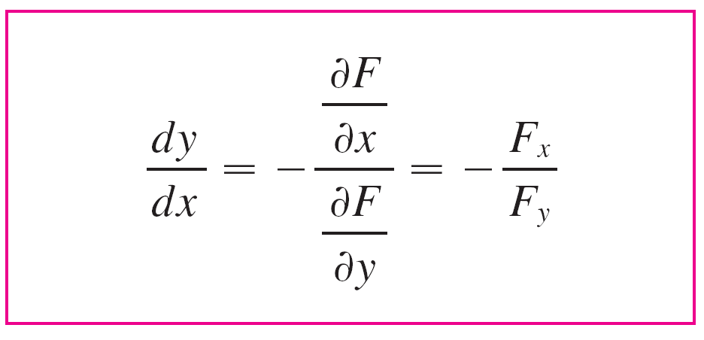

Implicit Differentiation
But dx/dx = 1, so if ∂F/∂x ≠ 0 we solve for dy/dx and obtain
To derive this equation we assumed that F (x, y) = 0 defines y implicitly as a function of x.

Slide 17
Implicit Differentiation
The Implicit Function Theorem, proved in advanced calculus, gives conditions under which this assumption is valid:
It states that if F is defined on a disk containing (a, b), where F (a, b) = 0, F_{y}(a, b) ≠ 0, and F_{x} and F_{y} are continuous on the disk, then the equation F (x, y) = 0 defines y as a function of x near the point (a, b) and the derivative of this function is given by Equation 6.

Slide 18
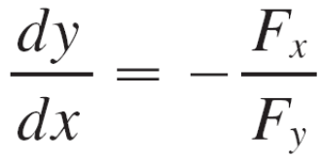
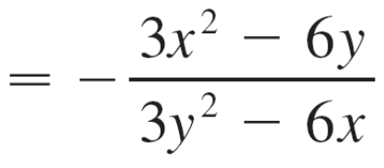
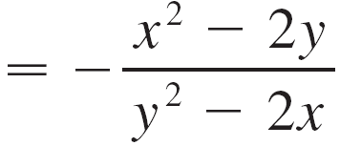
Example 8
Find y ′ if x³ + y³ = 6xy.
Solution:
The given equation can be written as
F (x, y) = x³ + y³ – 6xy = 0
so Equation 6 gives

Slide 19
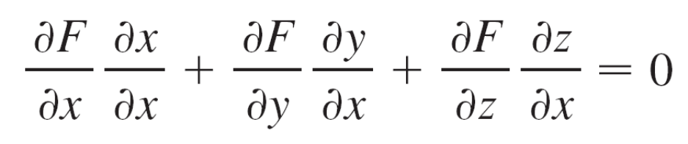
Implicit Differentiation
Now we suppose that z is given implicitly as a function z = f (x, y) by an equation of the form F (x, y, z) = 0.
This means that F (x, y, f (x, y)) = 0 for all (x, y) in the domain of f. If F and f are differentiable, then we can use the Chain Rule to differentiate the equation F (x, y, z) = 0 as follows:

Slide 20
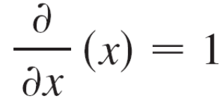
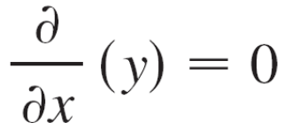
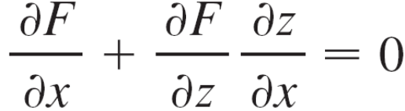
Implicit Differentiation
But and
so this equation becomes
If ∂F/∂z ≠ 0, we solve for ∂z/∂x and obtain the first formula in Equations 7.
The formula for ∂z/∂y is obtained in a similar manner.

Slide 21
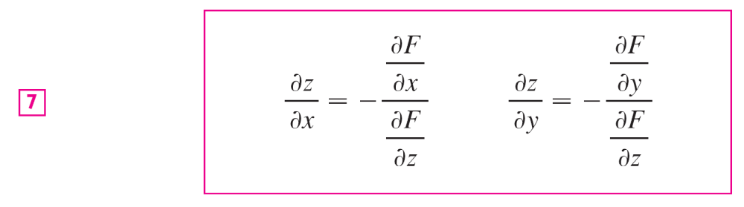
Implicit Differentiation
Again, a version of the Implicit Function Theorem gives conditions under which our assumption is valid:
If F is defined within a sphere containing (a, b, c), where F (a, b, c) = 0, F_{z} (a, b, c) ≠ 0, and F_{x}, F_{y}, and F_{z} are
continuous inside the sphere, then the equation
F (x, y, z) = 0 defines z as a function of x and y near the
point (a, b, c) and this function is differentiable, with partial
derivatives given by (7).

