Slide 1

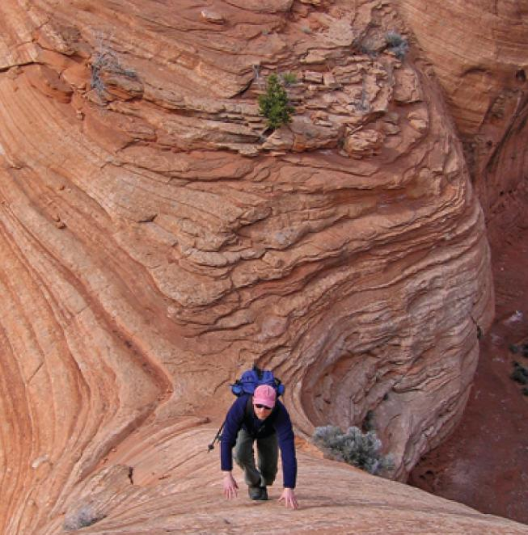
14
Partial Derivatives
Copyright © Cengage Learning. All rights reserved.

Slide 2
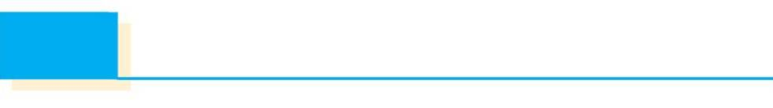
14.8
Lagrange Multipliers
Copyright © Cengage Learning. All rights reserved.

Slide 3
Lagrange Multipliers
In this section we present Lagrange’s method for maximizing or minimizing a general function f (x, y, z) subject to a constraint (or side condition) of the form
g(x, y, z) = k.
It’s easier to explain the geometric basis of Lagrange’s method for functions of two variables.
So we start by trying to find the extreme values of f (x, y) subject to a constraint of the form g(x, y) = k.
In other words, we seek the extreme values of f (x, y) when the point (x, y) is restricted to lie on the level curve
g(x, y) = k.

Slide 4
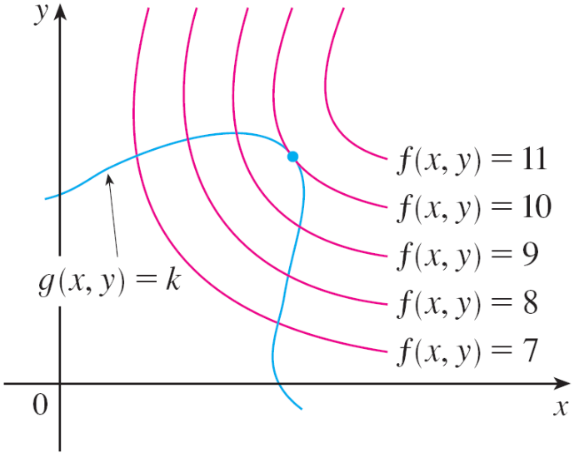
Lagrange Multipliers
Figure 1 shows this curve together with several level curves of f.
These have the equations f (x, y) = c,
where c = 7, 8, 9, 10, 11.
To maximize f (x, y) subject to
g(x, y) = k is to find the largest
value of c such that the level
curve f (x, y) = c intersects
g(x, y) = k.
It appears from Figure 1 that this happens when these curves just touch each other, that is, when they have a common tangent line. (Otherwise, the value of c could be increased further.)
Figure 1

Slide 5
Lagrange Multipliers
This means that the normal lines at the point (x₀, y₀) where they touch are identical. So the gradient vectors are parallel; that is, ∇f (x₀, y₀) = λ ∇g(x₀, y₀) for some scalar λ.
This kind of argument also applies to the problem of finding the extreme values of f (x, y, z) subject to the constraint
g(x, y, z) = k.
Thus the point (x, y, z) is restricted to lie on the level
surface S with equation g(x, y, z) = k.

Slide 6
Lagrange Multipliers
Instead of the level curves in Figure 1, we consider the level surfaces f (x, y, z) = c and argue that if the maximum value of f is f (x₀, y₀, z₀) = c, then the level surface
f (x, y, z) = c is tangent to the level surface g(x, y, z) = k and so the corresponding gradient vectors are parallel.
Figure 1

Slide 7
Lagrange Multipliers
This intuitive argument can be made precise as follows. Suppose that a function f has an extreme value at a point P(x₀, y₀, z₀) on the surface S and let C be a curve with vector equation r(t) = ⟨x(t), y(t), z(t)⟩ that lies on S and passes through P.
If t₀ is the parameter value corresponding to the point P, then r(t₀) = ⟨x₀, y₀, z₀⟩.
The composite function h(t) = f (x(t), y(t), z(t)) represents the values that f takes on the curve C.

Slide 8
Lagrange Multipliers
Since f has an extreme value at (x₀, y₀, z₀), it follows that h has an extreme value at t₀, so h′(t₀) = 0. But if f is differentiable, we can use the Chain Rule to write
0 = h′(t₀)
= f_{x}(x₀, y₀, z₀)x′(t₀) + f_{y}(x₀, y₀, z₀)y ′(t₀) + f_{z}(x₀, y₀, z₀)z′(t₀)
= ∇f (x₀, y₀, z₀)  r′(t₀)
This shows that the gradient vector ∇f (x₀, y₀, z₀) is orthogonal to the tangent vector r′(t₀) to every such curve C.
But we already know that the gradient vector of g,
∇g(x₀, y₀, z₀), is also orthogonal to r′(t₀) for every such curve.

Slide 9
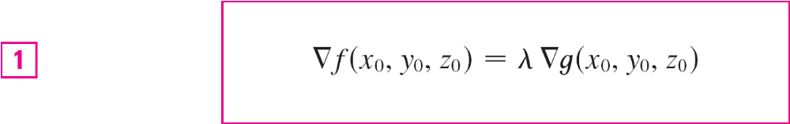
Lagrange Multipliers
This means that the gradient vectors ∇f (x₀, y₀, z₀) and
∇g(x₀, y₀, z₀) must be parallel. Therefore, if
∇g(x₀, y₀, z₀) ≠ 0, there is a number λ such that
The number λ in Equation 1 is called a Lagrange multiplier.

Slide 10
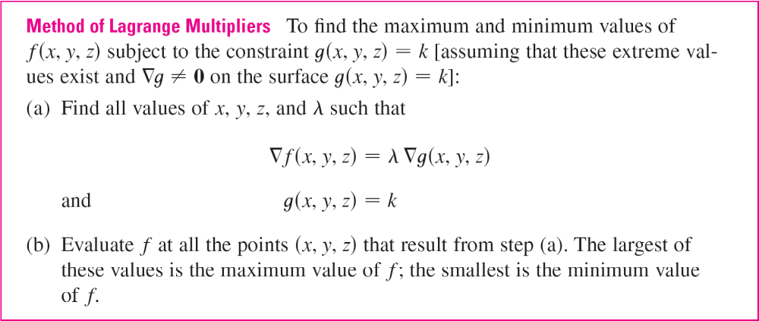
Lagrange Multipliers
The procedure based on Equation 1 is as follows.

Slide 11
Lagrange Multipliers
If we write the vector equation ∇f = λ ∇g in terms of components, then the equations in step (a) become
f_{x} = λg_{x} f_{y} = λg_{y} f_{z} = λg_{z} g(x, y, z) = k
This is a system of four equations in the four unknowns
x, y, z, and λ, but it is not necessary to find explicit values
for λ.
For functions of two variables the method of Lagrange multipliers is similar to the method just described.

Slide 12
Lagrange Multipliers
To find the extreme values of f (x, y) subject to the constraint g(x, y) = k, we look for values of x, y, and λ such that
∇f (x, y) = λ ∇g(x, y) and g(x, y) = k
This amounts to solving three equations in three unknowns:
f_{x} = λg_{x} f_{y} = λg_{y} g(x, y) = k

Slide 13
Example 1
A rectangular box without a lid is to be made from 12 m² of cardboard. Find the maximum volume of such a box.
Solution:
Let x, y, and z be the length, width, and height, respectively, of the box in meters.
Then we wish to maximize
V = xyz
subject to the constraint
g(x, y, z) = 2xz + 2yz + xy = 12
Using the method of Lagrange multipliers, we look for values of x, y, z, and λ such that ∇V = λ ∇g and
g(x, y, z) = 12.

Slide 14




Example 1 – Solution
cont’d
This gives the equations
V_{x} = λg_{x}
V_{y} = λg_{y}
V_{z} = λg_{z}
2xz + 2yz + xy = 12
which become
yz = λ(2z + y)
xz = λ(2z + x)
xy = λ(2x + 2y)
2xz + 2yz + xy = 12

Slide 15



Example 1 – Solution
cont’d
There are no general rules for solving systems of equations. Sometimes some ingenuity is required.
In the present example you might notice that if we multiply (2) by x, (3) by y, and (4) by z, then the left sides of these equations will be identical.
Doing this, we have
xyz = λ(2xz + xy)
xyz = λ(2yz + xy)
xyz = λ(2xz + 2yz)

Slide 16
Example 1 – Solution
cont’d
We observe that λ ≠ 0 because λ = 0 would imply yz = xz = xy = 0 from (2), (3), and (4) and this would contradict (5).
Therefore, from (6) and (7), we have
2xz + xy = 2yz + xy
which gives xz = yz.
But z ≠ 0 (since z = 0 would give V = 0), so x = y.

Slide 17
Example 1 – Solution
cont’d
From (7) and (8) we have
2yz + xy = 2xz + 2yz
which gives 2xz = xy and so (since x ≠ 0) y = 2z.
If we now put x = y = 2z in (5), we get
4z² + 4z² + 4z² = 12
Since x, y, and z are all positive, we therefore have z = 1 and so x = 2 and y = 2.
Then V = 2  2  1 = 4, so the maximum volume of the box
is 4 m^{3.}

Slide 18
Two Constraints

Slide 19
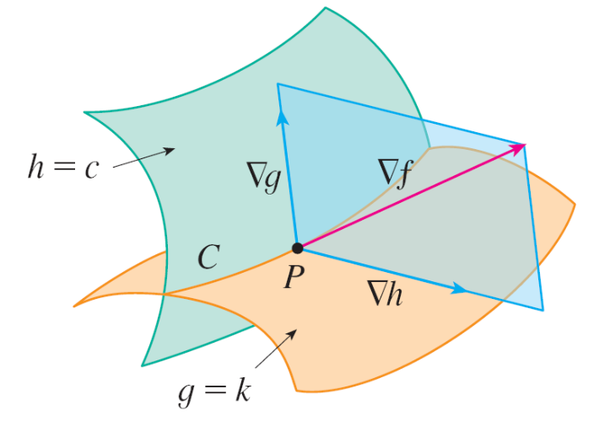
Two Constraints
Suppose now that we want to find the maximum and minimum values of a function f (x, y, z) subject to two constraints (side conditions) of the form g(x, y, z) = k and h(x, y, z) = c.
Geometrically, this means that
we are looking for the extreme
values of f when (x, y, z) is
restricted to lie on the curve of
intersection C of the level
surfaces g(x, y, z) = k and
h(x, y, z) = c. (See Figure 5.)
Figure 5

Slide 20
Two Constraints
Suppose f has such an extreme value at a point
P(x₀, y₀, z₀). We know from the beginning of this section that ∇f is orthogonal to C at P.
But we also know that ∇g is orthogonal to g(x, y, z) = k and ∇h is orthogonal to h(x, y, z) = c, so ∇g and ∇h are both orthogonal to C.
This means that the gradient vector ∇f (x₀, y₀, z₀) is in the plane determined by ∇g(x₀, y₀, z₀) and ∇h(x₀, y₀, z₀). (We assume that these gradient vectors are not zero and not parallel.)

Slide 21

Two Constraints
So there are numbers λ and μ (called Lagrange multipliers) such that
In this case Lagrange’s method is to look for extreme
values by solving five equations in the five unknowns
x, y, z, λ, and μ.

Slide 22
Two Constraints
These equations are obtained by writing Equation 16 in terms of its components and using the constraint equations:
f_{x} = λg_{x} + μh_{x}
f_{y} = λg_{y} + μh_{y}
f_{z} = λg_{z} + μh_{z}
g(x, y, z) = k
h(x, y, z) = c

Slide 23
Example 5
Find the maximum value of the function f (x, y, z) = x + 2y + 3z on the curve of intersection of the plane x – y + z = 1 and the cylinder x² + y² = 1.
Solution:
We maximize the function f (x, y, z) = x + 2y + 3z subject to the constraints g(x, y, z) = x – y + z = 1 and
h(x, y, z) = x² + y² = 1.

Slide 24





Example 5 – Solution
cont’d
The Lagrange condition is ∇f = λ ∇g + μ ∇h, so we solve the equations
1 = λ + 2xμ
2 = –λ + 2yμ
3 = λ
x – y + z = 1
x² + y² = 1
Putting λ = 3 [from (19)] in (17), we get 2xμ = –2, so x = –1/μ. Similarly, (18) gives y = 5/(2μ).

Slide 25
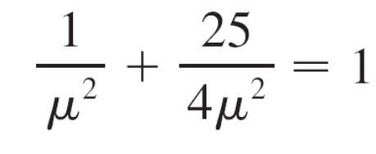


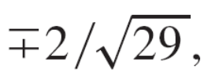


Example 5 – Solution
cont’d
Substitution in (21) then gives
and so μ ² = , μ = .
Then x = y = and, from (20),
z = 1 – x + y = 1 .

Slide 26
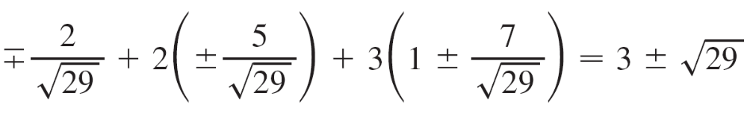

Example 5 – Solution
cont’d
The corresponding values of f are
Therefore the maximum value of f on the given curve is

