Slide 1


15
Multiple Integrals
Copyright © Cengage Learning. All rights reserved.

Slide 2

15.3
Double Integrals over General Regions
Copyright © Cengage Learning. All rights reserved.

Slide 3
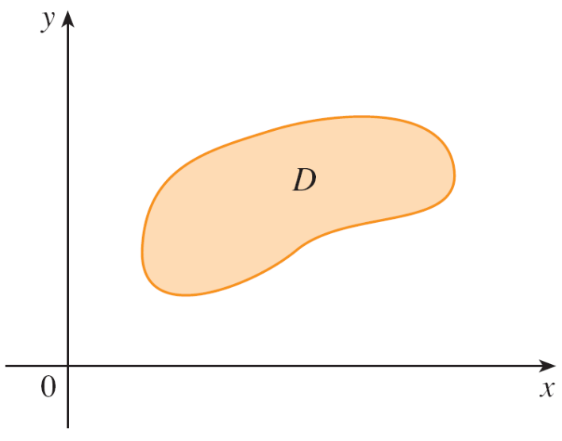
Double Integrals over General Regions
For single integrals, the region over which we integrate is always an interval.
But for double integrals, we want to be able to integrate a function f not just over rectangles but also over regions D of more general shape, such as the one illustrated in Figure 1.
Figure 1

Slide 4
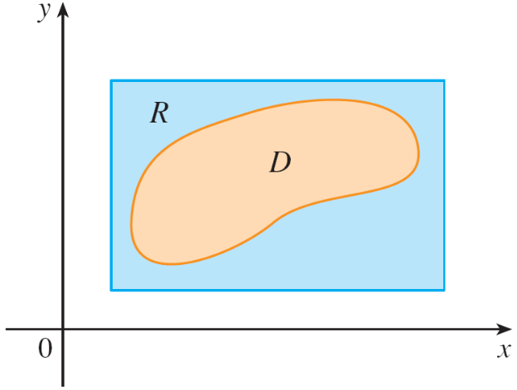


Double Integrals over General Regions
We suppose that D is a bounded region, which means that D can be enclosed in a rectangular region R as in Figure 2.
Then we define a new function F with domain R by
f(x, y) if (x, y) is in D
0 if (x, y) is in R but not in D
Figure 2
F(x, y) =

Slide 5

Double Integrals over General Regions
If F is integrable over R, then we define the double integral of f over D by
Definition 2 makes sense because R is a rectangle and so ∫∫_{R} F (x, y) dA has been previously defined.

Slide 6
Double Integrals over General Regions
The procedure that we have used is reasonable because the values of F (x, y) are 0 when (x, y) lies outside D and so they contribute nothing to the integral.
This means that it doesn’t matter what rectangle R we use as long as it contains D.
In the case where f (x, y) ≥ 0, we can still interpret ∫∫_{D} f (x, y) dA as the volume of the solid that lies above D and under the surface z = f (x, y) (the graph of f).

Slide 7
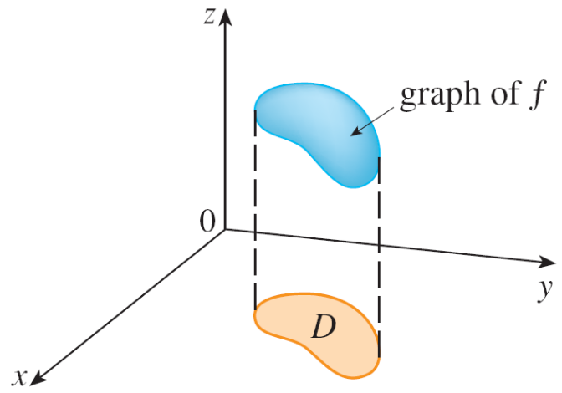
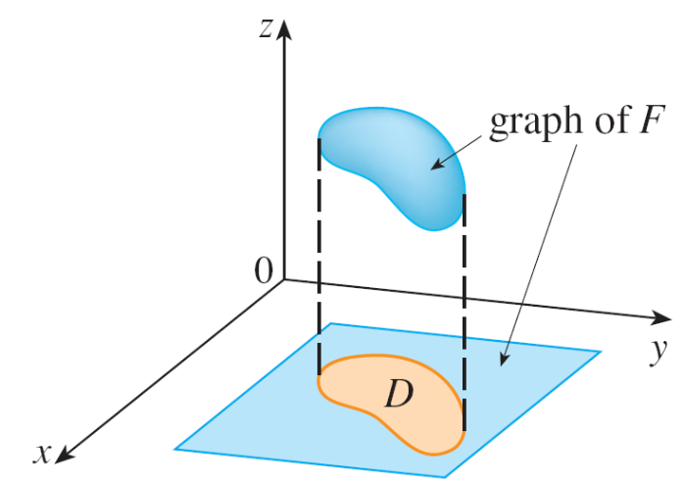
Double Integrals over General Regions
You can see that this is reasonable by comparing the graphs of f and F in Figures 3 and 4 and remembering that ∫∫_{R} F (x, y) dA is the volume under the graph of F.
Figure 3
Figure 4

Slide 8
Double Integrals over General Regions
Figure 4 also shows that F is likely to have discontinuities at the boundary points of D.
Nonetheless, if f is continuous on D and the boundary curve of D is “well behaved”, then it can be shown that
∫∫_{R} F (x, y) dA exists and therefore ∫∫_{D} f (x, y) dA exists.
In particular, this is the case for type I and type II regions.

Slide 9
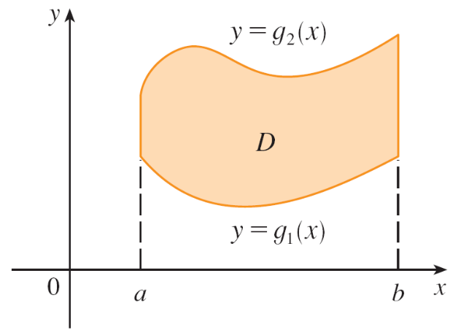
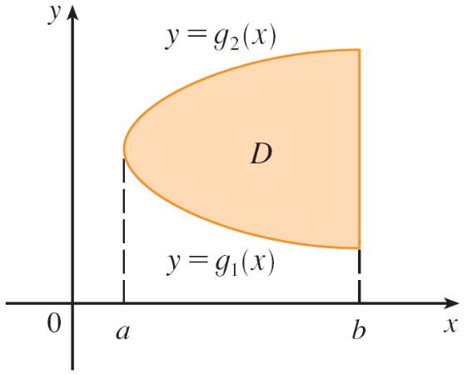
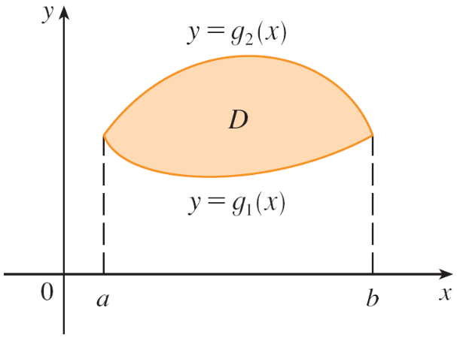
Double Integrals over General Regions
A plane region D is said to be of type I if it lies between the graphs of two continuous functions of x, that is,
D = {(x, y) | a ≤ x ≤ b, g₁(x) ≤ y ≤ g₂(x)}
where g₁ and g₂ are continuous on [a, b]. Some examples of type I regions are shown in Figure 5.
Some type I regions
Figure 5

Slide 10
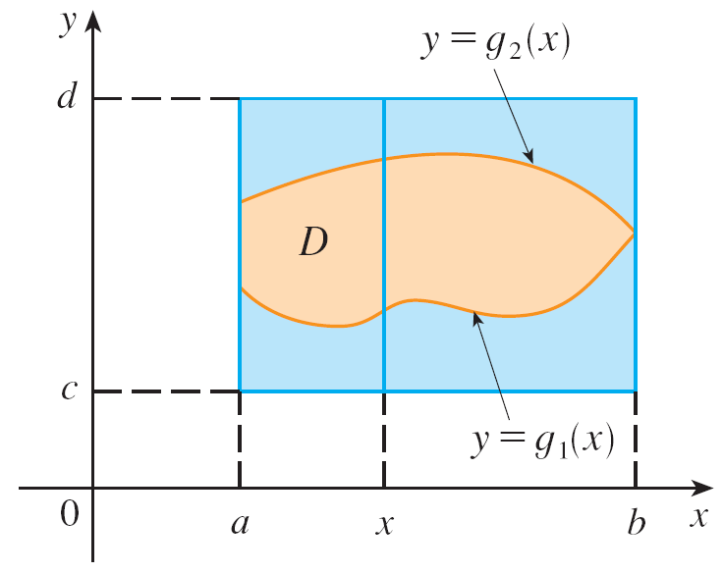
Double Integrals over General Regions
In order to evaluate ∫∫_{D} f (x, y) dA when D is a region of type I, we choose a rectangle R = [a, b] × [c, d ] that contains D, as in Figure 6, and we let F be the function given by Equation 1; that is, F agrees with f on D and F is 0
outside D.
Figure 6

Slide 11
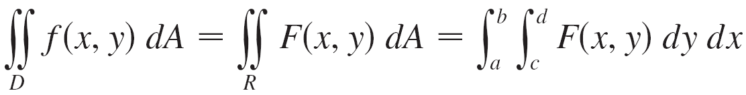
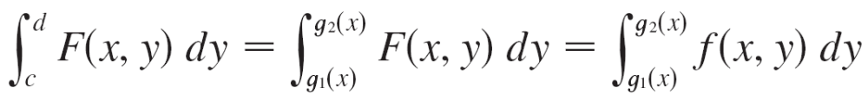
Double Integrals over General Regions
Then, by Fubini’s Theorem,
Observe that F (x, y) = 0 if y < g₁(x) or y > g₂(x) because (x, y) then lies outside D. Therefore
because F (x, y) = f (x, y) when g₁(x) ≤ y ≤ g₂(x).

Slide 12
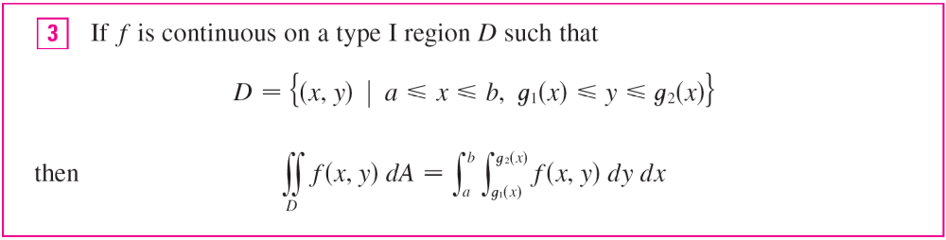

Double Integrals over General Regions
Thus we have the following formula that enables us to evaluate the double integral as an iterated integral.
The integral on the right side of is an iterated integral, except that in the inner integral we regard x as being constant not only in f (x, y) but also in the limits of integration, g₁(x) and g₂(x).

Slide 13

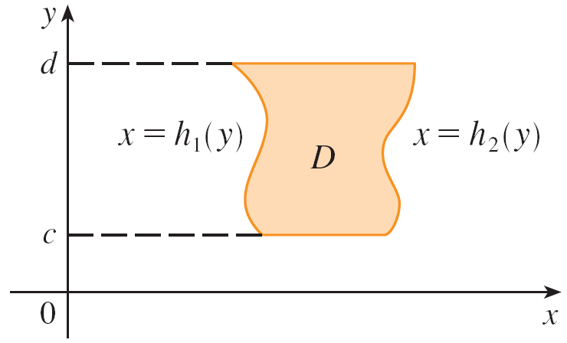
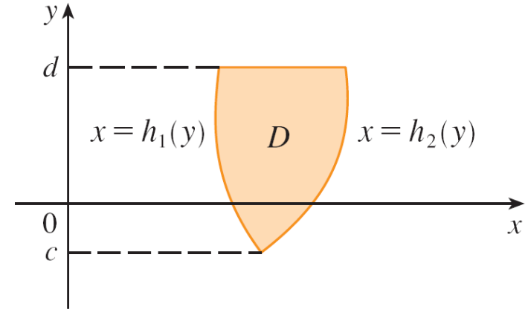
Double Integrals over General Regions
We also consider plane regions of type II, which can be expressed as
D = {(x, y) | c ≤ y ≤ d, h₁(y) ≤ x ≤ h₂(y)}
where h₁ and h₂ are continuous. Two such regions are illustrated in Figure 7.
Some type II regions
Figure 7

Slide 14

Double Integrals over General Regions
Using the same methods that were used in establishing , we can show that

Slide 15
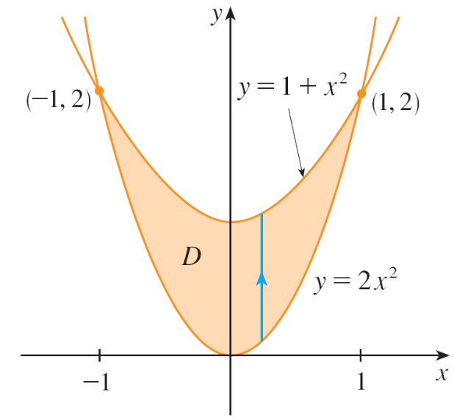
Example 1
Evaluate ∫∫_{D} (x + 2y) dA, where D is the region bounded by the parabolas y = 2x² and y = 1 + x².
Solution:
The parabolas intersect when 2x² = 1 + x², that is, x² = 1,
so x = ±1.
We note that the region D,
sketched in Figure 8, is a
type I region but not a type II
region and we can write
D = {(x, y) | –1 ≤ x ≤ 1, 2x² ≤ y ≤ 1 + x²}
Figure 8

Slide 16
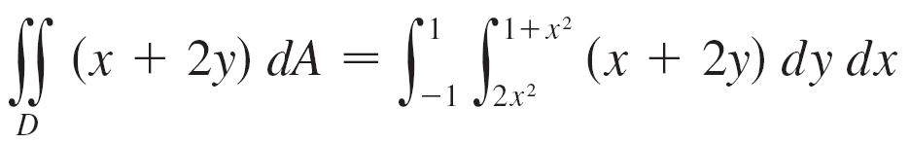
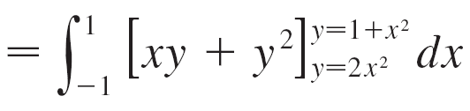
Example 1 – Solution
cont’d
Since the lower boundary is y = 2x² and the upper boundary is y = 1 + x², Equation 3 gives

Slide 17
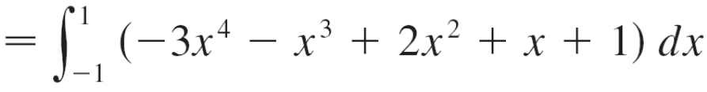
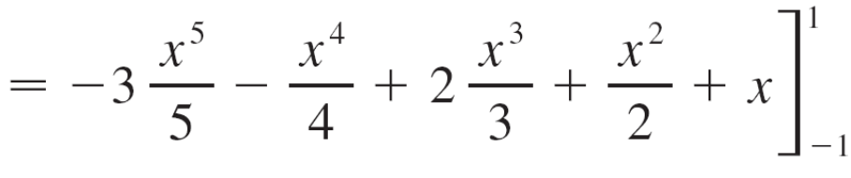
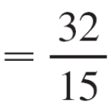
Example 1 – Solution
cont’d

Slide 18
Properties of Double Integrals

Slide 19

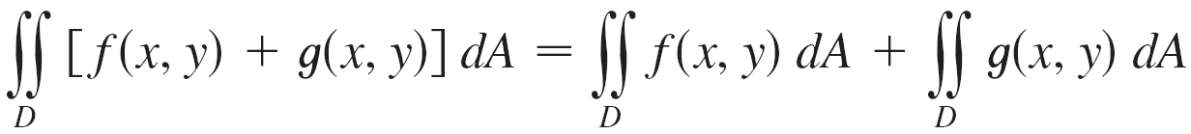
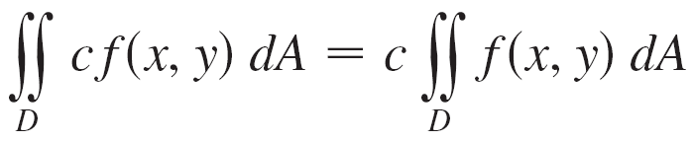


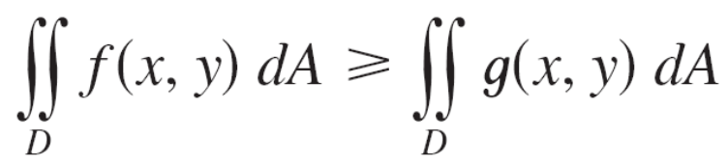
Properties of Double Integrals
We assume that all of the following integrals exist. The first three properties of double integrals over a region D follow immediately from Definition 2.
If f (x, y) ≥ g (x, y) for all (x, y) in D, then

Slide 20
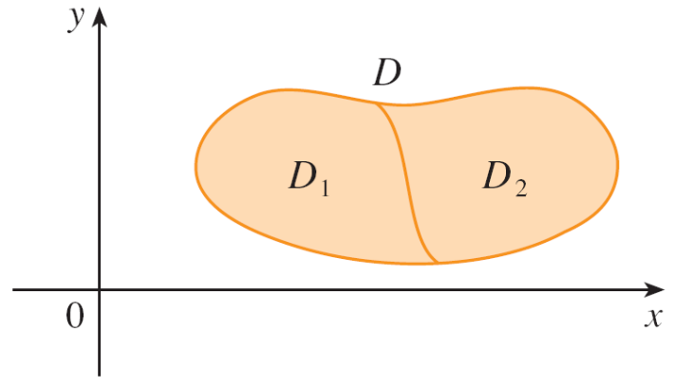
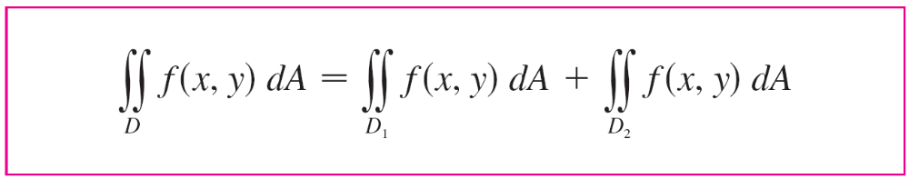

Properties of Double Integrals
The next property of double integrals is similar to the property of single integrals given by the equation
If D = D₁ U D₂, where D₁ and D₂
don’t overlap except perhaps on
their boundaries (see Figure 17),
then
Figure 17

Slide 21
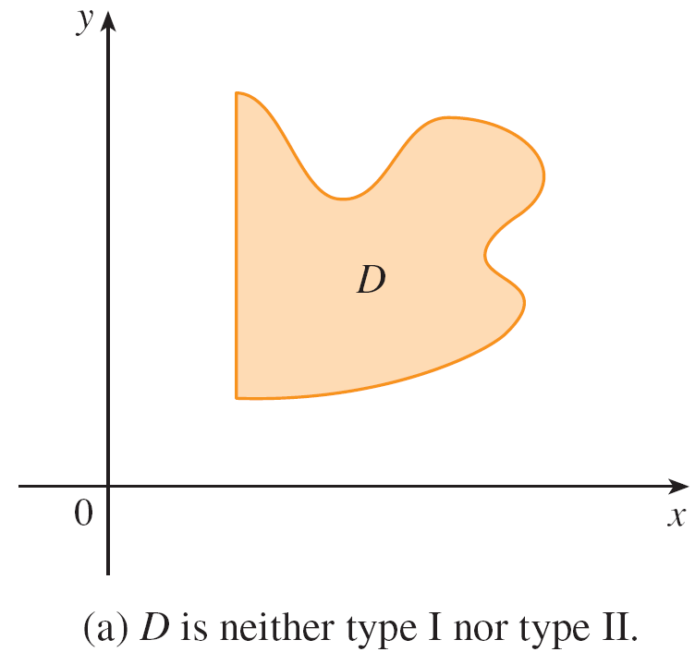
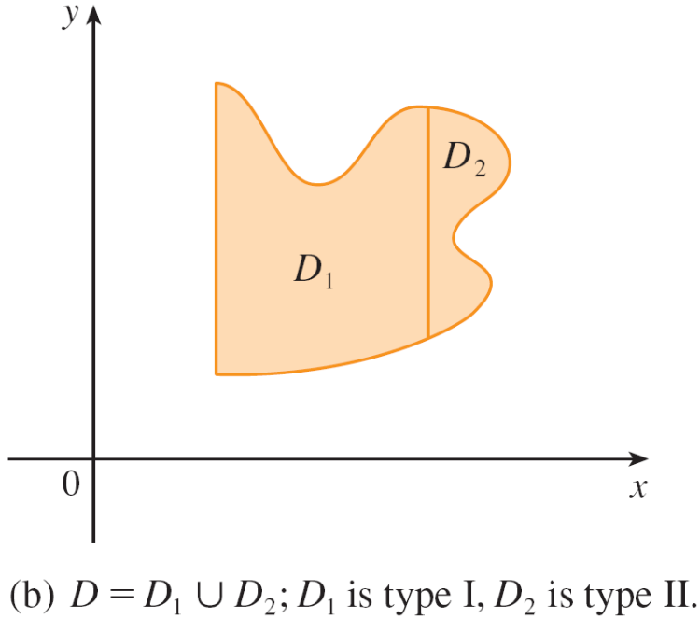
Properties of Double Integrals
Property 9 can be used to evaluate double integrals over regions D that are neither type I nor type II but can be expressed as a union of regions of type I or type II. Figure 18 illustrates this procedure.
Figure 18

Slide 22
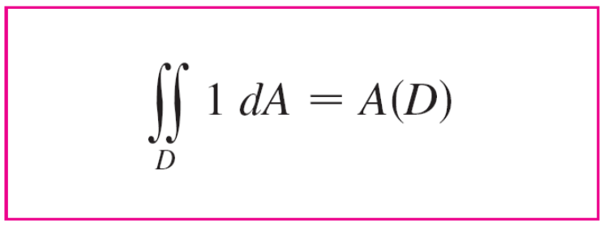

Properties of Double Integrals
The next property of integrals says that if we integrate the constant function f (x, y) = 1 over a region D, we get the area of D:

Slide 23
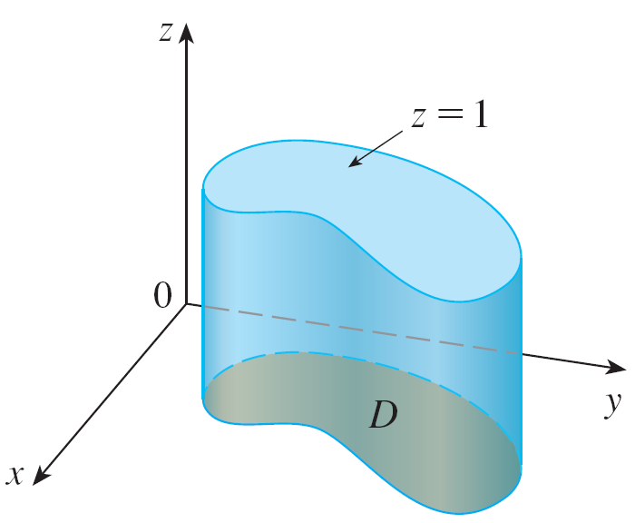
Properties of Double Integrals
Figure 19 illustrates why Equation 10 is true: A solid cylinder whose base is D and whose height is 1 has volume A(D)  1 = A(D), but we know that we can also write its volume as ∫∫_{D} 1 dA.
Cylinder with base D and height 1
Figure 19

Slide 24
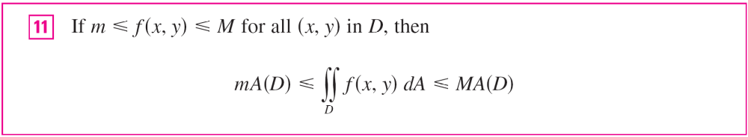
Properties of Double Integrals
Finally, we can combine Properties 7, 8, and 10 to prove the following property.

Slide 25
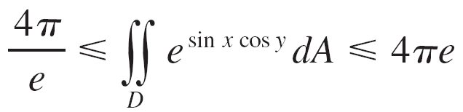
Example 6
Use Property 11 to estimate the integral ∫∫_{D} e^{sin x cos y} dA, where D is the disk with center the origin and radius 2.
Solution:
Since –1 ≤ sin x ≤ 1 and –1 ≤ cos y ≤ 1, we have –1 ≤ sin x cos y ≤ 1 and therefore
e^{–1} ≤ e^{sin x cos y} ≤ e¹ = e
Thus, using m = e^{–1} = 1/e, M = e, and A(D) = π(2)² in Property 11, we obtain

