Slide 1


15
Multiple Integrals
Copyright © Cengage Learning. All rights reserved.

Slide 2

15.7
Triple Integrals
Copyright © Cengage Learning. All rights reserved.

Slide 3

Triple Integrals
We have defined single integrals for functions of one variable and double integrals for functions of two variables, so we can define triple integrals for functions of three variables.
Let’s first deal with the simplest case where f is defined on a rectangular box:
B = {(x, y, z) | a ≤ x ≤ b, c ≤ y ≤ d, r ≤ z ≤ s}
The first step is to divide B into sub-boxes. We do this by dividing the interval [a, b] into l subintervals [x_{i – 1}, x_{i}] of equal width Δx, dividing [c, d ] into m subintervals of width Δy, and dividing [r, s] into n subintervals of width Δz.

Slide 4
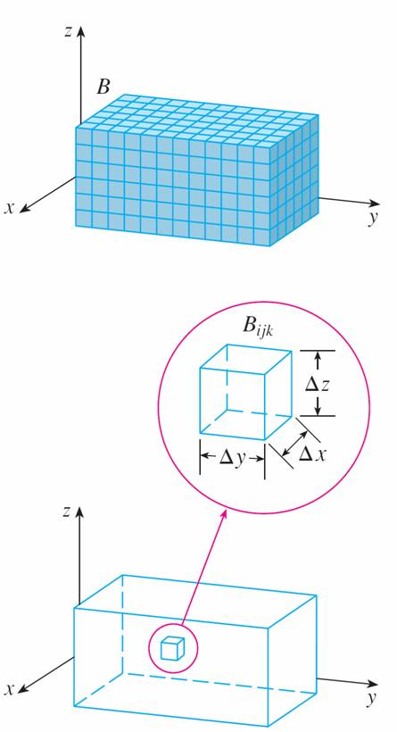
Triple Integrals
The planes through the endpoints of
these subintervals parallel to the
coordinate planes divide the box B
into lmn sub-boxes
B_{ijk} = [x_{i – 1}, x_{i}] × [y_{j – 1}, y_{j}] × [z_{k – 1}, z_{k}]
which are shown in Figure 1.
Each sub-box has volume
ΔV = Δx Δy Δz.
Figure 1

Slide 5
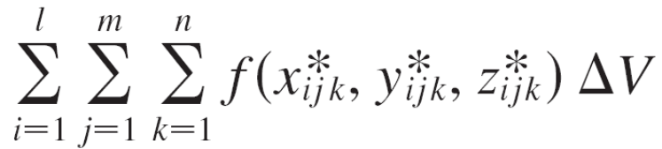


Triple Integrals
Then we form the triple Riemann sum
where the sample point is in B_{ijk}.
By analogy with the definition of a double integral, we define the triple integral as the limit of the triple Riemann sums in (2).

Slide 6
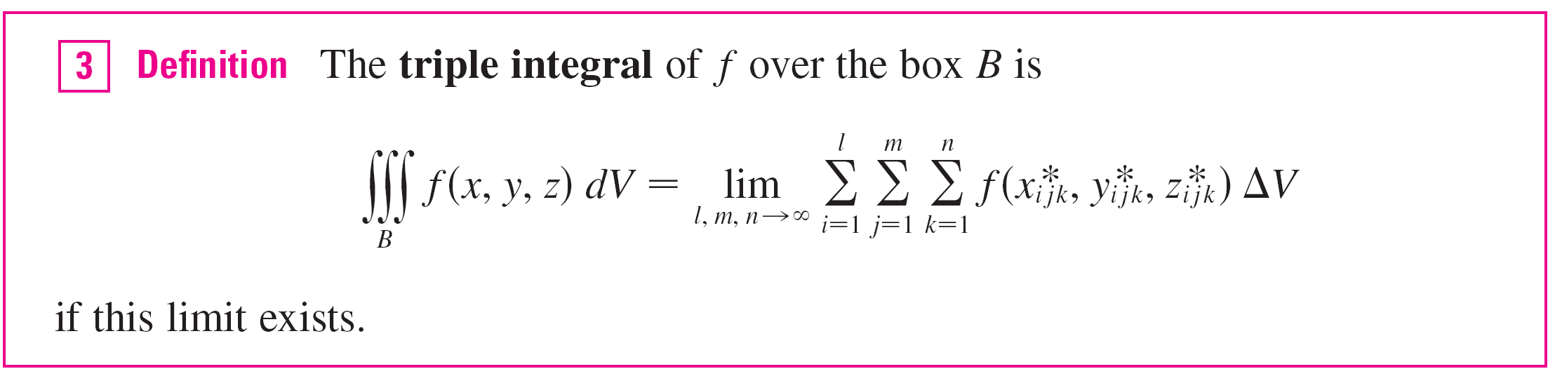
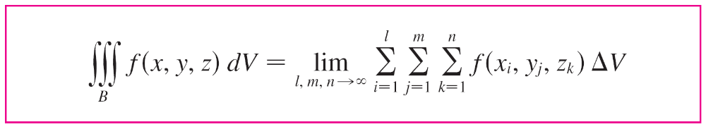
Triple Integrals
Again, the triple integral always exists if f is continuous. We can choose the sample point to be any point in the sub-box, but if we choose it to be the point (x_{i}, y_{j}, z_{k}) we get a simpler-looking expression for the triple integral:

Slide 7
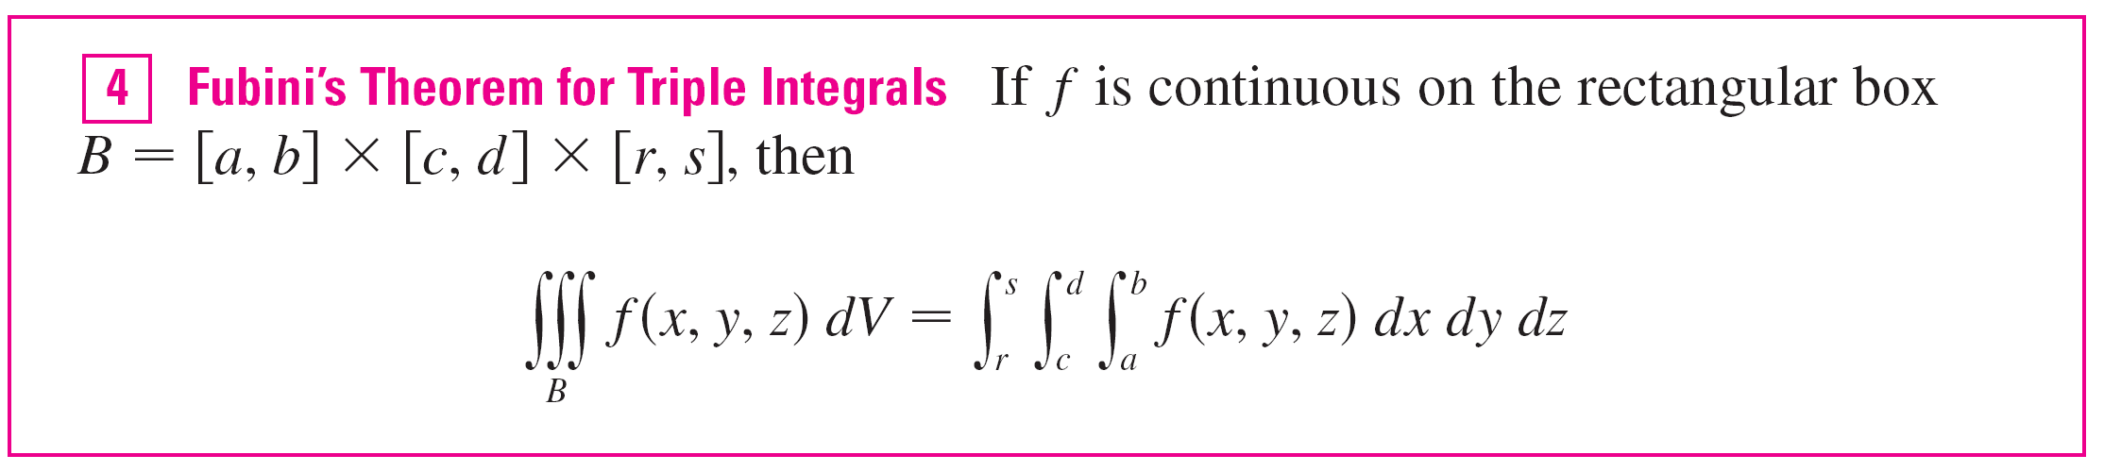
Triple Integrals
Just as for double integrals, the practical method for evaluating triple integrals is to express them as iterated integrals as follows.
The iterated integral on the right side of Fubini’s Theorem means that we integrate first with respect to x (keeping
y and z fixed), then we integrate with respect to y (keeping z fixed), and finally we integrate with respect to z.

Slide 8
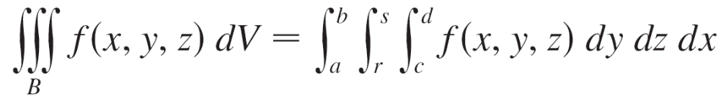
Triple Integrals
There are five other possible orders in which we can integrate, all of which give the same value.
For instance, if we integrate with respect to y, then z, and then x, we have

Slide 9
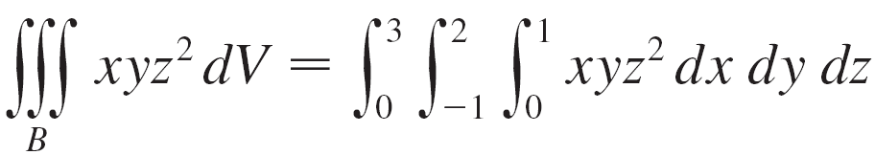
Example 1
Evaluate the triple integral ∫∫∫_{B} xyz² dV, where B is the rectangular box given by
B = {(x, y, z) | 0 ≤ x ≤ 1, –1 ≤ y ≤ 2, 0 ≤ z ≤ 3}
Solution:
We could use any of the six possible orders of integration.
If we choose to integrate with respect to x, then y, and then z, we obtain

Slide 10
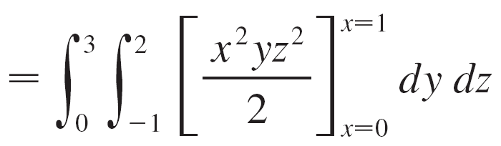
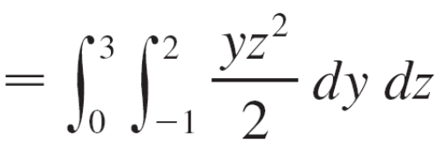
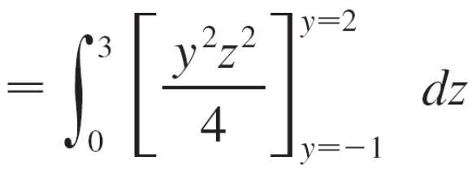
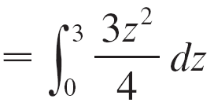
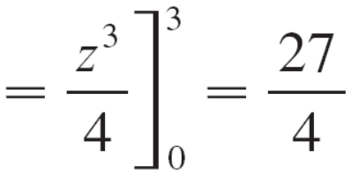
Example 1 – Solution
cont’d

Slide 11
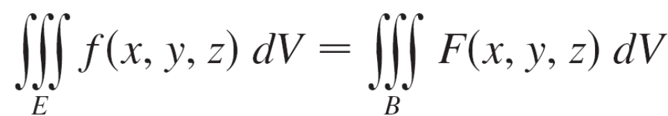
Triple Integrals
Now we define the triple integral over a general bounded region E in three-dimensional space (a solid) by much the same procedure that we used for double integrals.
We enclose E in a box B of the type given by Equation 1. Then we define a function F so that it agrees with f on E but is 0 for points in B that are outside E.
By definition,
This integral exists if f is continuous and the boundary of E is “reasonably smooth.”

Slide 12
Triple Integrals
The triple integral has essentially the same properties as the double integral.
We restrict our attention to continuous functions f and to certain simple types of regions.

Slide 13

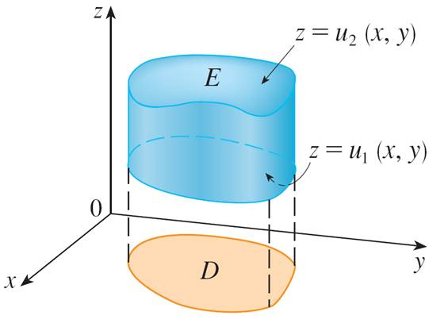
Triple Integrals
A solid region E is said to be of type 1 if it lies between the graphs of two continuous functions of x and y, that is,
E = {(x, y, z) | (x, y) ∈ D, u₁(x, y) ≤ z ≤ u₂(x, y)}
where D is the projection of E onto the xy-plane as shown in Figure 2.
A type 1 solid region
Figure 2

Slide 14
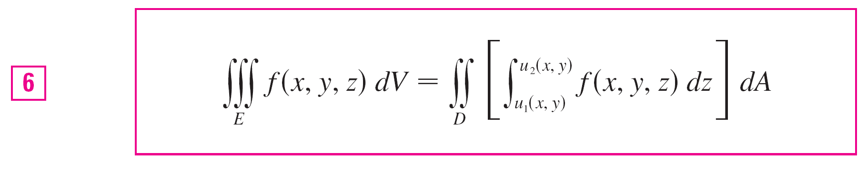
Triple Integrals
Notice that the upper boundary of the solid E is the surface with equation z = u₂(x, y), while the lower boundary is the surface z = u₁(x, y).
By the same sort of argument, it can be shown that if E is a type 1 region given by Equation 5, then
The meaning of the inner integral on the right side of Equation 6 is that x and y are held fixed, and therefore u₁(x, y) and u₂(x, y) are regarded as constants, while f (x, y, z) is integrated with respect to z.

Slide 15
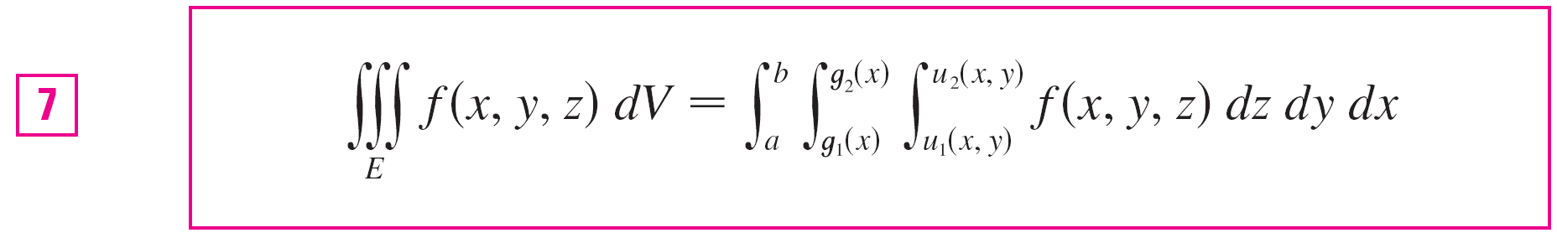
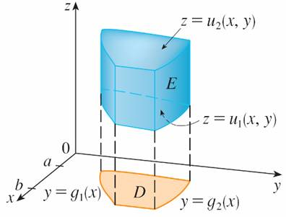
Triple Integrals
In particular, if the projection D of E onto the xy-plane is a type I plane region (as in Figure 3), then
E = {(x, y, z) | a ≤ x ≤ b, g₁(x) ≤ y ≤ g₂(x), u₁(x, y) ≤ z ≤ u₂(x, y)}
and Equation 6 becomes
A type 1 solid region where the projection D is a type I plane region
Figure 3

Slide 16
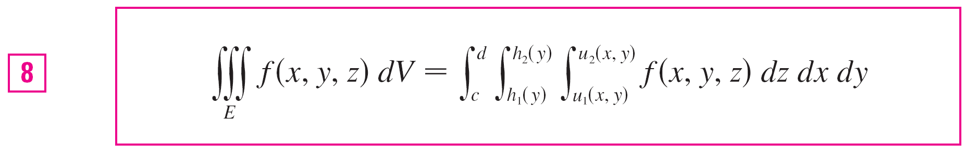
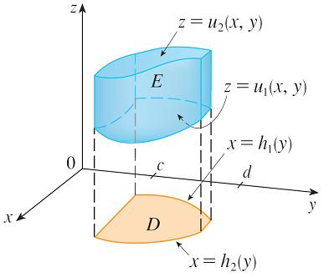
Triple Integrals
If, on the other hand, D is a type II plane region
(as in Figure 4), then
E = {(x, y, z) | c ≤ y ≤ d, h₁(y) ≤ x ≤ h₂(y), u₁(x, y) ≤ z ≤ u₂(x, y)}
and Equation 6 becomes
A type 1 solid region with a type II projection
Figure 4

Slide 17
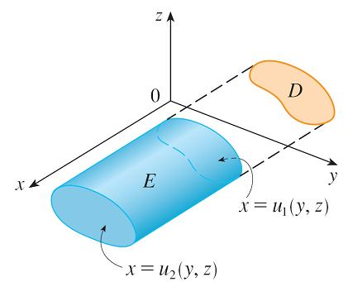
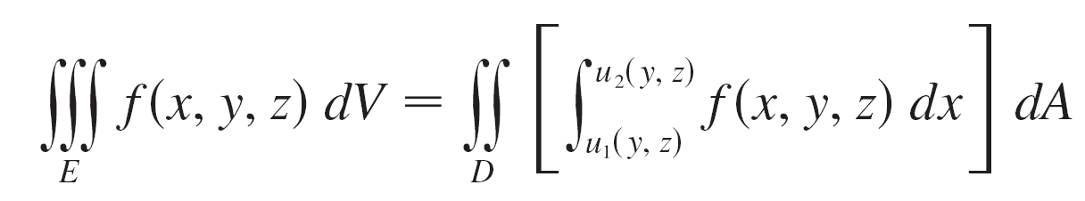

Triple Integrals
A solid region E is of type 2 if it is of the form
E = {(x, y, z) | (y, z) ∈ D, u₁(y, z) ≤ x ≤ u₂(y, z)}
where, this time, D is the projection
of E onto the yz-plane (see Figure 7).
The back surface is x = u₁(y, z),
the front surface is x = u₂(y, z),
and we have
A type 2 region
Figure 7

Slide 18
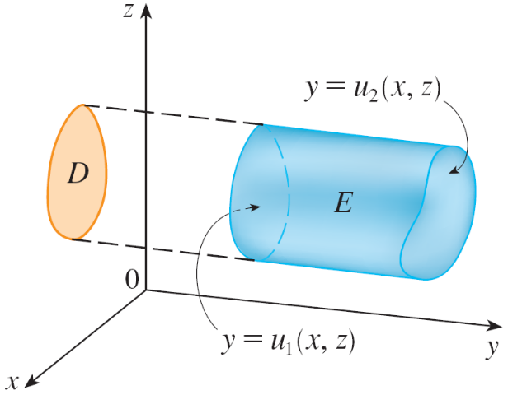
Triple Integrals
Finally, a type 3 region is of the form
E = {(x, y, z) | (x, z) ∈ D, u₁(x, z) ≤ y ≤ u₂(x, z)}
where D is the projection of E onto the xz-plane, y = u₁(x, z) is the left surface, and y = u₂(x, z) is the right surface (see Figure 8).
A type 3 region
Figure 8

Slide 19
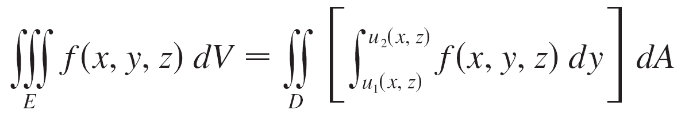

Triple Integrals
For this type of region we have
In each of Equations 10 and 11 there may be two possible expressions for the integral depending on whether D is a type I or type II plane region (and corresponding to Equations 7 and 8).

Slide 20
Applications of Triple Integrals

Slide 21

Applications of Triple Integrals
Recall that if f (x) ≥ 0, then the single integral represents the area under the curve y = f (x) from a to b, and if f (x, y) ≥ 0, then the double integral ∫∫_{D} f (x, y) dA represents the volume under the surface z = f (x, y) and above D.
The corresponding interpretation of a triple integral ∫∫∫_{E} f (x, y, z) dV, where f (x, y, z) ≥ 0, is not very useful because it would be the “hypervolume” of a four-dimensional object and, of course, that is very difficult to visualize. (Remember that E is just the domain of the function f ; the graph of f lies in four-dimensional space.)

Slide 22
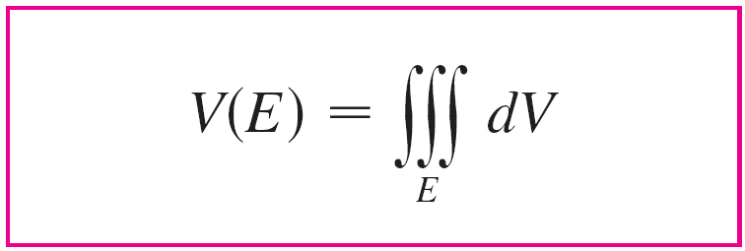

Applications of Triple Integrals
Nonetheless, the triple integral ∫∫∫_{E} f (x, y, z) dV can be interpreted in different ways in different physical situations, depending on the physical interpretations of x, y, z and f (x, y, z).
Let’s begin with the special case where f (x, y, z) = 1 for all points in E. Then the triple integral does represent the volume of E:

Slide 23
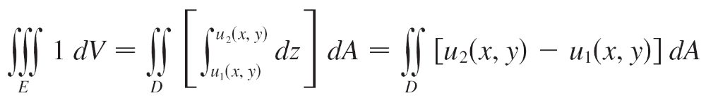
Applications of Triple Integrals
For example, you can see this in the case of a type 1 region by putting f (x, y, z) = 1 in Formula 6:
and we know this represents the volume that lies between the surfaces z = u₁(x, y) and z = u₂(x, y).

Slide 24
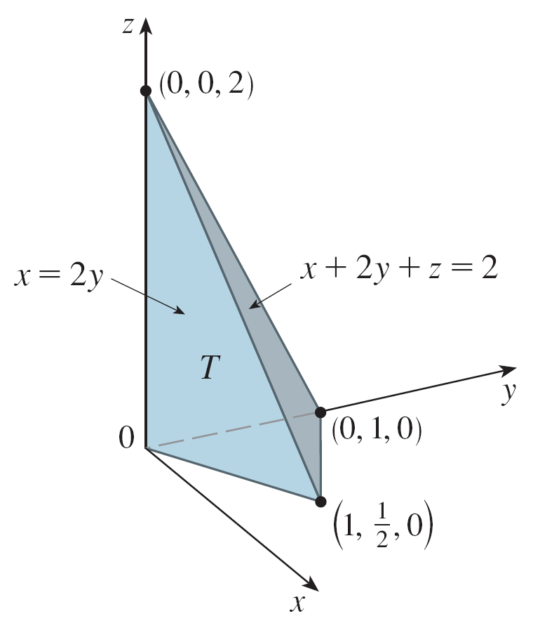
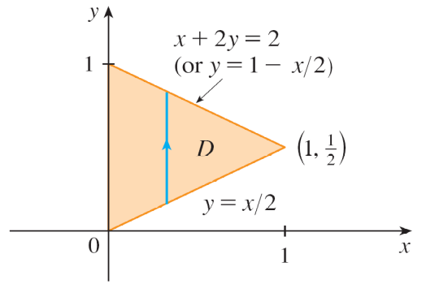
Example 5
Use a triple integral to find the volume of the tetrahedron T bounded by the planes x + 2y + z = 2, x = 2y, x = 0, and z = 0.
Solution:
The tetrahedron T and its projection D onto the xy-plane are shown in Figures 14 and 15.
Figure 14
Figure 15

Slide 25
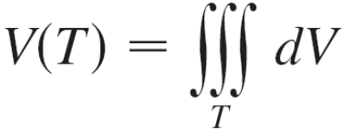
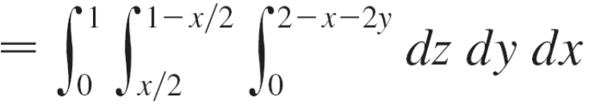
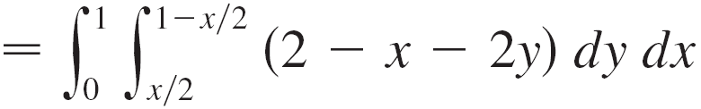
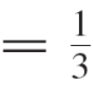
Example 5 – Solution
cont’d
The lower boundary of T is the plane z = 0 and the upper boundary is the plane x + 2y + z = 2, that is, z = 2 – x – 2y.
Therefore we have
(Notice that it is not necessary to use triple integrals to compute volumes. They simply give an alternative method for setting up the calculation.)

Slide 26

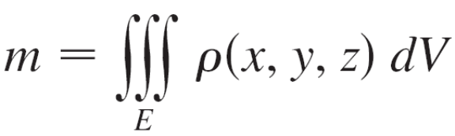

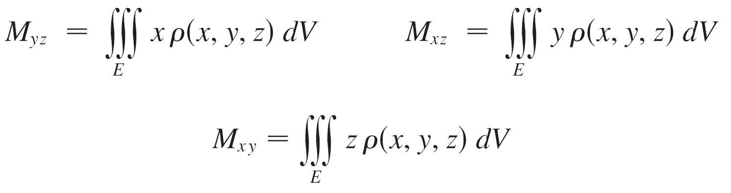
Applications of Triple Integrals
All the applications of double integrals can be immediately extended to triple integrals.
For example, if the density function of a solid object that occupies the region E is ρ (x, y, z), in units of mass per unit volume, at any given point (x, y, z), then its mass is
and its moments about the three coordinate planes are

Slide 27

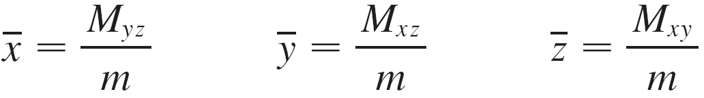

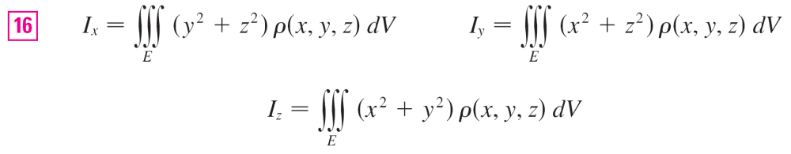
Applications of Triple Integrals
The center of mass is located at the point where
If the density is constant, the center of mass of the solid is called the centroid of E.
The moments of inertia about the three coordinate
axes are

Slide 28
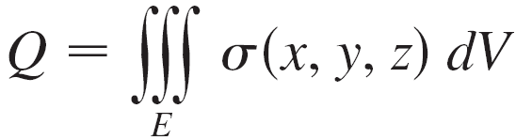
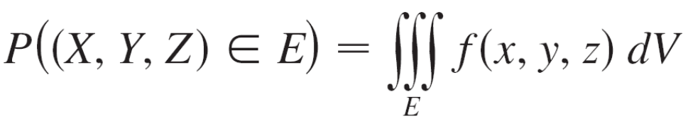
Applications of Triple Integrals
The total electric charge on a solid object occupying a region E and having charge density σ (x, y, z) is
If we have three continuous random variables X, Y, and Z, their joint density function is a function of three variables such that the probability that (X, Y, Z) lies in E is

Slide 29
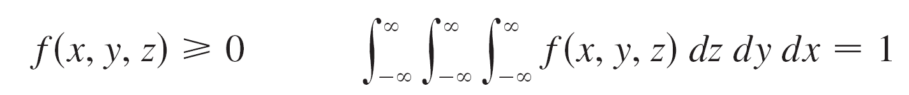
Applications of Triple Integrals
In particular,
The joint density function satisfies

