Slide 1


15
Multiple Integrals
Copyright © Cengage Learning. All rights reserved.

Slide 2

Triple Integrals in Cylindrical Coordinates
15.8
Copyright © Cengage Learning. All rights reserved.

Slide 3
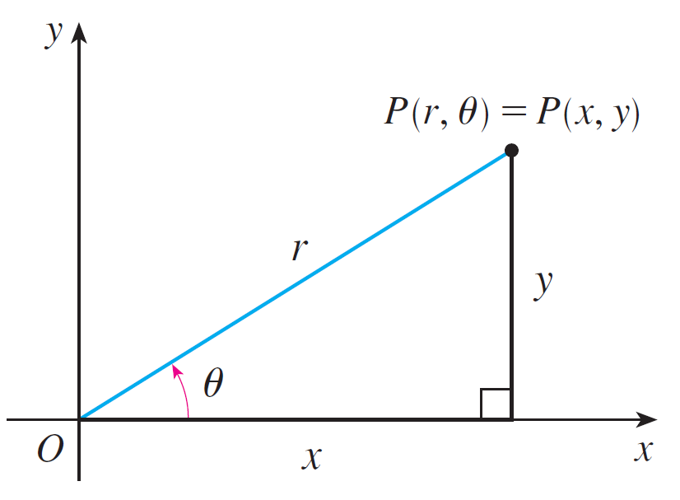
Triple Integrals in Cylindrical Coordinates
In plane geometry the polar coordinate system is used to give a convenient description of certain curves and regions.
Figure 1 enables us to recall the connection between polar and Cartesian coordinates.
Figure 1

Slide 4

Triple Integrals in Cylindrical Coordinates
If the point P has Cartesian coordinates (x, y) and polar coordinates (r, θ ), then, from the figure,
x = r cos θ y = r sin θ
r² = x² + y² tan θ =
In three dimensions there is a coordinate system, called cylindrical coordinates, that is similar to polar coordinates and gives convenient descriptions of some commonly occurring surfaces and solids. As we will see, some triple integrals are much easier to evaluate in cylindrical coordinates.

Slide 5
Cylindrical Coordinates

Slide 6
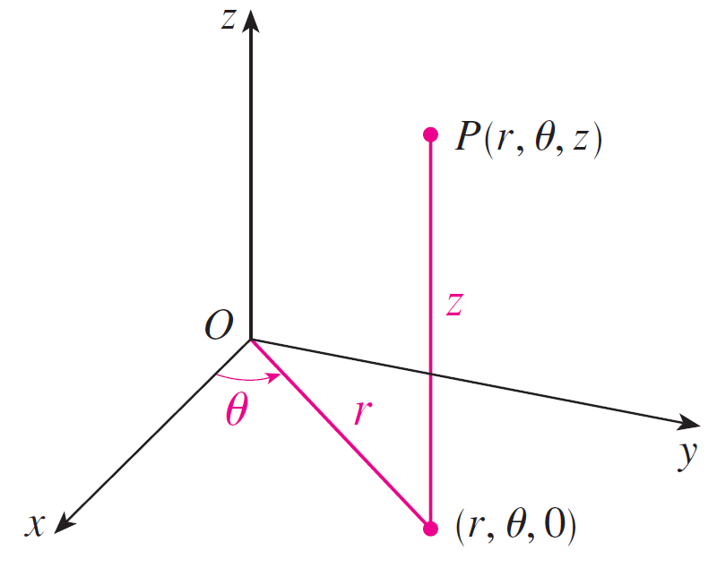
Cylindrical Coordinates
In the cylindrical coordinate system, a point P in
three-dimensional space is represented by the ordered triple (r, θ, z) where r and θ are polar coordinates of the projection of P onto the xy-plane and z is the directed distance from the xy-plane to P. (See Figure 2.)
The cylindrical coordinates of a point
Figure 2

Slide 7
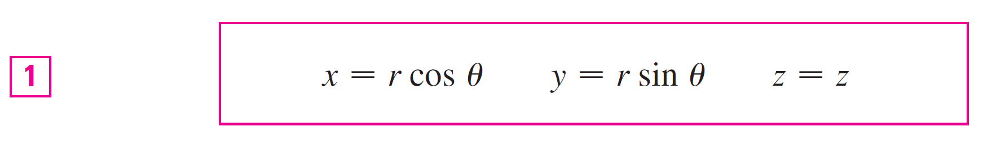
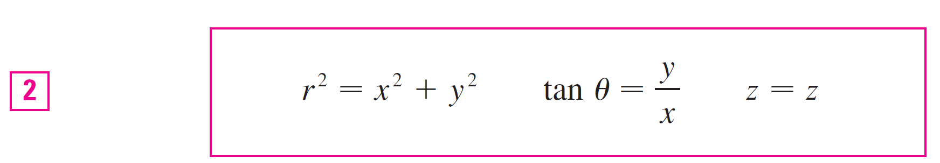
Cylindrical Coordinates
To convert from cylindrical to rectangular coordinates, we use the equations
whereas to convert from rectangular to cylindrical coordinates, we use

Slide 8
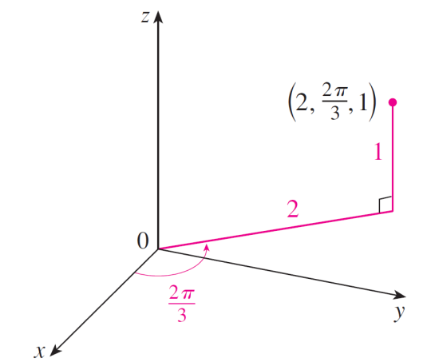
Example 1
(a) Plot the point with cylindrical coordinates (2, 2π /3, 1) and find its rectangular coordinates.
(b) Find cylindrical coordinates of the point with rectangular coordinates (3, –3, –7).
Solution:
(a) The point with cylindrical coordinates (2, 2π /3, 1) is plotted in Figure 3.
Figure 3

Slide 9
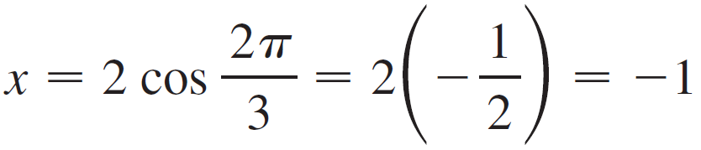
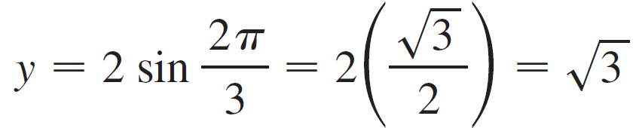


Example 1 – Solution
cont’d
From Equations 1, its rectangular coordinates are
Thus the point is (–1, , 1) in rectangular coordinates.

Slide 10
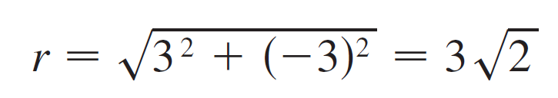
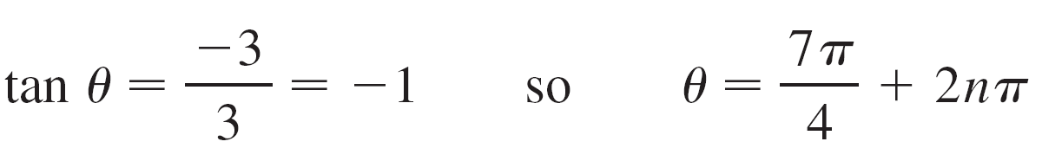


Example 1 – Solution
cont’d
(b) From Equations 2 we have
Therefore one set of cylindrical coordinates is ( , 7π /4, –7) . Another is ( , –π /4, –7). As with polar coordinates, there are infinitely many choices.

Slide 11
Evaluating Triple Integrals with
Cylindrical Coordinates

Slide 12
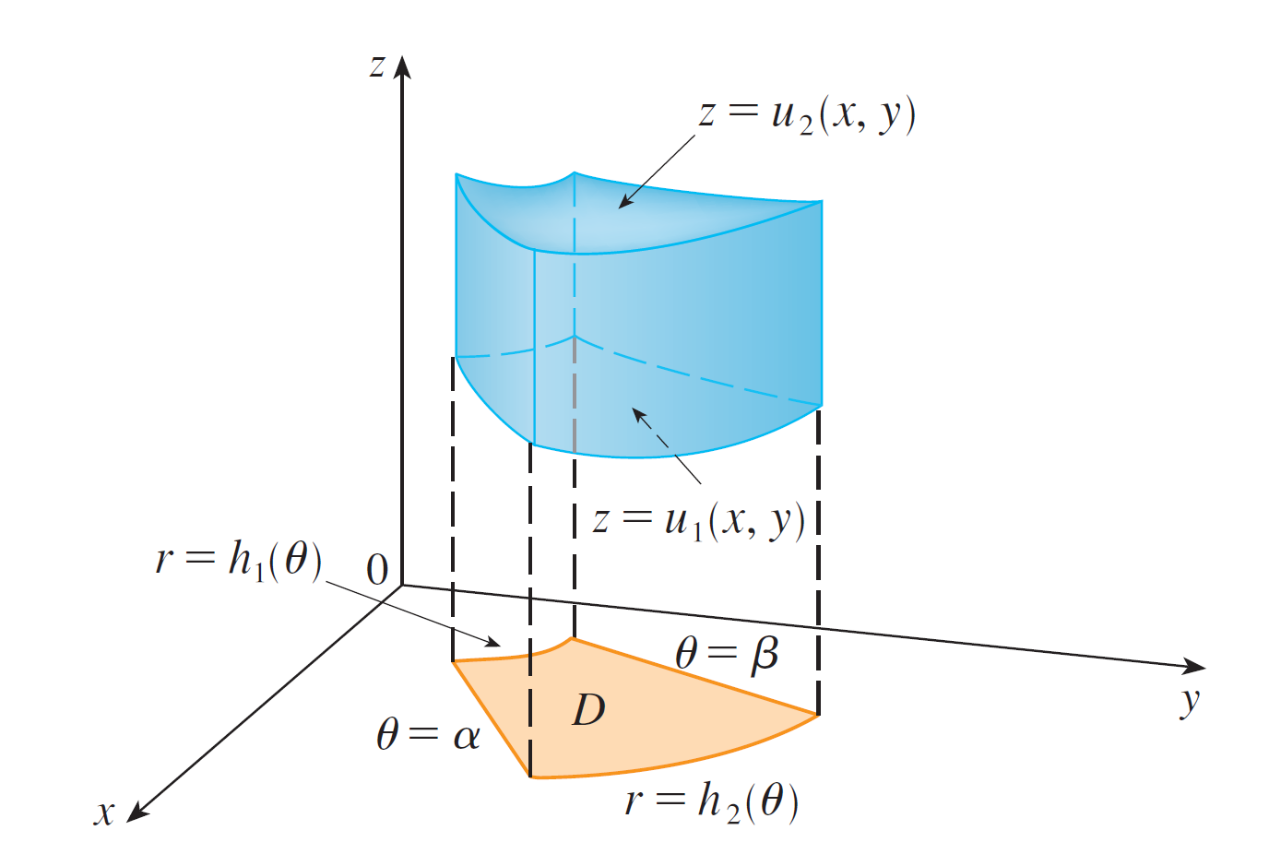
Evaluating Triple Integrals with Cylindrical Coordinates
Suppose that E is a type 1 region whose projection D onto the xy-plane is conveniently described in polar coordinates (see Figure 6).
Figure 6

Slide 13
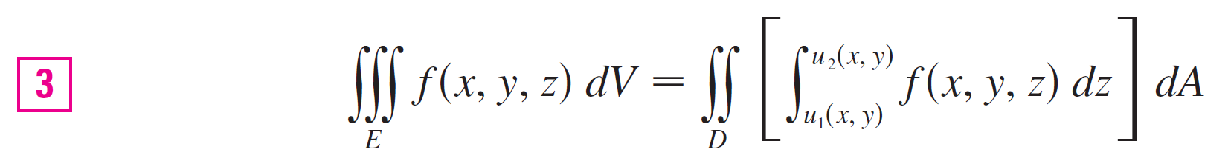
Evaluating Triple Integrals with Cylindrical Coordinates
In particular, suppose that f is continuous and
E = {(x, y, z) | (x, y) ∈ D, u₁(x, y) ≤ z ≤ u₂(x, y)}
where D is given in polar coordinates by
D = {(r, θ ) | α ≤ θ ≤ β , h₁(θ ) ≤ r ≤ h₂(θ )}
We know

Slide 14
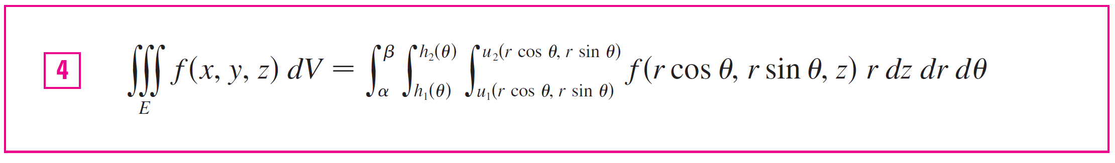
Evaluating Triple Integrals with Cylindrical Coordinates
But to evaluate double integrals in polar coordinates, we have the formula
Formula 4 is the formula for triple integration in cylindrical coordinates.

Slide 15
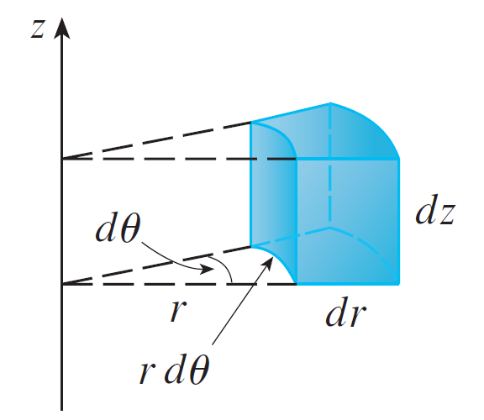
Evaluating Triple Integrals with Cylindrical Coordinates
It says that we convert a triple integral from rectangular to cylindrical coordinates by writing x = r cos θ, y = r sin θ, leaving z as it is, using the appropriate limits of integration for z, r, and θ, and replacing dV by r dz dr dθ.
(Figure 7 shows how to remember this.)
Volume element in cylindrical
coordinates: dV = r dz dr dθ
Figure 7

Slide 16
Evaluating Triple Integrals with Cylindrical Coordinates
It is worthwhile to use this formula when E is a solid region easily described in cylindrical coordinates, and especially when the function f (x, y, z) involves the expression x² + y².

Slide 17
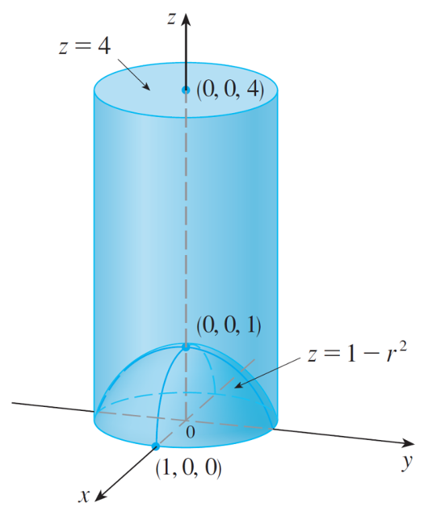
Example 3
A solid E lies within the cylinder x² + y² = 1, below the plane z = 4, and above the paraboloid z = 1 – x² – y².
(See Figure 8.) The density at any point is proportional to its distance from the axis of the cylinder. Find the mass
of E.
Figure 8

Slide 18

Example 3 – Solution
In cylindrical coordinates the cylinder is r = 1 and the paraboloid is z = 1 – r², so we can write
E = {(r, θ, z) | 0 ≤ θ ≤ 2π, 0 ≤ r ≤ 1, 1 – r² ≤ z ≤ 4}
Since the density at (x, y, z) is proportional to the distance from the z-axis, the density function is
where K is the proportionality constant.

Slide 19
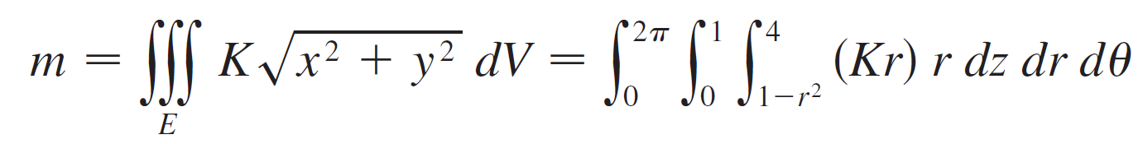
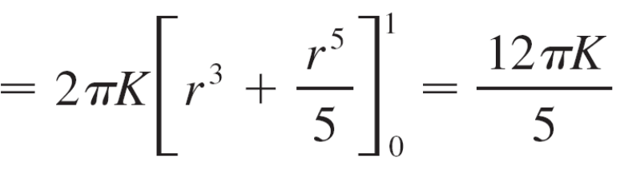
Example 3 – Solution
cont’d
Therefore, the mass of E is

