Slide 1


15
Multiple Integrals
Copyright © Cengage Learning. All rights reserved.

Slide 2

Triple Integrals in Spherical Coordinates
15.9
Copyright © Cengage Learning. All rights reserved.

Slide 3
Triple Integrals in Spherical Coordinates
Another useful coordinate system in three dimensions is the spherical coordinate system.
It simplifies the evaluation of triple integrals over regions bounded by spheres or cones.

Slide 4
Spherical Coordinates

Slide 5
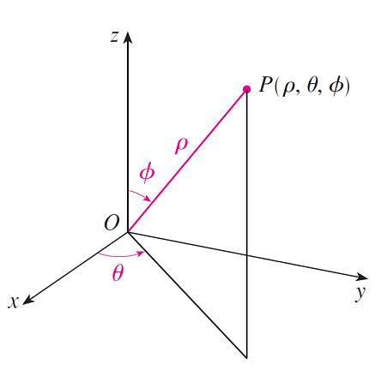
Spherical Coordinates
The spherical coordinates (ρ, θ, φ) of a point P in space are shown in Figure 1, where ρ = |OP | is the distance from the origin to P, θ is the same angle as in cylindrical coordinates, and φ is the angle between the positive z-axis and the line segment OP.
The spherical coordinates of a point
Figure 1

Slide 6
Spherical Coordinates
Note that
ρ ≥ 0 0 ≤ φ ≤ π
The spherical coordinate system is especially useful in problems where there is symmetry about a point, and the origin is placed at this point.

Slide 7
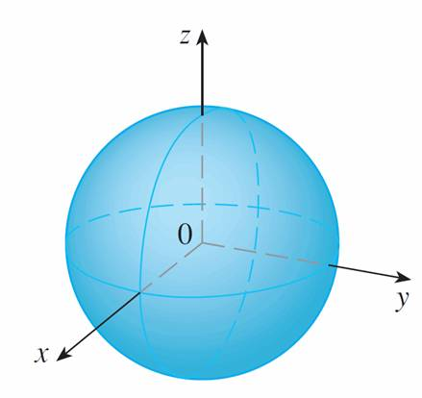
Spherical Coordinates
For example, the sphere with center the origin and radius c has the simple equation ρ = c (see Figure 2); this is the reason for the name “spherical” coordinates.
ρ = c, a sphere
Figure 2

Slide 8
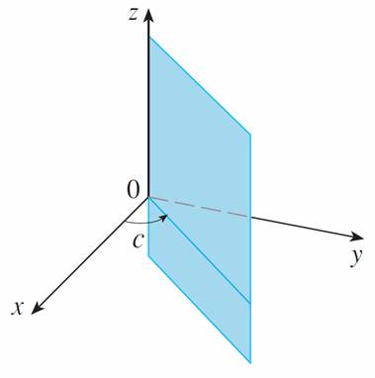
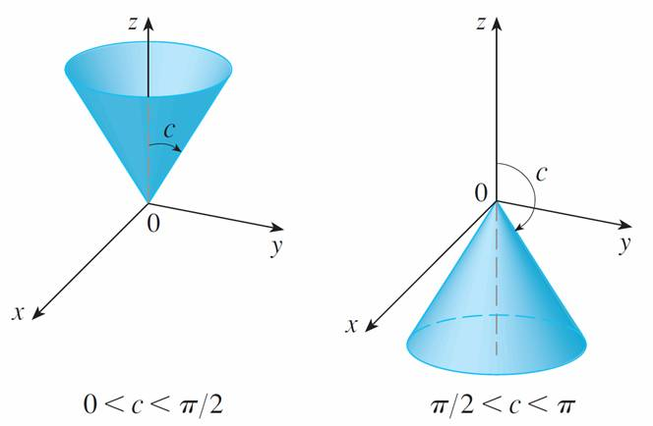
Spherical Coordinates
The graph of the equation θ = c is a vertical half-plane (see Figure 3), and the equation φ = c represents a
half-cone with the z-axis as its axis (see Figure 4).
θ = c, a half-plane
φ = c, a half-plane
Figure 3
Figure 4

Slide 9
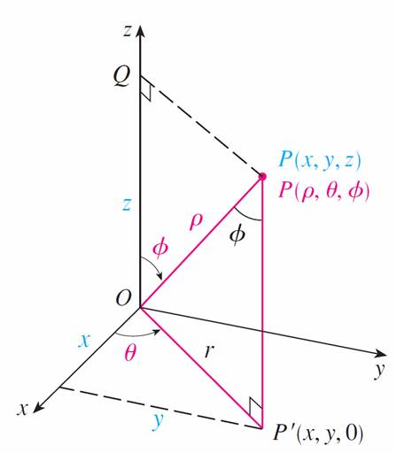
Spherical Coordinates
The relationship between rectangular and spherical coordinates can be seen from Figure 5.
From triangles OPQ and OPP ′ we have
z = ρ cos φ r = ρ sin φ
Figure 5

Slide 10
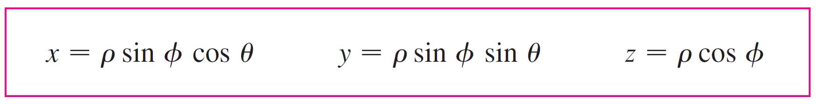

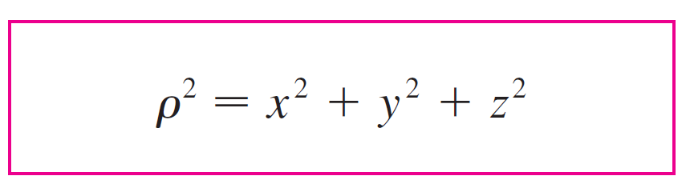

Spherical Coordinates
But x = r cos θ and y = r sin θ, so to convert from spherical to rectangular coordinates, we use the equations
Also, the distance formula shows that
We use this equation in converting from rectangular to spherical coordinates.

Slide 11
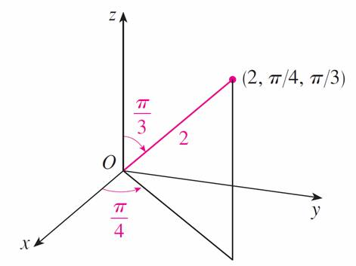
Example 1
The point (2, π /4, π /3) is given in spherical coordinates. Plot the point and find its rectangular coordinates.
Solution:
We plot the point in Figure 6.
Figure 6

Slide 12
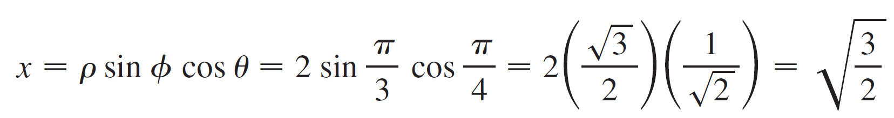
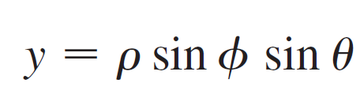
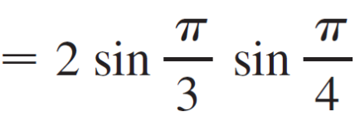
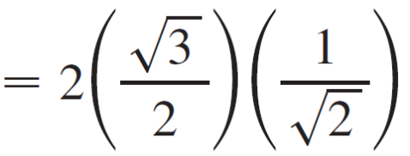
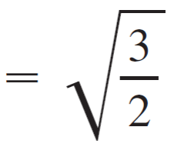

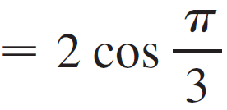



Example 1 – Solution
cont’d
From Equations 1 we have
Thus the point (2, π /4, π /3) is in rectangular coordinates.

Slide 13
Evaluating Triple Integrals with
Spherical Coordinates

Slide 14
Evaluating Triple Integrals with Spherical Coordinates
In the spherical coordinate system the counterpart of a rectangular box is a spherical wedge
E = {(ρ, θ, φ) | a ≤ ρ ≤ b, α ≤ θ ≤ β, c ≤ φ ≤ d}
where a ≥ 0 and β – α ≤ 2π, and d – c ≤ π. Although we defined triple integrals by dividing solids into small boxes, it can be shown that dividing a solid into small spherical wedges always gives the same result.
So we divide E into smaller spherical wedges E_{ijk} by means of equally spaced spheres ρ = ρ_{i}, half-planes θ = θ_{j}, and half-cones φ = φ_{k}.

Slide 15
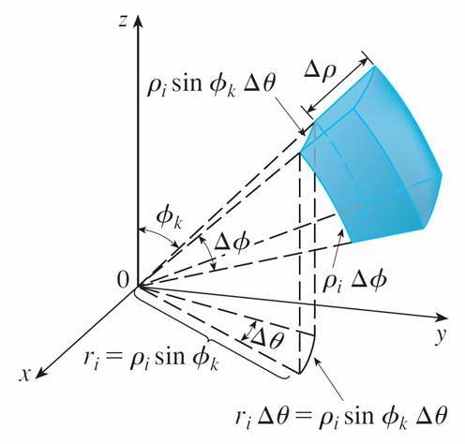
Evaluating Triple Integrals with Spherical Coordinates
Figure 7 shows that E_{ijk} is approximately a rectangular
box with dimensions Δρ, ρ_{i} Δφ (arc of a circle with
radius ρ_{i}, angle Δφ), and ρ_{i} sin φ_{k} Δθ (arc of a circle with radius ρ_{i} sin φ_{k}, angle Δθ ).
Figure 7

Slide 16


Evaluating Triple Integrals with Spherical Coordinates
So an approximation to the volume of E_{ijk} is given by
ΔV_{ijk} ≈ (Δρ)(ρ_{i} Δφ)(ρ_{i} sin φ_{k} Δθ) = sin φ_{k} Δρ Δθ Δφ
In fact, it can be shown, with the aid of the Mean Value Theorem that the volume of E_{ijk} is given exactly by
ΔV_{ijk} = sin φ_{k} Δρ Δθ Δφ
where (ρ_{i}, θ_{j}, φ_{k}) is some point in E_{ijk}.

Slide 17

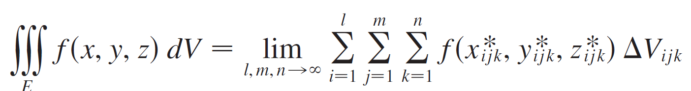
Evaluating Triple Integrals with Spherical Coordinates
Let (x_{ijk}, y_{ijk}, z_{ijk}) be the rectangular coordinates of
this point. Then

Slide 18
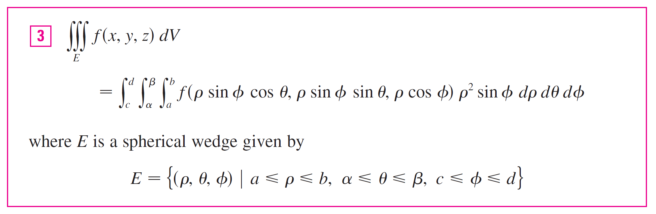
Evaluating Triple Integrals with Spherical Coordinates
But this sum is a Riemann sum for the function
F(ρ, θ, φ ) = f (ρ sin φ cos θ, ρ sin φ sin θ, ρ cos φ ) ρ ² sin φ
Consequently, we have arrived at the following formula for triple integration in spherical coordinates.

Slide 19
Evaluating Triple Integrals with Spherical Coordinates
Formula 3 says that we convert a triple integral from rectangular coordinates to spherical coordinates by writing
x = ρ sin φ cos θ y = ρ sin φ sin θ z = ρ cos φ
using the appropriate limits of integration, and replacing dv by ρ ² sin φ dρ dθ dφ .

Slide 20
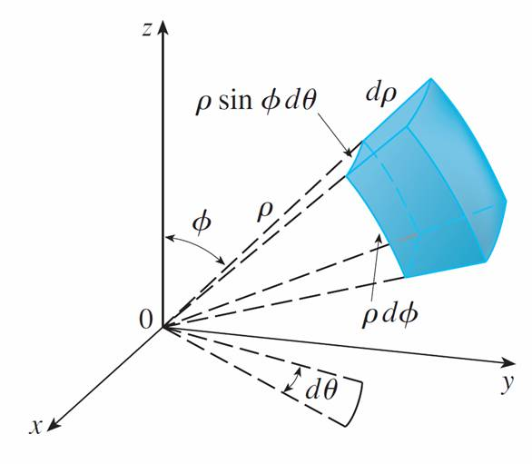
Evaluating Triple Integrals with Spherical Coordinates
This is illustrated in Figure 8.
Volume element in spherical
coordinates: dV = ρ ² sin φ dρ dθ dφ
Figure 8

Slide 21

Evaluating Triple Integrals with Spherical Coordinates
This formula can be extended to include more general spherical regions such as
E = {(ρ, θ, φ) | α ≤ θ ≤ β, c ≤ φ ≤ d, g₁(θ, φ) ≤ ρ ≤ g₂(θ, φ)}
In this case the formula is the same as in except that the limits of integration for ρ are g₁(θ, φ ) and g₂(θ, φ ).
Usually, spherical coordinates are used in triple integrals when surfaces such as cones and spheres form the boundary of the region of integration.

Slide 22

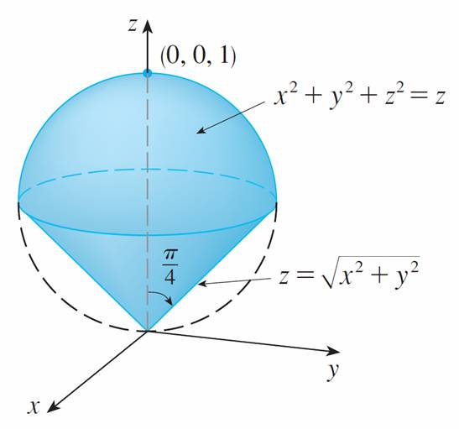
Example 4
Use spherical coordinates to find the volume of the solid that lies above the cone and below the sphere x² + y² + z² = z. (See Figure 9.)
Figure 9

Slide 23
Example 4 – Solution
Notice that the sphere passes through the origin and has center (0, 0, ). We write the equation of the sphere in spherical coordinates as
ρ ² = ρ cos φ or ρ = ρ cos φ
The equation of the cone can be written as

Slide 24
Example 4 – Solution
cont’d
This gives sin φ = cos φ, or φ = π /4. Therefore the description of the solid E in spherical coordinates is
E = {(ρ, θ, φ) | 0 ≤ θ ≤ 2π, 0 ≤ φ ≤ π/4 , 0 ≤ ρ ≤ cos φ}

Slide 25
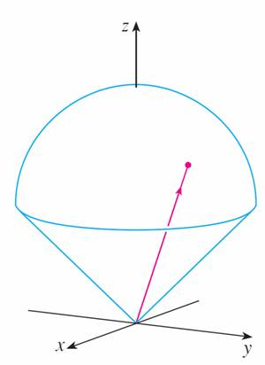
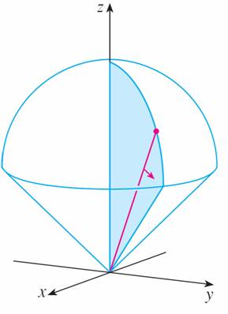
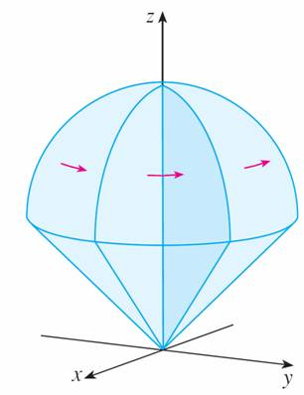
Example 4 – Solution
cont’d
Figure 11 shows how E is swept out if we integrate first with respect to ρ, then φ, and then θ.
ρ varies from 0 to cos φ
while φ and θ are constant.
φ varies from 0 to π /4
while θ is constant.
θ varies from 0 to 2π
Figure 11

Slide 26
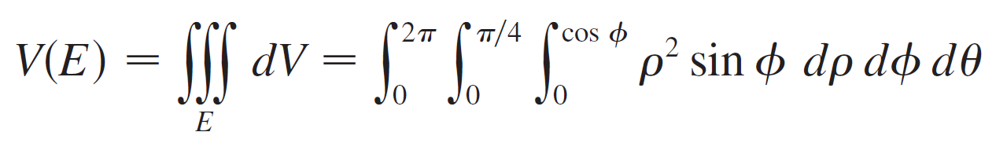
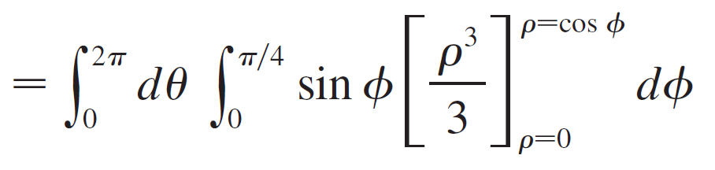
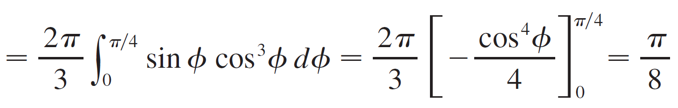
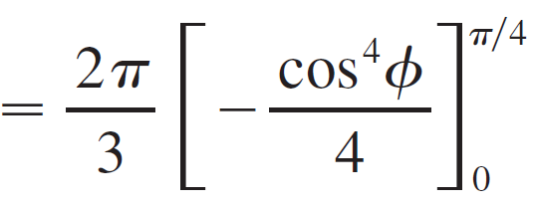
Example 4 – Solution
cont’d
The volume of E is

