Slide 1


16
Vector Calculus
Copyright © Cengage Learning. All rights reserved.

Slide 2

16.2
Line Integrals
Copyright © Cengage Learning. All rights reserved.

Slide 3
Line Integrals
In this section we define an integral that is similar to a single integral except that instead of integrating over an interval [a, b], we integrate over a curve C.
Such integrals are called line integrals, although “curve integrals” would be better terminology.
They were invented in the early 19th century to solve problems involving fluid flow, forces, electricity, and magnetism.

Slide 4

Line Integrals
We start with a plane curve C given by the parametric equations
x = x(t) y = y(t) a ≤ t ≤ b
or, equivalently, by the vector equation r(t) = x(t) i + y(t) j,
and we assume that C is a smooth curve. [This means that r′ is continuous and r′(t) ≠ 0.]

Slide 5
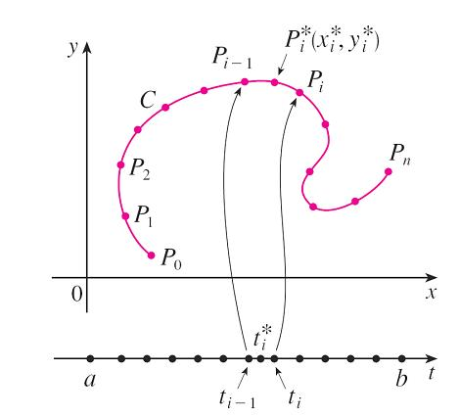
Line Integrals
If we divide the parameter interval [a, b] into n subintervals [t_{i – 1}, t_{i}] of equal width and we let x_{i} = x(t_{i}), and y_{i} = y(t_{i}), then the corresponding points P_{i}(x_{i}, y_{i}) divide C into n subarcs with lengths Δs₁, Δs₂, . . . , Δs_{n}. (See Figure 1.)
Figure 1

Slide 6



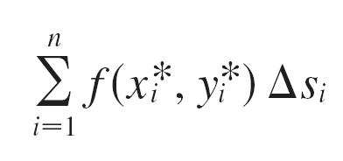
Line Integrals
We choose any point in the ith subarc. (This corresponds to a point in [t_{i – 1}, t_{i}].)
Now if f is any function of two variables whose domain includes the curve C, we evaluate f at the point multiply by the length Δs_{i} of the subarc, and form the sum
which is similar to a Riemann sum.

Slide 7
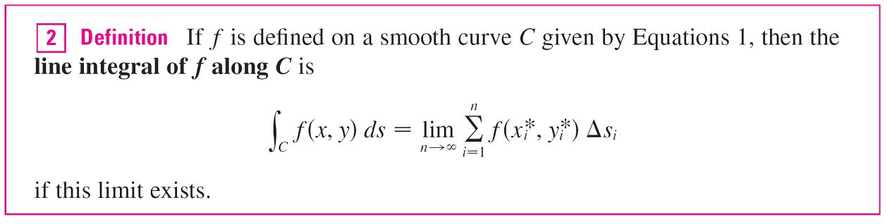
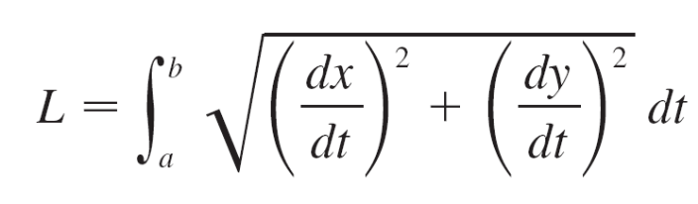
Line Integrals
Then we take the limit of these sums and make the following definition by analogy with a single integral.
We have found that the length of C is

Slide 8
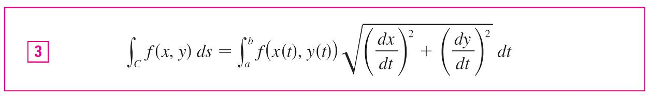
Line Integrals
A similar type of argument can be used to show that if f is a continuous function, then the limit in Definition 2 always exists and the following formula can be used to evaluate the line integral:
The value of the line integral does not depend on the parametrization of the curve, provided that the curve is traversed exactly once as t increases from a to b.

Slide 9
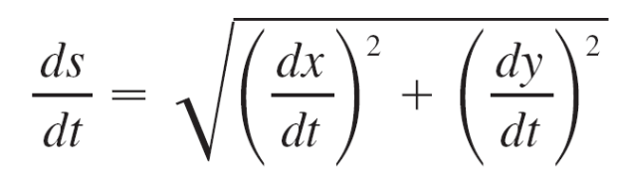
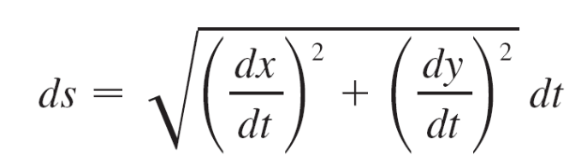
Line Integrals
If s(t) is the length of C between r(a) and r(t), then
So the way to remember Formula 3 is to express everything in terms of the parameter t: Use the parametric equations to express x and y in terms of t and write ds as

Slide 10
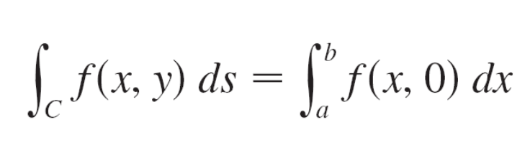
Line Integrals
In the special case where C is the line segment that joins (a, 0) to (b, 0), using x as the parameter, we can write the parametric equations of C as follows: x = x, y = 0, a ≤ x ≤ b.
Formula 3 then becomes
and so the line integral reduces to an ordinary single integral in this case.

Slide 11
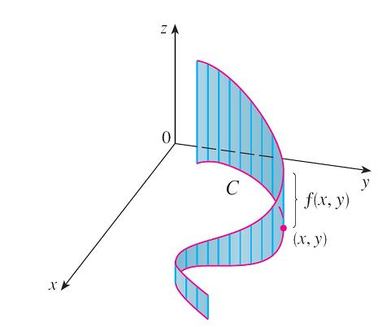
Line Integrals
Just as for an ordinary single integral, we can interpret the line integral of a positive function as an area.
In fact, if f (x, y) ≥ 0, ∫_{C} f (x, y) ds represents the area of one side of the “fence” or “curtain” in Figure 2, whose base is C and whose height above the point (x, y) is f (x, y).
Figure 2

Slide 12
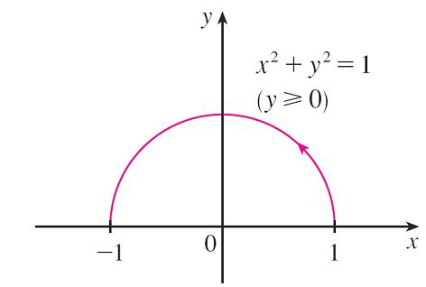
Example 1
Evaluate ∫_{C} (2 + x²y) ds, where C is the upper half of the unit circle x² + y² = 1.
Solution:
In order to use Formula 3, we first need parametric equations to represent C.
Recall that the unit circle can be parametrized by means of the equations
x = cos t y = sin t
and the upper half of the circle is
described by the parameter
interval 0 ≤ t ≤ π. (See Figure 3.)
Figure 3

Slide 13
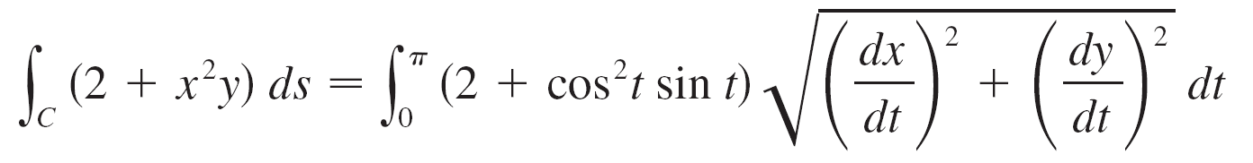
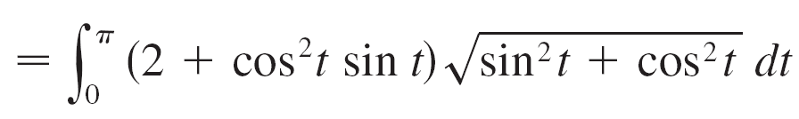
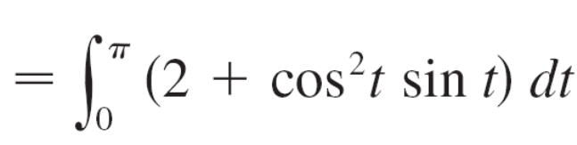
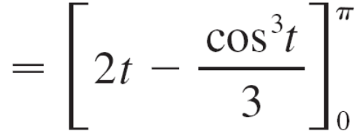

Example 1 – Solution
cont’d
Therefore Formula 3 gives

Slide 14
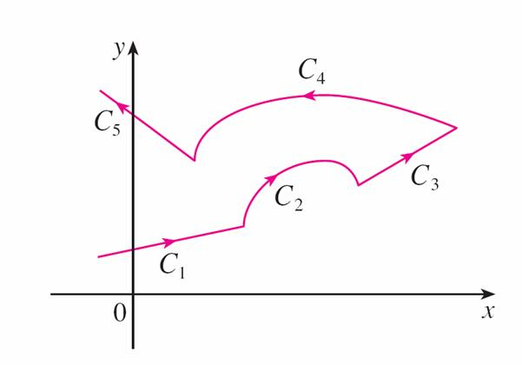
Line Integrals
Suppose now that C is a piecewise-smooth curve; that is, C is a union of a finite number of smooth curves C₁, C₂, …., C_{n}, where, as illustrated in Figure 4, the initial point of C_{i + 1} is the terminal point of C_{i}.
Figure 4
A piecewise-smooth curve

Slide 15
Line Integrals
Then we define the integral of f along C as the sum of the
integrals of f along each of the smooth pieces of C:

Slide 16


Line Integrals
Any physical interpretation of a line integral ∫_{C} f (x, y) ds depends on the physical interpretation of the function f.
Suppose that ρ(x, y) represents the linear density at a point (x, y) of a thin wire shaped like a curve C.
Then the mass of the part of the wire from P_{i – 1} to P_{i} in
Figure1 is approximately and so the total mass of the wire is approximately
Figure 1

Slide 17
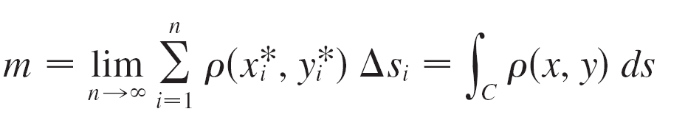
Line Integrals
By taking more and more points on the curve, we obtain the mass m of the wire as the limiting value of these approximations:
[For example, if f (x, y) = 2 + x²y represents the density of a semicircular wire, then the integral in Example 1 would represent the mass of the wire.]

Slide 18

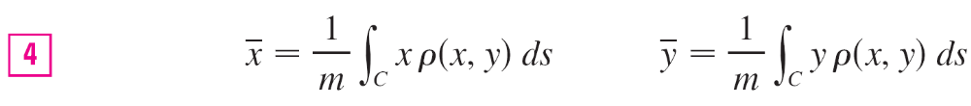
Line Integrals
The center of mass of the wire with density function ρ is located at the point , where

Slide 19
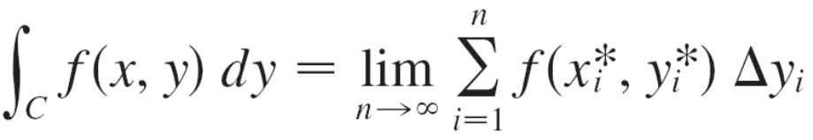

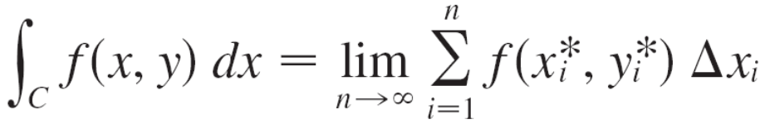

Line Integrals
Two other line integrals are obtained by replacing Δs_{i} by either Δx_{i} = x_{i} – x_{i –1} or Δy_{i} = y_{i} – y_{i – 1} in Definition 2.
They are called the line integrals of f along C with respect to x and y:

Slide 20
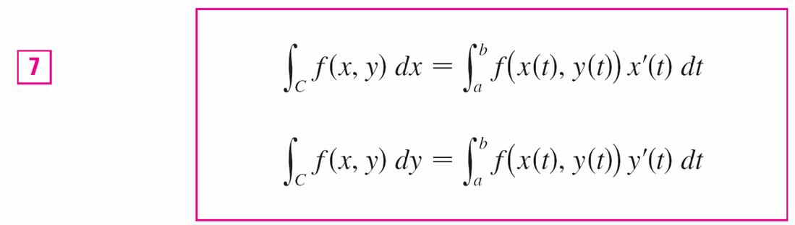
Line Integrals
When we want to distinguish the original line integral ∫_{C} f (x, y) ds from those in Equations 5 and 6, we call it the line integral with respect to arc length.
The following formulas say that line integrals with respect to x and y can also be evaluated by expressing everything in terms of t : x = x(t), y = y(t), dx = x ′(t) dt, dy = y ′(t) dt.

Slide 21
Line Integrals
It frequently happens that line integrals with respect to x and y occur together.
When this happens, it’s customary to abbreviate by writing ∫_{C} P (x, y) dx + ∫_{C} Q (x, y) dy = ∫_{C} P (x, y) dx + Q (x, y) dy
When we are setting up a line integral, sometimes the most difficult thing is to think of a parametric representation for a curve whose geometric description is given.

Slide 22
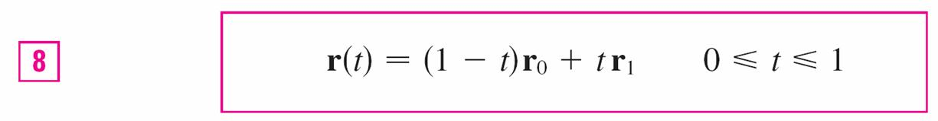
Line Integrals
In particular, we often need to parametrize a line segment, so it’s useful to remember that a vector representation of the line segment that starts at r₀ and ends at r₁ is given by

Slide 23
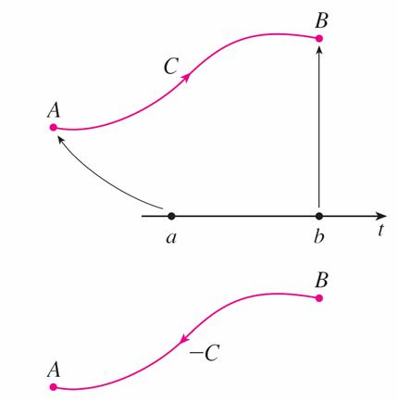
Line Integrals
In general, a given parametrization x = x(t), y = y(t), a ≤ t ≤ b, determines an orientation of a curve C, with the positive direction corresponding to increasing values of the parameter t. (See Figure 8, where the initial point A corresponds to the parameter value a and the terminal point B corresponds to t = b.)
Figure 8

Slide 24
Line Integrals
If –C denotes the curve consisting of the same points as C but with the opposite orientation (from initial point B to terminal point A in Figure 8), then we have
∫_{–C} f (x, y) dx = – ∫_{C} f (x, y) dx ∫_{–C} f (x, y) dy = – ∫_{C} f (x, y) dy
But if we integrate with respect to arc length, the value of the line integral does not change when we reverse the orientation of the curve:
∫_{–C} f (x, y) ds = ∫_{C} f (x, y) ds
This is because Δs_{i} is always positive, whereas Δx_{i} and Δy_{i} change sign when we reverse the orientation of C.

Slide 25
Line Integrals in Space

Slide 26
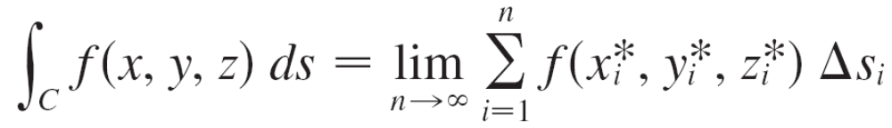
Line Integrals in Space
We now suppose that C is a smooth space curve given by the parametric equations
x = x(t) y = y(t) z = z(t) a ≤ t ≤ b
or by a vector equation r(t) = x(t) i + y(t) j + z(t) k.
If f is a function of three variables that is continuous on some region containing C, then we define the line integral of f along C (with respect to arc length) in a manner similar to that for plane curves:

Slide 27
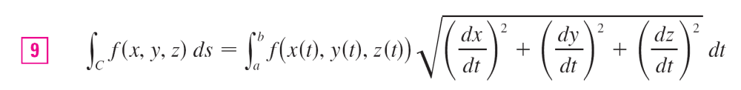
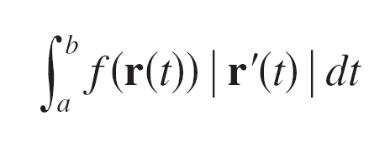
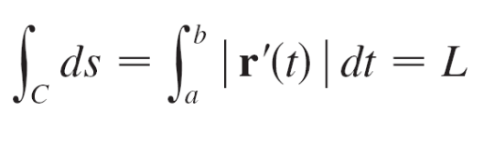
Line Integrals in Space
We evaluate it using a formula similar to Formula 3:
Observe that the integrals in both Formulas 3 and 9 can be written in the more compact vector notation
For the special case f (x, y, z) = 1, we get
where L is the length of the curve C.

Slide 28
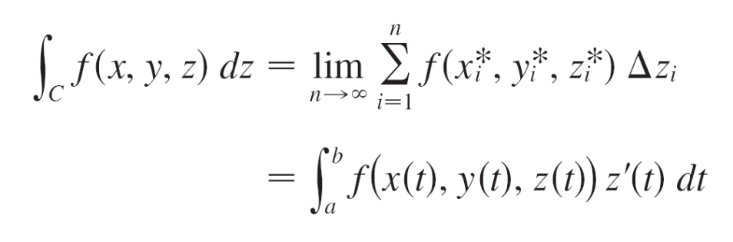
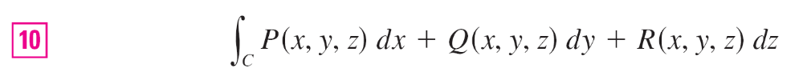
Line Integrals in Space
Line integrals along C with respect to x, y, and z can also be defined. For example,
Therefore, as with line integrals in the plane, we evaluate integrals of the form
by expressing everything (x, y, z, dx, dy, dz) in terms of the parameter t.

Slide 29
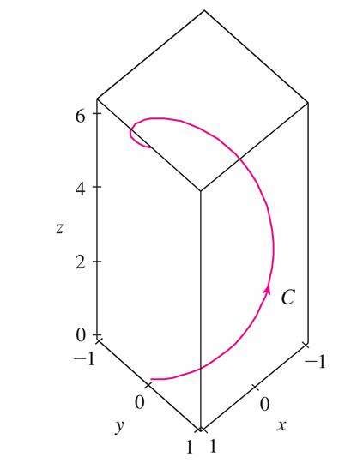
Example 5
Evaluate ∫_{C} y sin z ds, where C is the circular helix given by the equations x = cos t, y = sin t, z = t, 0 ≤ t ≤ 2π.
(See Figure 9.)
Figure 9

Slide 30
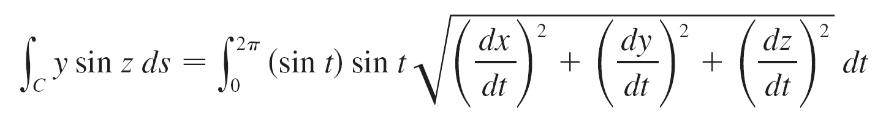
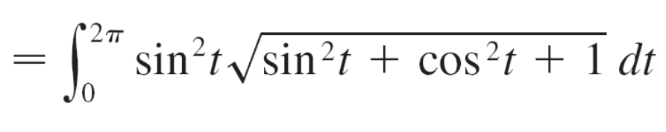
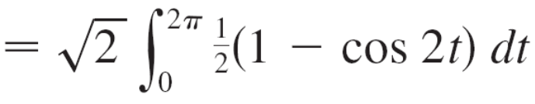
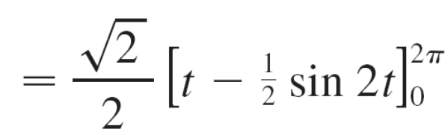
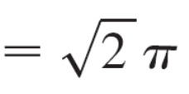
Example 5 – Solution
Formula 9 gives

Slide 31
Line Integrals of Vector Fields

Slide 32




Line Integrals of Vector Fields
Recall that the work done by a variable force f (x) in moving a particle from a to b along the x-axis is
Then we have found that the work done by a constant force F in moving an object from a point P to another point Q in space is W = F  D, where D = is the displacement vector.
Now suppose that F = P i + Q j + R k is a continuous force field on . (A force field on could be regarded as a special case where R = 0 and P and Q depend only on x and y.)
We wish to compute the work done by this force in moving
a particle along a smooth curve C.

Slide 33
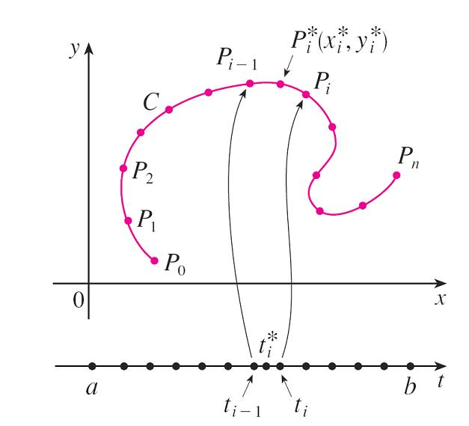
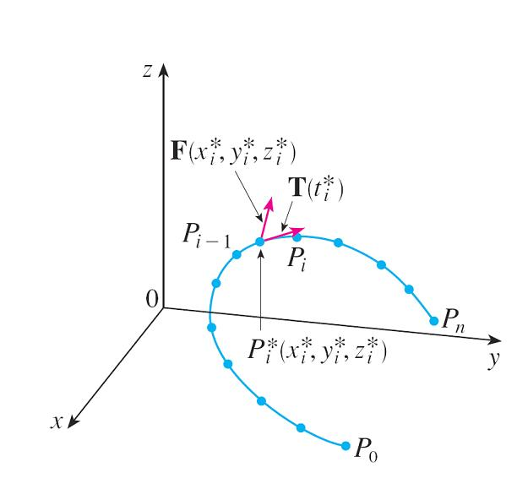
Line Integrals of Vector Fields
We divide C into subarcs P_{i – 1} P_{i} with lengths Δs_{i} by dividing the parameter interval [a, b] into subintervals of equal width. (See Figure 1 for the two-dimensional case or Figure 11 for the three-dimensional case.)
Figure 1
Figure 11

Slide 34




Line Integrals of Vector Fields
Choose a point on the ith subarc corresponding to the parameter value
If Δs_{i} is small, then as the particle moves from P_{i – 1} to P_{i} along the curve, it proceeds approximately in the direction of the unit tangent vector at

Slide 35
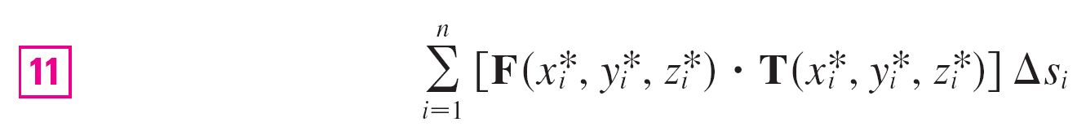
Line Integrals of Vector Fields
Thus the work done by the force F in moving the particle from P_{i – 1} to P_{i} is approximately
and the total work done in moving the particle along C is approximately
where T(x, y, z) is the unit tangent vector at the point (x, y, z) on C.

Slide 36

Line Integrals of Vector Fields
Intuitively, we see that these approximations ought to become better as n becomes larger.
Therefore we define the work W done by the force field F as the limit of the Riemann sums in , namely,
Equation 12 says that work is the line integral with respect to arc length of the tangential component of the force.

Slide 37
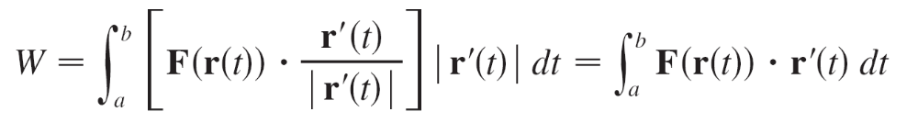
Line Integrals of Vector Fields
If the curve C is given by the vector equation
r(t) = x(t) i + y(t) j + z(t) k,
then T(t) = r′(t)/ |r′(t)|, so using Equation 9 we can rewrite Equation 12 in the form
This integral is often abbreviated as ∫_{C} F  dr and occurs in other areas of physics as well.

Slide 38
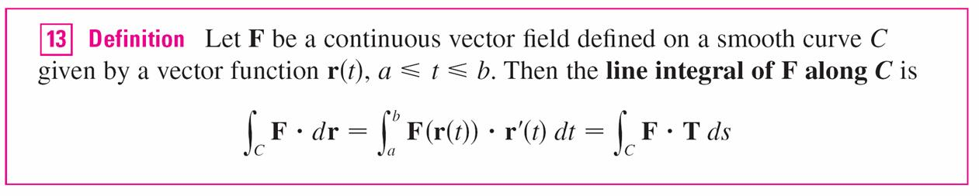
Line Integrals of Vector Fields
Therefore we make the following definition for the line integral of any continuous vector field.
When using Definition 13, remember that F(r(t)) is just an abbreviation for F(x(t), y(t), z(t)), so we evaluate F(r(t)) simply by putting x = x(t), y = y(t), and z = z(t) in the expression for F(x, y, z).
Notice also that we can formally write dr = r′(t) dt.

Slide 39
Example 7
Find the work done by the force field F(x, y) = x² i – xy j
in moving a particle along the quarter-circle
r(t) = cos t i + sin t j, 0 ≤ t ≤ π/2.
Solution:
Since x = cos t and y = sin t, we have
F(r(t)) = cos²t i – cos t sin t j
and r′(t) = –sin t i + cos t j

Slide 40
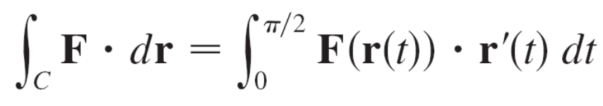
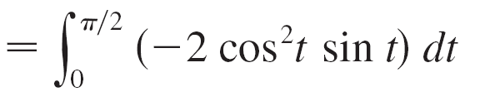
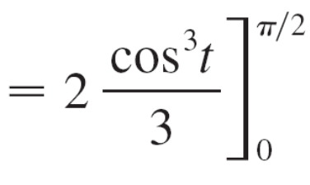
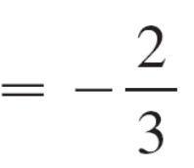
Example 7 – Solution
cont’d
Therefore the work done is

Slide 41

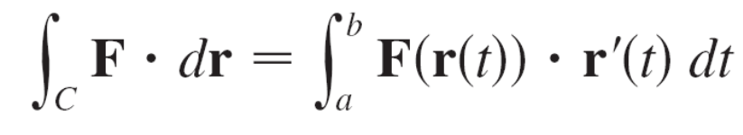
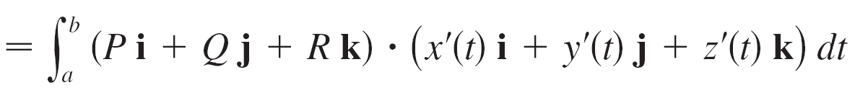
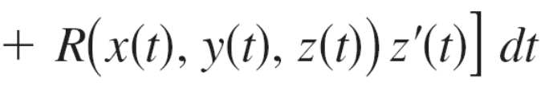
Line Integrals of Vector Fields
Finally, we note the connection between line integrals of vector fields and line integrals of scalar fields. Suppose the vector field F on is given in component form by the equation F = P i + Q j + R k.
We use Definition 13 to compute its line integral along C:

Slide 42

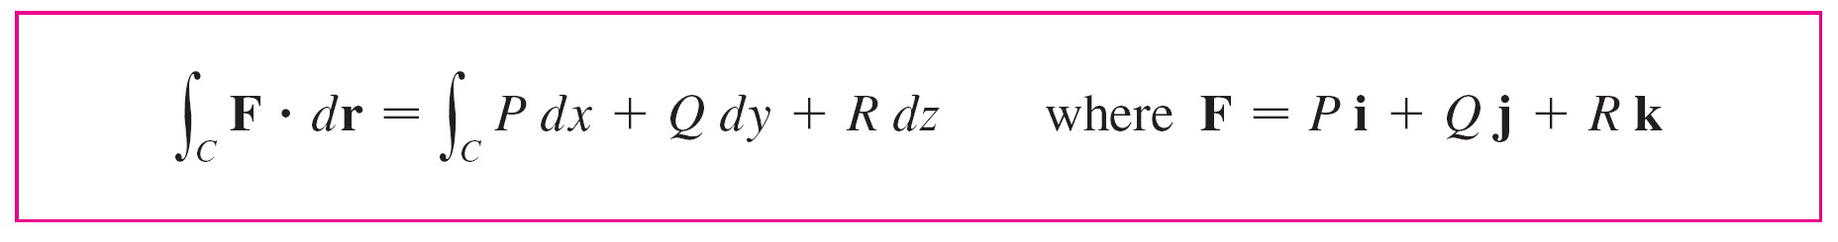
Line Integrals of Vector Fields
But this last integral is precisely the line integral in . Therefore we have
For example, the integral ∫_{C} y dx + z dy + x dz could be expressed as ∫_{C} F  dr where
F(x, y, z) = y i + z j + x k

