Slide 1


16
Vector Calculus
Copyright © Cengage Learning. All rights reserved.

Slide 2

16.3
The Fundamental Theorem for Line Integrals
Copyright © Cengage Learning. All rights reserved.

Slide 3

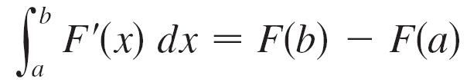
The Fundamental Theorem for Line Integrals
Recall that Part 2 of the Fundamental Theorem of Calculus can be written as
where F ′ is continuous on [a, b].
We also called Equation 1 the Net Change Theorem: The
integral of a rate of change is the net change.

Slide 4
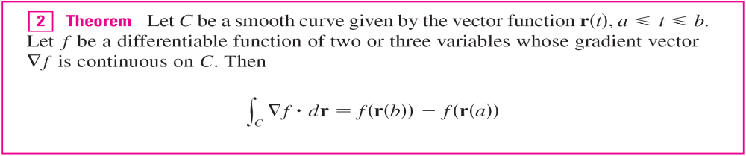
The Fundamental Theorem for Line Integrals
If we think of the gradient vector ∇f of a function f of two or three variables as a sort of derivative of f, then the following theorem can be regarded as a version of the Fundamental
Theorem for line integrals.

Slide 5
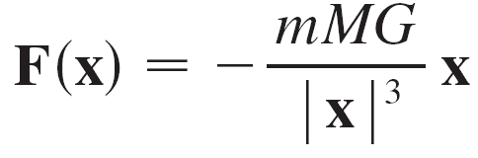
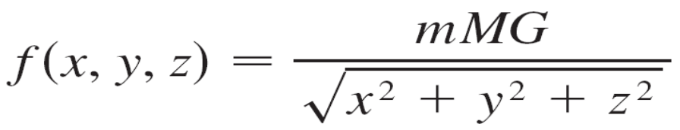
Example 1
Find the work done by the gravitational field
in moving a particle with mass m from the point (3, 4, 12) to the point (2, 2, 0) along a piecewise-smooth curve C.
Solution:
We know that F is a conservative vector field and, in fact,
F = ∇f, where

Slide 6
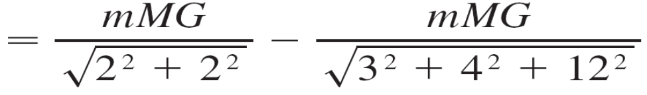
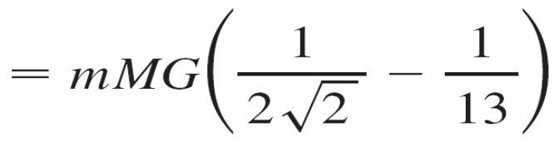
Example 1 – Solution
cont’d
Therefore, by Theorem 2, the work done is
W = ∫_{C} F  dr
= ∫_{C} ∇f  dr
= f (2, 2, 0) – f (3, 4, 12)

Slide 7
Independence of Path

Slide 8
Independence of Paths
Suppose C₁ and C₂ are two piecewise-smooth curves (which are called paths) that have the same initial point A and terminal point B.
We know that, in general, ∫_{C1} F  dr ≠ ∫_{C2} F  dr. But one implication of Theorem 2 is that ∫_{C1}∇f  dr = ∫_{C2}∇f  dr
whenever ∇f is continuous.
In other words, the line integral of a conservative vector field depends only on the initial point and terminal point of a curve.

Slide 9
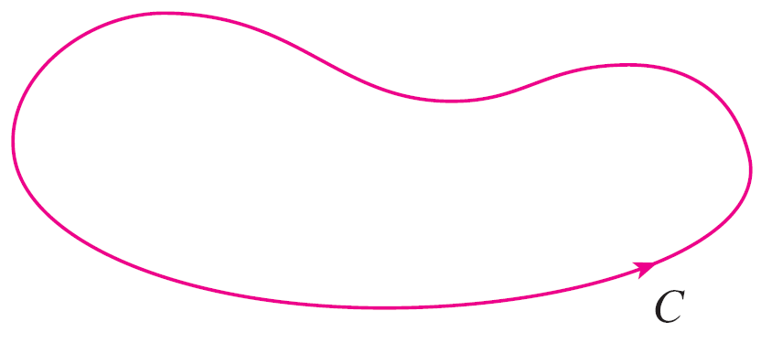
Independence of Paths
In general, if F is a continuous vector field with domain D, we say that the line integral ∫_{C} F  dr is independent of path if ∫_{C1} F  dr = ∫_{C2} F  dr for any two paths C₁ and C₂ in D that have the same initial and terminal points.
With this terminology we can say that line integrals of conservative vector fields are independent of path.
A curve is called closed if its
terminal point coincides with
its initial point, that is,
r(b) = r(a). (See Figure 2.)
Figure 2
A closed curve

Slide 10
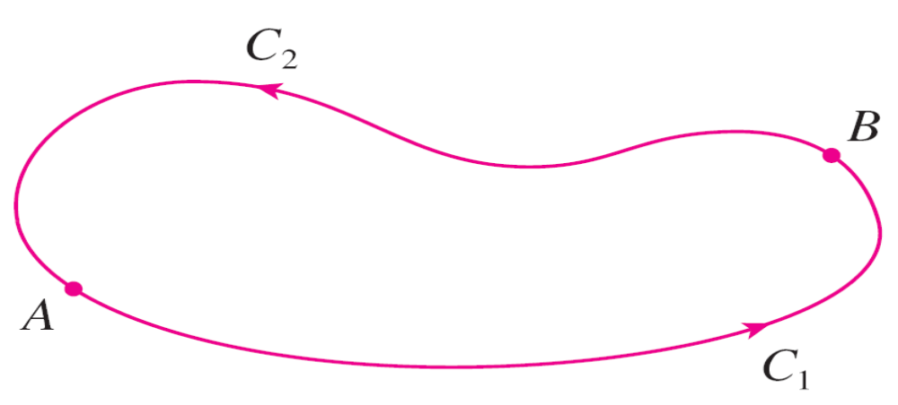
Independence of Paths
If ∫_{C} F  dr is independent of path in D and C is any closed path in D, we can choose any two points A and B on C and regard C as being composed of the path C₁ from A to B followed by the path C₂ from B to A. (See Figure 3.)
Figure 3

Slide 11
Independence of Paths
Then
∫_{C} F  dr = ∫_{C1} F  dr + ∫_{C2} F  dr = ∫_{C1} F  dr – ∫_{–C2} F  dr = 0
since C₁ and –C₂ have the same initial and terminal points.
Conversely, if it is true that ∫_{C} F  dr = 0 whenever C is a closed path in D, then we demonstrate independence of path as follows.
Take any two paths C₁ and C₂ from A to B in D and define C to be the curve consisting of C₁ followed by –C₂.

Slide 12
Independence of Paths
Then
0 = ∫_{C} F  dr = ∫_{C1} F  dr + ∫_{–C2} F  dr = ∫_{C1} F  dr – ∫_{C2} F  dr
and so ∫_{C1} F  dr = ∫_{C2} F  dr.
Thus we have proved the following theorem.
Since we know that the line integral of any conservative vector field F is independent of path, it follows that
∫_{C} F  dr = 0 for any closed path.

Slide 13
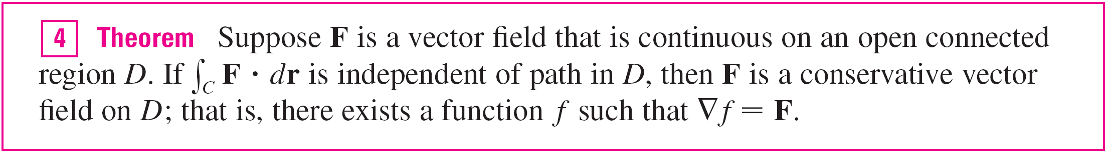
Independence of Paths
The physical interpretation is that the work done by a conservative force field as it moves an object around a closed path is 0.
The following theorem says that the only vector fields that are independent of path are conservative. It is stated and proved for plane curves, but there is a similar version for space curves.

Slide 14
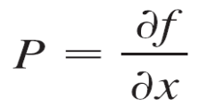
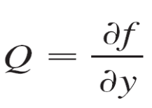
Independence of Paths
We assume that D is open, which means that for every point P in D there is a disk with center P that lies entirely in D. (So D doesn’t contain any of its boundary points.)
In addition, we assume that D is connected: this means that any two points in D can be joined by a path that lies in D.
The question remains: How is it possible to determine whether or not a vector field F is conservative? Suppose it is known that F = P i + Q j is conservative, where P and Q have continuous first-order partial derivatives. Then there is a function f such that F = ∇f, that is, and

Slide 15
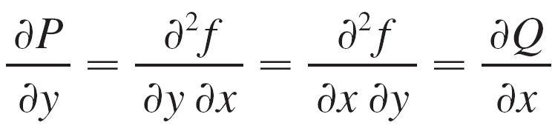
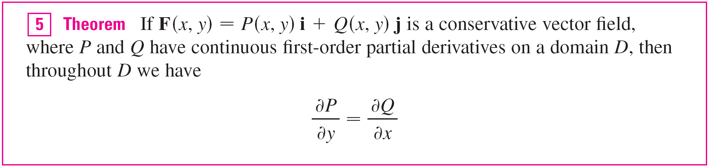
Independence of Paths
Therefore, by Clairaut’s Theorem,
The converse of Theorem 5 is true only for a special type of region.

Slide 16
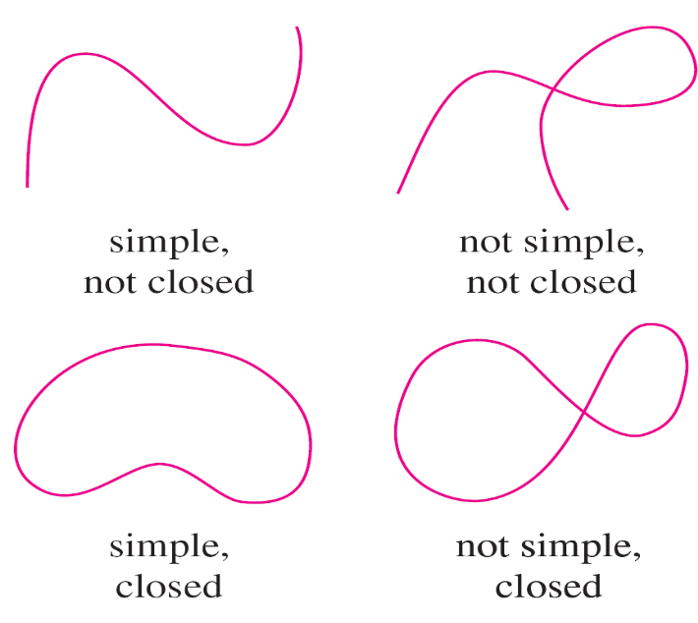
Independence of Paths
To explain this, we first need the concept of a simple curve, which is a curve that doesn’t intersect itself anywhere between its endpoints. [See Figure 6; r(a) = r(b) for a simple closed curve, but r(t₁) ≠ r(t₂) when
a < t₁ < t₂ < b.]
Types of curves
Figure 6

Slide 17
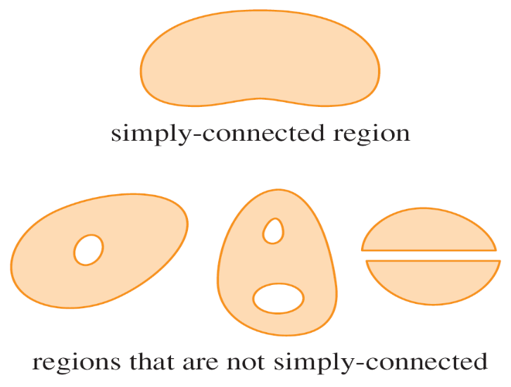
Independence of Paths
In Theorem 4 we needed an open connected region. For the next theorem we need a stronger condition.
A simply-connected region in the plane is a connected
region D such that every simple closed curve in D
encloses only points that are in D.
Notice from Figure 7 that,
intuitively speaking, a
simply-connected region
contains no hole and can’t
consist of two separate pieces.
Figure 7

Slide 18

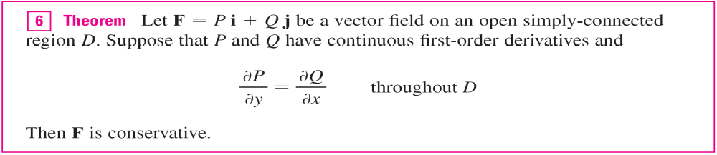
Independence of Paths
In terms of simply-connected regions, we can now state a partial converse to Theorem 5 that gives a convenient method for verifying that a vector field on is conservative.

Slide 19
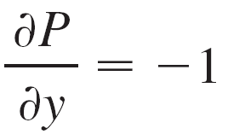
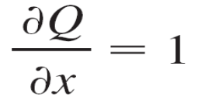
Example 2
Determine whether or not the vector field
F(x, y) = (x – y) i + (x – 2) j
is conservative.
Solution:
Let P(x, y) = x – y and Q(x, y) = x – 2.
Then
Since ∂ P/∂ y ≠ ∂ Q/∂ x, F is not conservative by Theorem 5.

Slide 20
Conservation of Energy

Slide 21
Conservation of Energy
Let’s apply the ideas of this chapter to a continuous force field F that moves an object along a path C given by r(t),
a ≤ t ≤ b, where r(a) = A is the initial point and r(b) = B is the terminal point of C. According to Newton’s Second Law of Motion, the force F(r(t)) at a point on C is related to the acceleration a(t) = r^{n}(t) by the equation
F(r(t)) = mr^{n}(t)
So the work done by the force on the object is

Slide 22
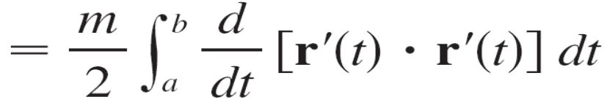

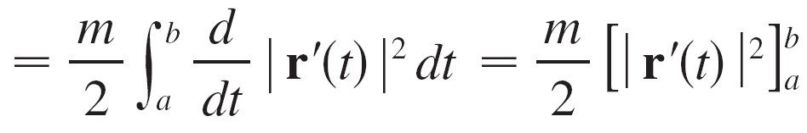
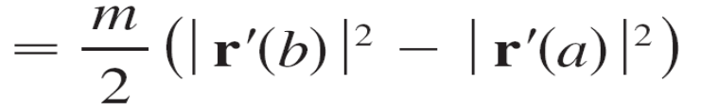

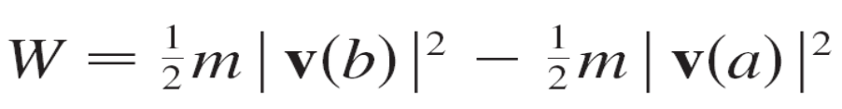
Conservation of Energy
Therefore
where v = r ′ is the velocity.
(By formula [u(t)  v(t)]
= u′(t)  v(t) + u(t)  v′(t))
(Fundamental Theorem
of Calculus)

Slide 23


Conservation of Energy
The quantity that is, half the mass times the square of the speed, is called the kinetic energy of the object. Therefore we can rewrite Equation 15 as
W = K(B) – K(A)
which says that the work done by the force field along C is equal to the change in kinetic energy at the endpoints of C.
Now let’s further assume that F is a conservative force field; that is, we can write F = ∇f.

Slide 24
Conservation of Energy
In physics, the potential energy of an object at the point (x, y, z) is defined as P(x, y, z) = –f (x, y, z), so we have F = –∇P.
Then by Theorem 2 we have
W = ∫_{C} F  dr
= – ∫_{C} ∇P  dr
= –[P(r(b)) – P(r(a))]
= P(A) – P(B)

Slide 25
Conservation of Energy
Comparing this equation with Equation 16, we see that
P(A) + K(A) = P(B) + K(B)
which says that if an object moves from one point A to another point B under the influence of a conservative force field, then the sum of its potential energy and its kinetic energy remains constant.
This is called the Law of Conservation of Energy and it is the reason the vector field is called conservative.

