Slide 1

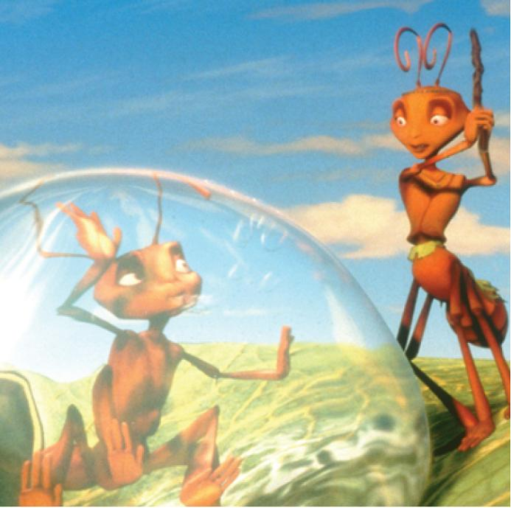
16
Vector Calculus
Copyright © Cengage Learning. All rights reserved.

Slide 2

16.4
Green’s Theorem
Copyright © Cengage Learning. All rights reserved.

Slide 3
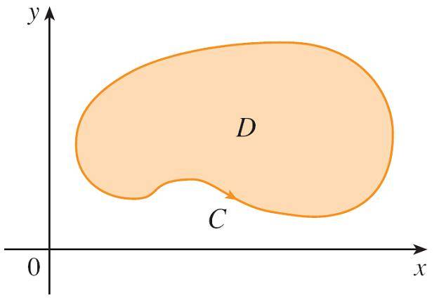
Green's Theorem
Green’s Theorem gives the relationship between a line integral around a simple closed curve C and a double integral over the plane region D bounded by C. (See
Figure 1. We assume that D consists of all points inside C as well as all points on C.)
Figure 1

Slide 4
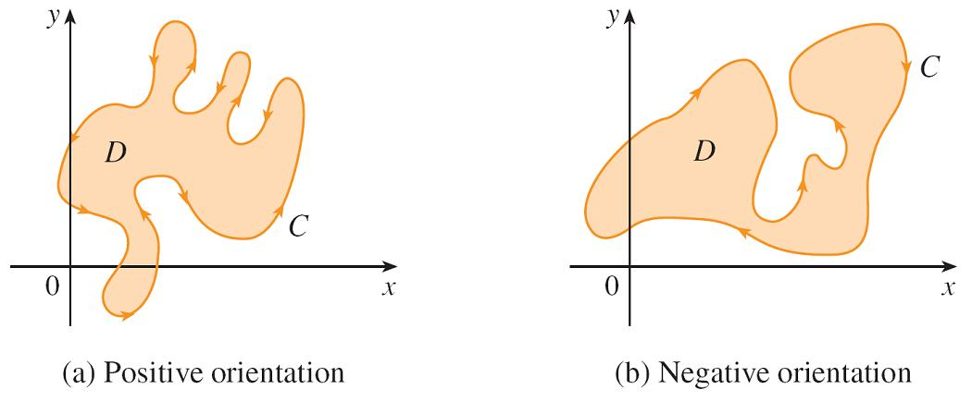
Green's Theorem
In stating Green’s Theorem we use the convention that the positive orientation of a simple closed curve C refers to a single counterclockwise traversal of C. Thus, if C is given by the vector function r(t), a ≤ t ≤ b, then the region D is always on the left as the point r(t) traverses C.
(See Figure 2.)
Figure 2

Slide 5
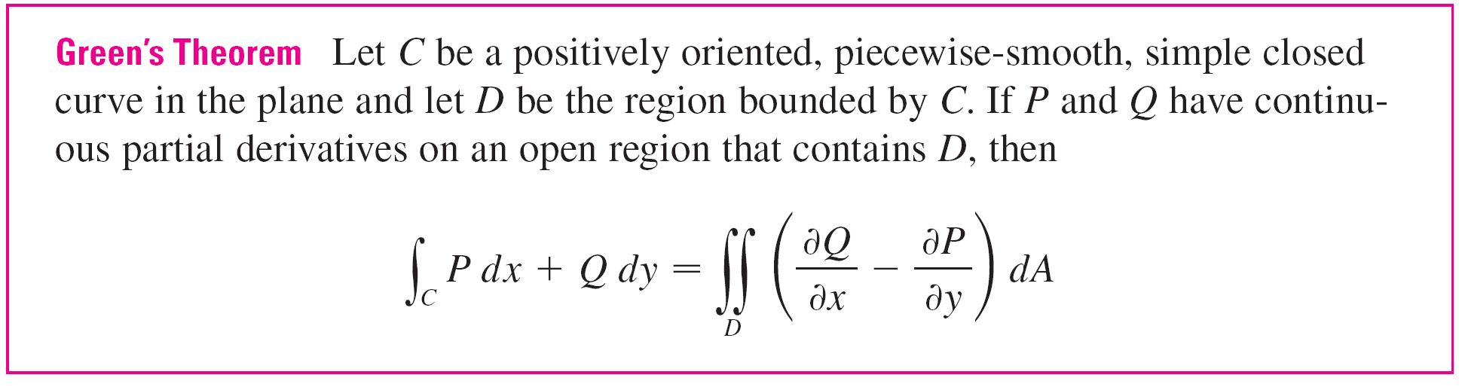
Green's Theorem

Slide 6
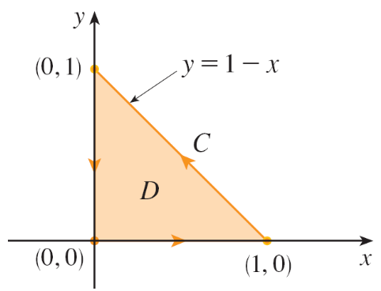
Example 1
Evaluate ∫_{C} x⁴ dx + xy dy, where C is the triangular curve consisting of the line segments from (0, 0) to (1, 0), from
(1, 0) to (0, 1), and from (0, 1) to (0, 0).
Solution:
Although the given line integral could be evaluated as usual by the methods, that would involve setting up three separate integrals along the three sides of the triangle, so let’s use Green’s Theorem instead.
Notice that the region D enclosed
by C is simple and C has positive
orientation (see Figure 4).
Figure 4

Slide 7
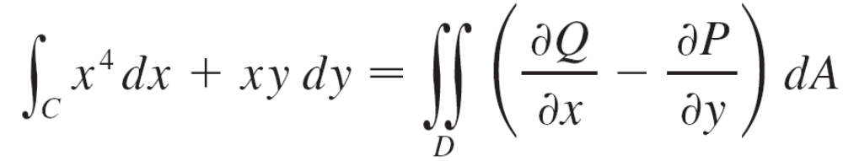
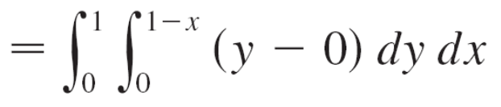
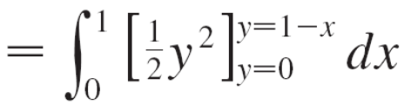
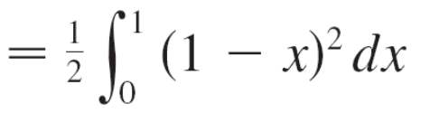


Example 1 – Solution
cont’d
If we let P(x, y) = x⁴ and Q(x, y) = xy, then we have

Slide 8
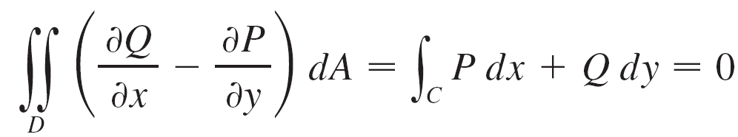
Green's Theorem
In Example 1 we found that the double integral was easier to evaluate than the line integral.
But sometimes it’s easier to evaluate the line integral, and Green’s Theorem is used in the reverse direction.
For instance, if it is known that P(x, y) = Q(x, y) = 0 on the curve C, then Green’s Theorem gives
no matter what values P and Q assume in the region D.

Slide 9
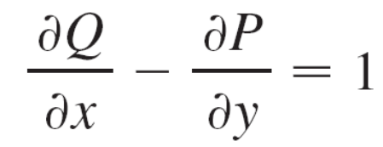


Green's Theorem
Another application of the reverse direction of Green’s Theorem is in computing areas. Since the area of D is
∫∫_{D} 1 dA, we wish to choose P and Q so that
There are several possibilities:
P(x, y) = 0 P(x, y) = –y P(x, y) = y
Q(x, y) = x Q(x, y) = 0 Q(x, y) = x

Slide 10
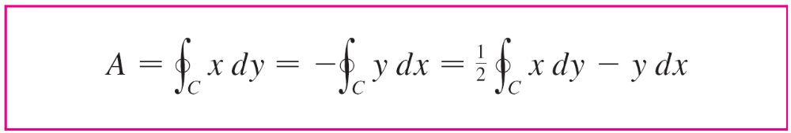

Green's Theorem
Then Green’s Theorem gives the following formulas for the area of D:

Slide 11
Green's Theorem
Formula 5 can be used to explain how planimeters work.
A planimeter is a mechanical instrument used for measuring the area of a region by tracing its boundary curve.
These devices are useful in all the sciences: in biology for measuring the area of leaves or wings, in medicine for measuring the size of cross-sections of organs or tumors, in forestry for estimating the size of forested regions from photographs.

Slide 12
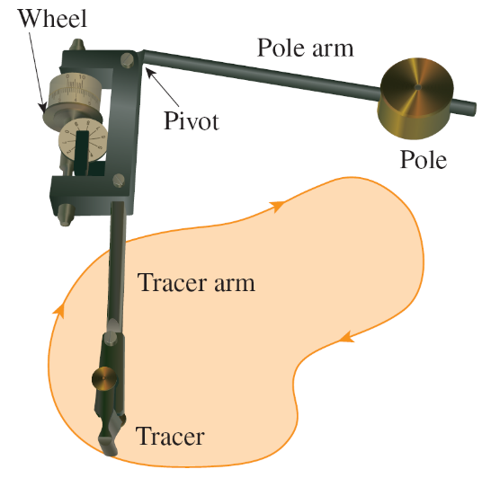
Green's Theorem
Figure 5 shows the operation of a polar planimeter: The pole is fixed and, as the tracer is moved along the boundary curve of the region, the wheel partly slides and partly rolls perpendicular to the tracer arm.
The planimeter measures the
distance that the wheel rolls
and this is proportional to the
area of the enclosed region.
A Keuffel and Esser polar planimeter
Figure 5

Slide 13
Extended Versions of Green’s Theorem

Slide 14
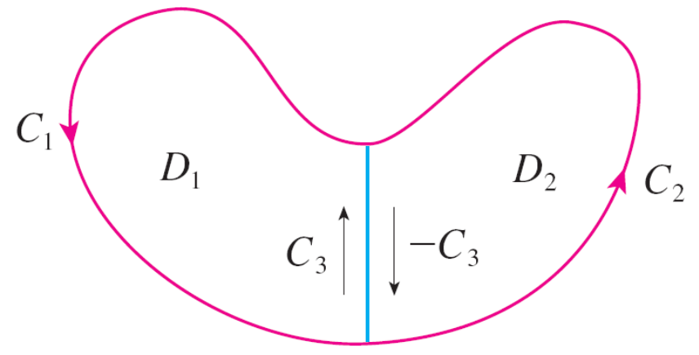
Extended Versions of Green’s Theorem
Although we have proved Green’s Theorem only for the case where D is simple, we can now extend it to the case where D is a finite union of simple regions.
For example, if D is the region shown in Figure 6, then we can write D = D₁ U D₂, where D₁ and D₂ are both simple.
Figure 6

Slide 15
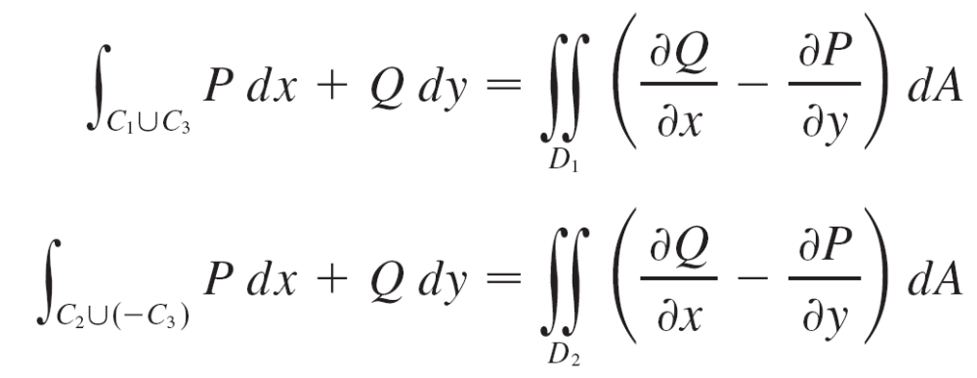
Extended Versions of Green’s Theorem
The boundary of D₁ is C₁ U C₃ and the boundary of D₂ is
C₂ U (–C₃) so, applying Green’s Theorem to D₁ and D₂ separately, we get

Slide 16
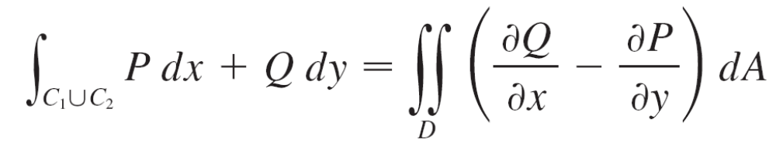
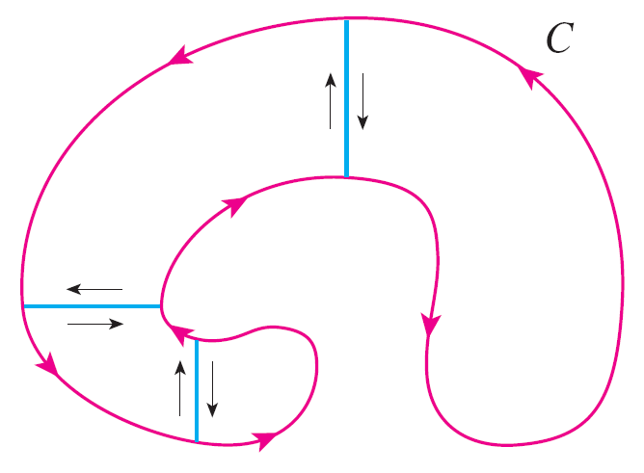
Extended Versions of Green’s Theorem
If we add these two equations, the line integrals along
C₃ and –C₃ cancel, so we get
which is Green’s Theorem for D = D₁ U D₂, since its boundary is C = C₁ U C₂.
The same sort of argument
allows us to establish Green’s
Theorem for any finite union
of nonoverlapping simple
regions (see Figure 7).
Figure 7

Slide 17

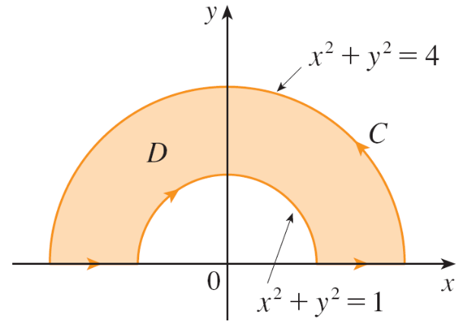
Example 4
Evaluate , where C is the boundary of the semiannular region D in the upper half-plane between the circles x² + y² = 1 and x² + y² = 4.
Solution:
Notice that although D is not simple, the y-axis divides it into two simple regions (see Figure 8).
In polar coordinates we can write
D = {(r, θ ) | 1 ≤ r ≤ 2, 0 ≤ θ ≤ π }
Figure 8

Slide 18
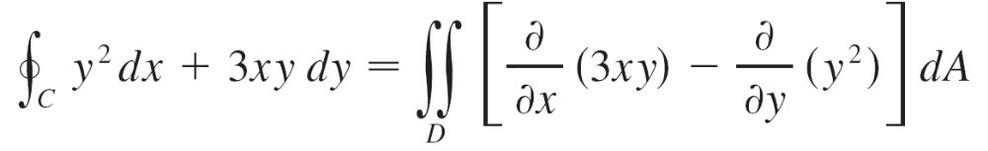
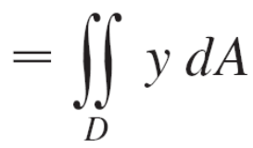
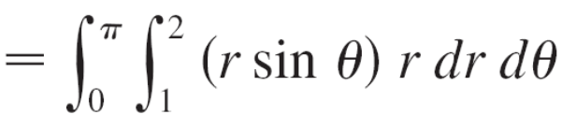
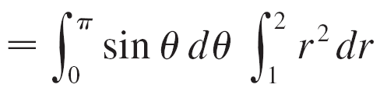
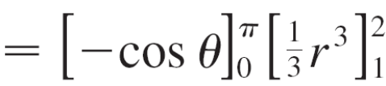

Example 4 – Solution
cont’d
Therefore Green’s Theorem gives

Slide 19
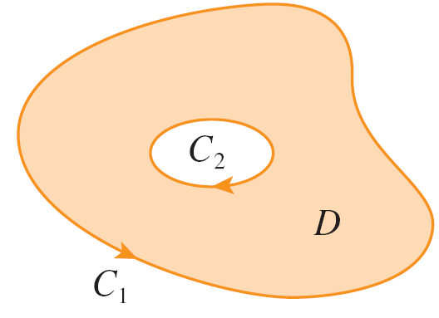
Extended Versions of Green’s Theorem
Green’s Theorem can be extended to apply to regions with holes, that is, regions that are not simply-connected.
Observe that the boundary C of the region D in Figure 9 consists of two simple closed curves C₁ and C₂.
We assume that these boundary curves are oriented so that the region D is always on the left as the curve C is traversed.
Thus the positive direction is
counterclockwise for the outer
curve C₁ but clockwise for the
inner curve C₂.
Figure 9

Slide 20
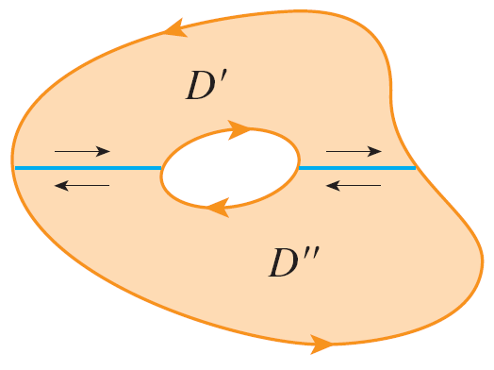
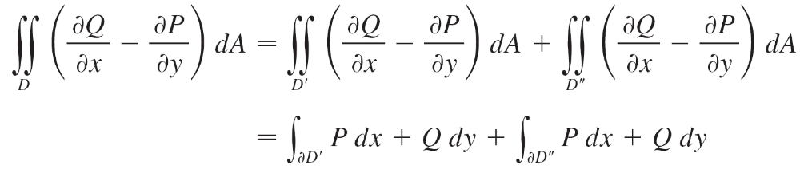
Extended Versions of Green’s Theorem
If we divide D into two regions D ′ and D ′′ by means of the
lines shown in Figure 10 and then apply Green’s Theorem
to each of D ′ and D ′′, we get
Figure 10

Slide 21
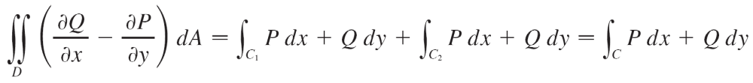
Extended Versions of Green’s Theorem
Since the line integrals along the common boundary lines are in opposite directions, they cancel and we get
which is Green’s Theorem for the region D.

