Slide 1

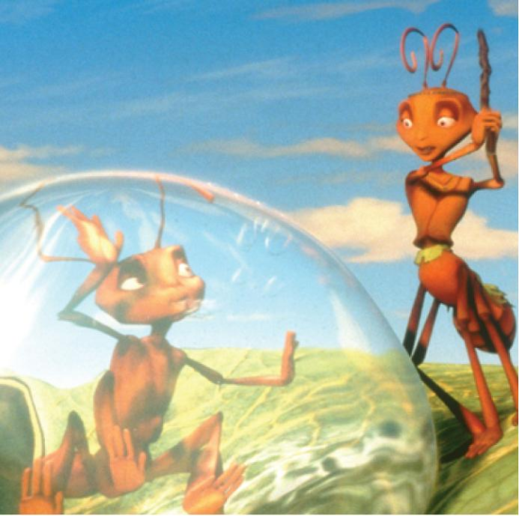
16
Vector Calculus
Copyright © Cengage Learning. All rights reserved.

Slide 2

16.5
Curl and Divergence
Copyright © Cengage Learning. All rights reserved.

Slide 3
Curl

Slide 4

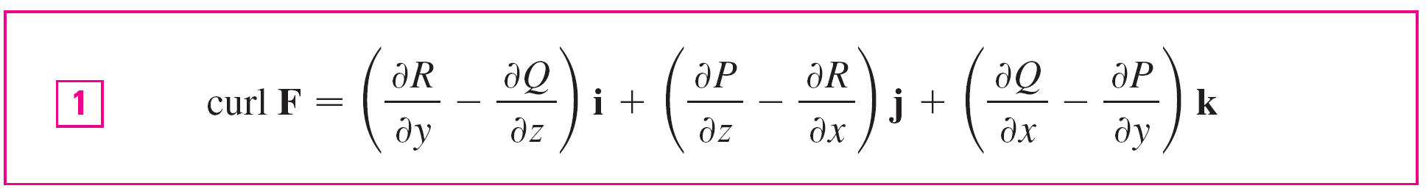
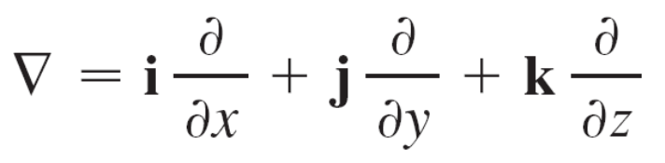
Curl
If F = P i + Q j + R k is a vector field on and the partial
derivatives of P, Q, and R all exist, then the curl of F is the
vector field on defined by
Let’s rewrite Equation 1 using operator notation. We introduce the vector differential operator ∇ (“del”) as

Slide 5
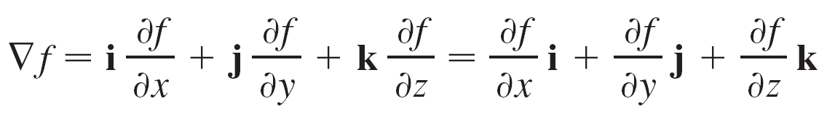
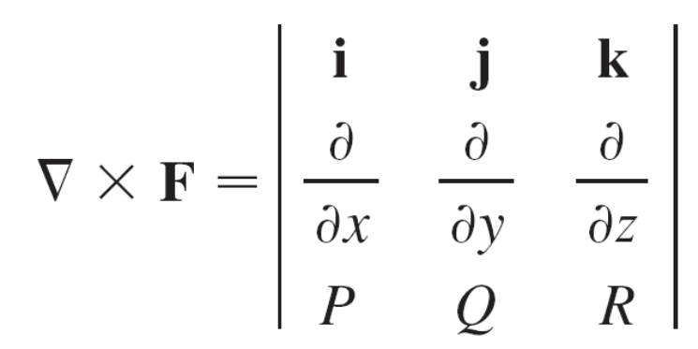
Curl
It has meaning when it operates on a scalar function to produce the gradient of f :
If we think of ∇ as a vector with components ∂/∂x, ∂/∂y, and ∂/∂z, we can also consider the formal cross product of ∇ with the vector field F as follows:

Slide 6
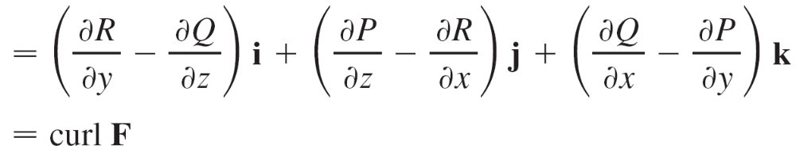


Curl
So the easiest way to remember Definition 1 is by means of the symbolic expression

Slide 7
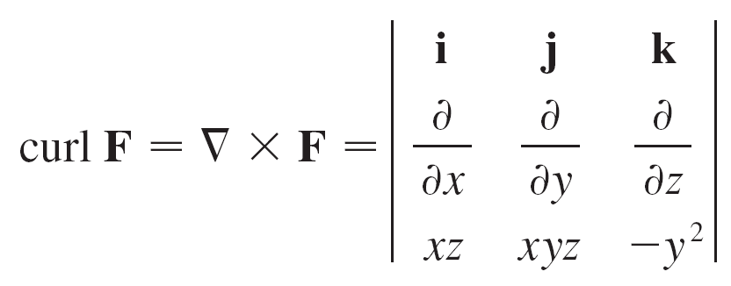
Example 1
If F(x, y, z) = xz i + xyz j – y² k, find curl F.
Solution:
Using Equation 2, we have

Slide 8
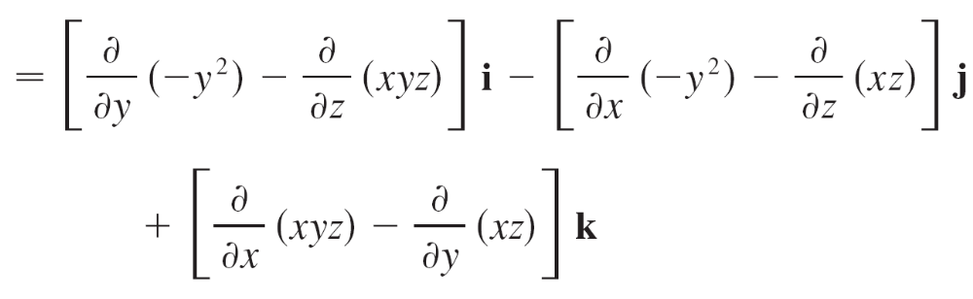

Example 1 – Solution
cont’d

Slide 9

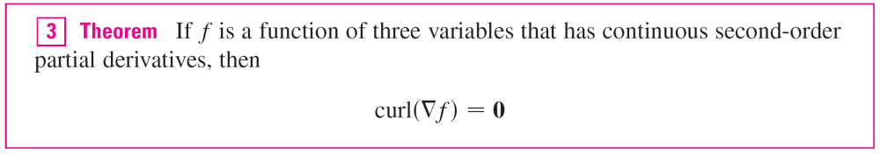
Curl
Recall that the gradient of a function f of three variables is a vector field on and so we can compute its curl.
The following theorem says that the curl of a gradient vector field is 0.

Slide 10
Curl
Since a conservative vector field is one for which F = ∇f, Theorem 3 can be rephrased as follows:
If F is conservative, then curl F = 0.
This gives us a way of verifying that a vector field is not conservative.

Slide 11
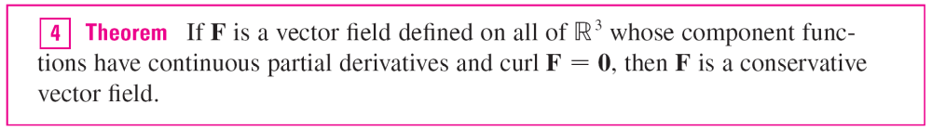
Curl
The converse of Theorem 3 is not true in general, but the following theorem says the converse is true if F is defined everywhere. (More generally it is true if the domain is simply-connected, that is, “has no hole.”)

Slide 12
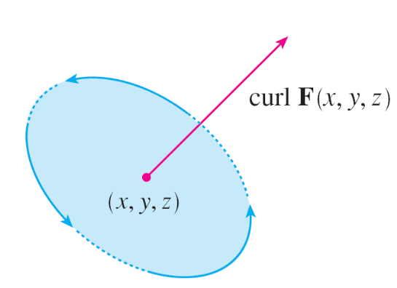
Curl
The reason for the name curl is that the curl vector is associated with rotations.
Another occurs when F represents the velocity field in fluid flow. Particles near (x, y, z) in the fluid tend to rotate about the axis that points in the direction of curl F(x, y, z), and the length of this curl vector is a measure of how quickly the particles move around the axis (see Figure 1).
Figure 1

Slide 13
Curl
If curl F = 0 at a point P, then the fluid is free from rotations at P and F is called irrotational at P.
In other words, there is no whirlpool or eddy at P.
If curl F = 0, then a tiny paddle wheel moves with the fluid but doesn’t rotate about its axis.
If curl F ≠ 0, the paddle wheel rotates about its axis.

Slide 14
Divergence

Slide 15
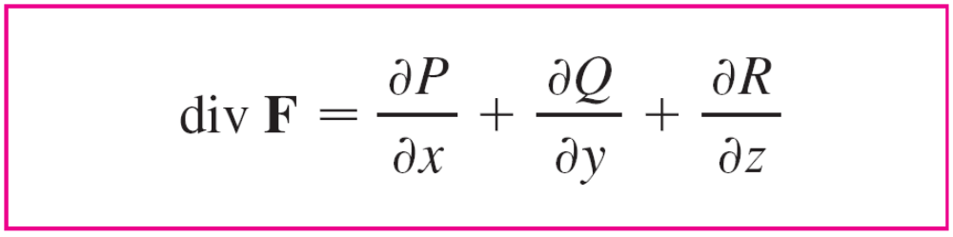

Divergence
If F = P i + Q j + R k is a vector field on and ∂P/∂x, ∂Q/∂y, and ∂R/∂z exist, then the divergence of F is the function of three variables defined by
Observe that curl F is a vector field but div F is a scalar field.

Slide 16
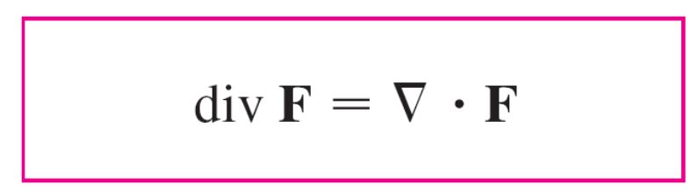

Divergence
In terms of the gradient operator
∇ = (∂/∂x) i + (∂/∂y) j + (∂/∂z) k, the divergence of F can be written symbolically as the dot product of ∇ and F:

Slide 17
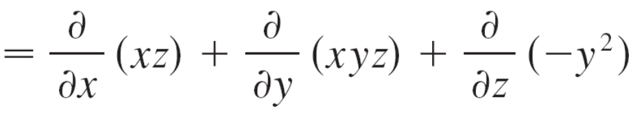
Example 4
If F(x, y, z) = xz i + xyz j + y² k, find div F.
Solution:
By the definition of divergence (Equation 9 or 10) we have
div F = ∇  F
= z + xz

Slide 18

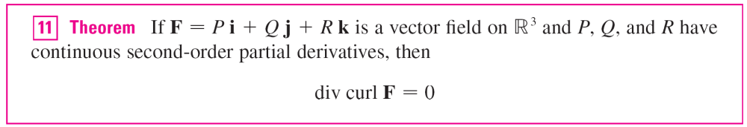
Divergence
If F is a vector field on , then curl F is also a vector field
on . As such, we can compute its divergence.
The next theorem shows that the result is 0.
Again, the reason for the name divergence can be understood in the context of fluid flow.

Slide 19
Divergence
If F(x, y, z) is the velocity of a fluid (or gas), then
div F(x, y, z) represents the net rate of change (with respect to time) of the mass of fluid (or gas) flowing from the point (x, y, z) per unit volume.
In other words, div F(x, y, z) measures the tendency of the fluid to diverge from the point (x, y, z).
If div F = 0, then F is said to be incompressible.
Another differential operator occurs when we compute the divergence of a gradient vector field ∇f.

Slide 20
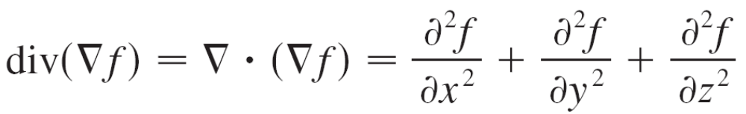
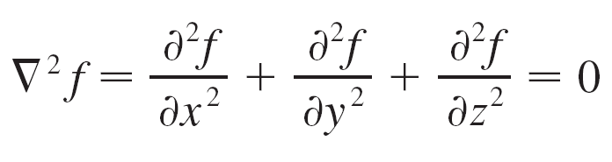
Divergence
If f is a function of three variables, we have
and this expression occurs so often that we abbreviate it as ∇²f. The operator
∇² = ∇  ∇
is called the Laplace operator because of its relation to Laplace’s equation

Slide 21
Divergence
We can also apply the Laplace operator ∇² to a vector field
F = P i + Q j + R k
in terms of its components:
∇²F = ∇²P i + ∇²Q j + ∇²R k

Slide 22
Vector Forms of Green’s Theorem

Slide 23
Vector Forms of Green’s Theorem
The curl and divergence operators allow us to rewrite Green’s Theorem in versions that will be useful in our later work.
We suppose that the plane region D, its boundary curve C, and the functions P and Q satisfy the hypotheses of Green’s Theorem.
Then we consider the vector field F = P i + Q j.

Slide 24
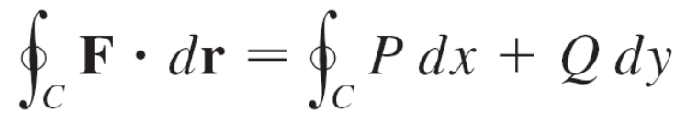

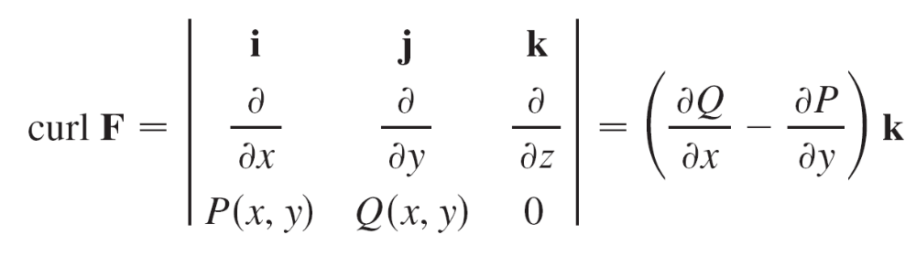
Vector Forms of Green’s Theorem
Its line integral is
and, regarding F as a vector field on with third component 0, we have

Slide 25
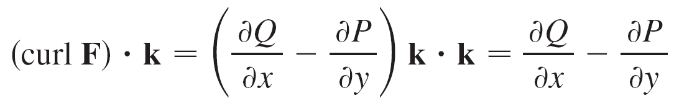
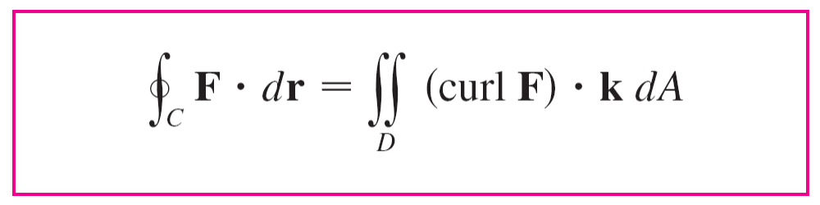

Vector Forms of Green’s Theorem
Therefore
and we can now rewrite the equation in Green’s Theorem in the vector form

Slide 26
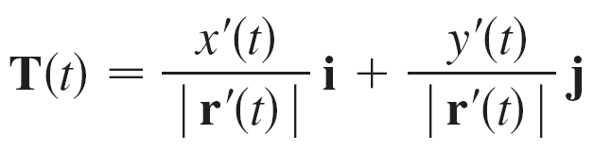
Vector Forms of Green’s Theorem
Equation 12 expresses the line integral of the tangential component of F along C as the double integral of the vertical component of curl F over the region D enclosed by C. We now derive a similar formula involving the normal component of F.
If C is given by the vector equation
r(t) = x(t) i + y(t) j a ≤ t ≤ b
then the unit tangent vector is

Slide 27
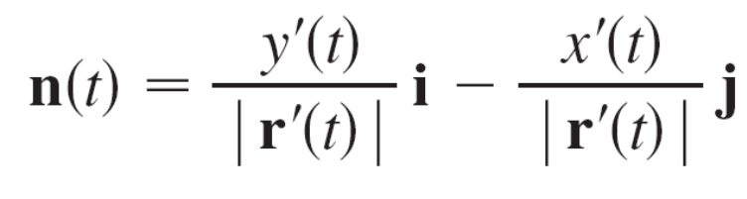
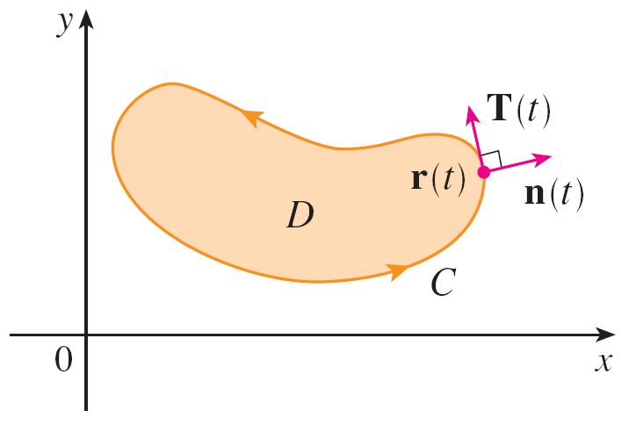
Vector Forms of Green’s Theorem
You can verify that the outward unit normal vector to C is given by
(See Figure 2.)
Figure 2

Slide 28
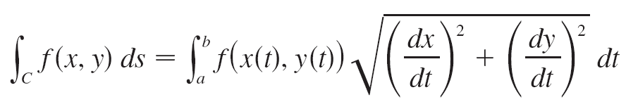
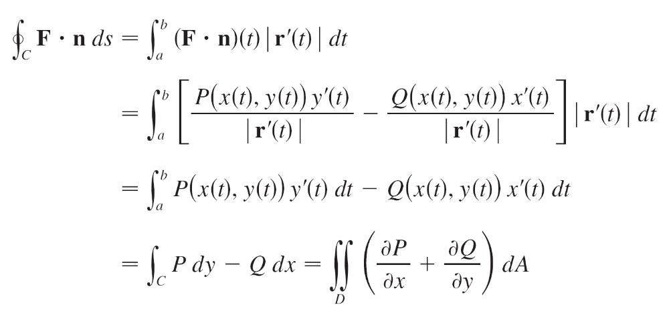
Vector Forms of Green’s Theorem
Then, from equation
we have
by Green’s Theorem.

Slide 29
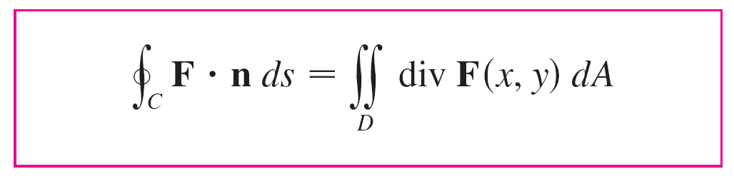

Vector Forms of Green’s Theorem
But the integrand in this double integral is just the divergence of F. So we have a second vector form of Green’s Theorem.
This version says that the line integral of the normal component of F along C is equal to the double integral of the divergence of F over the region D enclosed by C.

