Slide 1


16
Vector Calculus
Copyright © Cengage Learning. All rights reserved.

Slide 2

Parametric Surfaces and Their Areas
16.6
Copyright © Cengage Learning. All rights reserved.

Slide 3
Parametric Surfaces and Their Areas
Here we use vector functions to describe more general surfaces, called parametric surfaces, and compute their areas.
Then we take the general surface area formula and see how it applies to special surfaces.

Slide 4
Parametric Surfaces

Slide 5

Parametric Surfaces
In much the same way that we describe a space curve by a vector function r(t) of a single parameter t, we can describe a surface by a vector function r(u, v) of two parameters u and v.
We suppose that
r(u, v) = x(u, v)i + y(u, v)j + z(u, v)k
is a vector-valued function defined on a region D in the
uv-plane.

Slide 6


Parametric Surfaces
So x, y, and, z, the component functions of r, are functions of the two variables u and v with domain D.
The set of all points (x, y, z) in such that
x = x(u, v) y = y(u, v) z = z(u, v)
and (u, v) varies throughout D, is called a parametric surface S and Equations 2 are called parametric equations of S.

Slide 7
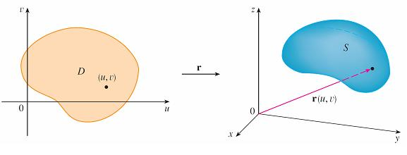
Parametric Surfaces
Each choice of u and v gives a point on S; by making all choices, we get all of S.
In other words, the surface is traced out by the tip of the position vector r(u, v) as (u, v) moves throughout the
region D. (See Figure 1.)
A parametric surface
Figure 1

Slide 8
Example 1
Identify and sketch the surface with vector equation
r(u, v) = 2 cos u i + v j + 2 sin u k
Solution:
The parametric equations for this surface are
x = 2 cos u y = v z = 2 sin u

Slide 9
Example 1 – Solution
cont’d
So for any point (x, y, z) on the surface, we have
x² + z² = 4 cos²u + 4 sin²u
= 4
This means that vertical cross-sections parallel to the
xz-plane (that is, with y constant) are all circles with
radius 2.

Slide 10
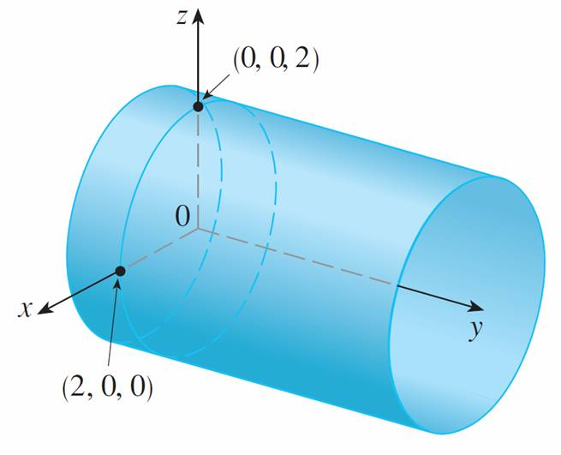
Example 1 – Solution
cont’d
Since y = v and no restriction is placed on v, the surface is a circular cylinder with radius 2 whose axis is the y-axis (see Figure 2).
Figure 2

Slide 11
Parametric Surfaces
If a parametric surface S is given by a vector function
r(u, v), then there are two useful families of curves that lie on S, one family with u constant and the other with v constant.
These families correspond to vertical and horizontal lines in the uv-plane.

Slide 12
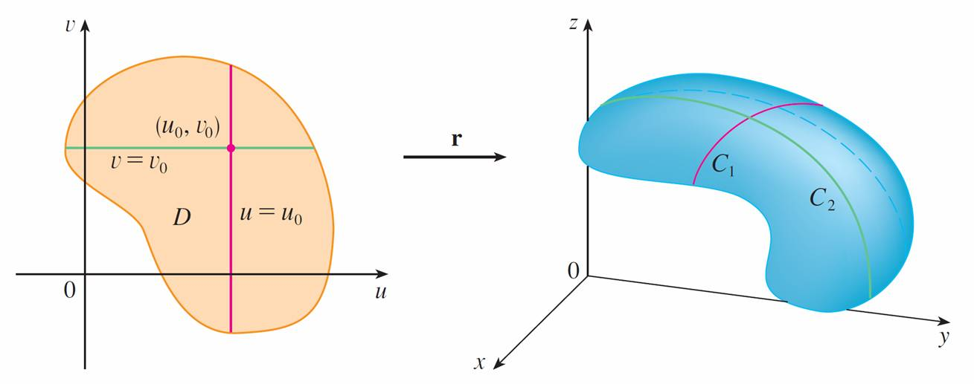
Parametric Surfaces
If we keep u constant by putting u = u₀, then r(u₀, v) becomes a vector function of the single parameter v and defines a curve C₁ lying on S. (See Figure 4.)
Figure 4

Slide 13
Parametric Surfaces
Similarly, if we keep v constant by putting v = v₀, we get a curve C₂ given by r(u, v₀) that lies on S.
We call these curves grid curves. (In Example 1, for instance, the grid curves obtained by letting u be constant are horizontal lines whereas the grid curves with v constant are circles.)
In fact, when a computer graphs a parametric surface, it usually depicts the surface by plotting these grid curves, as we see in the next example.

Slide 14
Example 2
Use a computer algebra system to graph the surface
r(u, v) = ⟨(2 + sin v) cos u, (2 + sin v) sin u, u + cos v⟩
Which grid curves have u constant? Which have v constant?

Slide 15
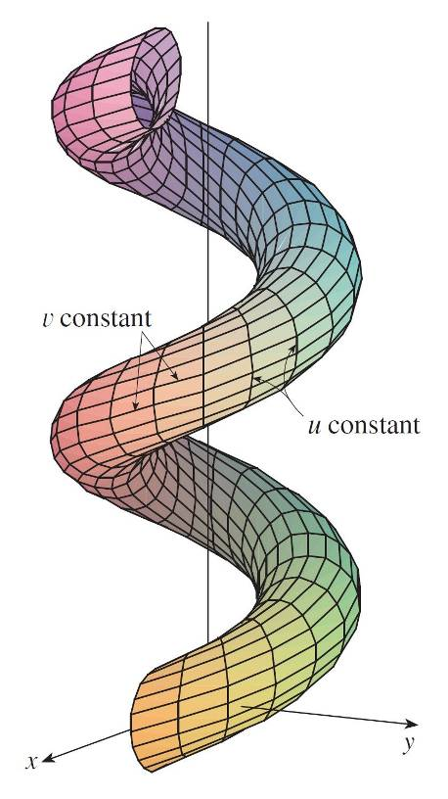
Example 2 – Solution
We graph the portion of the surface with parameter domain
0 ≤ u ≤ 4π, 0 ≤ v ≤ 2π in Figure 5.
Figure 5

Slide 16
Example 2 – Solution
cont’d
It has the appearance of a spiral tube.
To identify the grid curves, we write the corresponding parametric equations:
x = (2 + sin v) cos u y = (2 + sin v) sin u z = u + cos v
If v is constant, then sin v and cos v are constant, so the parametric equations resemble those of the helix.
Thus the grid curves with v constant are the spiral curves in Figure 5.

Slide 17
Example 2 – Solution
cont’d
We deduce that the grid curves with u constant must be curves that look like circles in the figure.
Further evidence for this assertion is that if u is kept constant, u = u₀ , then the equation z = u₀ + cos v shows that the z-values vary from u₀ – 1 to u₀ + 1.

Slide 18
Example 4
Find a parametric representation of the sphere
x² + y² + z² = a²
Solution:
The sphere has a simple representation ρ = a in spherical coordinates, so let’s choose the angles φ and θ in spherical coordinates as the parameters.

Slide 19
Example 4 – Solution
cont’d
Then, putting ρ = a in the equations for conversion from spherical to rectangular coordinates, we obtain
x = a sin φ cos θ y = a sin φ sin θ z = a cos φ
as the parametric equations of the sphere.
The corresponding vector equation is
r(φ, θ ) = a sin φ cos θ i + a sin φ sin θ j + a cos φ k

Slide 20
Example 4 – Solution
cont’d
We have 0 ≤ φ ≤ π and 0 ≤ θ ≤ 2π, so the parameter domain is the rectangle D = [0, π] × [0, 2π].
The grid curves with φ constant are the circles of constant latitude (including the equator).

Slide 21
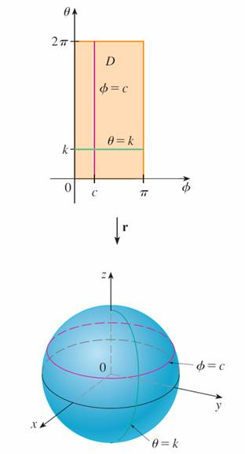
Example 4 – Solution
cont’d
The grid curves with θ constant are the meridians
(semi-circles), which connect the north and south poles (see Figure 7).
Figure 7

Slide 22
Parametric Surfaces
Note:
We saw in Example 4 that the grid curves for a sphere are curves of constant latitude and longitude.
For a general parametric surface we are really making a map and the grid curves are similar to lines of latitude and longitude.
Describing a point on a parametric surface (like the one in Figure 5) by giving specific values of u and v is like giving the latitude and longitude of a point.

Slide 23
Surfaces of Revolution

Slide 24
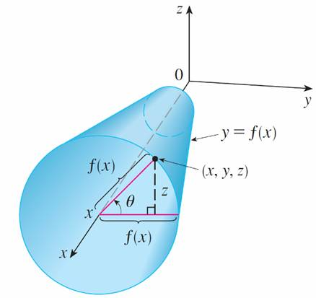
Surfaces of Revolution
Surfaces of revolution can be represented parametrically and thus graphed using a computer. For instance, let’s consider the surface S obtained by rotating the curve
y = f (x), a ≤ x ≤ b, about the x-axis, where f (x) ≥ 0.
Let θ be the angle of rotation as shown in Figure 10.
Figure 10

Slide 25

Surfaces of Revolution
If (x, y, z) is a point on S, then
x = x y = f (x) cos θ z = f (x) sin θ
Therefore we take x and θ as parameters and regard Equations 3 as parametric equations of S.
The parameter domain is given by a ≤ x ≤ b, 0 ≤ θ ≤ 2π .

Slide 26
Example 8
Find parametric equations for the surface generated by rotating the curve y = sin x, 0 ≤ x ≤ 2π, about the x-axis. Use these equations to graph the surface of revolution.
Solution:
From Equations 3, the parametric equations are
x = x y = sin x cos θ z = sin x sin θ
and the parameter domain is 0 ≤ x ≤ 2π , 0 ≤ θ ≤ 2π.

Slide 27
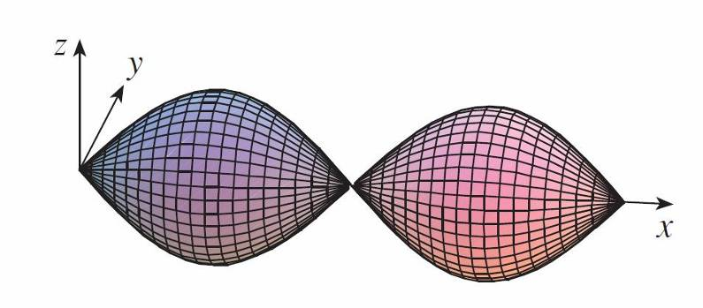
Example 8 – Solution
cont’d
Using a computer to plot these equations and rotate the image, we obtain the graph in Figure 11.
Figure 11

Slide 28
Tangent Planes

Slide 29
Tangent Planes
We now find the tangent plane to a parametric surface S traced out by a vector function
r(u, v) = x(u, v) i + y(u, v) j + z(u, v) k
at a point P₀ with position vector r(u₀, v₀).

Slide 30
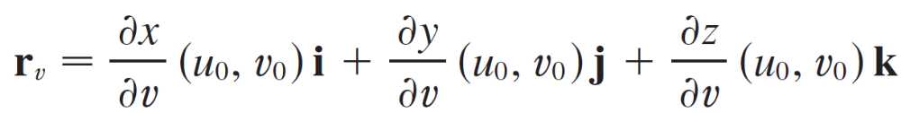

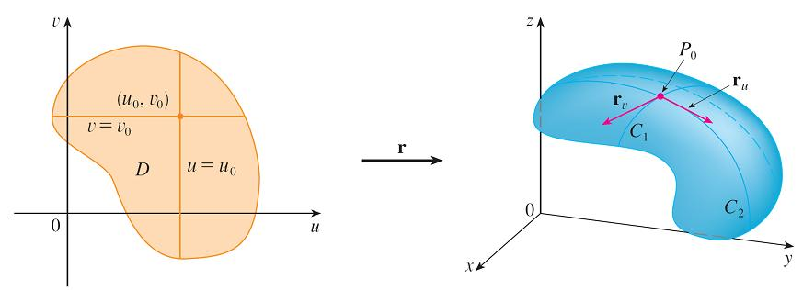
Tangent Planes
If we keep u constant by putting u = u₀, then r(u₀, v) becomes a vector function of the single parameter v and defines a grid curve C₁ lying on S. (See Figure 12.) The tangent vector to C₁ at P₀ is obtained by taking the partial derivative of r with respect to v:
Figure 12

Slide 31

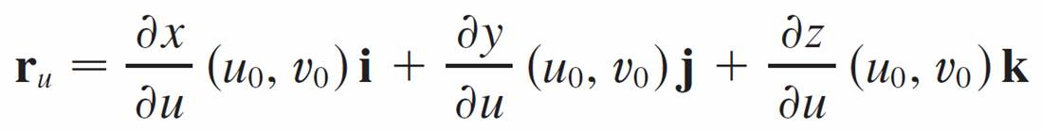
Tangent Planes
Similarly, if we keep v constant by putting v = v₀, we get a grid curve C₂ given by r(u, v₀) that lies on S, and its tangent vector at P₀ is
If r_{u} × r_{v} is not 0, then the surface S is called smooth
(it has no “corners”).
For a smooth surface, the tangent plane is the plane that contains the tangent vectors r_{u} and r_{v}, and the vector
r_{u} × r_{v} is a normal vector to the tangent plane.

Slide 32
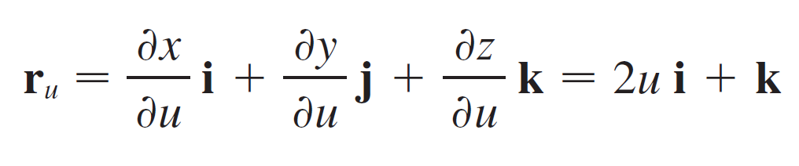
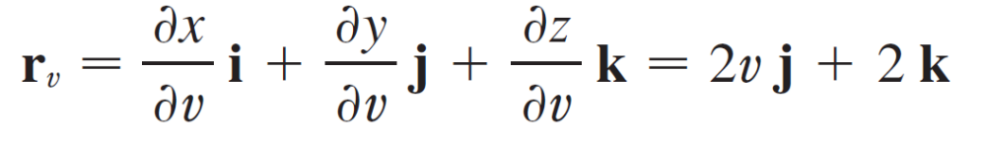
Example 9
Find the tangent plane to the surface with parametric equations x = u², y = v², z = u + 2v at the point (1, 1, 3).
Solution:
We first compute the tangent vectors:

Slide 33
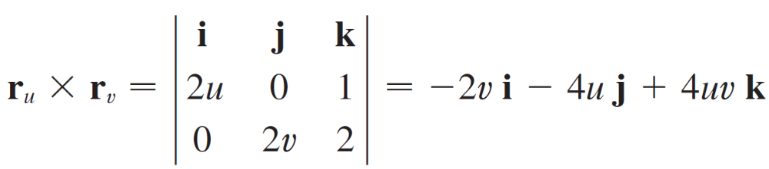
Example 9 – Solution
cont’d
Thus a normal vector to the tangent plane is
Notice that the point (1, 1, 3) corresponds to the parameter values u = 1 and v = 1, so the normal vector there is
–2 i – 4 j + 4 k

Slide 34
Example 9 – Solution
cont’d
Therefore an equation of the tangent plane at (1, 1, 3) is
–2(x – 1) – 4(y – 1) + 4(z – 3) = 0
or
x + 2y – 2z + 3 = 0

Slide 35
Surface Area

Slide 36
Surface Area
Now we define the surface area of a general parametric surface given by Equation 1.
For simplicity we start by considering a surface whose parameter domain D is a rectangle, and we divide it into subrectangles R_{ij}.

Slide 37

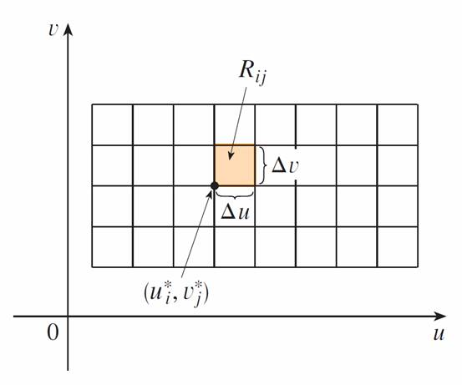
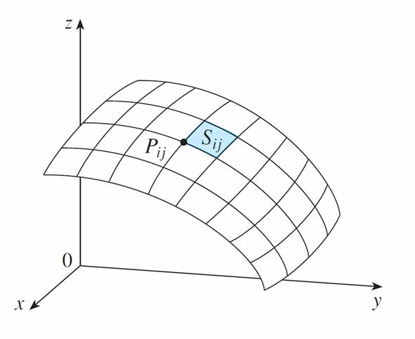
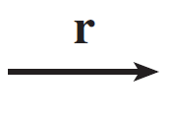
Surface Area
Let’s choose to be the lower left corner of R_{ij}.
(See Figure 14.)
The image of the subrectangle R_{ij} is the patch S_{ij}.
Figure 14

Slide 38

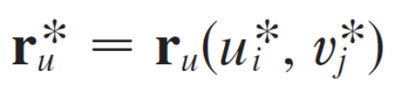
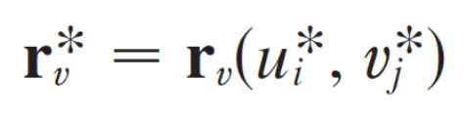
Surface Area
The part of S_{ij} the surface that corresponds to R_{ij} is called a patch and has the point P_{ij} with position vector as one of its corners.
Let
and
be the tangent vectors at P_{ij} as given by Equations 5 and 4.

Slide 39


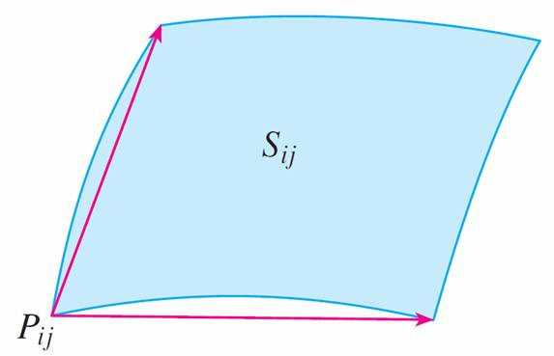
Surface Area
Figure 15(a) shows how the two edges of the patch that meet at P_{ij} can be approximated by vectors. These vectors, in turn, can be approximated by the vectors and because partial derivatives can be approximated by difference quotients.
Approximating a patch by a parallelogram.
Figure 15(a)

Slide 40
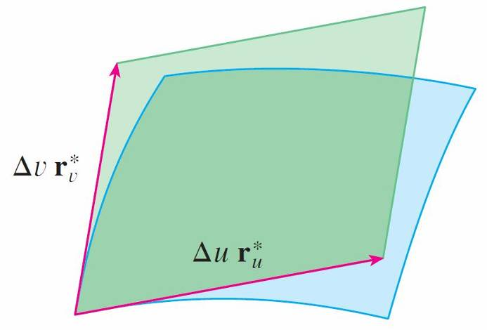
Surface Area
So we approximate S_{ij} by the parallelogram determined by the vectors and .
This parallelogram is shown in Figure 15(b) and lies in the tangent plane to S at P_{ij}.
Approximating a patch by a parallelogram.
Figure 15(b)

Slide 41
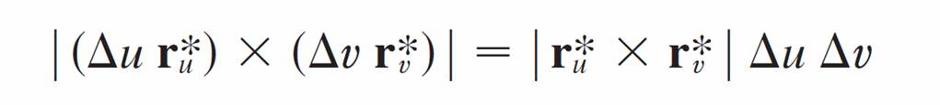
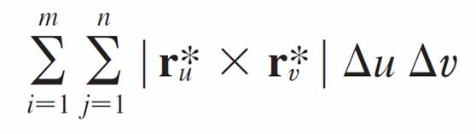
Surface Area
The area of this parallelogram is
and so an approximation to the area of S is

Slide 42

Surface Area
Our intuition tells us that this approximation gets better as we increase the number of subrectangles, and we recognize the double sum as a Riemann sum for the double integral

Slide 43
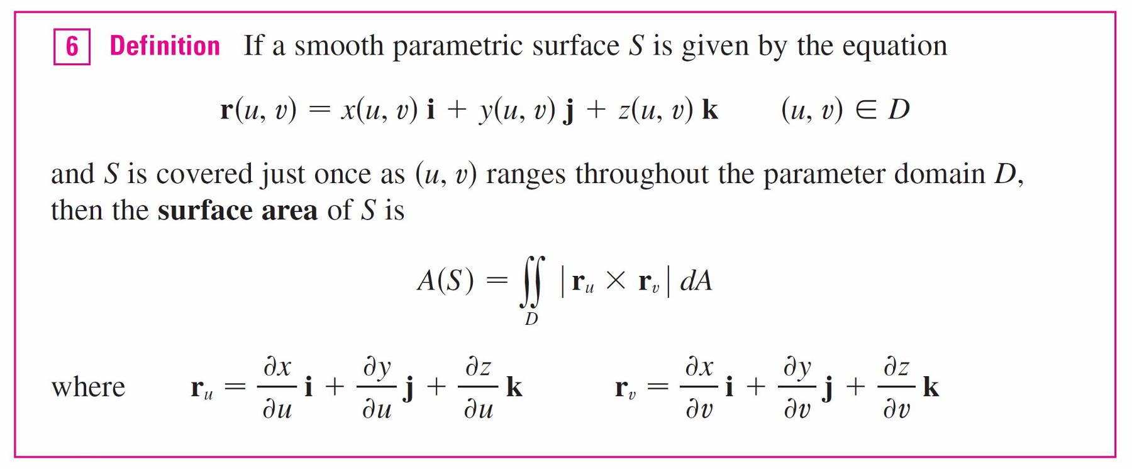
Surface Area
This motivates the following definition.

Slide 44
Example 10
Find the surface area of a sphere of radius a.
Solution:
In Example 4 we found the parametric representation
x = a sin φ cosθ y = a sin φ sin θ z = a cos φ
where the parameter domain is
D = {(φ, θ) | 0 ≤ φ ≤ π, 0 ≤ θ ≤ 2π}

Slide 45
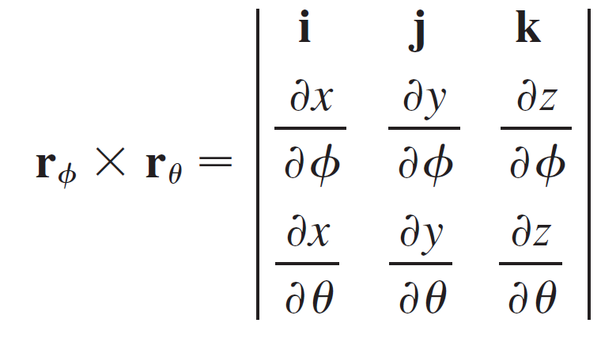
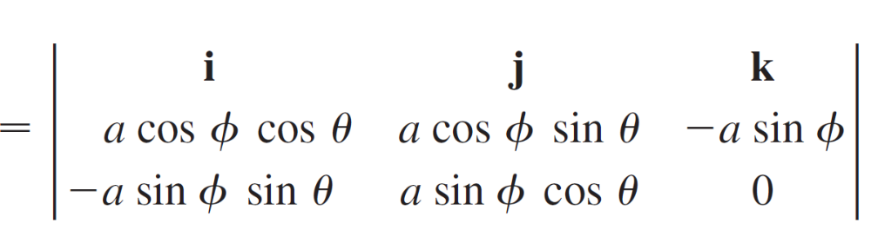
Example 10 – Solution
cont’d
We first compute the cross product of the tangent vectors:

Slide 46
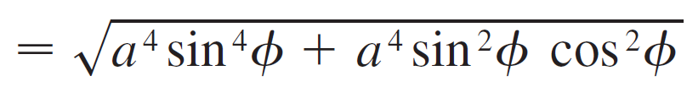
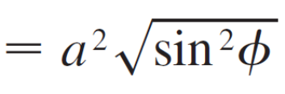
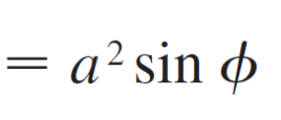
Example 10 – Solution
cont’d
= a² sin²φ cos θ i + a² sin² φ sin θ j + a² sin φ cos φ k
Thus
since sin φ ≥ 0 for 0 ≤ φ ≤ π.

Slide 47
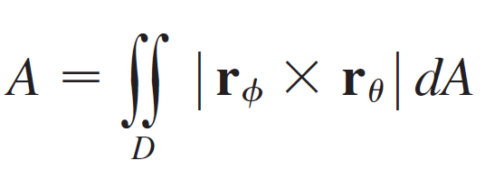
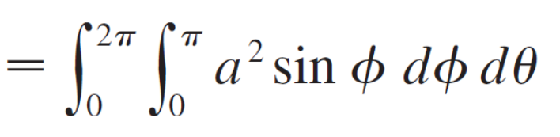
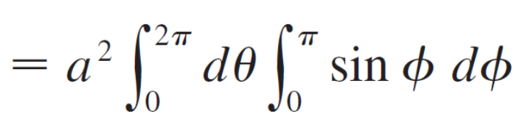
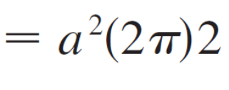

Example 10 – Solution
cont’d
Therefore, by Definition 6, the area of the sphere is

Slide 48
Surface Area of the
Graph of a function

Slide 49
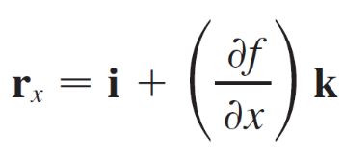
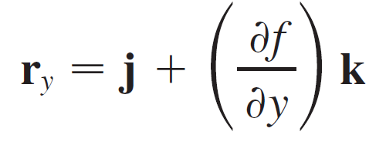
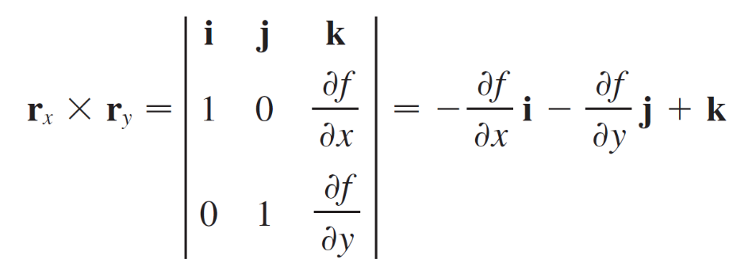

Surface Area of the Graph of a Function
For the special case of a surface S with equation z = f (x, y), where (x, y) lies in D and f has continuous partial derivatives, we take x and y as parameters.
The parametric equations are
x = x y = y z = f (x, y)
so
and

Slide 50
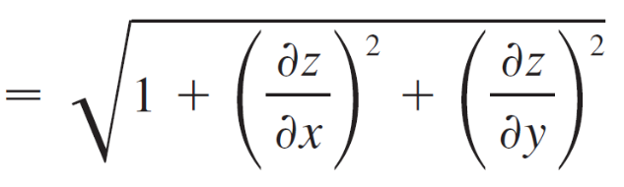
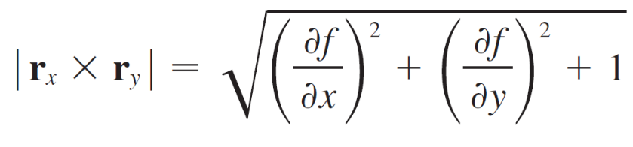

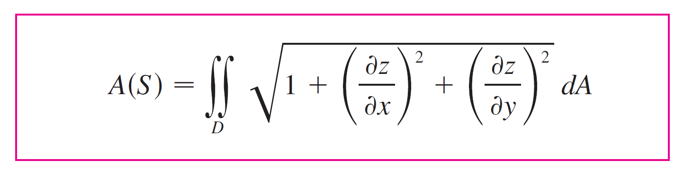

Surface Area of the Graph of a Function
Thus we have
and the surface area formula in Definition 6 becomes

Slide 51
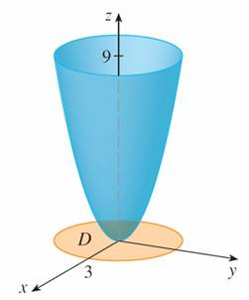
Example 11
Find the area of the part of the paraboloid z = x² + y² that lies under the plane z = 9.
Solution:
The plane intersects the paraboloid in the circle
x² + y² = 9, z = 9. Therefore the given surface lies above the disk D with center the origin and radius 3.
(See Figure 16.)
Figure 16

Slide 52
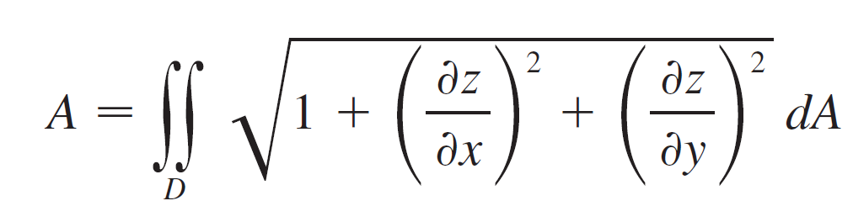
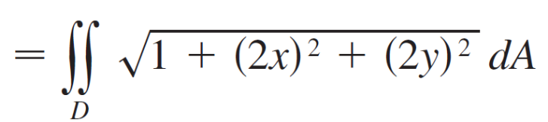
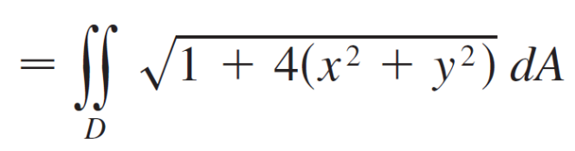
Example 11 – Solution
cont’d
Using Formula 9, we have

Slide 53
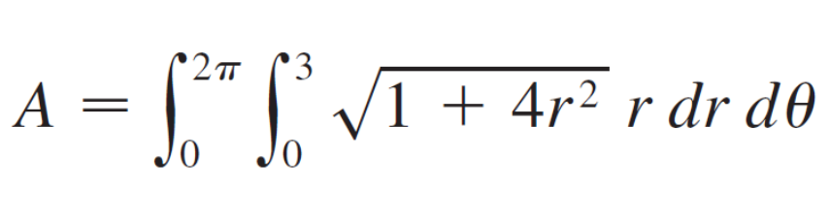
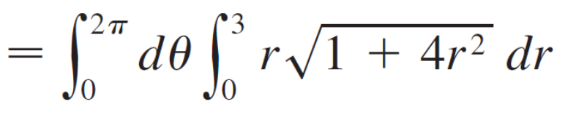
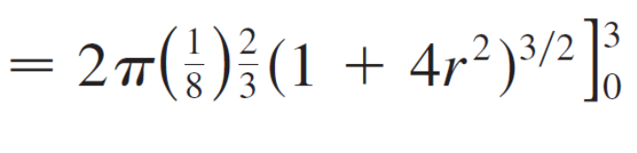
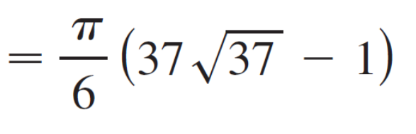
Example 11 – Solution
cont’d
Converting to polar coordinates, we obtain

