Slide 1


16
Vector Calculus
Copyright © Cengage Learning. All rights reserved.

Slide 2

16.10
Summary
Copyright © Cengage Learning. All rights reserved.

Slide 3
Summary
We collect all higher-dimensional versions of the Fundamental Theorem of Calculus together here (without hypotheses) so that you can see more easily their essential similarity.
Notice that in each case we have an integral of a “derivative” over a region on the left side, and the right side involves the values of the original function only on the boundary of the region.

Slide 4
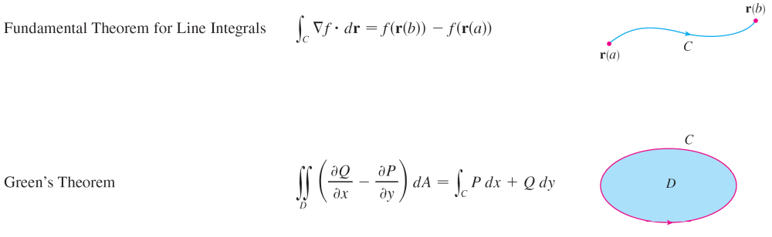
Summary
cont’d

Slide 5
Summary
cont’d

