Slide 1

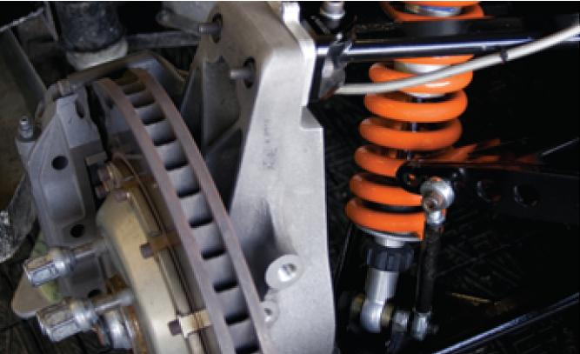
Second-Order Differential
Equations
17
Copyright © Cengage Learning. All rights reserved.

Slide 2

Applications of Second-Order Differential Equations
17.3
Copyright © Cengage Learning. All rights reserved.

Slide 3
Applications of Second-Order Differential Equations
Second-order linear differential equations have a variety of applications in science and engineering. In this section we explore two of them: the vibration of springs and electric circuits.

Slide 4
Vibrating Springs

Slide 5
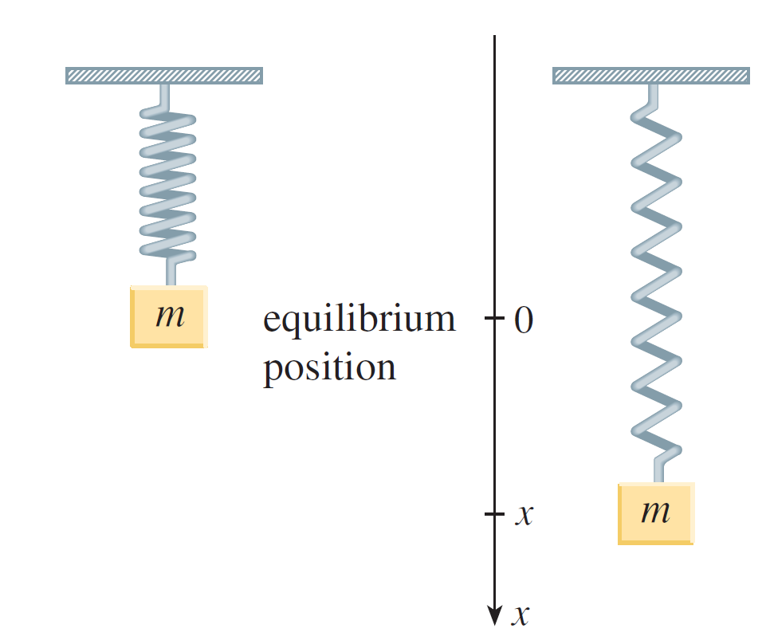
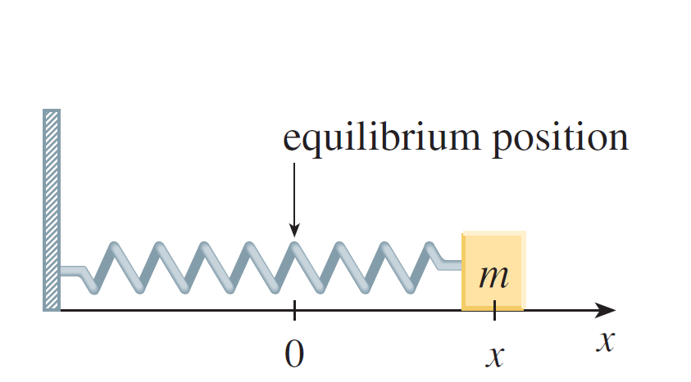
Vibrating Springs
We consider the motion of an object with mass m at the end of a spring that is either vertical (as in Figure 1) or horizontal on a level surface (as in Figure 2).
Figure 1
Figure 2

Slide 6
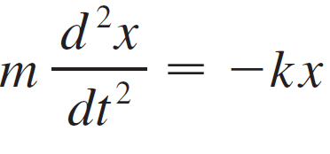
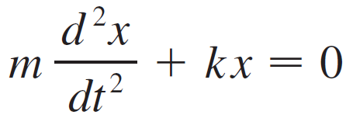

Vibrating Springs
The Hooke’s Law, says that if the spring is stretched (or compressed) x units from its natural length, then it exerts a force that is proportional to x:
restoring force = –kx
where k is a positive constant (called the spring constant). If we ignore any external resisting forces (due to air resistance or friction) then, by Newton’s Second Law (force equals mass times acceleration), we have
or

Slide 7



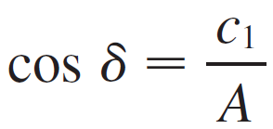
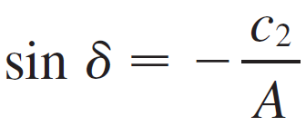
Vibrating Springs
This is a second-order linear differential equation. Its auxiliary equation is mr² + k = 0 with roots r = ±ωi, where Thus the general solution is
x (t) = c₁ cos ωt + c₂ sin ωt
which can also be written as
x (t) = A cost(ωt + δ)
where
This type of motion is called simple harmonic motion.
(frequency)
(amplitude)
(δ is the phase angle)

Slide 8
Example 1
A spring with a mass of 2 kg has natural length 0.5 m.
A force of 25.6 N is required to maintain it stretched to a length of 0.7 m. If the spring is stretched to a length of
0.7 m and then released with initial velocity 0, find the position of the mass at any time t.
Solution:
From Hooke’s Law, the force required to stretch the spring is
k (0.2) = 25.6
so k = 25.6/0.2 = 128.

Slide 9
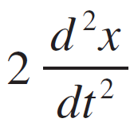

Example 1 – Solution
cont’d
Using this value of the spring constant k, together with
m = 2 in Equation 1, we have
+ 128x = 0
As in the earlier general discussion, the solution of this equation is
x (t) = c₁ cos 8t + c₂ sin 8t
We are given the initial condition that x (0) = 0.2. But, from Equation 2, x (0) = c₁.

Slide 10
Example 1 – Solution
cont’d
Therefore c₁ = 0.2. Differentiating Equation 2, we get
x′ (t) = –8c₁ sin 8t + 8c₂ cos 8t
Since the initial velocity is given as x′(0) = 0, we have
c₂ = 0 and so the solution is
x (t) = cos 8t

Slide 11
Damped Vibrations

Slide 12
Damped Vibrations
We next consider the motion of a spring that is subject to a frictional force (in the case of the horizontal spring or a damping force (in the case where a vertical spring moves through a fluid.
An example is the damping force supplied by a shock absorber in a car or a bicycle.
We assume that the damping force is proportional to the velocity of the mass and acts in the direction opposite to the motion. (This has been confirmed, at least approximately, by some physical experiments.)

Slide 13

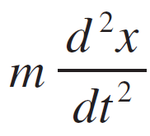
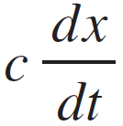
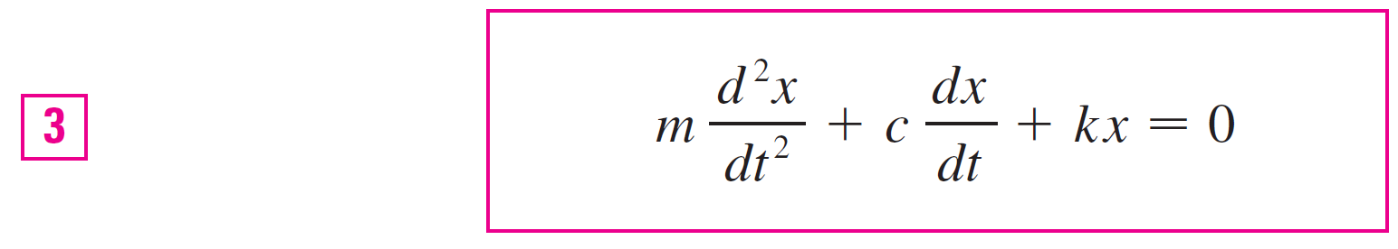
Damped Vibrations
Thus
damping force = –c
where c is a positive constant, called the damping
constant. Thus, in this case, Newton’s Second Law gives
= restoring force + damping force = –kx –
or

Slide 14
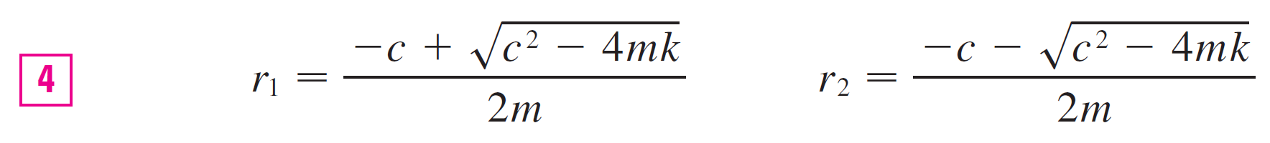

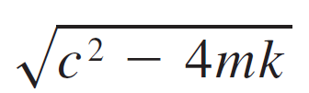

Damped Vibrations
Equation 3 is a second-order linear differential equation and its auxiliary equation is mr² + cr + k = 0. The roots are
Case I: c² – 4mk > 0 (overdamping)
In this case r₁ and r₂ are distinct real roots and
Since c, m, and k are all positive, we have < c, so the roots r₁ and r₂ given by Equations 4 must both be negative. This shows that x → 0 as t → .

Slide 15
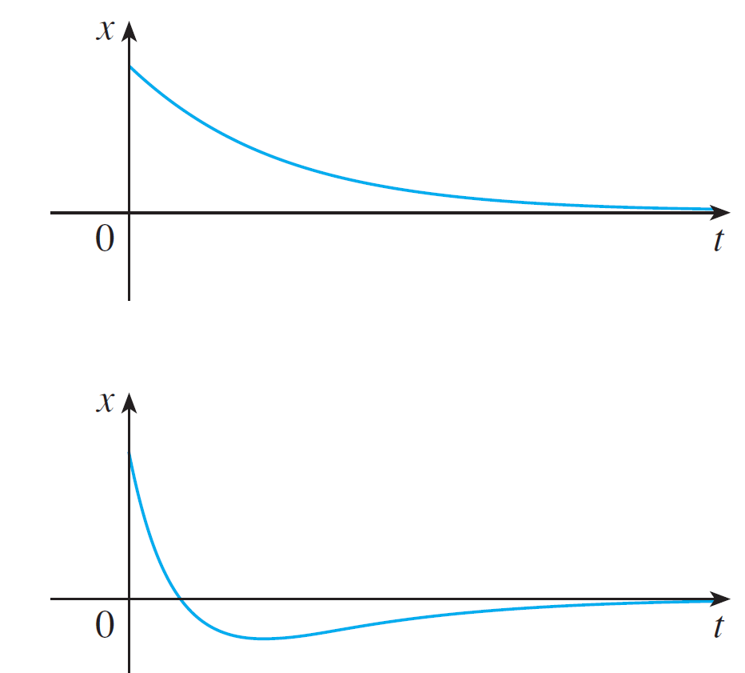
Damped Vibrations
Typical graphs of x as a function of t are shown in Figure 4. Notice that oscillations do not occur. (It’s possible for the mass to pass through the equilibrium position once, but only once.)
Overdamping
Figure 4

Slide 16
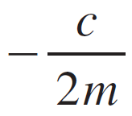
Damped Vibrations
This is because c² > 4mk means that there is a strong damping force (high-viscosity oil or grease) compared with a weak spring or small mass.
Case II: c² – 4mk = 0 (critical damping)
This case corresponds to equal roots
r₁ = r₂ =
and the solution is given by
x = (c₁ + c₂t)e^{–(c/2m)t}

Slide 17
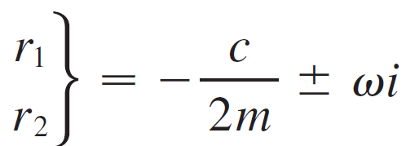
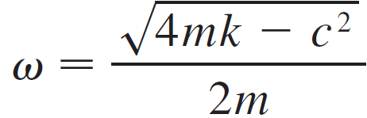
Damped Vibrations
It is similar to Case I, and typical graphs resemble those in Figure 4, but the damping is just sufficient to suppress vibrations. Any decrease in the viscosity of the fluid leads to the vibrations of the following case.
Case III: c² – 4mk < 0 (underdamping)
Here the roots are complex:
where

Slide 18
Damped Vibrations
The solution is given by
x = e^{– (c/2m)t}(c₁ cos ωt + c₂ sin ωt)
We see that there are oscillations that are damped by the factor e^{– (c/2m)t}. Since c > 0 and m > 0, we have –(c/2m) < 0 so e^{– (c/2m)t} → 0 as t → .

Slide 19
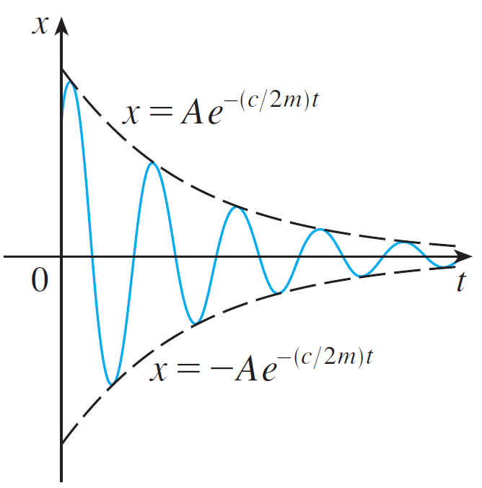
Damped Vibrations
This implies that x → 0 as t → ; that is, the motion decays to 0 as time increases. A typical graph is shown in Figure 5.
Underdamping
Figure 5

Slide 20
Forced Vibrations

Slide 21
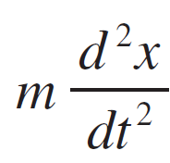


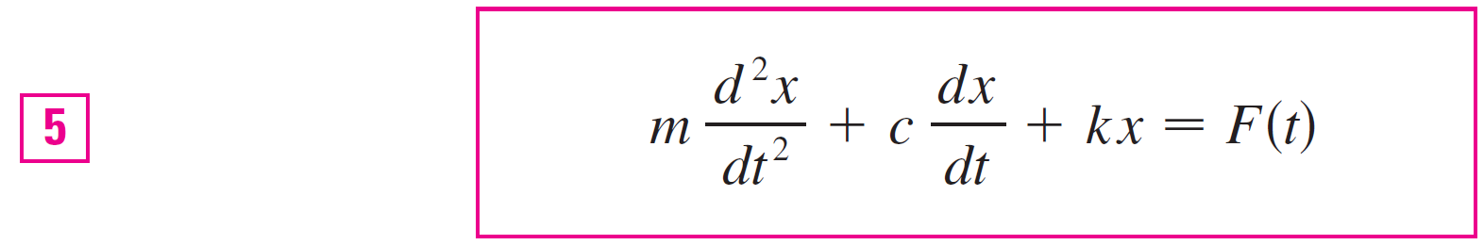
Forced Vibrations
Suppose that, in addition to the restoring force and the damping force, the motion of the spring is affected by an external force F(t). Then Newton’s Second Law gives
= restoring force + damping force + external force
= –kx – c + F (t)
Thus, instead of the homogeneous equation , the motion of the spring is now governed by the following nonhomogeneous differential equation:

Slide 22

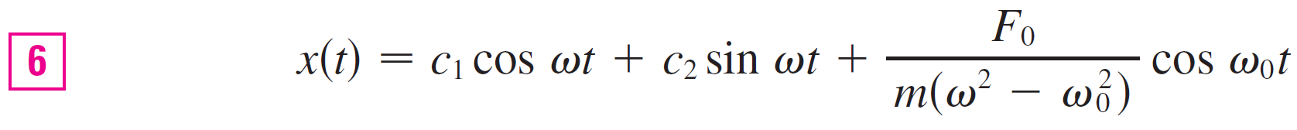
Forced Vibrations
A commonly occurring type of external force is a periodic force function
F(t) = F₀ cos ω₀t where ω₀ ≠ ω =
In this case, and in the absence of a damping force (c = 0), you are asked to use the method of undetermined coefficients to show that
If ω₀ = ω, then the applied frequency reinforces the natural frequency and the result is vibrations of large amplitude. This is the phenomenon of resonance.

Slide 23
Electric Circuits

Slide 24
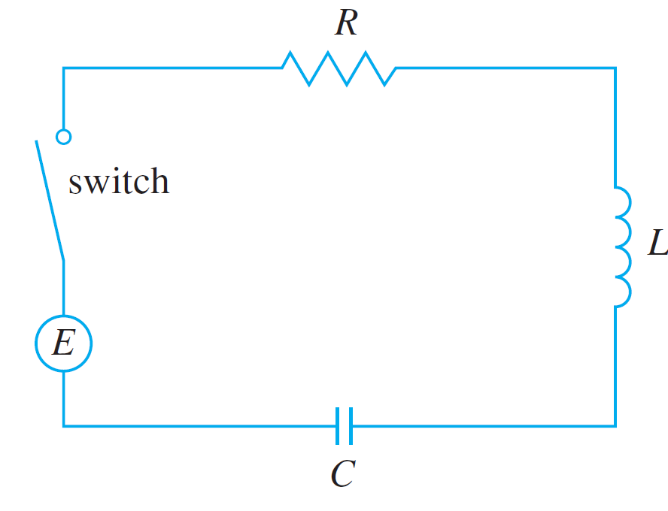
Electric Circuits
Earlier we have seen how to use first-order separable and linear equations to analyze electric circuits that contain a resistor and inductor or a resistor and capacitor. Now that we know how to solve second-order linear equations, we are in a position to analyze the circuit shown in Figure 7.
Figure 7

Slide 25
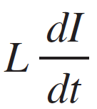


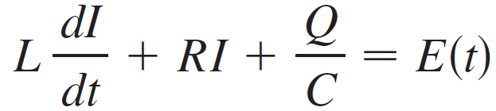
Electric Circuits
It contains an electromotive force E (supplied by a battery or generator), a resistor R, an inductor L, and a capacitor C, in series. If the charge on the capacitor at time t is
Q = Q(t), then the current is the rate of change of Q with respect to t: I = dQ/dt. It is known from physics that the voltage drops across the resistor, inductor, and capacitor are
respectively. Kirchhoff’s voltage law says that the sum of these voltage drops is equal to the supplied voltage:

Slide 26
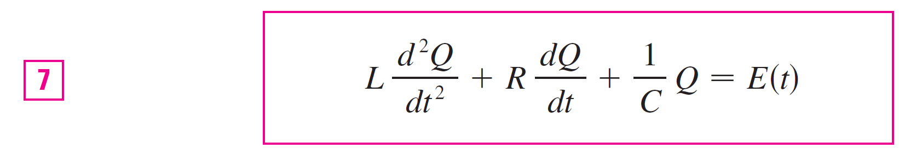
Electric Circuits
Since I = dQ/dt, this equation becomes
which is a second-order linear differential equation with constant coefficients. If the charge Q₀ and the current I₀ are known at time 0, then we have the initial conditions
Q (0) = Q₀ Q′(0) = I (0) = I₀

Slide 27
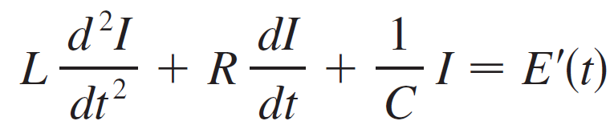
Electric Circuits
A differential equation for the current can be obtained by differentiating Equation 7 with respect to t and remembering that I = dQ/dt:

Slide 28
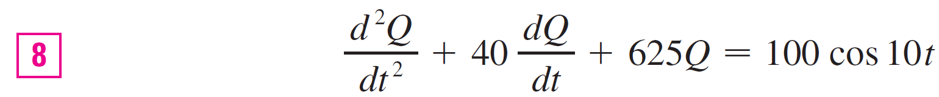
Example 3
Find the charge and current at time t in the circuit of
Figure 7 if R = 40 Ω, L = 1H, C = 16 × 10^{–4} F,
E (t) = 100 cos 10t, and the initial charge and current are both 0.
Solution:
With the given values of L, R, C, and E (t), Equation 7becomes

Slide 29
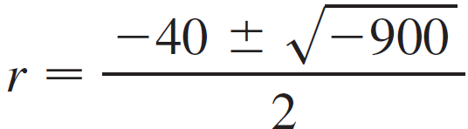
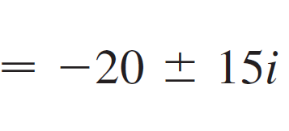
Example 3 – Solution
cont’d
The auxiliary equation is r² + 40r + 625 = 0 with roots
so the solution of the complementary equation is
Q_{c}(t) = e^{–20t}(c₁ cos 15t + c₂ sin 15t)
For the method of undetermined coefficients we try the particular solution
Q_{p}(t) = A cos 10t + B sin 10t

Slide 30


Example 3 – Solution
cont’d
Then
= –10A sin 10t + 10B cos 10t
= –100A cos 10t – 100B sin 10t
Substituting into Equation 8, we have
(–100A cos 10t – 100B sin 10t) + 40(–10A sin 10t
+10B cos 10t) + 625(A cos 10t + B sin 10t) = 100 cos 10t
or
(525A + 400B) cos 10t + (–400A + 525B) sin 10t = 100 cos 10t

Slide 31
Example 3 – Solution
cont’d
Equating coefficients, we have
525A + 400B = 100 21A + 16B = 4
or
–400A + 525B = 0 –16A + 21B = 0

Slide 32
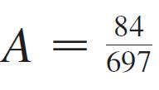



Example 3 – Solution
cont’d
The solution of this system is and , so a particular solution is
Q_{p} (t) = (84 cos 10t + 64 sin 10t)
and the general solution is
Q (t) = Q_{c} (t) + Q_{p} (t)
= e^{–20t}(c₁ cos 15t + c₂ sin 15t) + (21 cos 10t + 16 sin 10t)

Slide 33






Example 3 – Solution
cont’d
Imposing the initial condition Q (0) = 0, we get
Q(0) = c₁ + = 0 c₁ =
To impose the other initial condition, we first differentiate to find the current:
I = = e^{–20t} [(–20c₁ + 15c₂) cos 15t
+ (–15c₁ –20c₂) sin 15t]
+ (–21 sin 10t + 16 cos 10t)
I (0) = –20c₁ + 15c₂ + = 0 c₂ =

Slide 34

Example 3 – Solution
cont’d
Thus the formula for the charge is
and the expression for the current is
I (t) = [e^{–20t} (–1920 cos 15t + 13,060 sin 15t)
+ 120(–21 sin 10t + 16 cos 10t)]

Slide 35
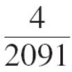

Electric Circuits
Note 1:
In Example 3 the solution for Q (t) consists of two parts. Since e^{–20t} 0 as and both and are bounded functions,
Q_{c} (t) = e^{–20t} (–63 cos 15t – 116 sin 15t) 0 as t
So, for large values of t,
Q (t) ≈ Q_{p} t = (21 cos 10t + 16 sin 10t)
and, for this reason, Q_{p} (t), is called the steady state solution.

Slide 36
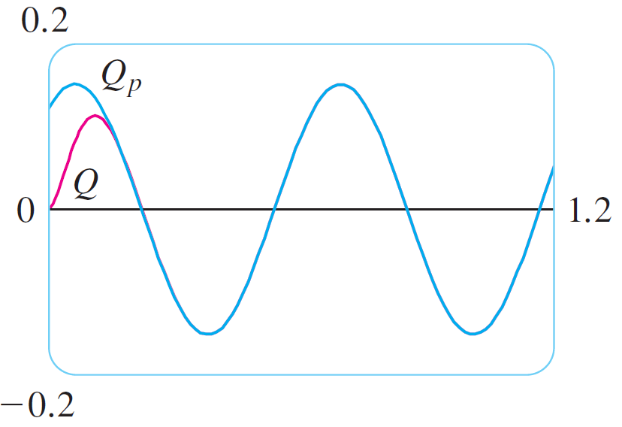
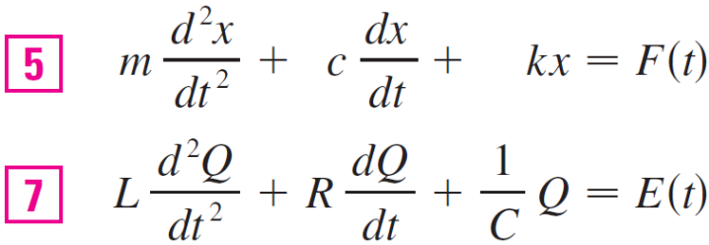
Electric Circuits
Figure 8 shows how the graph of the steady state solution compares with the graph of Q in this case.
Figure 8

Slide 37
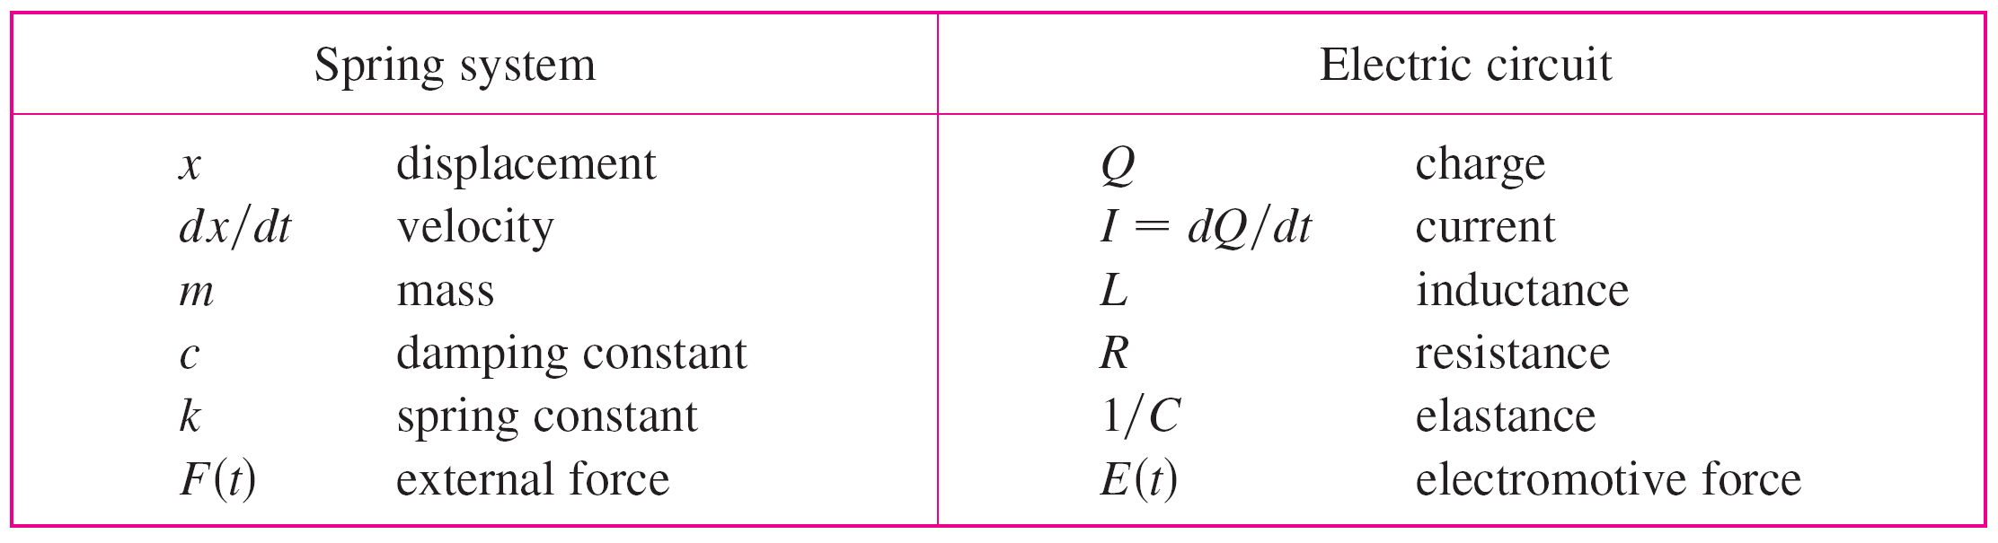
Electric Circuits
Note 2:
Comparing Equations 5 and 7, we see that mathematically they are identical. This suggests the analogies given in the following chart between physical situations that, at first glance, are very different.

