Slide 1


Second-Order Differential
Equations
17
Copyright © Cengage Learning. All rights reserved.

Slide 2

17.4
Series Solutions
Copyright © Cengage Learning. All rights reserved.

Slide 3

Series Solutions
Many differential equations can’t be solved explicitly in terms of finite combinations of simple familiar functions.
This is true even for a simple-looking equation like
y ″ – 2xy ′ + y = 0
But it is important to be able to solve equations such as Equation 1 because they arise from physical problems and, in particular, in connection with the Schrödinger equation in quantum mechanics.

Slide 4

Series Solutions
In such a case we use the method of power series; that is, we look for a solution of the form
y = f (x) = c_{n} x^{n} = c₀ + c₁ x + c₂ x² + c₃ x³ + . . .
The method is to substitute this expression into the differential equation and determine the values of the coefficients c₀, c₁, c₂, . . . . This technique resembles the method of undetermined coefficients.

Slide 5
Series Solutions
Before using power series to solve Equation 1, we illustrate the method on the simpler equation y ″ + y = 0 in Example1.
But it’s easier to understand the power series method when it is applied to this simpler equation.

Slide 6
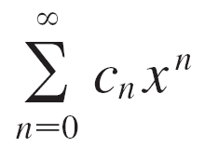


Example 1
Use power series to solve the equation y ″ + y = 0.
Solution:
We assume there is a solution of the form
y = c₀ + c₁ x + c₂ x² + c₃ x³ + . . . =
We can differentiate power series term by term, so
y ′ = c₁ + 2c₂ x + 3c₃ x² + . . . = nc_{n} x^{n – 1}

Slide 7




Example 1 – Solution
cont’d
y ″ = 2c₂ + 2  3c₃x + . . . = n(n – 1)c_{n}x^{n – 2}
In order to compare the expressions for y and y ″ more easily, we rewrite y ″ as follows:
y ″ = (n + 2)(n + 1)c_{n + 2}x^{n}
Substituting the expressions in Equations 2 and 4 into the differential equation, we obtain
(n + 2)(n + 1)c_{n + 2}x^{n} + c_{n}x^{n} = 0

Slide 8

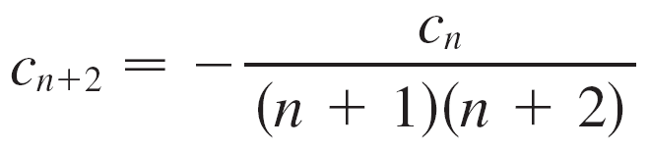

Example 1 – Solution
cont’d
or
[(n + 2)(n + 1)c_{n + 2} + c_{n}]x^{n} = 0
If two power series are equal, then the corresponding coefficients must be equal. Therefore the coefficients of x^{n}
in Equation 5 must be 0:
(n + 2)(n + 1)c_{n + 2} + c_{n} = 0
n = 0, 1, 2, 3, . . .

Slide 9
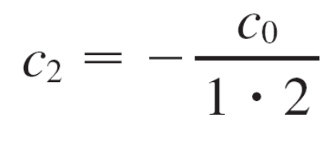
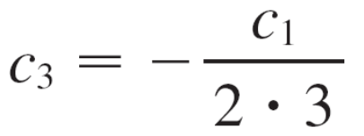
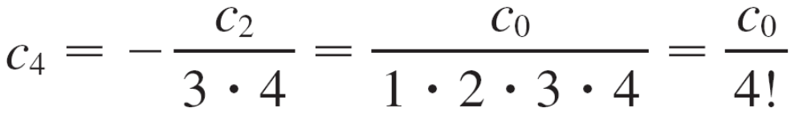
Example 1 – Solution
cont’d
Equation 6 is called a recursion relation. If c₀ and c₁ are known, this equation allows us to determine the remaining coefficients recursively by putting n = 0, 1, 2, 3, . . . in
succession.
Put n = 0:
Put n = 1:
Put n = 2:

Slide 10
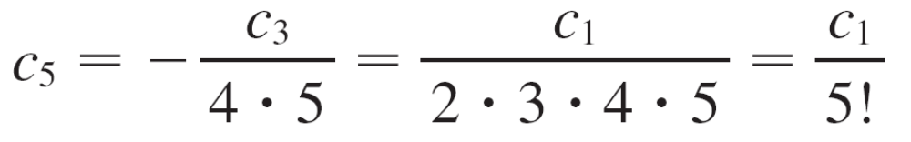
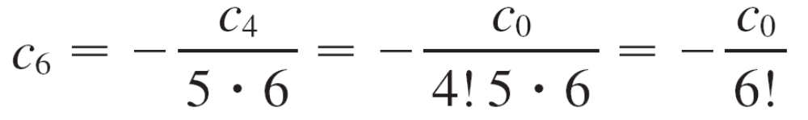
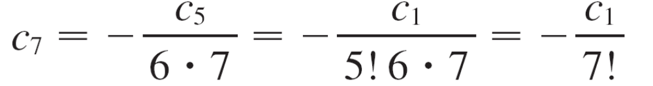
Example 1 – Solution
cont’d
Put n = 3:
Put n = 4:
Put n = 5:

Slide 11
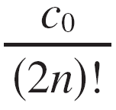
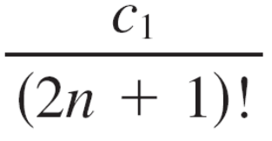
Example 1 – Solution
cont’d
By now we see the pattern:
For the even coefficients, c_{2n} = (–1)^{n}
For the odd coefficients, c_{2n+1} = (–1)^{n}
Putting these values back into Equation 2, we write the solution as
y = c₀ + c₁ x + c₂ x² + c₃ x³ + c₄ x⁴ + c₅ x⁵ + . . .

Slide 12
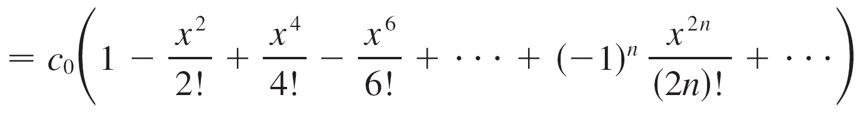
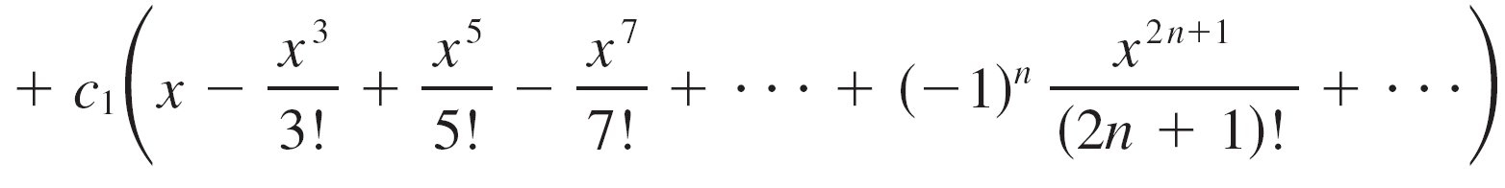
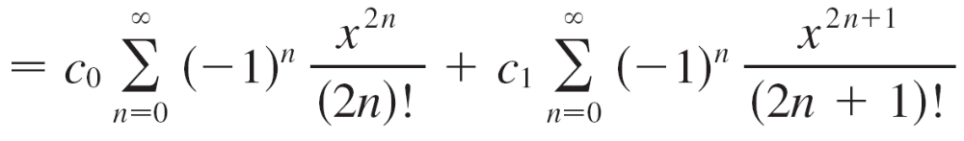
Example 1 – Solution
cont’d
Notice that there are two arbitrary constants, c₀ and c₁.

Slide 13
Series Solutions
Note 1:
We recognize the series obtained in Example 1 as being the Maclaurin series for cos x and sin x. Therefore we could write the solution as
y (x) = c₀ cos x + c₁ sin x
But we are not usually able to express power series solutions of differential equations in terms of known functions.

Slide 14
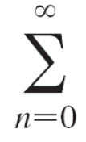


Example 2
Solve y ″ – 2xy ′ + y = 0.
Solution:
We assume there is a solution of the form
y = c_{n}x^{n}
Then
y ′ = nc_{n}x^{n –1}
and
y ″ = n(n – 1)c_{n} x^{n – 2} = (n + 2)(n + 1)c_{n + 2}x^{n}
as in Example 1.

Slide 15
Example 2 – Solution
cont’d
Substituting in the differential equation, we get
(n + 2)(n + 1)c_{n + 2}x^{n} – 2x nc_{n}x^{n – 1} + c_{n}x^{n} = 0
(n + 2)(n + 1)c_{n + 2}x^{n} – 2nc_{n}x^{n} + c_{n}x^{n} = 0
[(n + 2)(n + 1)c_{n + 2} – (2n – 1)c_{n}]x^{n} = 0

Slide 16
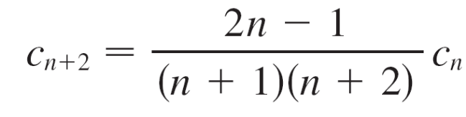

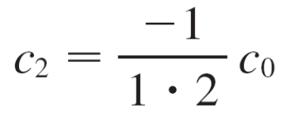
Example 2 – Solution
cont’d
This equation is true if the coefficient of x^{n} is 0:
(n + 2)(n + 1)c_{n + 2} – (2n – 1)c_{n} = 0
n = 0, 1, 2, 3, . . .
We solve this recursion relation by putting n = 0, 1, 2, 3, . . .
successively in Equation 7:
Put n = 0:

Slide 17
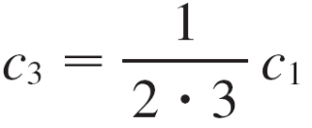
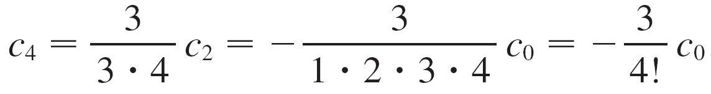
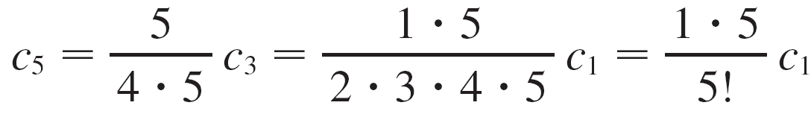
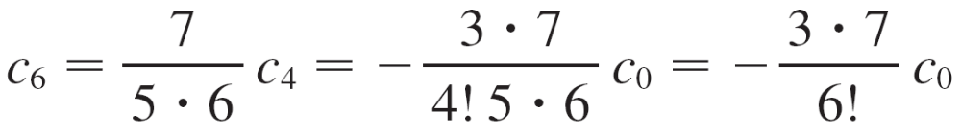
Example 2 – Solution
cont’d
Put n = 1:
Put n = 2:
Put n = 3:
Put n = 4:

Slide 18
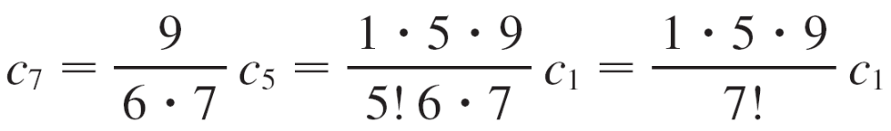
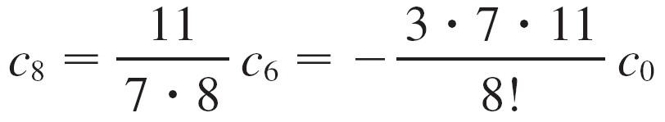
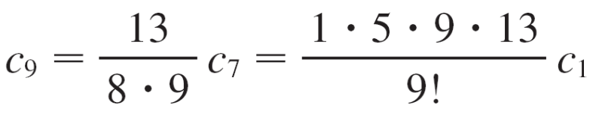
Example 2 – Solution
cont’d
Put n = 5:
Put n = 6:
Put n = 7:

Slide 19
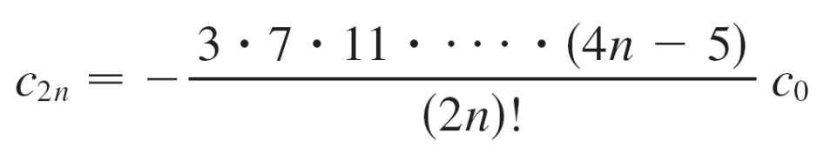
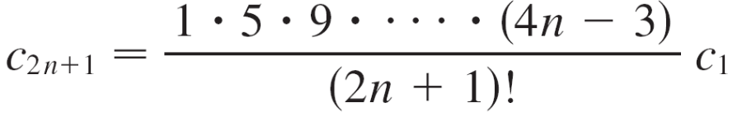
Example 2 – Solution
cont’d
In general, the even coefficients are given by
and the odd coefficients are given by
The solution is
y = c₀ + c₁ x + c₂ x² + c₃ x³ + c₄ x⁴ + . . .

Slide 20
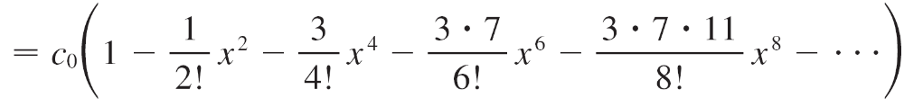
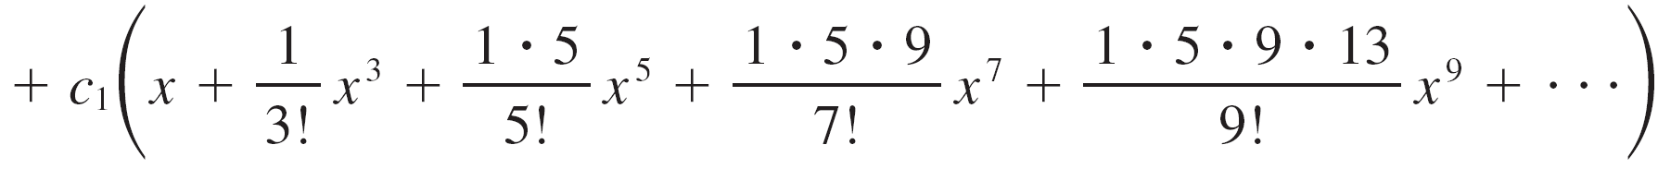
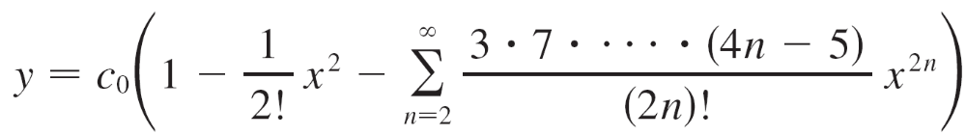

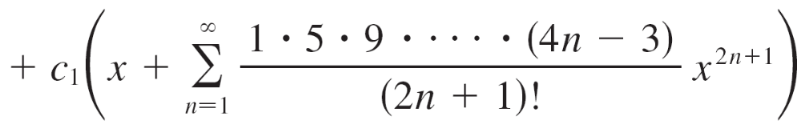
Example 2 – Solution
cont’d
or

Slide 21
Series Solutions
Note 2:
In Example 2 we had to assume that the differential equation had a series solution. But now we could verify directly that the function given by Equation 8 is indeed a solution.
Note 3:
Unlike the situation of Example 1, the power series that arise in the solution of Example 2 do not define elementary functions.

Slide 22
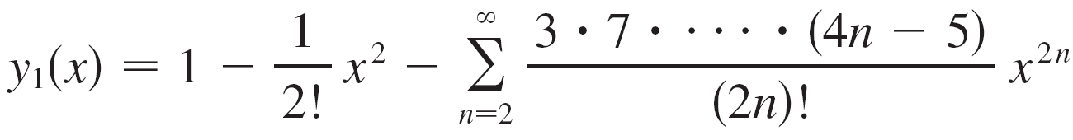
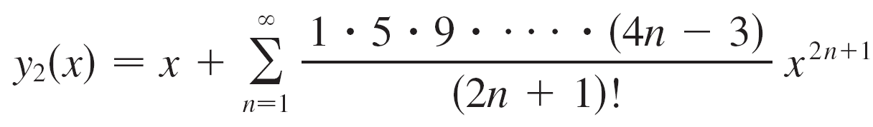
Series Solutions
The functions
and
are perfectly good functions but they can’t be expressed in terms of familiar functions.
We can use these power series expressions for y₁ and y₂ to compute approximate values of the functions and even to graph them.

Slide 23
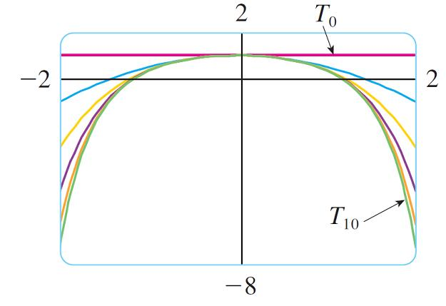
Series Solutions
Figure 1 shows the first few partial sums T₀, T₂, T₄, . . . (Taylor polynomials) for y₁ (x), and we see how they converge to y₁.
Figure 1

Slide 24
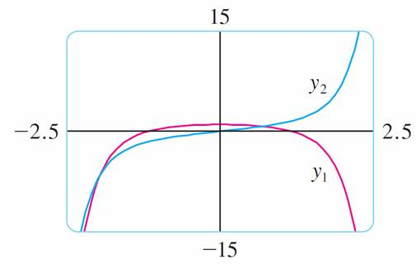
Series Solutions
In this way we can graph both y₁ and y₂ in Figure 2.
Note 4:
If we were asked to solve the initial-value problem
y ″ – 2xy ′ + y = 0 y (0) = 1 y ′(0) = 1
Figure 2

Slide 25
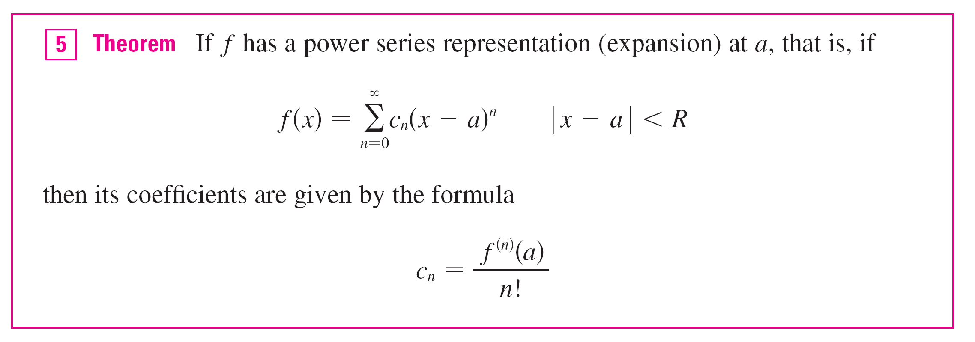
Series Solutions
we would observe from this Theorem that
c₀ = y (0) = 0 c₁ = y ′ (0) = 1

Slide 26
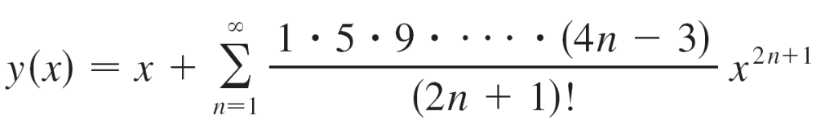
Series Solutions
This would simplify the calculations in Example 2, since all of the even coefficients would be 0. The solution to the initial-value problem is

