Slide 1
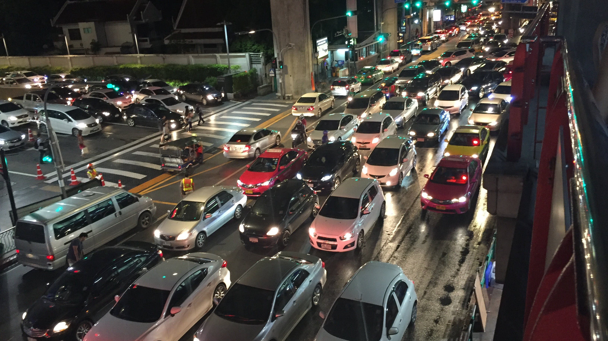
VERDI
Rewarding lower-impact choices
Shayaan Haq and Alexander Lu
Notes:
VC product update, November 2026. Original photograph and founder names retained from the supplied presentation. Working demo uses synthetic accounts. No customer or revenue traction is asserted.

Slide 2
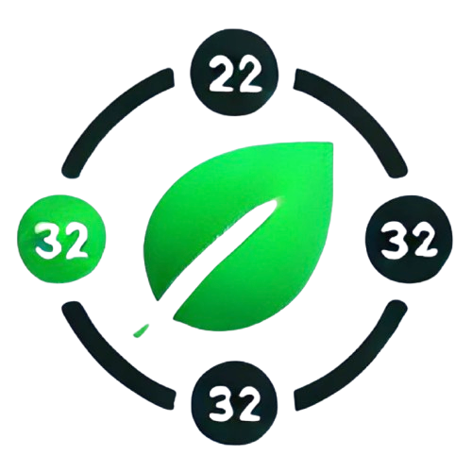
Verdi
For people
Connected activity, personal guidance and rewards for supported reductions.
For program owners
Consent-based analytics to understand participation and emission sources.
For distribution partners
A sustainability experience designed for banks, employers and campuses.
VERDI
02
Notes:
Business direction follows DECA Verdi Unofficial.pdf sections III–VII. Bank, employer and campus partnerships are target distribution paths, not signed contracts.

Slide 3
The problem
Activity data arrives in fragments
A payment, meter reading and journey can describe overlapping parts of the same behavior.
People need a reason to keep participating
A useful action and a tangible reward can make feedback worth returning to.
Institutions need evidence they can act on
Program teams need coverage and source breakdowns, with participant control over sharing.
VERDI
03
Notes:
Problem hypotheses from supplied business plan. Product framing, not a quantified market study. Customer discovery and retention evidence remain to be collected.

Slide 4
Initial customers and distribution
Initial users: people in a defined program
Commuting and home-energy activity provide a focused first use case.
Initial buyer hypothesis: campuses and employers
Evaluate a sustainability incentive program with consented participant analytics.
Expansion: financial institutions
Bank distribution and optional round-ups follow provider integration and pilot evidence.
VERDI
04
Notes:
Proposed go-to-market sequence. No paid pilots or partnerships are evidenced by the capsule or repository. Government and policy analytics remain a later segment from the original business plan.

Slide 5
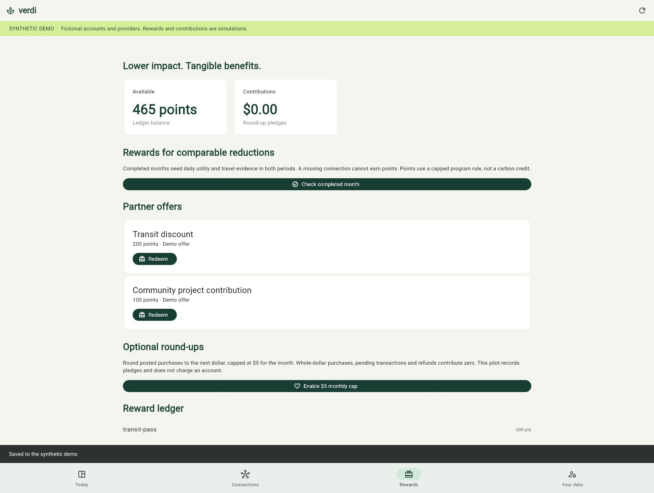
The incentive experience
A reward ledger connects comparable activity coverage to a concrete program benefit.
Completed periods require comparable evidence. Missing records earn no reduction reward. Round-ups stay optional and capped.
Working synthetic demo. Offers and contributions are simulated.
VERDI
05
Notes:
Screenshot from browser-verified product. Demo earned 665 points from a 66.58 kg estimated monthly reduction and redeemed 200 points. Points are a capped program rule, not tradable carbon credits. No funds move, discounts are not delivered, and no tax deduction is promised.

Slide 6
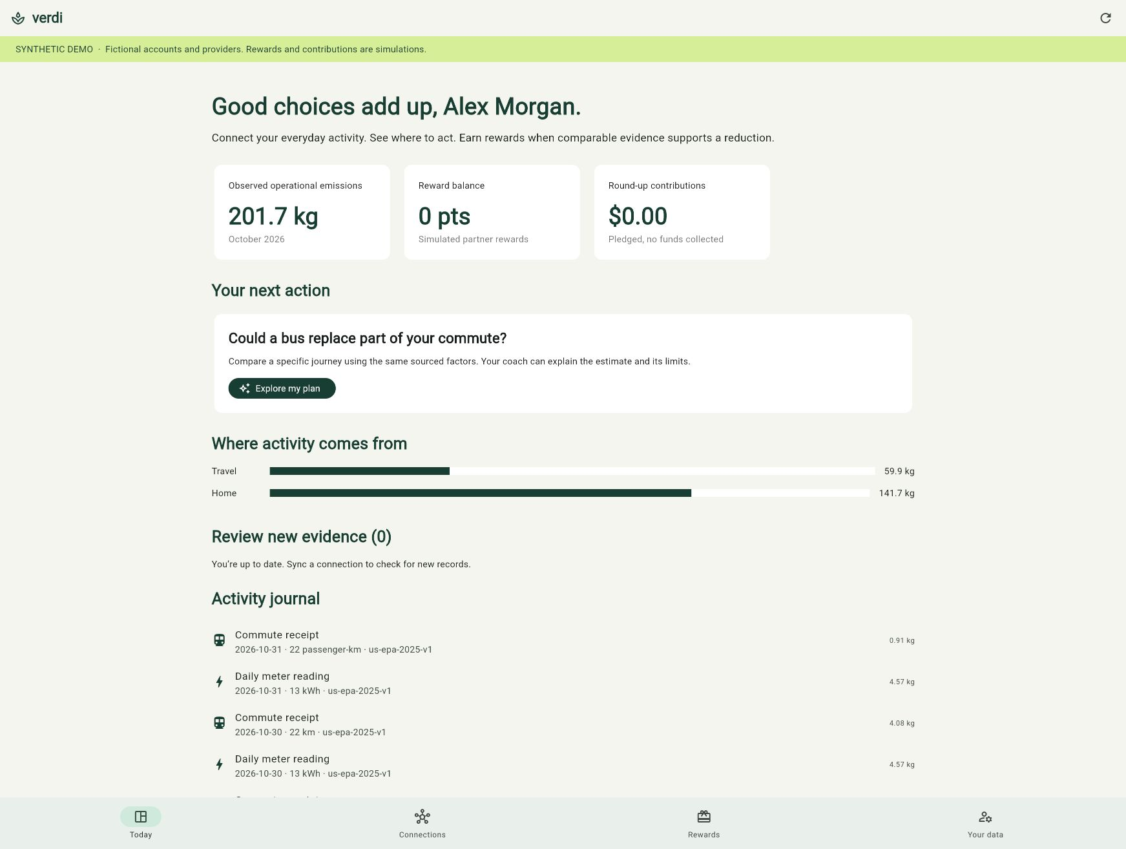
The consumer app
Everyday activity becomes an explainable next action
Review new evidence. Compare a specific journey. Manage connections and sharing. Track rewards in a durable ledger.
Flutter for web, Android and iOS. Synthetic demo shown.
VERDI
06
Notes:
Consumer lib/main.dart, synthetic lib/main_demo.dart, shared lib/product/platform_app.dart and backend/platform.py. Screenshot captures actual database-backed UI. A Flutter web release and tests verify browser implementation. Mobile targets require separate build/device validation.

Slide 7
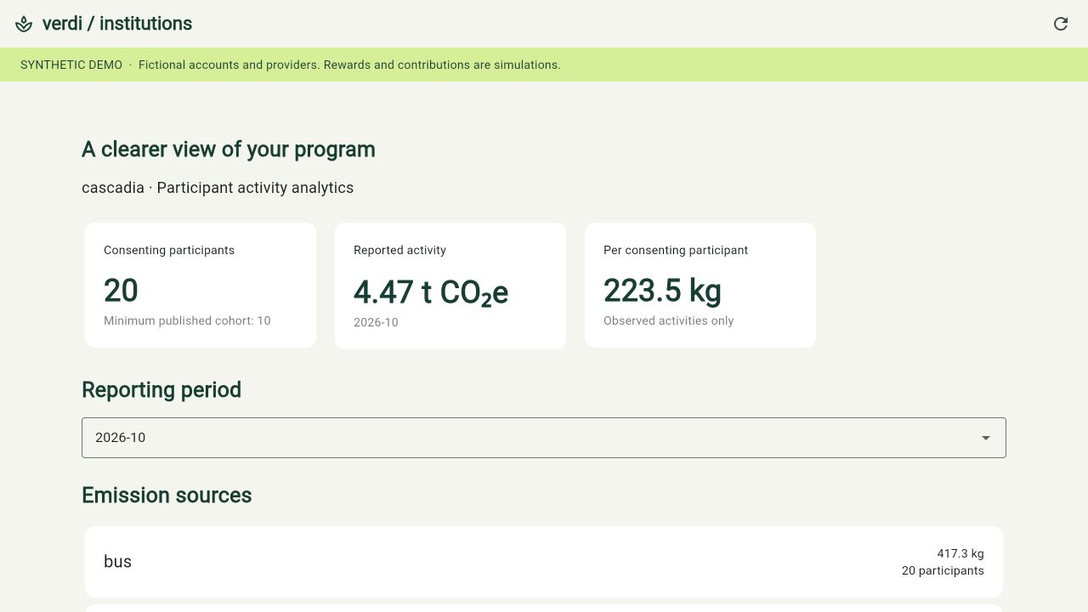
The institution app
Reports use the same underlying activity database
Compare reporting periods and activity sources. Include only consenting participants. Suppress cohorts below 10.
Synthetic program: 20 consenting participants. No real customer data.
VERDI
07
Notes:
Institution lib/main_institution.dart and synthetic counterpart. Fixed SQLite aggregates, scoped to authenticated analyst organization. Cohort thresholds are a basic safeguard, not differential privacy. Reports cover participant activity and are not a complete audited corporate GHG inventory.

Slide 8
Revenue model
Subscriptions
Institutional program access and optional consumer premium features.
Sponsored rewards
Brands fund offers under a transparent program budget.
Consulting and reporting
Program setup, interpretation and institution-specific analysis.
Contribution and offset services
Potential service fees require payment and verified project partners.
VERDI
08
Notes:
Preserves four revenue pathways in supplied plan. All are business hypotheses. No revenue, pricing, customer counts or signed reward/offset partnerships are verified. Contributions and gross payment volume must not be presented as Verdi revenue.

Slide 9
Product readiness
Built and demonstrated
Flutter consumer and institution interfaces, SQLite persistence, review workflow, consent and reward ledger.
Implemented, awaiting live validation
Ollama coach integration with calculated guidance fallback. National operational factor coverage.
Next external dependencies
Provider authorization, payment and reward fulfillment partners, mobile field testing and a consented pilot.
VERDI
09
Notes:
Local product branch from capsule-91fc43f9d941 / base 8b3ddbf. Live banking/utility OAuth and mobile device validation are incomplete. AI uses computed facts, never determines factors or issues points. A successful credentialed call is required before claiming live AI validation.

Slide 10
Pilot metrics
Consumer usefulness
Connection activation, review completion and return usage.
Evidence quality
Coverage days, duplicate rate, source conflicts and correction rate.
Program economics
Reward cost per retained participant and willingness to pay.
Reduction evidence
Comparable period estimates, with a separate study of causal impact.
VERDI
10
Notes:
Proposed measurements, not achieved traction. Synthetic participants, simulated points and demo emissions are excluded from user, revenue and environmental impact claims.

Slide 11
What can become defensible
A useful incentive loop built on traceable evidence
Data reconciliation and provenance
Resolve duplicate evidence while preserving calculations and their boundaries.
Partner distribution and reward economics
Build repeatable adoption through programs that benefit users and buyers.
A growing evidence base
Validate data quality and engagement with real pilots over time.
VERDI
11
Notes:
Prospective advantages, not proven moats. Original claims of first-to-market status, patents, exclusivity contracts and superior accuracy are removed because no supporting evidence was supplied.

Slide 12
Proposed financing
$600,000
Original proposal: 20% equity, implying a $3 million post-money valuation
Fund the next evidence milestones
Provider integrations and device validation
A consented pilot with funded rewards
Pricing, retention and program economics
VERDI
12
Notes:
Amount and equity retained as original business-plan proposal, not newly approved terms. No guaranteed investor repayments/returns. Original tables contain inconsistent costs, dates and loan/equity wording, omitted pending a rebuilt operating model. No budget allocations or runway assertions.

Slide 13
Verdi
A product you can walk through
Consumer activity, incentives and institutional insight share one working foundation.
The next proof is a real pilot.
VERDI
13
Notes:
Show local synthetic consumer/institution demo. Old GitHub Pages deployment does not yet contain this update. Walkthrough: sync, review, reward claim, simulated redemption, consent change, institution report. Public release remains a separate deployment step.

