Slide 1
Pyrate!
(noun) an archaic spelling of “pirate”

Slide 2
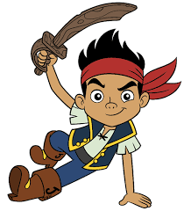
What is a roguelike?
Subgenre of role-playing video games
Dungeon crawl
Procedurally-generated levels
Turn-based play
Tile-based graphics
Permanent death

Slide 3

Rogue – the “original” roguelike
Not the first, but considered the forerunner
ASCII graphics
Inspired hundreds of games
Including modern games like…
Diablo (I, II, and III)
UnReal World

Slide 4
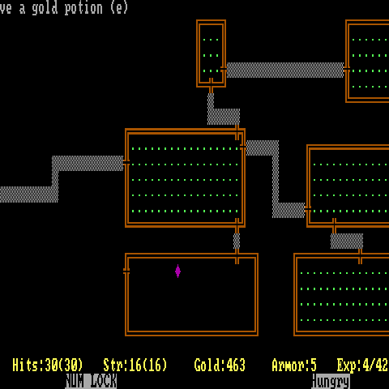
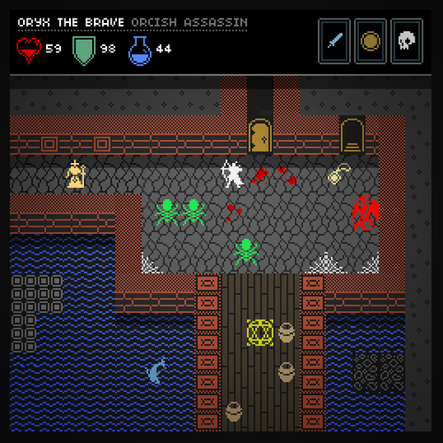
Evolution of roguelikes…

Slide 5
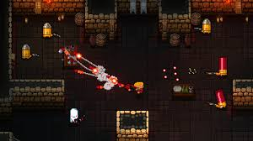
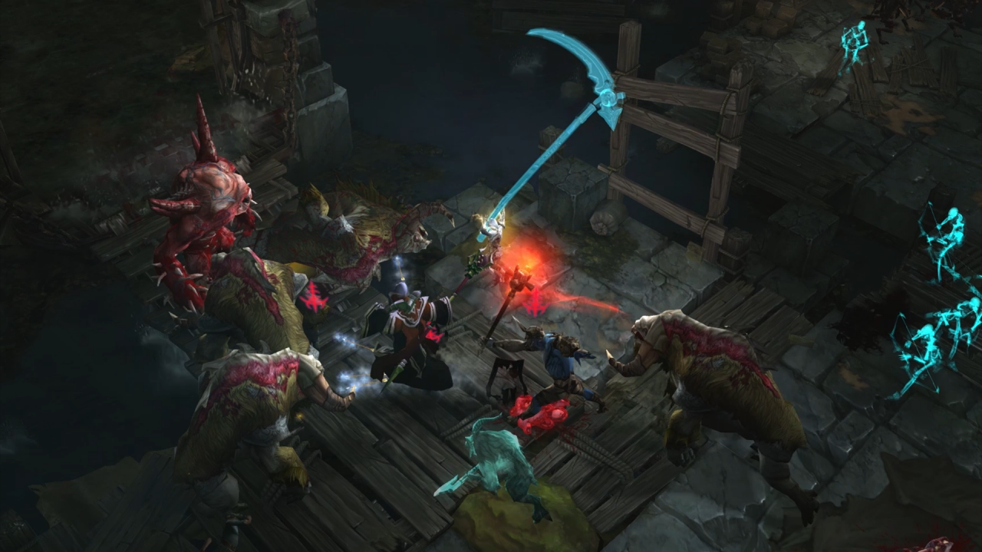
Evolution of roguelikes (part 2)…

Slide 6
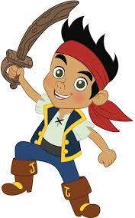
Goals and target audience
Create a classic, retro-style roguelike game
Python GUI
Animated tiles and sprites
Gamers – roguelike enthusiasts
Numerous examples in the Google Play Store

Slide 7
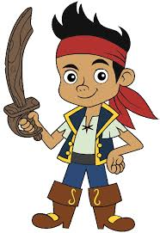
Development
GUI
Tiles (graphics)
AI
Line-of-sight visibility
Level generation
Limited scope initially
Turn-based (twitch gamers need not apply)

Slide 8

Investors
Solo project
$50.⁰⁰ per hour x 90 hours = $450.⁰⁰
Graphics assets
$500.⁰⁰
Total: $950.⁰⁰
Advertising revenues / Ad-free premium cost (99 cents)
100k to 1M downloads

