Slide 1
Knowball
Knowball is sports trivia with a twist. It will be powered by our “obscurity engine,” which considers an athlete’s public presence – from their achievements on the field to their following off it. Given prompts, players will name athletes and be scored on their obscurity.

Slide 2
Roster
Ben Cimini (ciminibb)
Blair Bowen (bowenbv)
Stetson King (king3ss)
Will Hawkins PhD (hawkinwh)

Slide 3
Abstract
Knowball is the digital realization of a common game among friends. It will answer an interesting question: how can obscurity be defined computationally? That load is slated for our “obscurity engine,” a logical structure tuned to quantify an athlete’s obscurity given parameters about their achievements, social capital, and more. Players will enter athletes in our Vue.js front end and, if one isn’t cached in our SQL database, the engine will be run to produce an obscurity coefficient. Those coefficients, after being scaled to a score, will be pushed to daily leaderboards and back to the front end. We expect the engine to be a unique solution, and to agree with our human interpretation of obscurity; we expect Knowball, the game, to be playable online. The project, as described, employs our interest in sports to explore the capacity of deterministic computations to handle vagueness.

Slide 4
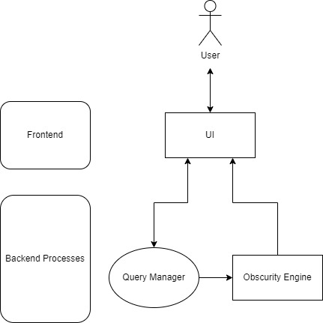
Basic components
Design: Level 1

Slide 5
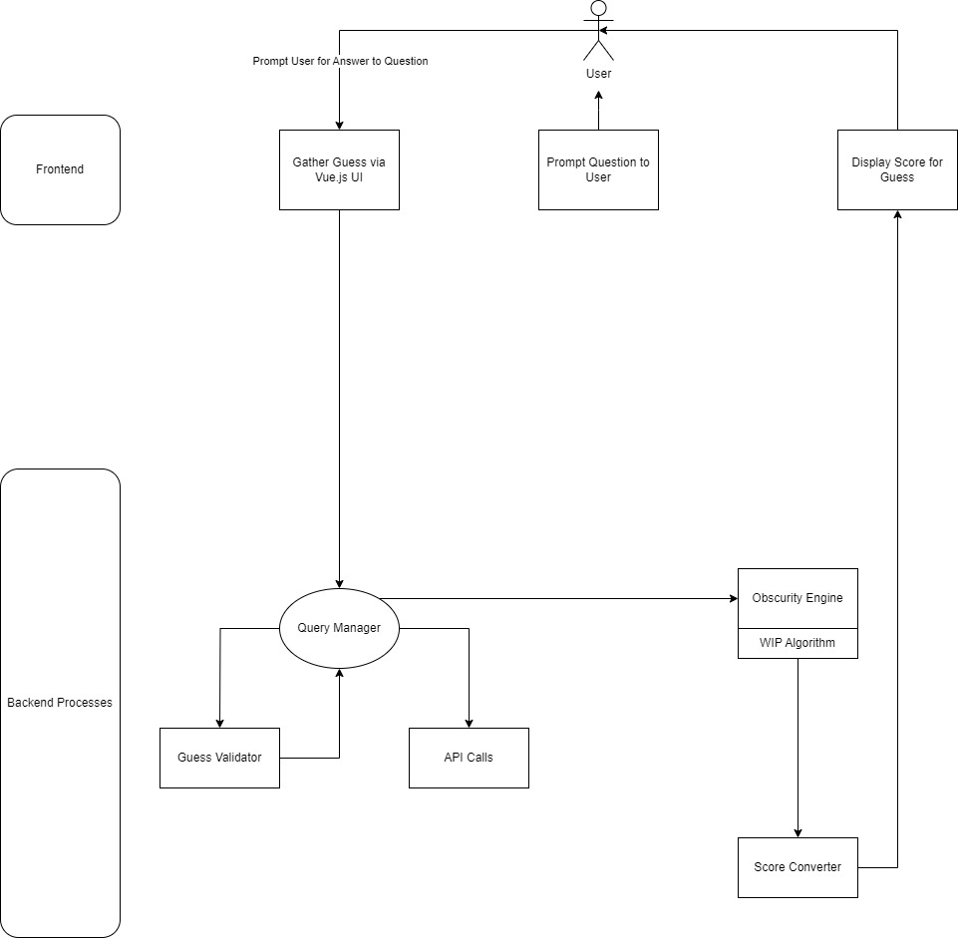
System topography
Design: Level 2

Slide 6
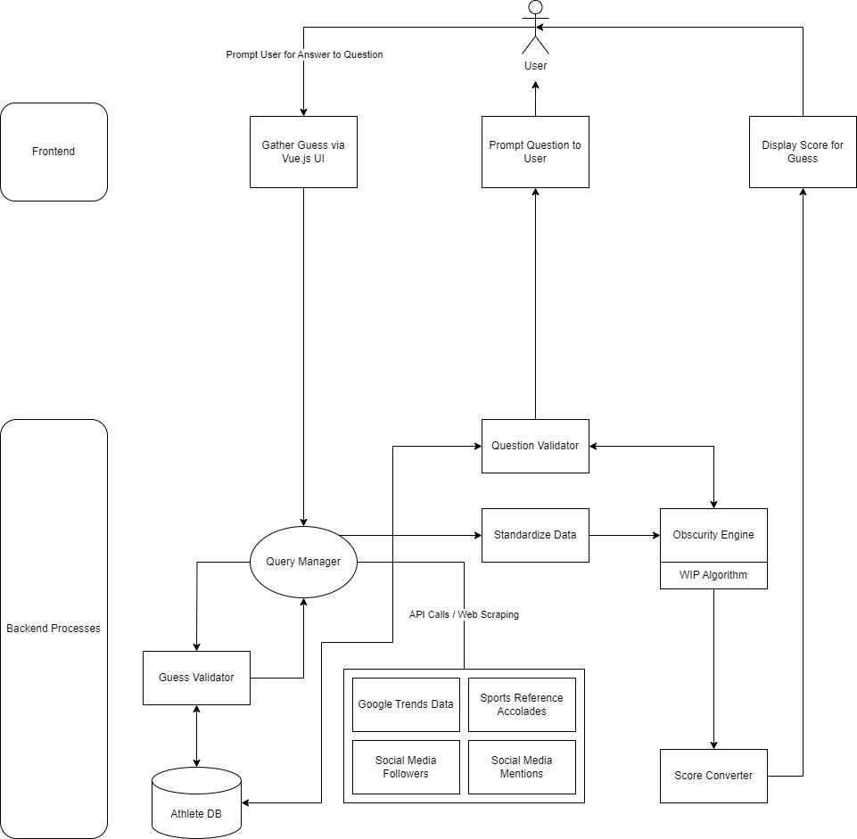
All components
Design: Level 3

Slide 7
Project Constraints
Data Availability
Variability
Economics
Legality

Slide 8
Data Availability
Description
To ensure we have an ample range of athletes that contains obscure athletes with names, stats, accomplishments, etc.
Challenge
Many databases have restrictions and/or limited access, especially for obscure athletes
Influence
May require reliance on open-source or paid databases
Limited or costly data could restrict the range of available athletes

Slide 9
Economics
Description
Subscription or licensing for data usage and server hosting could add significant costs to the project
Challenge
Managing server costs and data subscriptions within our limited personal limits
Influence
Need to find cost-effective or free solutions for data and hosting
Cost constraints may limit the scope of the project

Slide 10
Legality of Data Collection
Description
Web scraping can be an option to gather data, but we must ensure compliance with relevant laws and terms of service
Challenge
Unauthorized scraping could lead to legal issue or restricted use of the website
Influence
May force us to rely on licensed or paid sources
Legal concerns could limit how we obtain and use data

Slide 11
Sport Variability
Description
Accolades in different sports (e.g., MVP in football vs. basketball) may carry different significance affecting the obscurity of athletes
Challenge
Creating a fair weighting system that adjusts for differences across sports
Influence
Adds complexity to the algorithm in our Obscurity Engine
Requires the development of a weighting system across multiple sports

Slide 12
Current Status of Project
Our project is currently in the pre-planning phase, where we have focused primarily on high-level discussions about the overall vision and end goals of Knowball. We've been refining the key features, user experience, and technical requirements.
Additionally, we've placed a strong emphasis on setting up resources and tools for future project management, ensuring that we have the necessary systems in place for smoother development cycles. In preparation for the next phases, we have selected project management tools like GitHub Projects to help us adhere to the Agile Methodology, which will guide our progress through iterative sprints.
We’ve also worked on creating design diagrams to visualize the system architecture and workflow of Knowball. These diagrams, including system architecture and user flowcharts, help to ensure the team has a clear, consistent understanding of the project’s structure, helping us identify potential challenges and streamline development.

Slide 13
Expected Accomplishments
Moving forward, we plan to transition from this high-level planning stage into a more low-level planning phase. Before the semester ends, we want a full sprint of tickets as well as an adequate backlog of tickets that we can refine as we continue into the development process
We also want to do some preliminary research on the specific tooling required for this project so that we know the pros and cons to each option before the term end. This includes front-end frameworks, database systems, data collection methodologies, etc.
Also depending on the route we choose for data collection (web scraping), we may need to start the process this term, so it doesn’t become a blocker for us when we start developing the application in the spring

Slide 14
Division of Work
Ben
Refine system operations during gameplay
Research
Database frameworks
Hosting platforms
Sports statistic APIs
Design & create Athlete DB
Blair
Research
Front-end frameworks
Models for obscurity engine
Design UI
Develop front-end & connect to back-end
Determine features for obscurity engine
Stetson
Obscurity engine
Determine weights
Tune hyperparameters
Data preprocessing
Format output data (score)
Determine libraries and models to use for Obscurity engine

Slide 15
Expected Demo
Allow viewers to play Knowball
Fully functioning gameplay
Leaderboard of expo participants
Breakdown of the obscurity engine

