Slide 1
Knowball

Slide 2




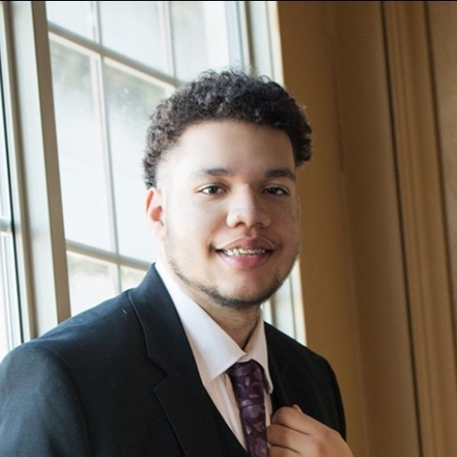

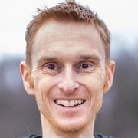
Team
Ben Cimini (ciminibb)
Blair Bowen (bowenbv)
Stetson King (king3ss)
Will Hawkins PhD (hawkinwh)

Slide 3
Background
We love sports. We’d all, at one time or another, sat around naming obscure athletes with friends. It’s a sneaky challenge that never seems to get old. So, we thought “Why not make it a computer game?” Writing a computational model for obscurity was intriguing and, of course, would show us who really knows ball :)

Slide 4
Goals
Develop an accurate model of obscurity.
Practice good data science in sourcing and leveraging our dataset.
Design and bring to life a smooth, engaging UI.
Produce a game that’s fun to play.

Slide 5
Merits
Knowball’s most interesting aspect is the use of AI to quantify obscurity. Today, AI is hardly novel. However, we ventured to test its efficacy for computing a vague, human concept. Sourcing the dataset needed to train it was a challenge, too. We derived a statistical picture of obscurity, pulled corresponding data from public sources, and then transferred it to our database with an automated pipeline. More details are provided throughout this presentation!

Slide 6
Impacts
Experimental offering to human-like computation.
Ethical use of AI.
Fun, shareable, low-commitment leisure activity!
Bringing a little joy back to frontend design.

Slide 7
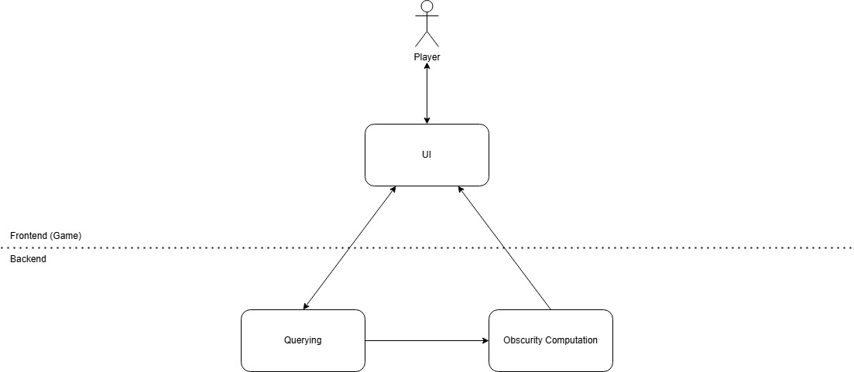
L1

Slide 8
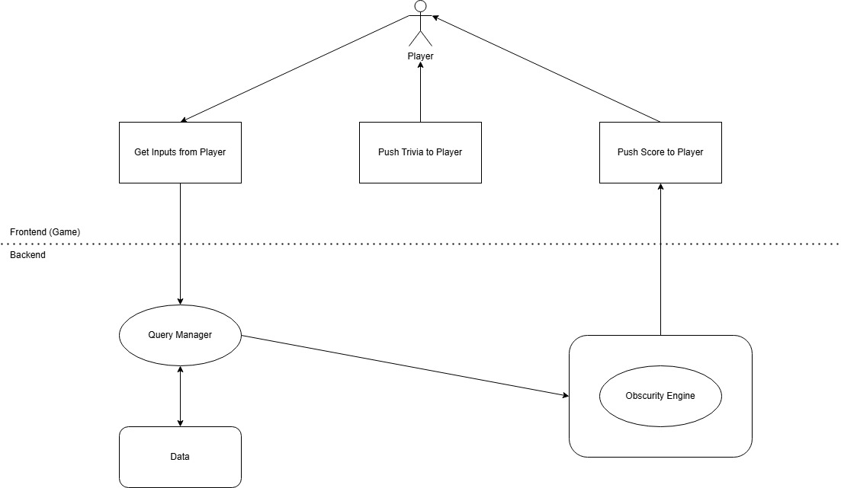
L2

Slide 9
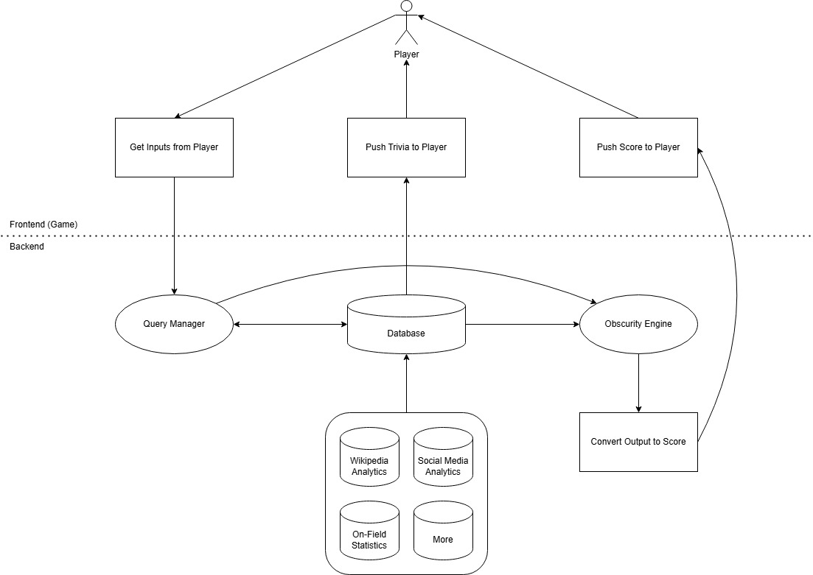
L3

Slide 10



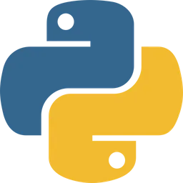








Technologies
External
Backend
Engine
Frontend

Slide 11
Milestones
Jan 20
Research & data sourcing
Feb 3
Backend setup & data transfer
Mar 17
Obscurity Engine operational
Mar 31
Production UI & gameplay loop
Continuous Revisions

Slide 12


Results
Research & data sourcing
Backend setup & data transfer
Production UI & gameplay loop
Continuous Revisions

Slide 13
Progress
As indicated, the Obscurity Engine, UI, and continuous revisions remain to be completed. However, work on all systems is underway. Currently, all core gameplay mechanics are implemented, pending only refinements and a mature Obscurity Engine. It follows that the engine is a largely-untuned working draft, still needing data cleansing and parameter optimization for satisfactory accuracy. We will focus our resources on that, while continuing to revise elsewhere in the project.

Slide 14
Challenges
Sourcing data was our biggest challenge. No free dataset or public API had the necessary breadth and depth, so we had to compile our own. Our data engineering process was an undertaking and an accomplishment, not least in that it’s compliant with all ToS. Developing the Obscurity Engine was rather difficult, too. In early versions, many athletes clustered around a narrow range of obscurity scores. We curbed the behavior, in part, by supplying only those parameters that a human might care about – resulting in a more human-like readout.

