Slide 1
Case Study 2
Blake Freeman

Slide 2
Topics being covered today?
The data
What categories affect the data
What models were built

Slide 3
The Data – the manipulation.
When reviewing data that was provided to create the predictive models there was apparent there was several categorical categories in the data. I wanted to be able to make sure to incorporate this in the model appropriately. So I did a method call One Hot Encoding where I created a column for each categorical variable and coded it as a 0 (if it is false) or a 1 (if it is true). This helped me when selecting the impact of the variables that were present.

Slide 4
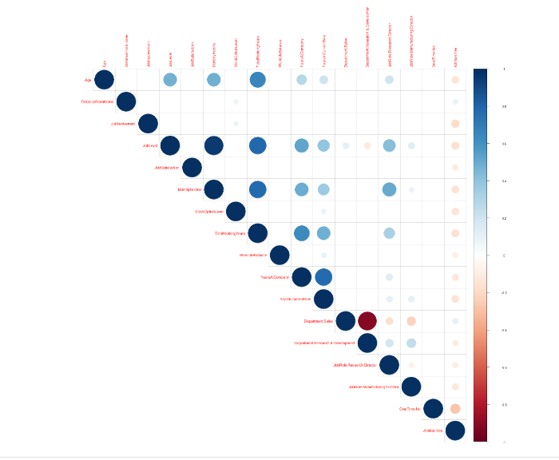
What categories affect the data
After the One Hot Encoding I was able to create a Correlation Matrix based on the P Value (the calculated probability of finding the observed) to see which ones were statistically significant to build my models.

Slide 5
What categories affect the data - Attrition.
From here I was able to narrow down the categories. After reviewing this data it allowed me to determine that Age Job Involvement and Overtime were 3 of the top factors in Attrition.

Slide 6
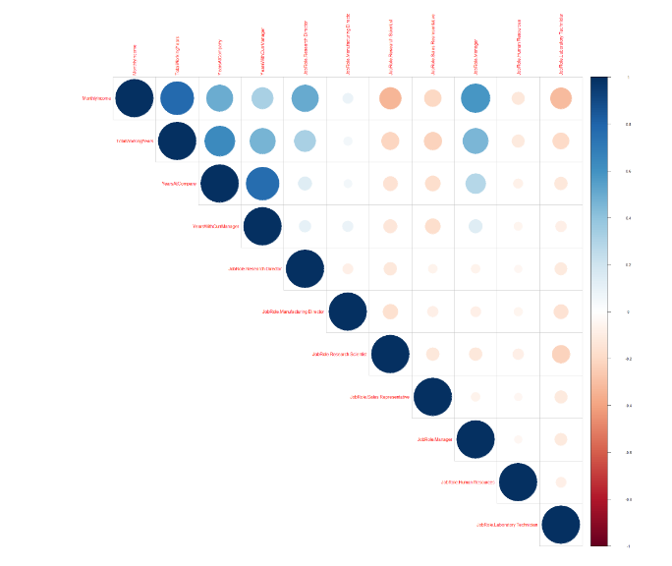
What categories affect the data - Salary
For Salary the that has Job Role, Number of Company's Worked and Education as the 3 top categories that affected Salary.

Slide 7
Models used and results
For attrition I used a model called KNN to determine the productions. Using the significant variables from running the correlation matrix. I ran my model and using test data I received an accuracy of 83.89%. Showing my model based on the variables chosen can predict 83.89% right based on the test data that was randomly created.
The second Model I created was a Linear Regression to predict Salary. Where I got an Adjusted R-squared score of .8753 when running my predictions showing that the data’s predictions are highly associated with the data therefore leading to greater accuracy.

