Slide 1

Trajectory
Long Shot studio

Slide 2

Context Diagram

Slide 3
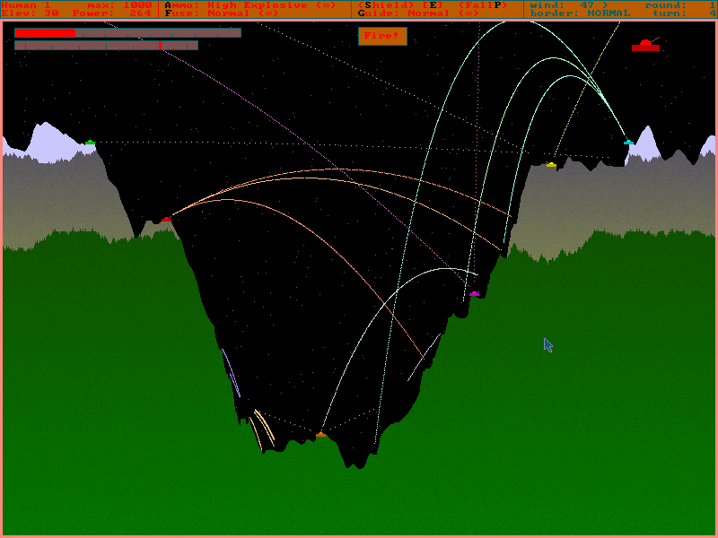
Classic Inspiration

Slide 4
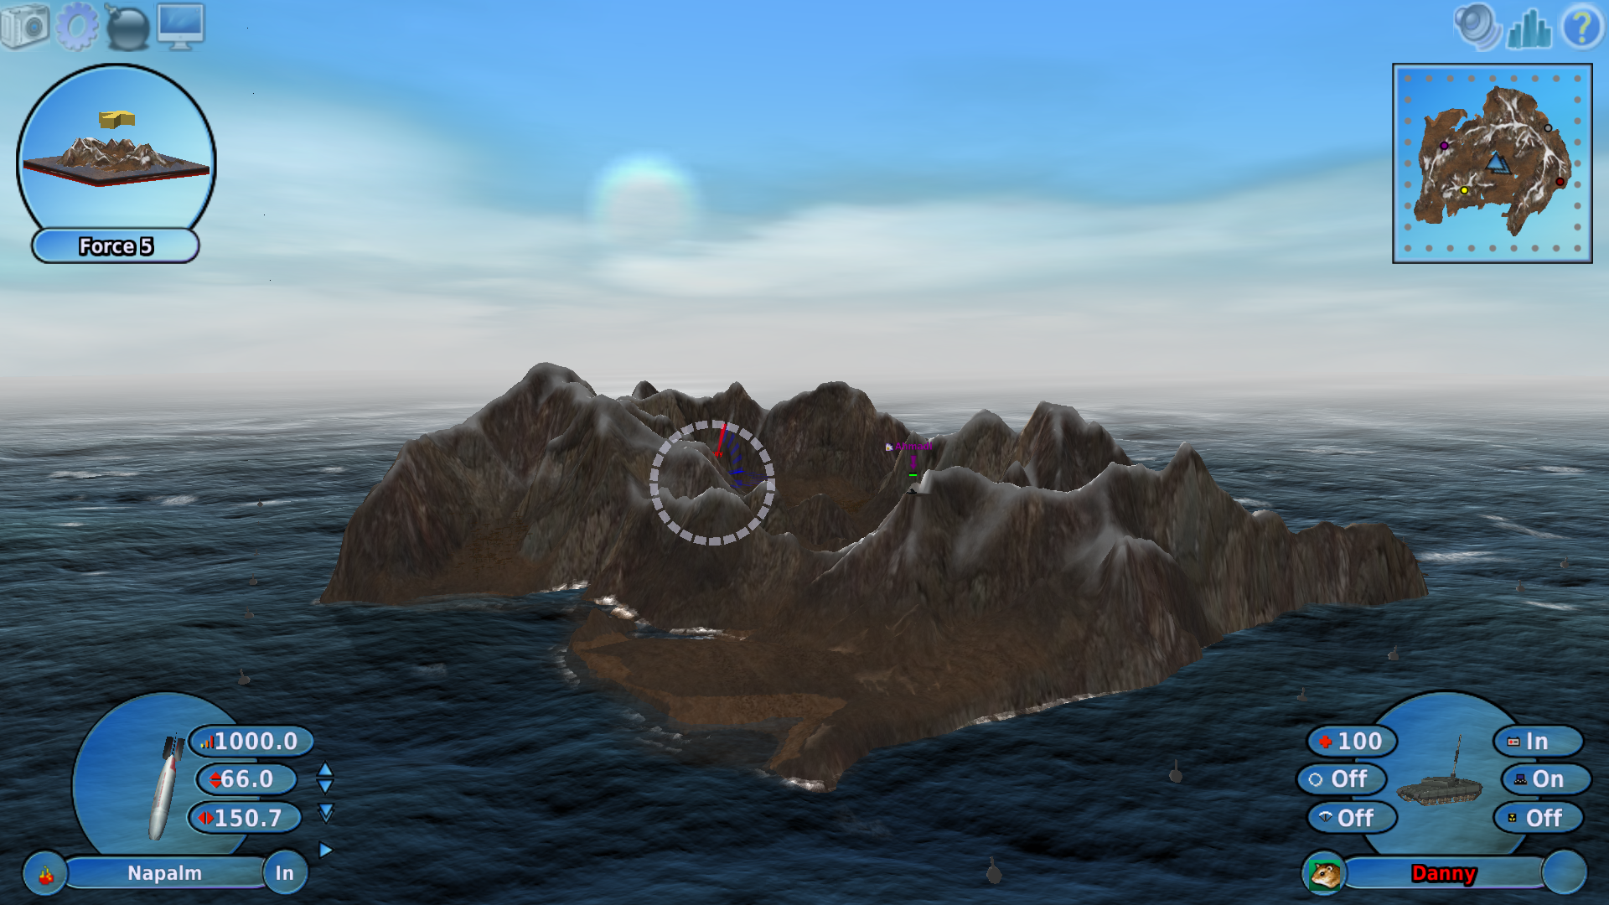
Modern Inspiration

Slide 5
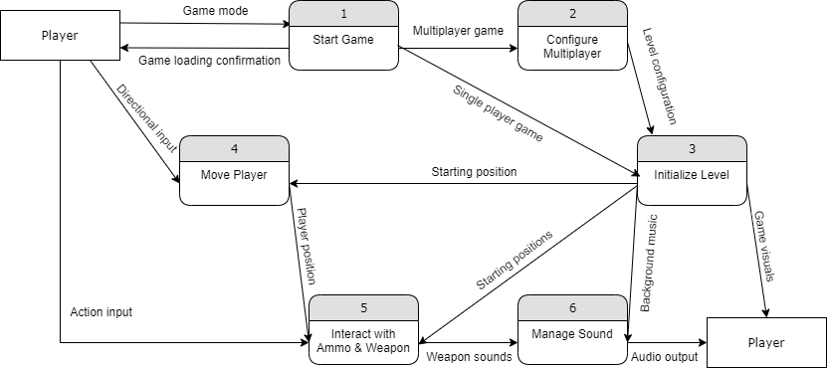
Diagram 0

Slide 6
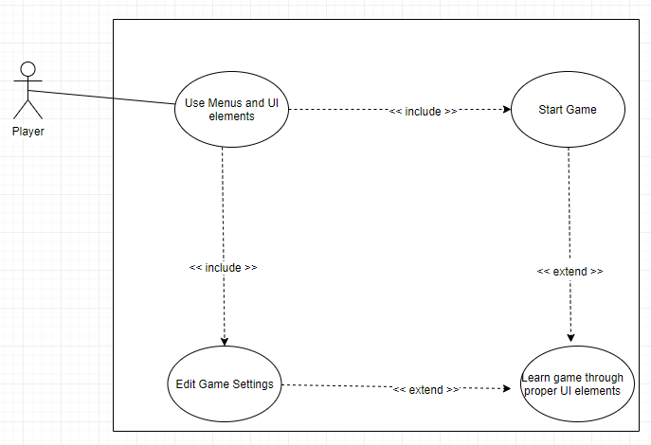
Blake

Slide 7
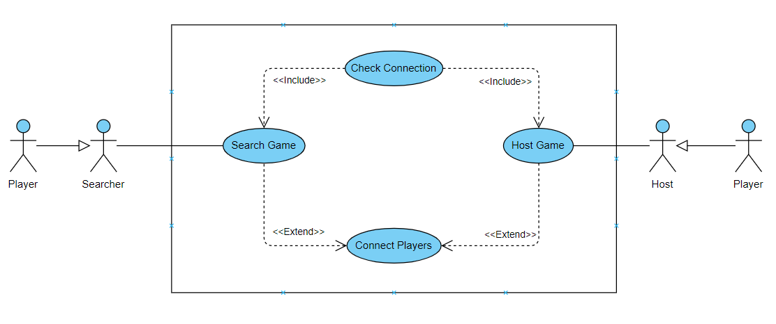
Noah

Slide 8
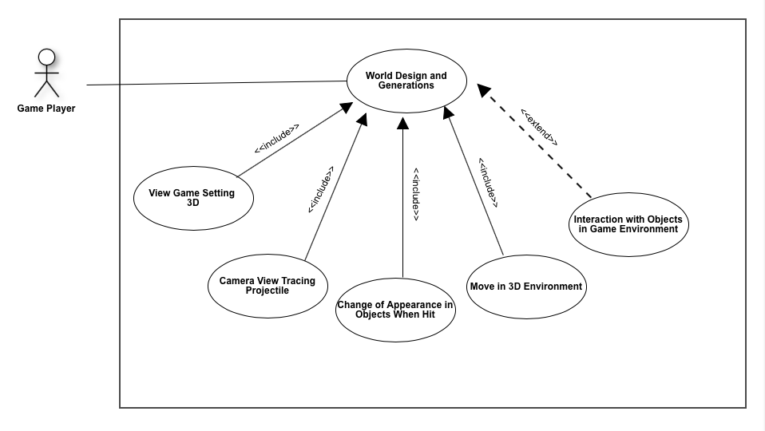
Yingruo

Slide 9
Kiran
Input
<<includes>>
Change
character state
Player
<<extends>>
World Interaction
<<includes>>
<<includes>>
<<includes>>
<<extends>>
Object interaction
Camera switching
Fire Weapons
Movement

Slide 10
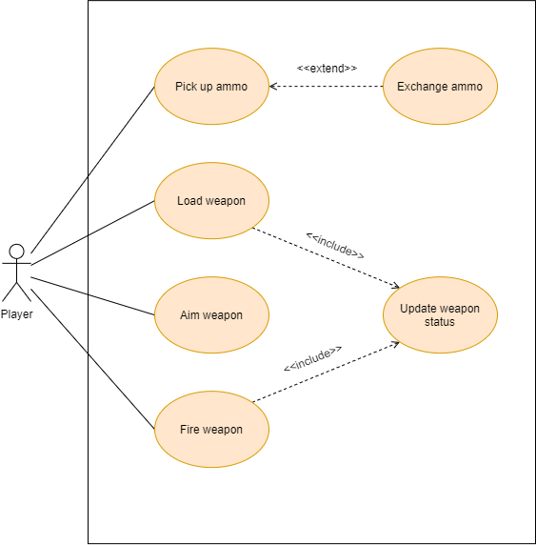
Lucas

Slide 11
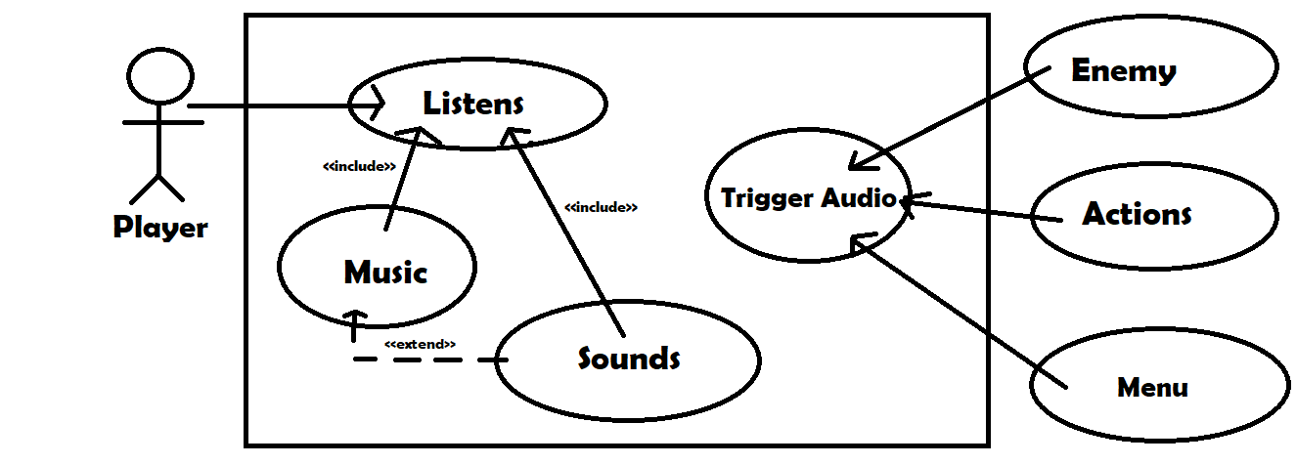
Max

Slide 12





Any questions?
Hi I am Maine

