Slide 1

LongShot Trajectory Progress update Team Lead 1 Presentation
Blake Rude

Slide 2
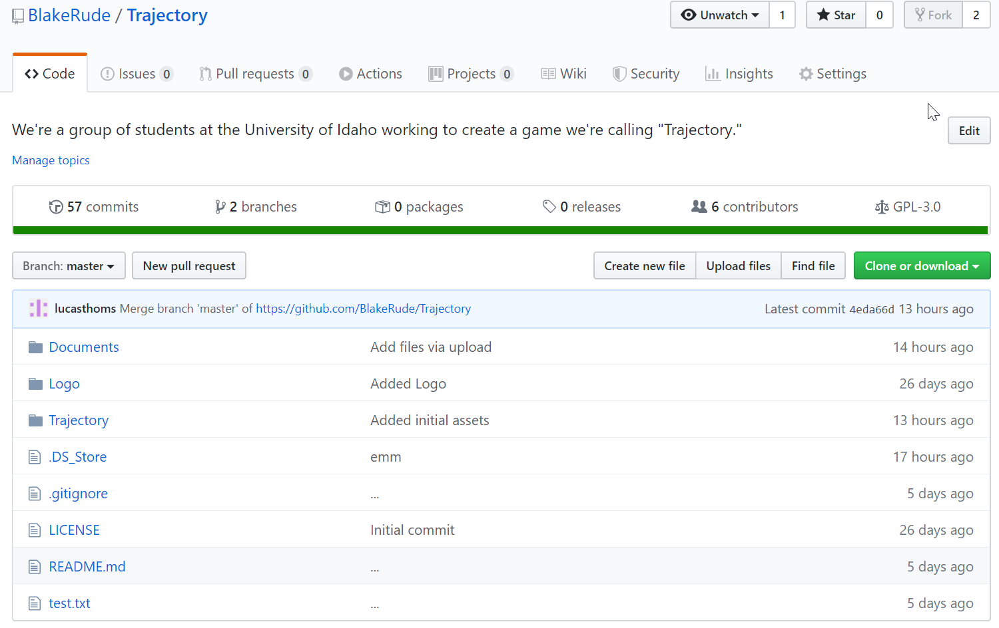

Slide 3
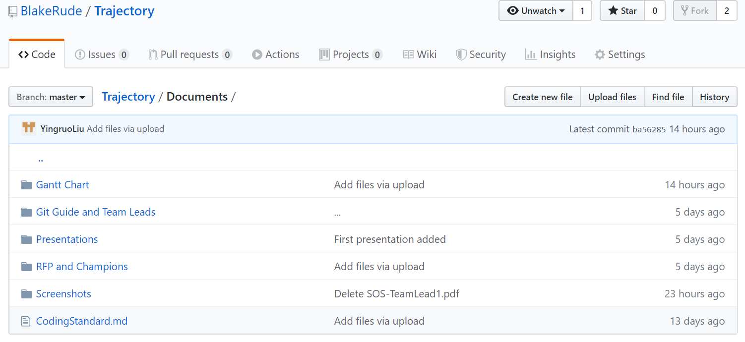

Slide 4
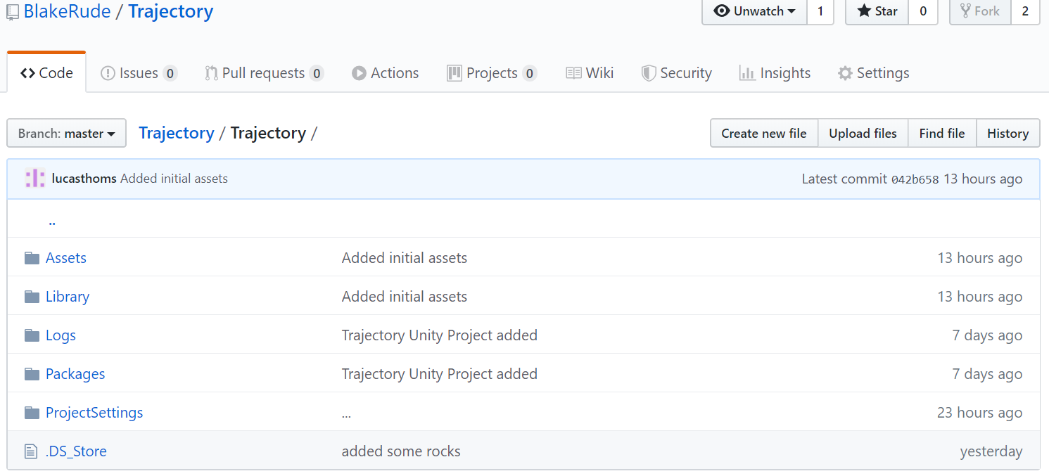

Slide 5
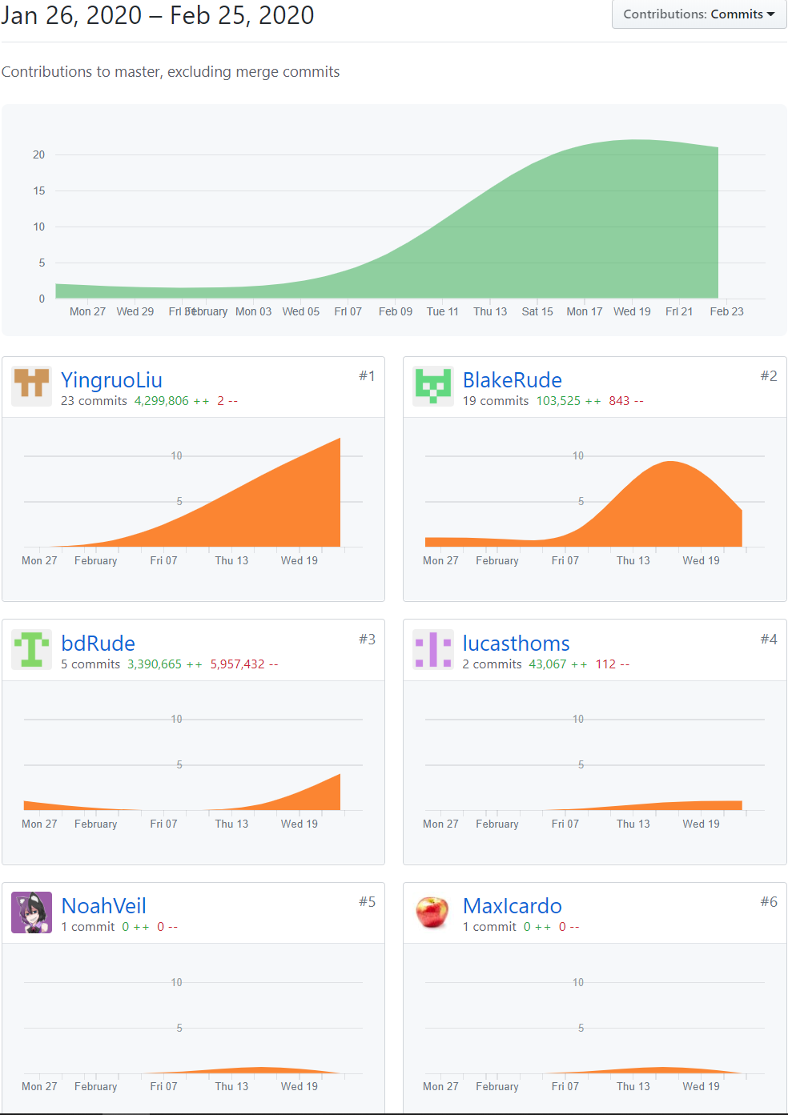

Slide 6
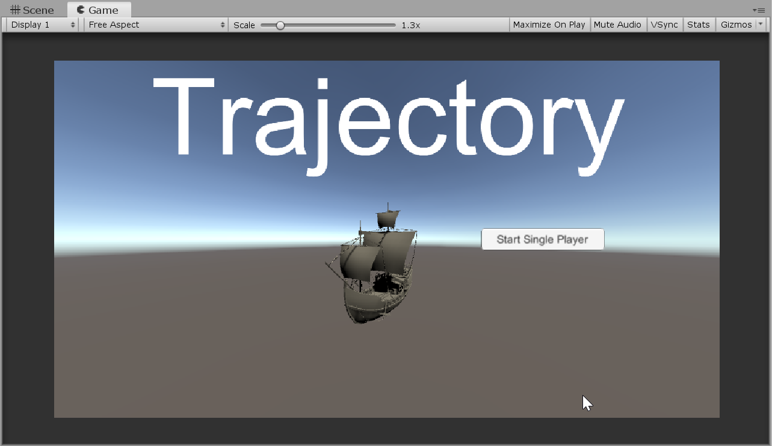
Blake

Slide 7

Lucas

Slide 8
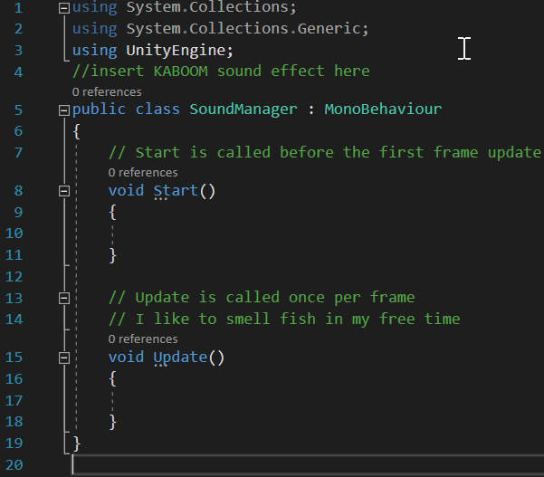
MAX

Slide 9
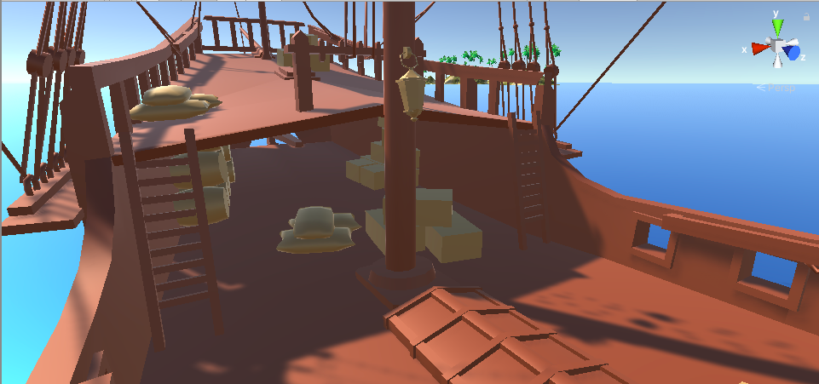
Yingruo

Slide 10
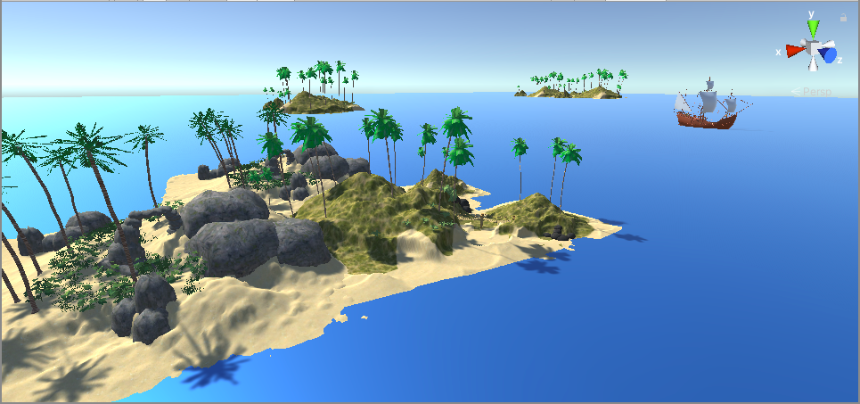
Yingruo

Slide 11
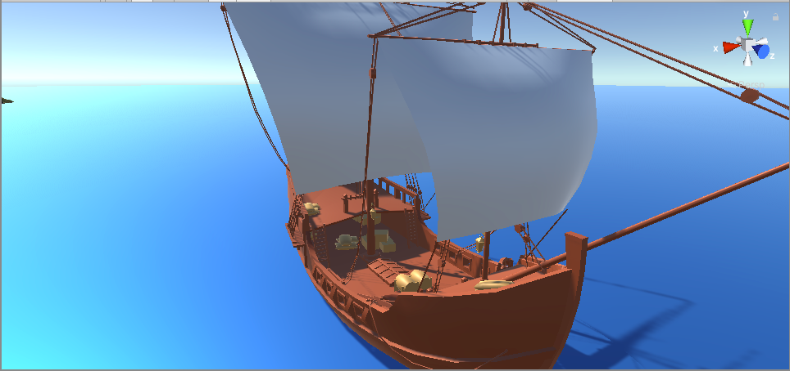
Yingruo

Slide 12
Kiran

Slide 13
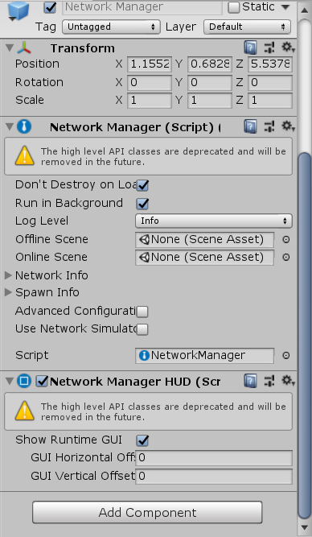

Noah

Slide 14

gantt

Slide 15
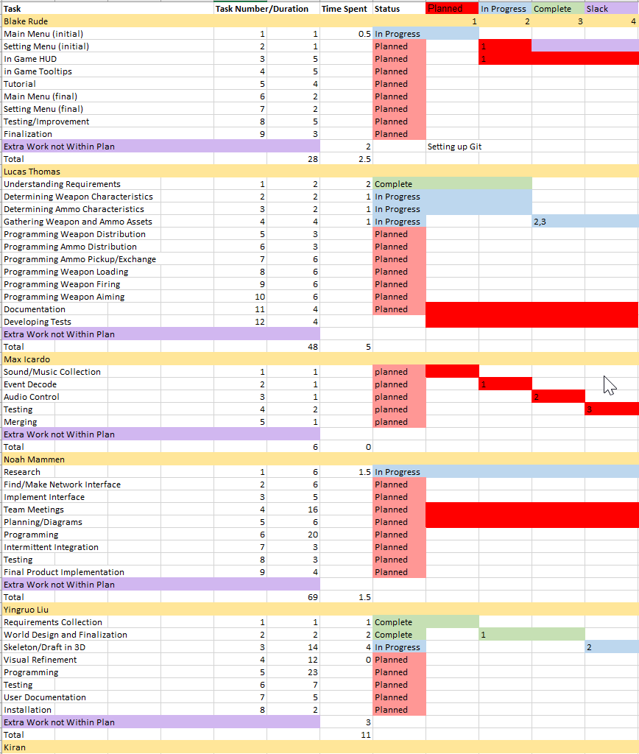

gantt

