Slide 1
Lake Michigan influences
Blake Wallace
May 17, 2019

Slide 2
Data science questions
Existence of significant differences in temperature?
Can a predictive model that explains at least 80% of the variance in the precipitation differences be constructed?

Slide 3
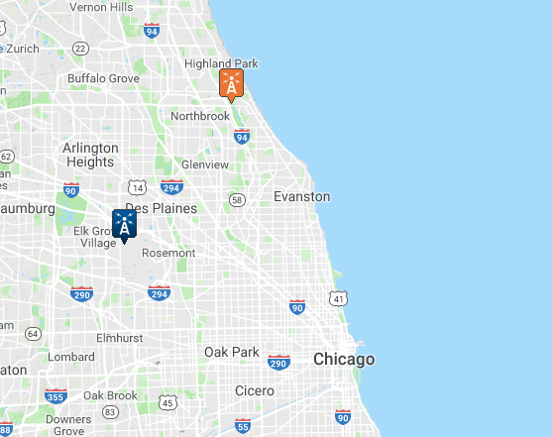
Data Sources
National Centers for Environmental Information
Global Historical Climatology Network (GHCN)
- a network of worldwide weather data available to
the public for analysis and evaluation. - Source
O’Hare Airport
Chicago Botanical Gardens
Great Lakes Statistics: Average Surface Water
Temperature from the Great Lakes Surface Environmental
Analysis (GLSEA) - Source
Lake Michigan Average Daily Temperatures

Slide 4
data
The Global Historical Climatological Network defines five core values
Precipitation
Snowfall
Snow Depth
Maximum Temperature
Minimum Temperature
The Great Lakes Statistics:
Average Daily Temperatures of Each Great Lake

Slide 5
Feature engineering
target - absolute difference between the precipitation measurements at
O’Hare and the gardens
garden_didrain - categorical, 1 for yes, 0 for no
ohare_didrain - categorical, 1 for yes, 0 for no
tmpdiff - difference between the median temperatures at ohare
and the garden (ohare_medtmp - garden_medtmp)

Slide 6
Data gathering
Scraping –
Lake Michigan Temperature Data
Weather Underground Weather Data (unsuccessfully)
Direct Downloads –
Global Historical Climatology Network .csv files
Web API –
Global Historical Climatology Network has a direct
Application Programming Interface

Slide 7
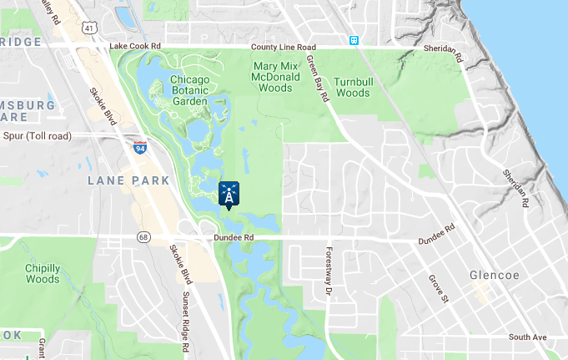
Cleaning the data
Incomplete Data
determined the choice
of the Botanical Gardens

Slide 8
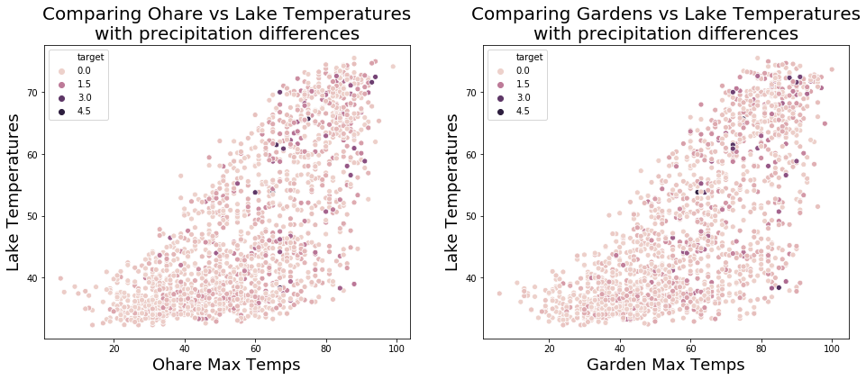
Exploratory Data Analysis
As temperatures increase and there is precipitation at both locations,
the difference in precipitation between locations increases.

Slide 9
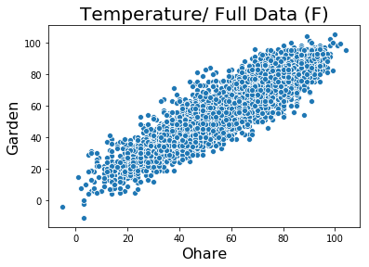
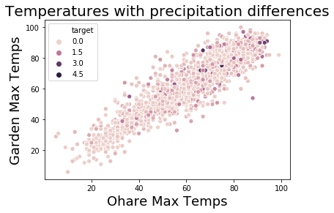
Exploratory Data Analysis
Again, as the temperatures increase, the difference in precipitation increases.

Slide 10
Significance testing
Testing to see if there is any significant difference between the temperatures at
O’Hare and the Chicago Botanical Gardens.
Data | Quantity of Data | t-score | p-value | significance | Gardens Avg (F) | Ohare Avg (F)
All Data | 7923 | 0.5876 | 0.5568 | None | 59.24 | 59.43
No Rain | 4022 | 3.285 | 0.001 | Yes | 58.99 | 60.57
Both Rain | 1648 | -2.629 | 0.0086 | Yes | 59.48 | 57.7
ohareRain | 1193 | -1.9557 | 0.0506 | None | 59.06 | 57.43
gardensRain | 1060 | 0.0904 | 0.928 | None | 59.99 | 60.07
Statistically significant difference when there is similar precipitation at both locations!

Slide 11
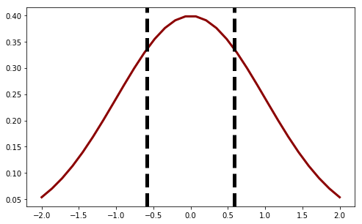
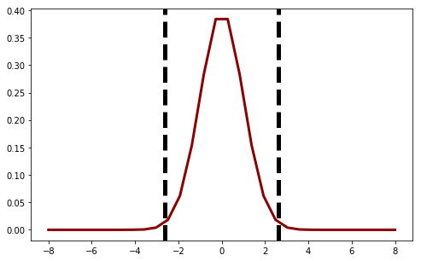
Significance testing
Baseline T-distributions
Full Dataset (7923 data points)
Both Rain (1648 data points)
No Significant Difference
Significant Difference

Slide 12
Modeling
Can a predictive model that explains at least 80% of the variance in the
precipitation differences be constructed?
Sadly, NO.
Not with the given data.
During the modeling process we trained
more than 25 models!
Best Scores:
Training – 0.8704
Testing – 0.1153
Cross Validation – 0.0767
The best scores were obtained using a direct Random Forest.
Full dataset (7923 data points)
Train/test split (75/25)
Squared polynomial features
Training set shape – (5942, 120)
n_estimator = 100
max_features = ‘sqrt’

Slide 13
conclusions

Slide 14
Future iterations

Slide 15
questions

