Slide 1
Lake Michigan influences
Blake Wallace
May 17, 2019

Slide 2
Data science questions
Existence of significant differences in temperature?
Can a predictive model that explains at least 80% of the variance in the precipitation differences be constructed?

Slide 3

Data Sources
National Centers for Environmental Information
Global Historical Climatology Network (GHCN)
- a network of worldwide weather data available to
the public for analysis and evaluation. - Source
O’Hare Airport
Chicago Botanical Gardens
Great Lakes Statistics: Average Surface Water
Temperature from the Great Lakes Surface Environmental
Analysis (GLSEA) - Source
Lake Michigan Average Daily Temperatures

Slide 4
data
The Global Historical Climatological Network defines five core values
Precipitation
Snowfall
Snow Depth
Maximum Temperature
Minimum Temperature
Years considered:
1995 – 2018
8766 days
The Great Lakes Statistics:
Average Daily Temperatures of Lake Michigan

Slide 5
Feature engineering
target - absolute difference between the precipitation measurements at
O’Hare and the Chicago Botanical Gardens
garden_didrain - categorical, 1 for yes, 0 for no
ohare_didrain - categorical, 1 for yes, 0 for no
tmpdiff - difference between the median temperatures at ohare
and the garden (ohare_medtmp - garden_medtmp)

Slide 6
Data gathering
Scraping –
Lake Michigan Temperature Data
Weather Underground Weather Data (unsuccessfully)
Direct Downloads –
Global Historical Climatology Network .csv files
Web API –
Global Historical Climatology Network has a direct
Application Programming Interface

Slide 7
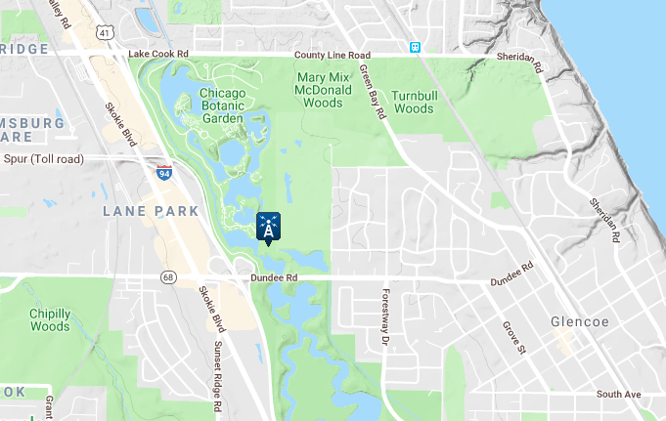
Cleaning the data
Incomplete Data
determined the choice
of the Botanical Gardens

Slide 8
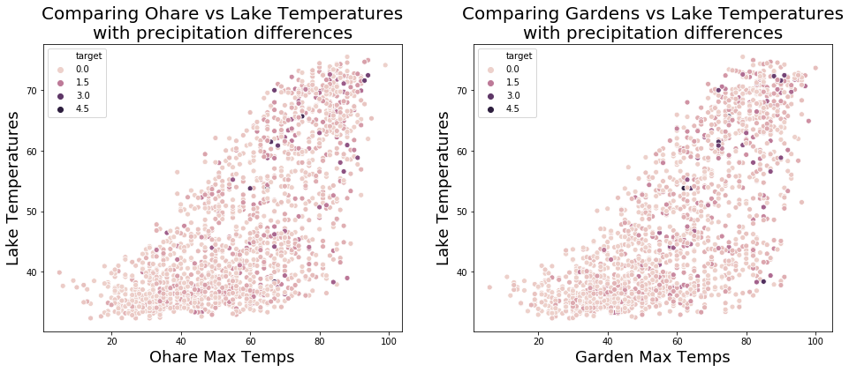
Exploratory Data Analysis
As temperatures increase and there is precipitation at both locations,
the difference in precipitation between locations increases.

Slide 9
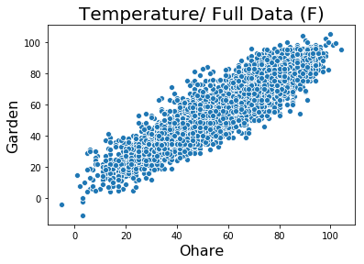
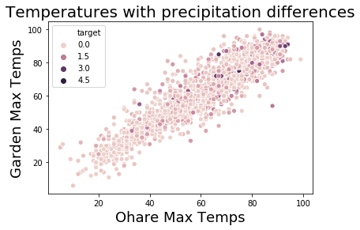
Exploratory Data Analysis
Again, as the temperatures increase, the difference in precipitation increases.

Slide 10
Significance testing
Testing to see if there is any significant difference between the temperatures at
O’Hare and the Chicago Botanical Gardens.
Data | Quantity of Data | t-score | p-value | significance | Gardens Avg (F) | Ohare Avg (F)
All Data | 7923 | 0.5876 | 0.5568 | None | 59.24 | 59.43
No Rain | 4022 | 3.285 | 0.001 | Yes | 58.99 | 60.57
Both Rain | 1648 | -2.629 | 0.0086 | Yes | 59.48 | 57.7
ohareRain | 1193 | -1.9557 | 0.0506 | None | 59.06 | 57.43
gardensRain | 1060 | 0.0904 | 0.928 | None | 59.99 | 60.07
Statistically significant difference when there is similar precipitation at both locations!

Slide 11
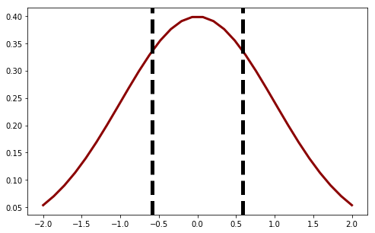
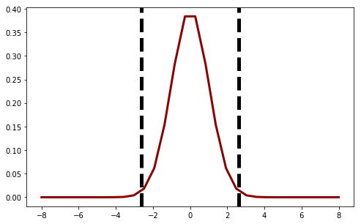
Significance testing
Baseline T-distributions
Full Dataset (7923 data points)
Both Rain (1648 data points)
No Significant Difference
Significant Difference

Slide 12
Modeling
Can a predictive model that explains at least 80% of the variance in the
precipitation differences be constructed?
Sadly, NO.
Not with the given data.
During the modeling process we trained
more than 25 models!
Best Scores:
Training – 0.8704
Testing – 0.1153
Cross Validation – 0.0767
The best scores were obtained using a direct Random Forest.
Full dataset (7923 data points)
Train/test split (75/25)
Squared polynomial features
Training set shape – (5942, 120)
n_estimator = 100
max_features = ‘sqrt’

Slide 13
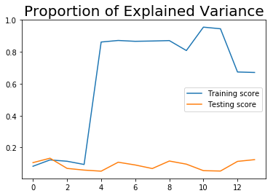
modeling
Other models used:
Linear no Poly
Linear Grid Searchs
Regularized
Decision Tree
Boosted Decision Tree
Boosted Random Forest
Bagged Random Forest
Feed Forward Neural Networks

Slide 14
conclusions
Existence of significant differences in temperature?
- Even though there is a relatively close proximity between the two locations in the
Greater Chicagoland area, there are indications that temperature differences do exist
under certain weather conditions.
2. Can a predictive model that explains at least 80% of the variance in the precipitation
differences be constructed?
- Not when comparing only the Chicago Botanical Gardens and O’Hare airport over
years 1995-2018.

Slide 15
Future iterations
The significant differences in temperature when there is similar precipitation
activity at both the Gardens and O’Hare should be investigated further. It is possible
That there is a seasonal component.
A similar comparison between other locations close Lake Michigan and the airport
should also be performed to determine whether this difference is truly a large
scale trend.
Include more data for modeling. There are hundreds of weather towers,
192 in the Chicagoland area. The next model constructions will be spatio-temporal
in nature, utilizing a much wider berth of data to build temperature fields that capture
trends over a larger area.

Slide 16

Tux says, Thanks!
For preparing him to go into the
wild world of data!

Slide 17
questions

