Slide 1

Lego or not
Blake Wallace
April 5, 2019

Slide 2
Defining the problem
train two classification models,
bayes classification plus one
to predict lego sub-reddit, while minimizing the
Model’s variance.

Slide 3
Gather the data
Challenge # 1: Getting the data
Reddit Posts from 6 sub-reddits were used.
r/popular
r/Pictures
r/original
r/lego
r/legos
r/legostarwars
Shout out to Felippe Rodrigues

Slide 4
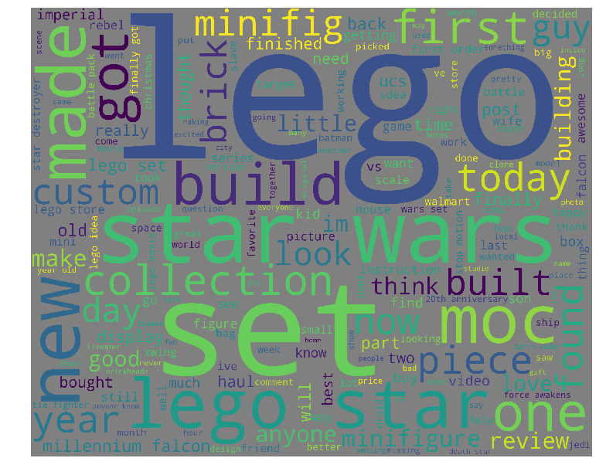
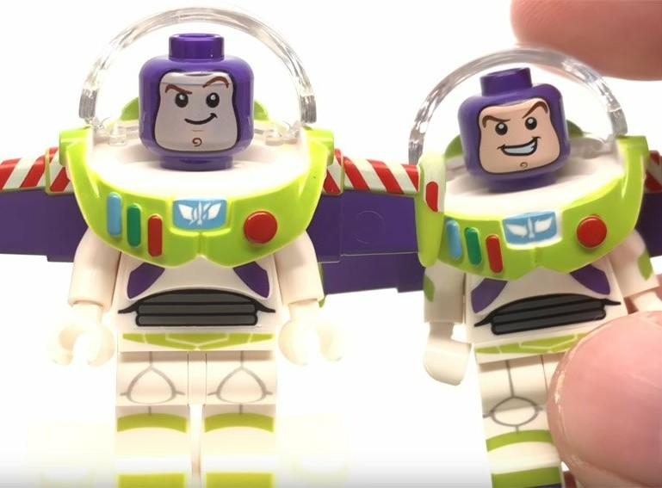
Exploring the data
Challenge #2: Main Body Photos
Positive Class Picts only:
5812 out of 6566 → 88%

Slide 5
Model the data
Challenge # 3: Choosing a Model
Count Vectorizer → tokens, Regex
Ada Boost with Random Forest
Bag → variance control
Grid Search → Model comparison
Random Forest
Multinomial Naïve Bayes

Slide 6
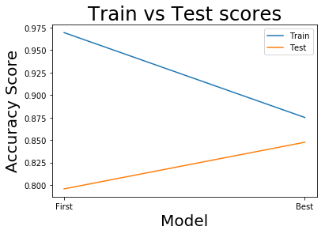
Evaluate the model
A reduction of variance
of nearly 15%!!!!
The trade-off, almost 10% reduction in our
model’s ability to account for variance
(i.e., an increase in training
bias of just under10%.

Slide 7
Conclusion
Naïve Bayes Classification outperformed the other models in
reducing variance
With Naïve Bayes we were able to reduce our variance by
almost 15%.
Lego fans love to post pictures!

Slide 8
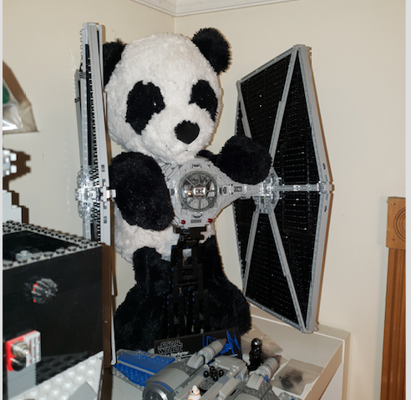
Tux included!

Slide 9
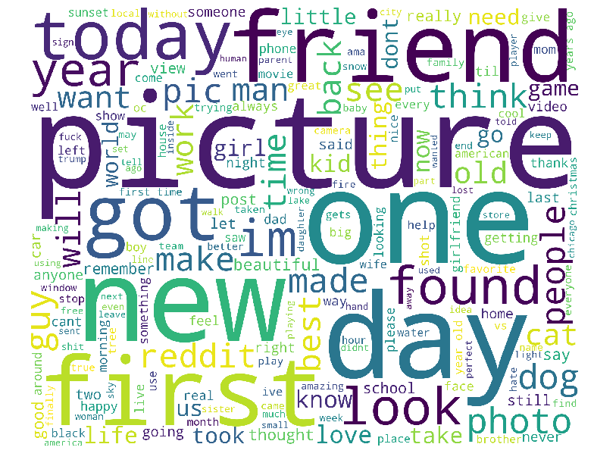
Questions

