Slide 1

Detection of Spam in Email
By: Blake Zurman
NLP IST 664
06/10/25

Slide 2
Introduction
What is Spam Detection? Spam detection refers to identifying unsolicited or harmful email messages and filtering them out of users’ inboxes. It’s crucial for cybersecurity and productivity.
Project Goal: Develop an NLP-based system to classify emails as “ham” (legitimate) or “spam” (unsolicited).

Slide 3
Dataset
Dataset Source: Enron email corpus subset – http://www.aueb.gr/users/ion/data/enron-spam/
Subset Used:
100 ham emails
100 spam emails (Used a smaller balanced set for faster experimentation)
Class Distribution:
Balanced dataset

Slide 4
Data Preprocessing
Goal: Clean and prepare text for feature extraction
Steps Taken:
Tokenization using NLTK
Lowercasing text
Removing punctuation
Stopword removal (optional experiment)

Slide 5
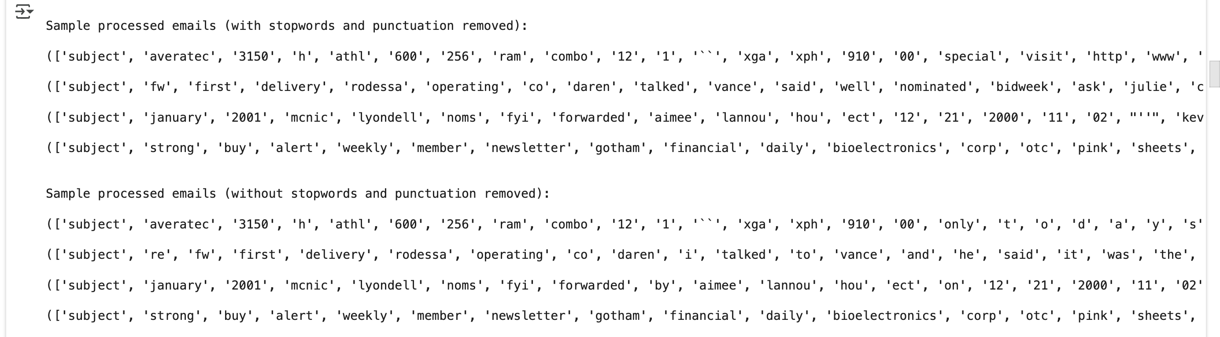
Stop Word Removal

Slide 6
Feature Engineering
Unigram Features:
Selected top 2000 most frequent words across emails
Used presence/absence or frequency in feature dictionary
Bigram Features:
Extracted bigram collocations
Limited to top 1000 based on Pointwise Mutual Information (PMI)
Custom Feature – Exclamation Point Count:
Counts the number of “!” in each email
Rationale: Spammers often use excessive punctuation for emphasis
Combined Features:
Feature set = Unigrams + Bigrams + Exclamation Count

Slide 7
Classification Approach
NLTK Naive Bayes Classifier:
Rule-based, probabilistic model using word frequency
Trained with 5-fold cross-validation
Scikit-learn Classifier – Multinomial Naive Bayes:
Used Scikit-learn for robust implementation
Converted NLTK-style feature dicts with DictVectorizer
Used 80/20 train-test split

Slide 8
Results – NLTK Naive Bayes UNIGRAM Feature set
Evaluation Metrics (Average over 5-fold CV):
Precision: 0.9290
Recall: 0.6252
F1-Score: 0.7456
Interpretation: Baseline performance was moderate, showing room for improvement with more advanced methods or richer features.

Slide 9
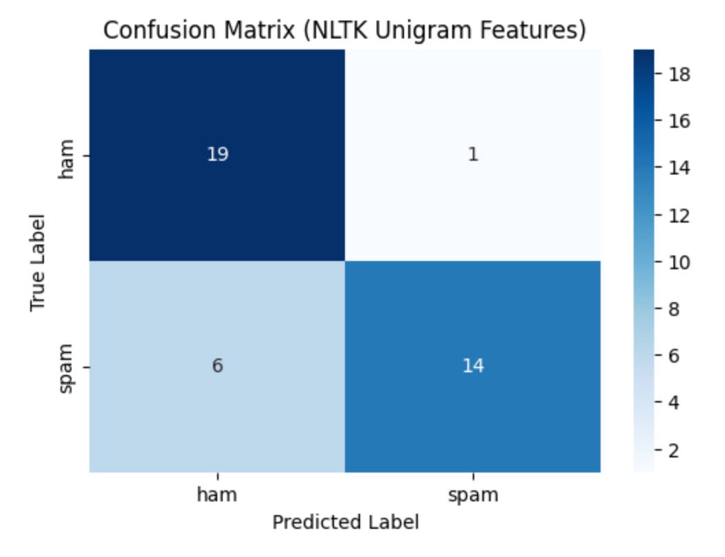
Results – NLTK Naive Bayes UNIGRAM Feature set

Slide 10
Results – NLTK Naive Bayes COMBINED Feature Set
Evaluation Metrics (Average over 5-fold CV):
Precision: 0.9183
Recall: 0.5341
F1-Score: 0.6714
Interpretation: Baseline performance was worse than the unigram feature set.

Slide 11
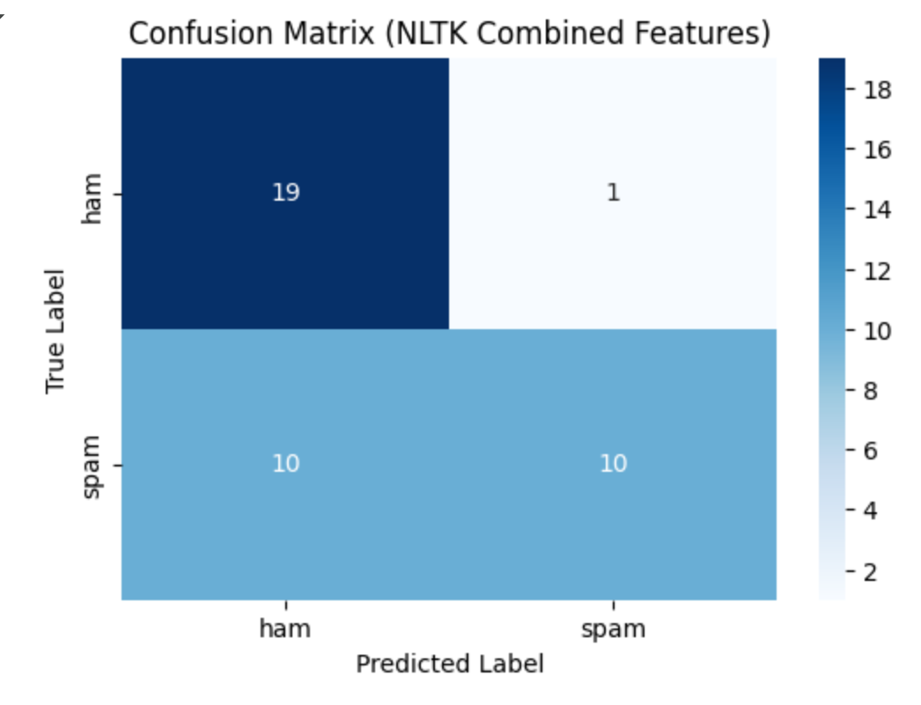
Results – NLTK Naive Bayes COMBINED Feature Set

Slide 12
Results – Scikit-learn Classifier Combined Feature Set
Evaluation Metrics (Train-Test Split)
Accuracy: 0.9500
Precision: 1.0000
Recall: 0.9048
F1-score: 0.9500
Comparison with NLTK: Scikit-learn classifier outperformed NLTK in all metrics, likely due to better handling of sparse data and more efficient implementation.

Slide 13
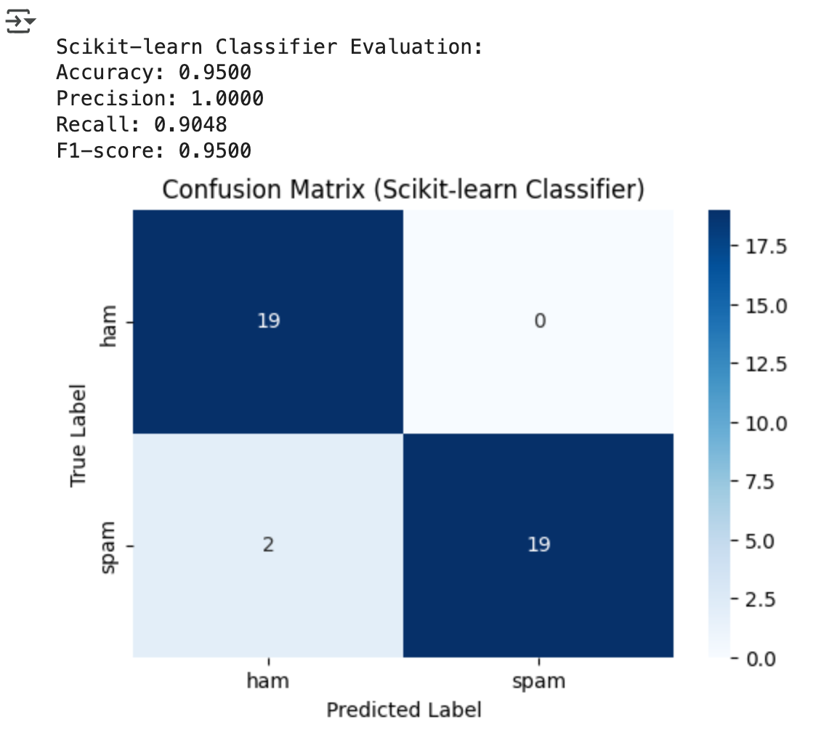
Sci Kit Confustion Matrix

Slide 14
Analysis
Why Scikit-learn Performed Better:
Optimized algorithms and vectorization
Better handling of numeric features
Feature Insights:
Emails with more exclamation points were often classified as spam
Certain bigrams (e.g., “click now”, “free money”) appeared frequently in spam
Challenges Faced:
Small sample size
Some overlap in vocabulary between spam and ham

Slide 15
Future work
Potential Improvements:
Try classifiers like Logistic Regression or SVM
Use TF-IDF instead of binary features
Integrate POS tagging or sentiment lexicons
Expand dataset to full Enron corpus
Perform cross-validation with scikit-learn pipeline

Slide 16
Conclusion
Summary: Successfully implemented a spam detection system using NLP techniques, including preprocessing, feature engineering, and classification.
Key Takeaway: Thoughtful feature design and algorithm selection have a major impact on text classification accuracy.
Thank You! Any questions?

