Slide 1


Securing PSRemoting
•James Petty •Twitter: PSJamesP

Slide 2

Sponsors

Slide 3
Who is James
Chattanooga TN
Windows Server Administrator 2012 - 2019
CEO – The DevOps Collective INC
PowerShell.org
Co-Founder of the Chattanooga PowerShell User Group
Co Organizer of PowerShell Saturday in Chattanooga TN (2018-2019)

Slide 4
Remoting…101
PowerShell Remoting has been around since PowerShell v2
Windows PowerShell (5.1 and lower) WS-MAN
HTTP TCP / 5985
HTTPS TCP / 5986

Slide 5

https://leanpub.com/secretsofpowershellremoting/read#leanpub-auto-core-remoting-tasks

Slide 6
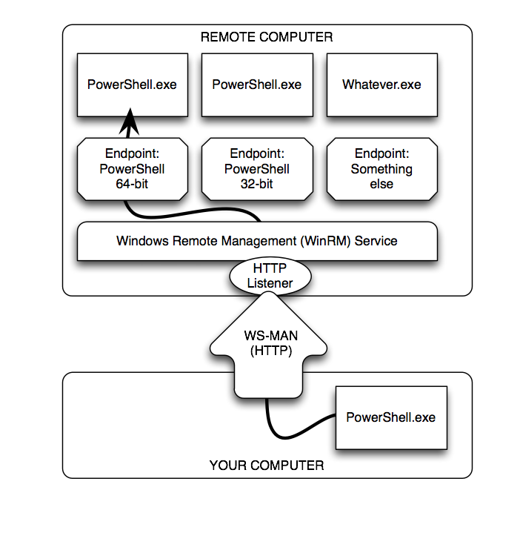

Slide 7
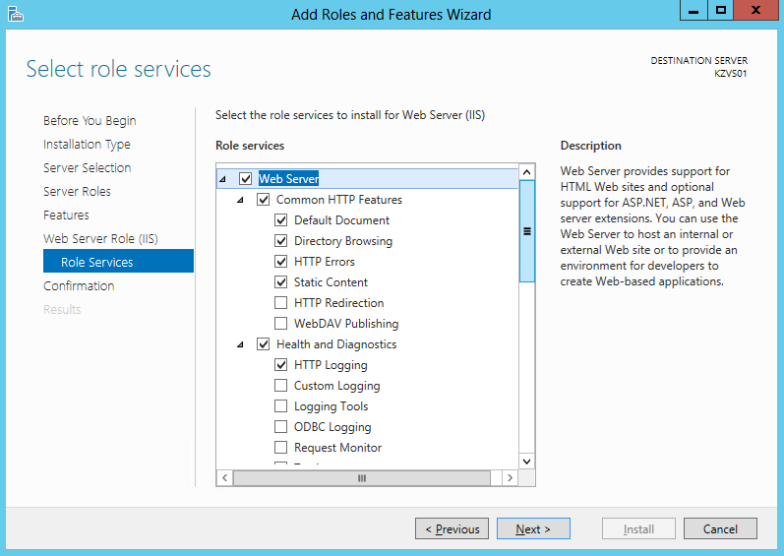
Why Remoting
Gone are the days of
click … click … next… Finish
How long would it take to install IIS on 60 servers using the gui?
With remoting I can do it in less than 5 minutes

Slide 8
Why Remoting
Its faster
Its easy
Constancy

Slide 9
Demos

