Slide 1


Slide 2

What are flowcharts?
2
A flowchart is a graphical way of representing an algorithm or program. It helps to visualize the process of performing a task and make it more understandable.

Slide 3
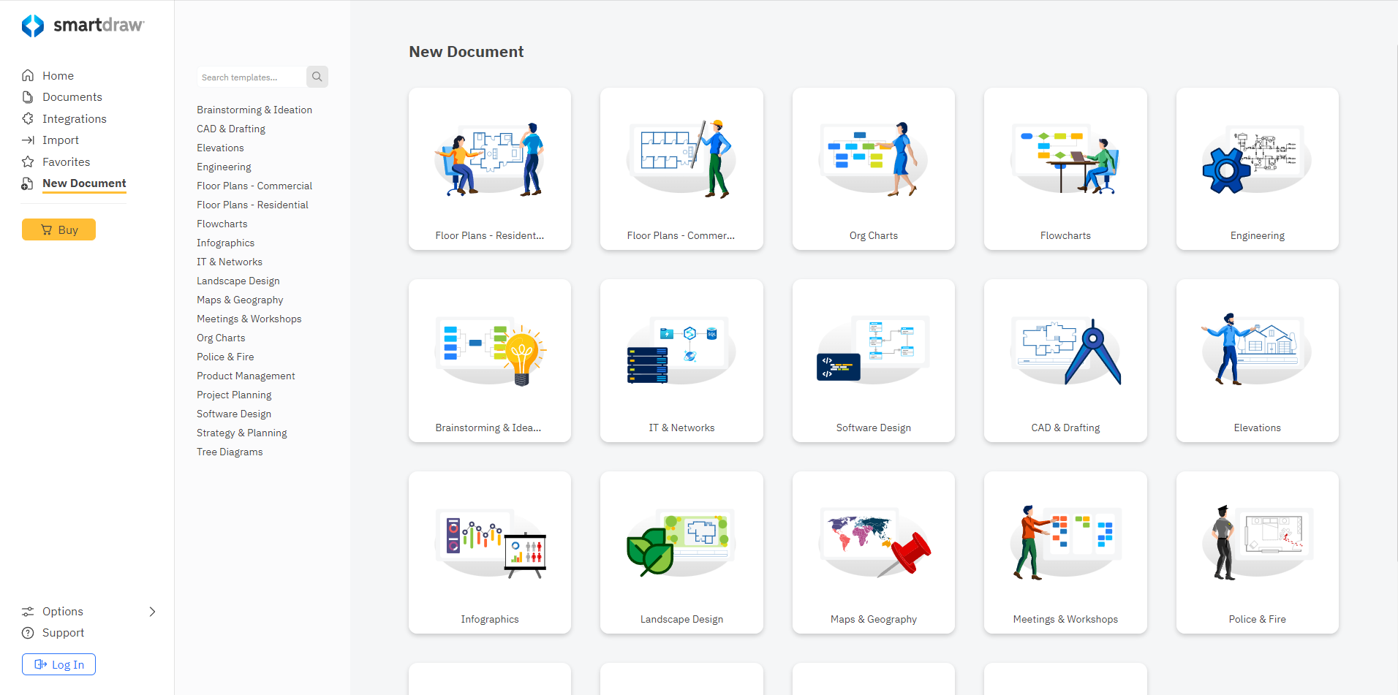

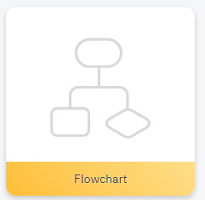
Where do we work with flowcharts?
2

Slide 4
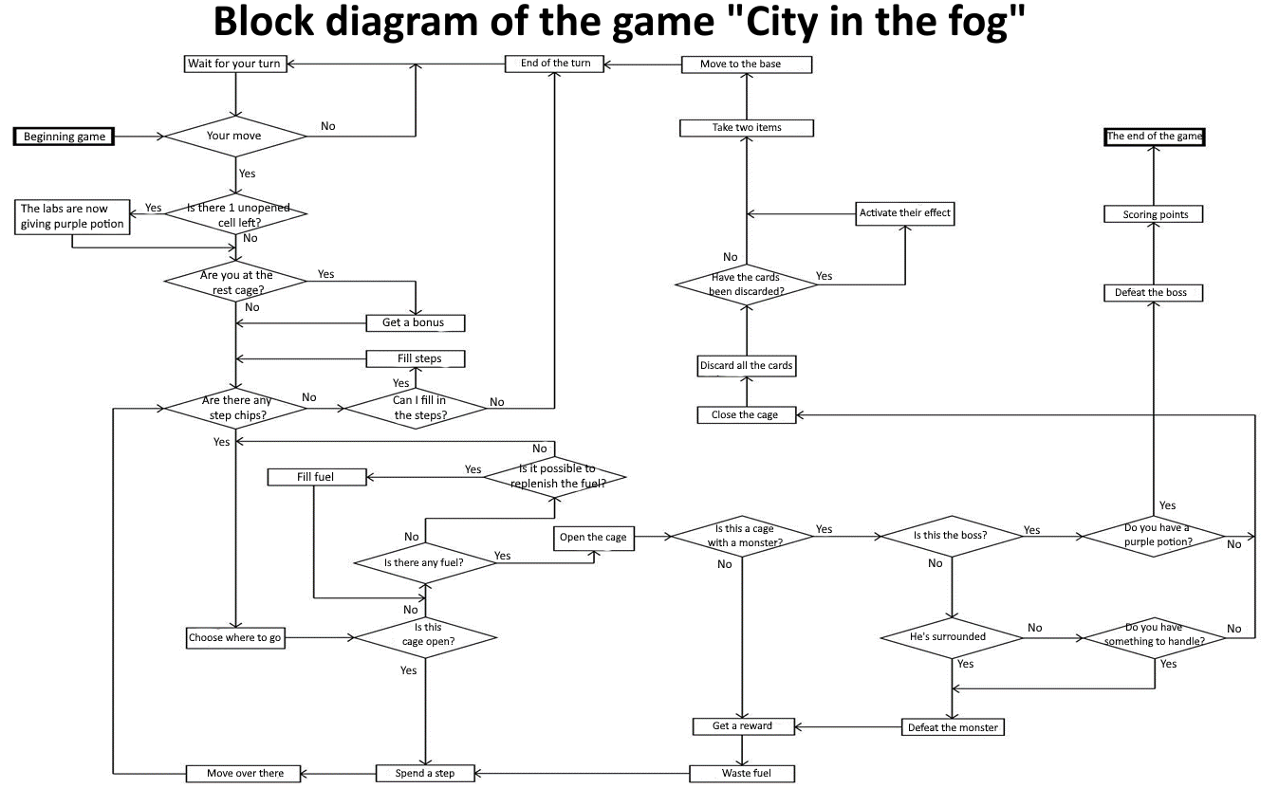
Example of a ready-made flowchart
3

Slide 5



Types of Blocks
4

Slide 6
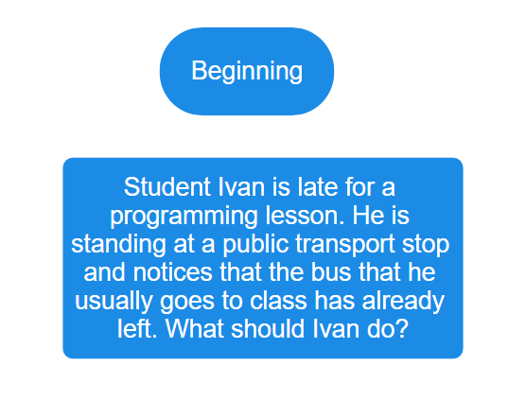
First Steps
5

Slide 7
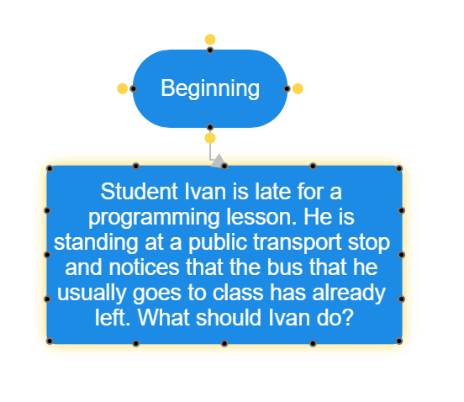
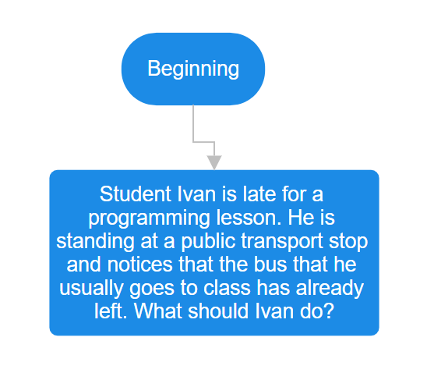
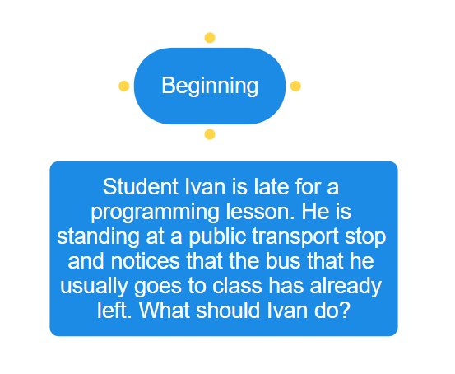
Chaining
6

Slide 8
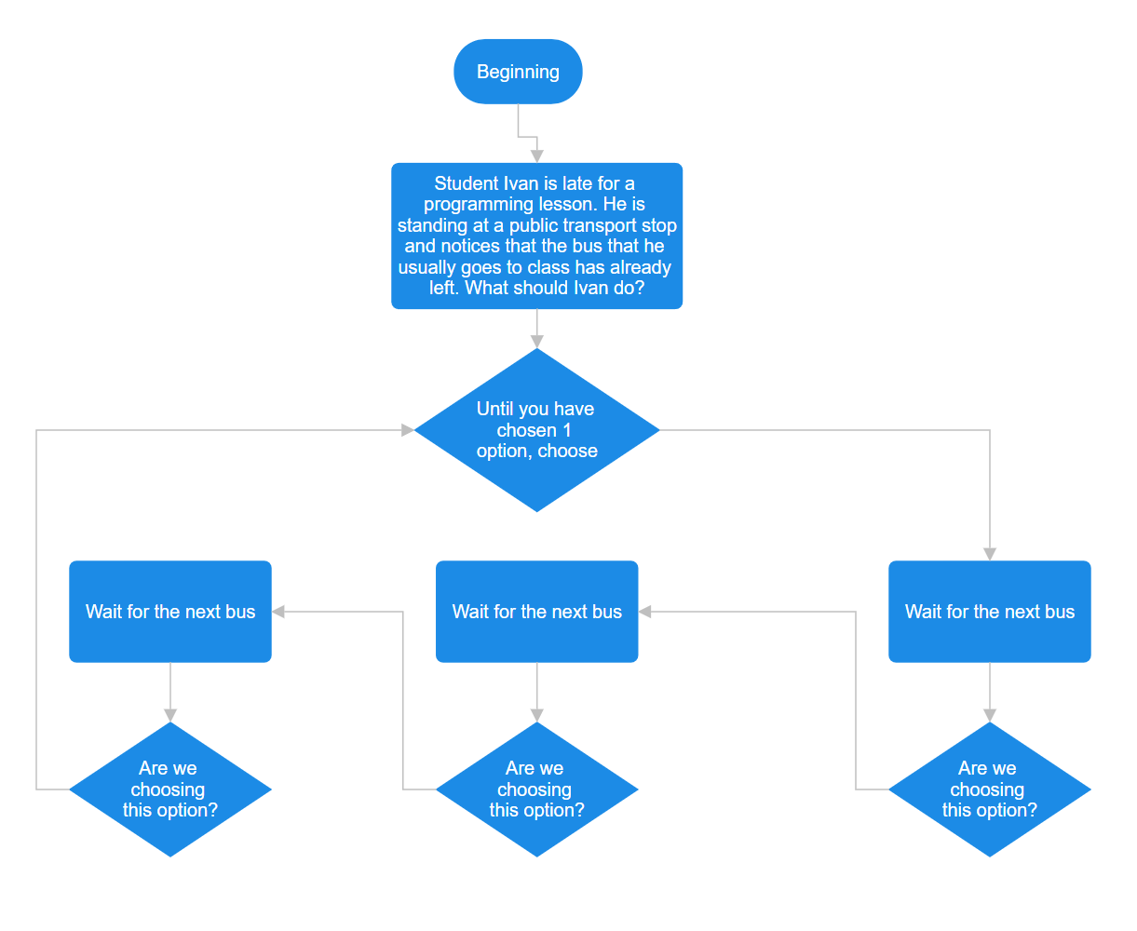
First Plot Twist
7

Slide 9
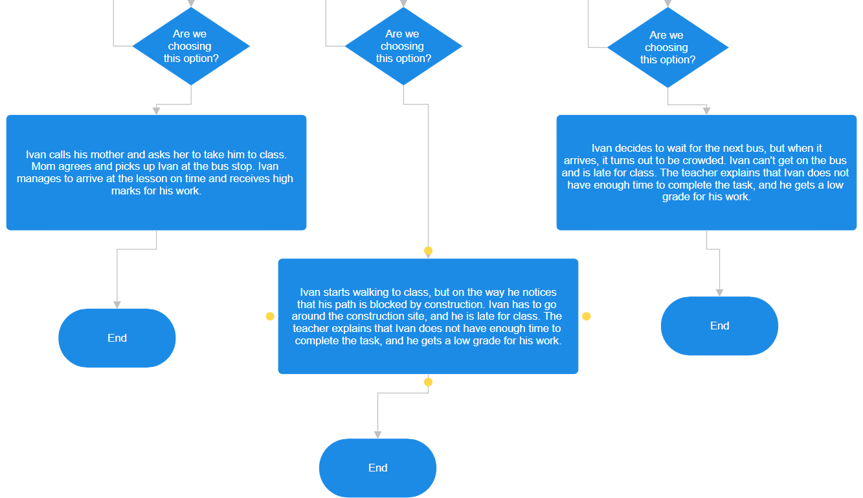
Plot Options
8

Slide 10
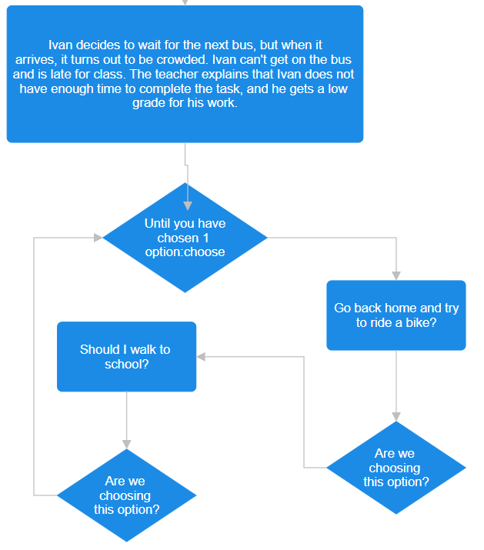
"Difficulties" are not a hindrance, but another step towards excellence!
9

Slide 11
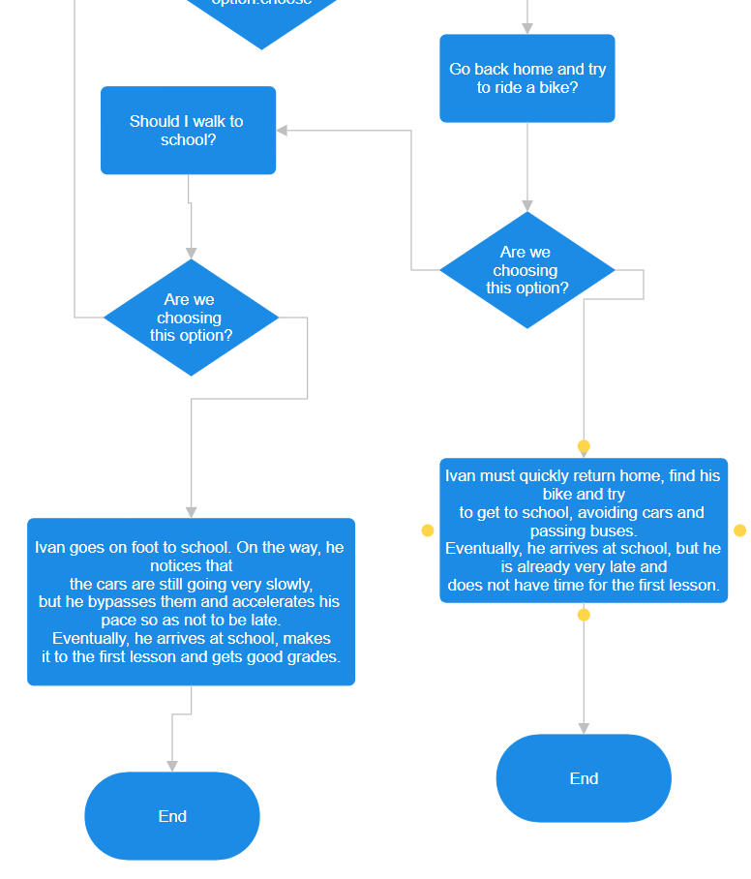
Consequences of “Difficulties"
10

Slide 12
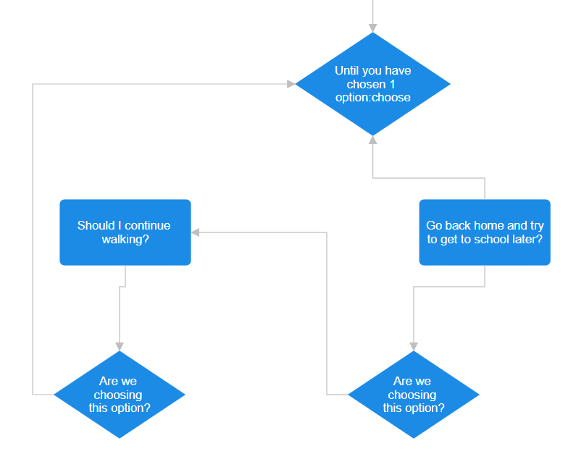
Expanding Our Horizons!
11

Slide 13
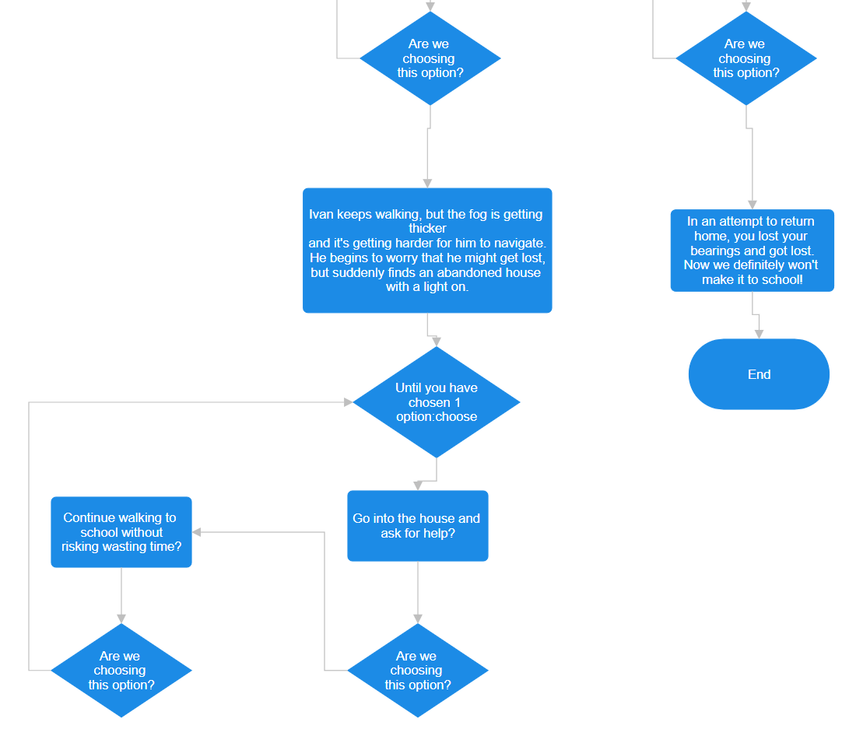
A Little Bit of Intrigue
12

Slide 14
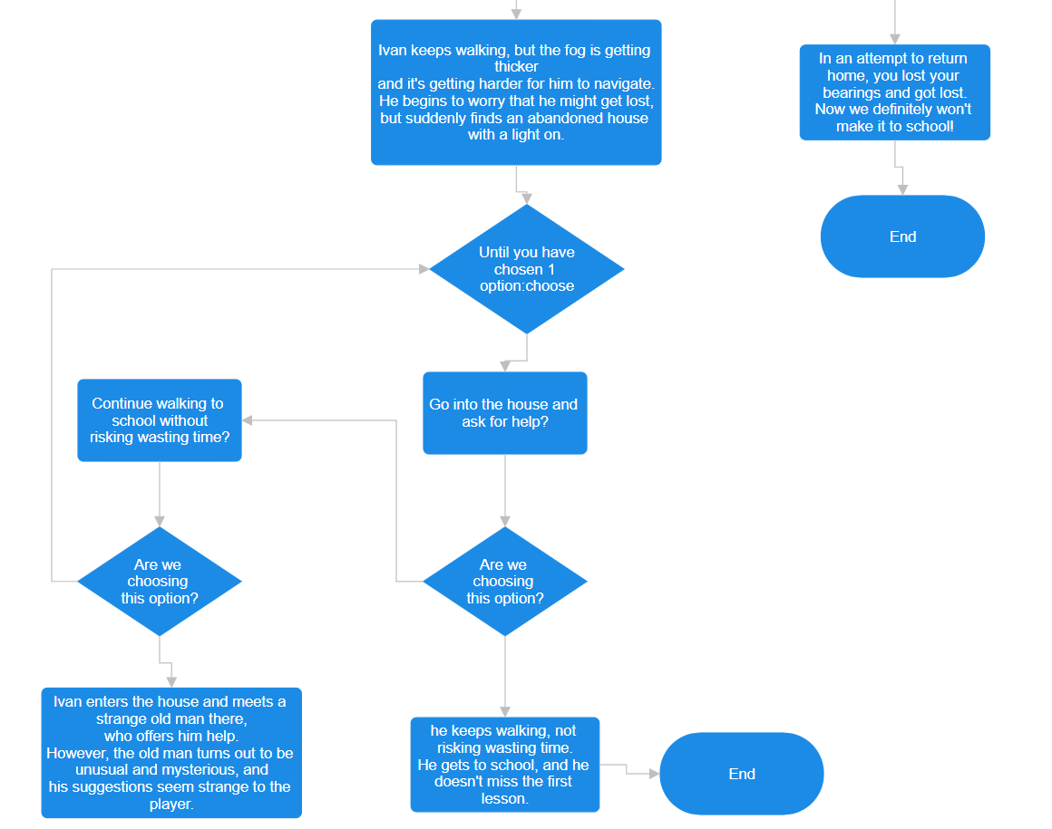
A Happy Ending?
13

Slide 15
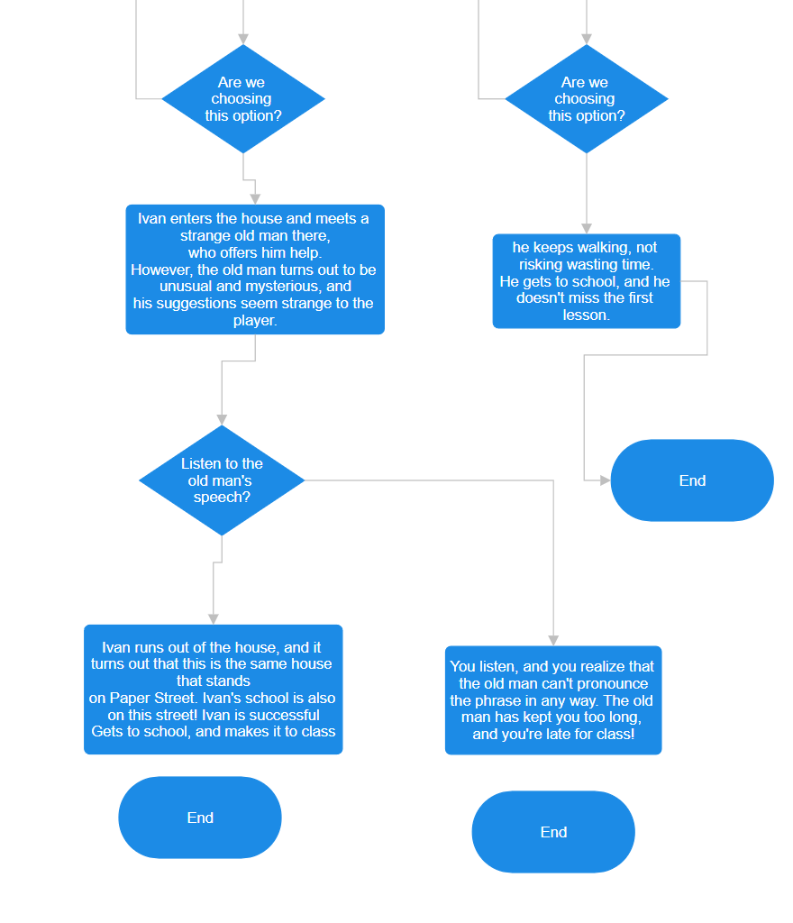
The Beginning "Horror" Story
14

Slide 16
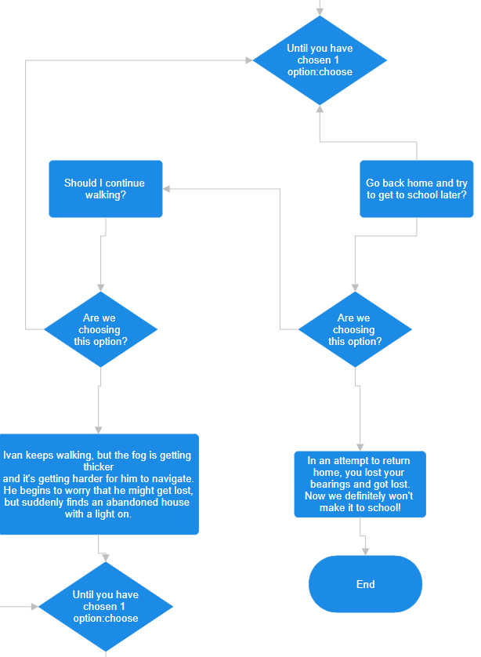
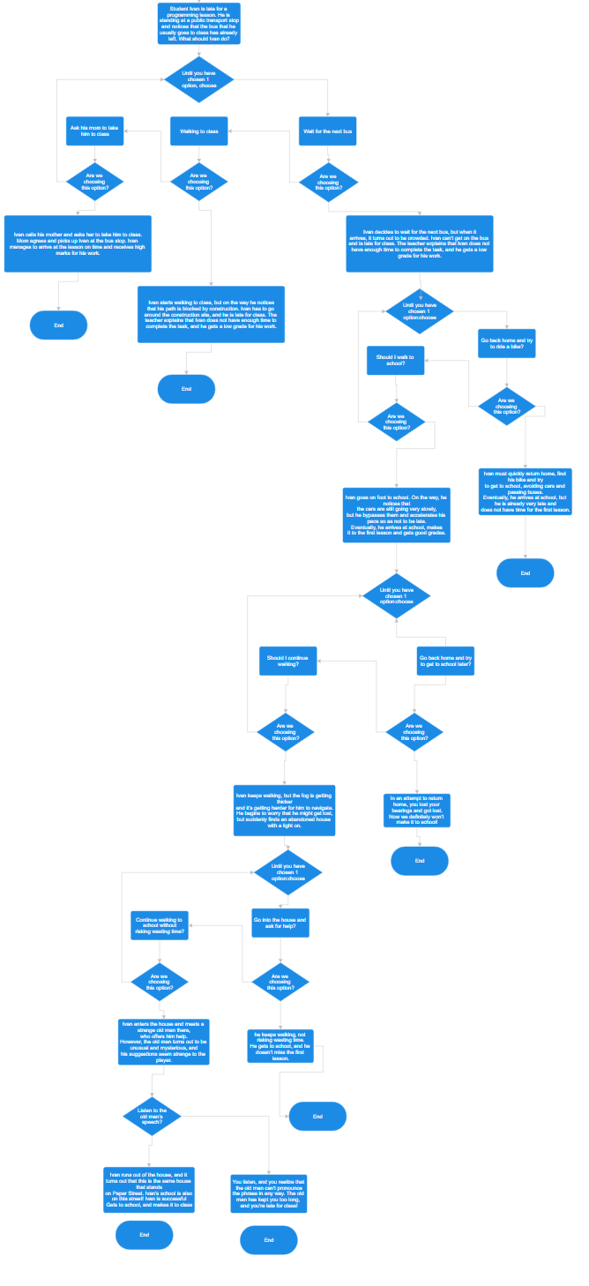
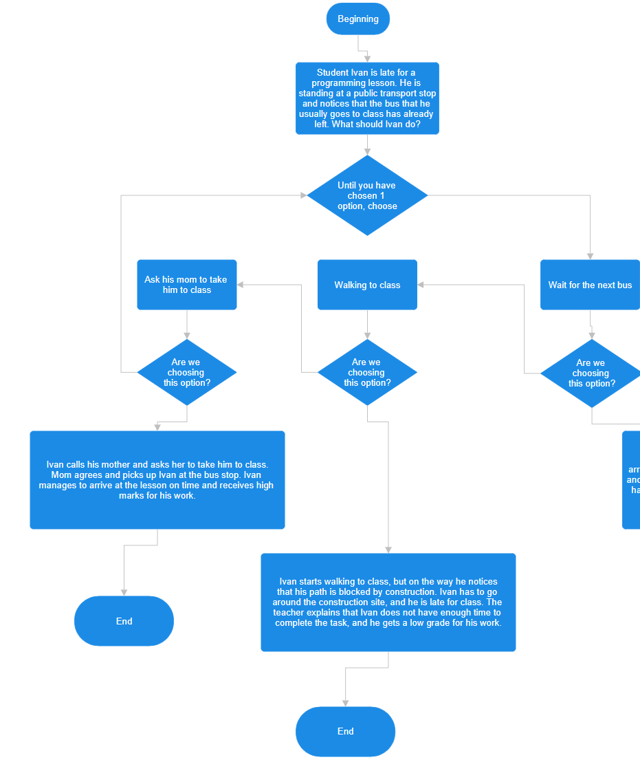
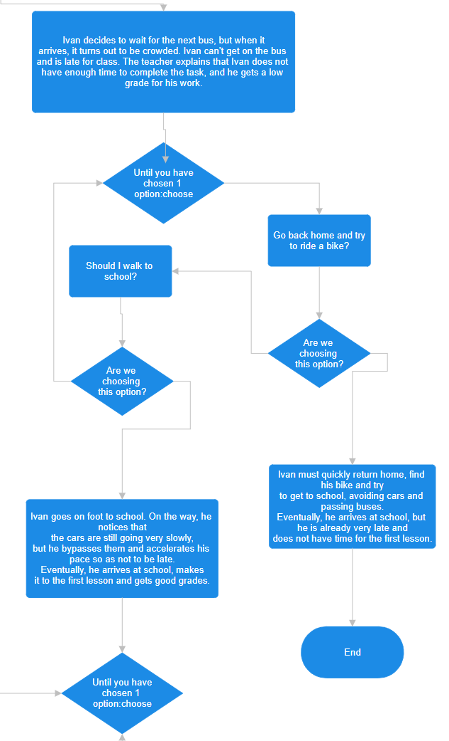
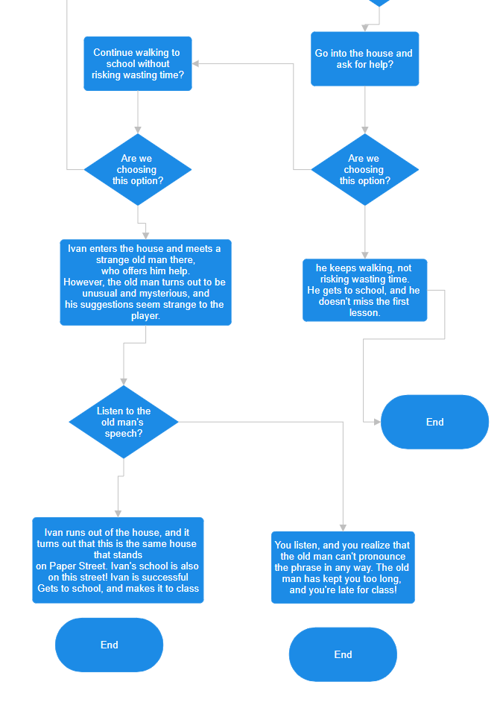
Result
19

