Slide 1
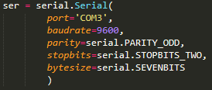
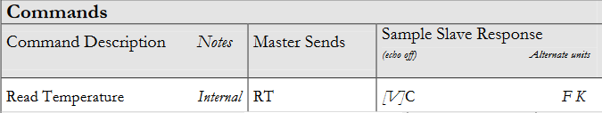
Starting out with the Chiller
Initial configuration
Select the serial port parameters for the communication.
Objective
Create a library in Python that includes all the commands available for the Chiller.
Problems
1 byte = 1 value
2 | 0 | . | 0 | C | CR
[V] |  |  |  | [U] | [CR]
Obtaining the values of the readings to be able to work with them (p.e.: temperature valuesm settings values)
We have to test the serial communication with the Chiller in order to prove that the library is working.

Slide 2

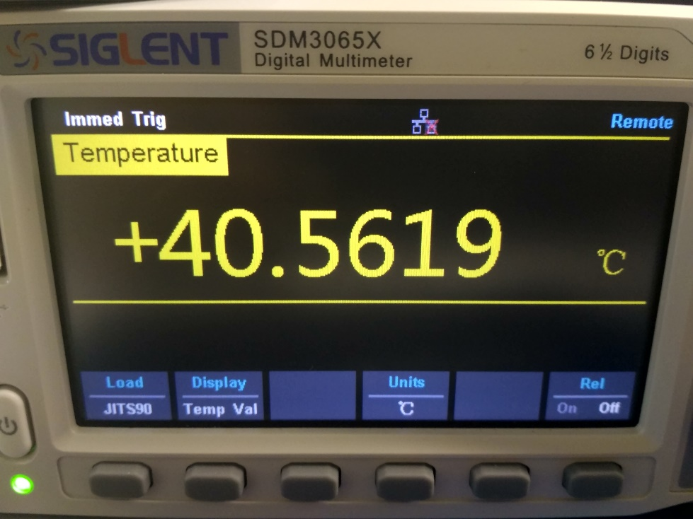

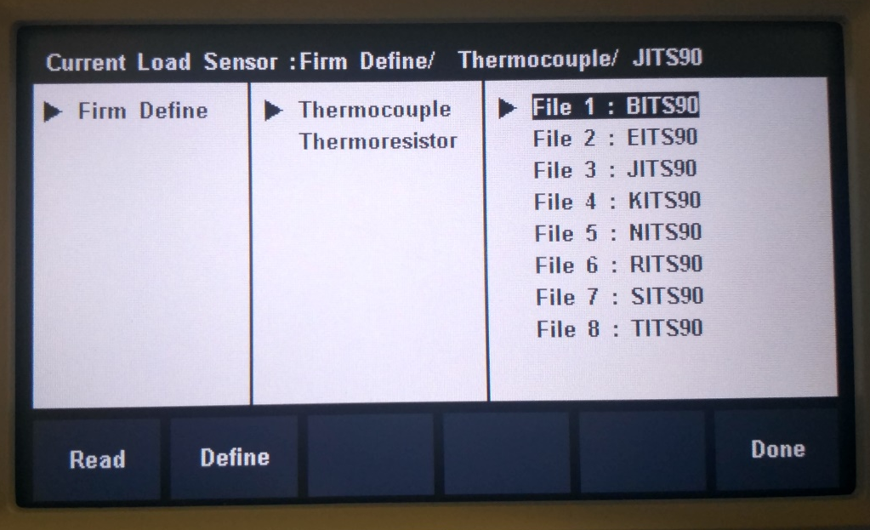

Temperature measurement with Multimeter
Create functions to set the sensor type used (Thermocouple or Thermoresistor) and to select the specific type of these sensors.

