Slide 1

GranaSat Batteries Tester
Names

Slide 2
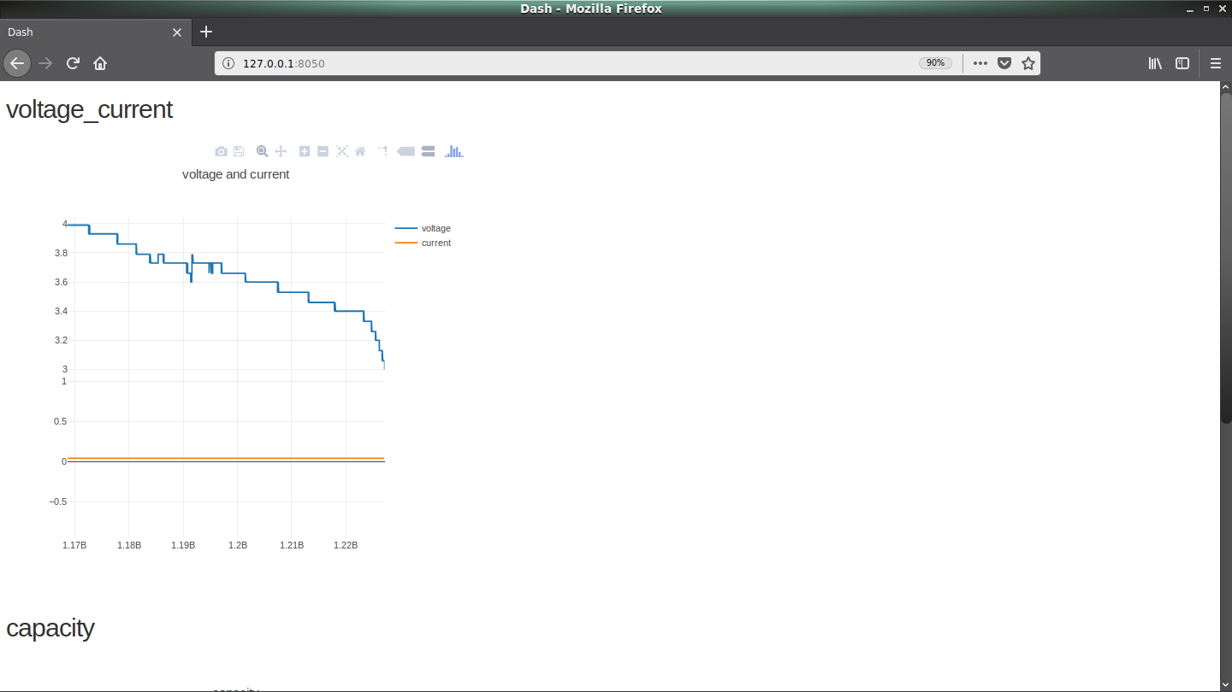
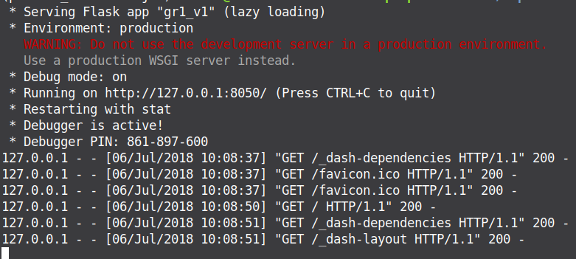

Python libraries in a virtual environment
Utilities
Installation
python3 -m pipenv shell
Libraries
Dash create our own server
Pandas: work with data
Plotly: graphic design
Design proyect
Select test type
Charge.csv data sheet
View result in real time
Stablish multimeter comunication
And control it
Error management

Slide 3
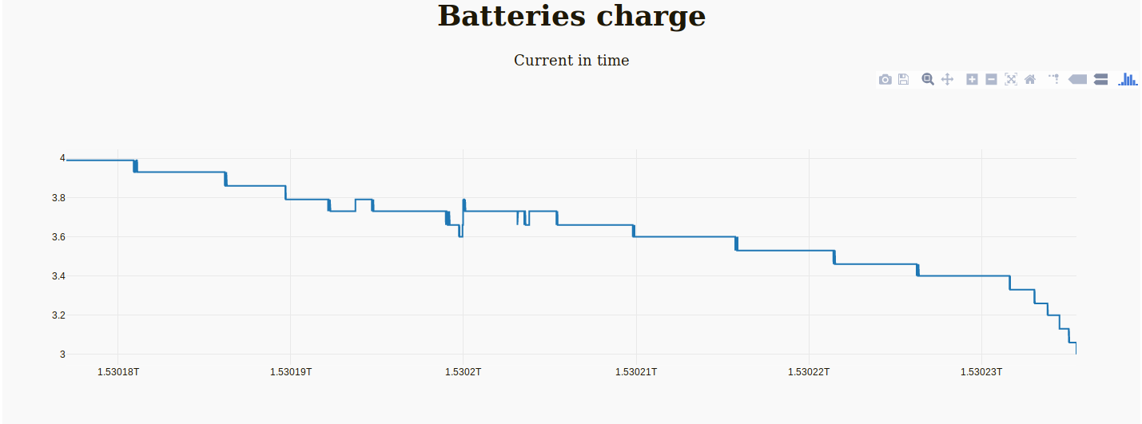
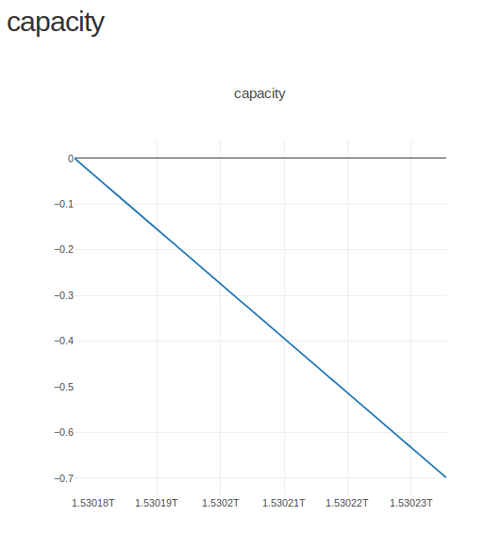
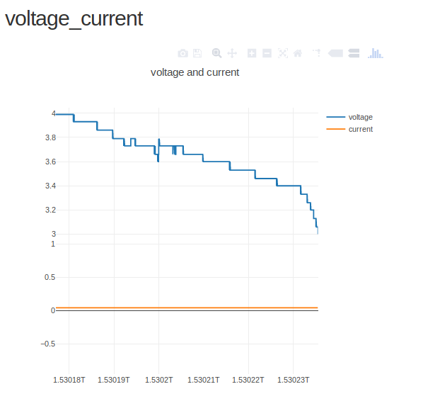
Interface evolution
Actual approach
Two graphics to measure current, voltage and capacity.
Posicionate moise over the graphic to know exactly data.
Posibility to export to png, pdf…
Zoom in, zoom aut
First approach
Make contact dash libray
Two decimal precision
Next implementation
Interactive visualization
Include checkboxes
Include buttons

Slide 4

That is all
HAVE YOU ANY QUERY?

Slide 5
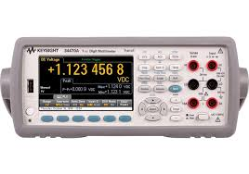
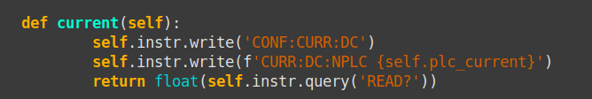
Multimeter control, software
Create our own class in python using visa libraries.
PCL value setting
Instrument comprobation
And value setting
PLC
Current
PCL value reading
voltage
Average in time of
Current
Capacity
Work at 60hz
Problems
Solutions
Create our own funtion of measure.
MEAS::CURR
Reconfigure all instrument

