Slide 1
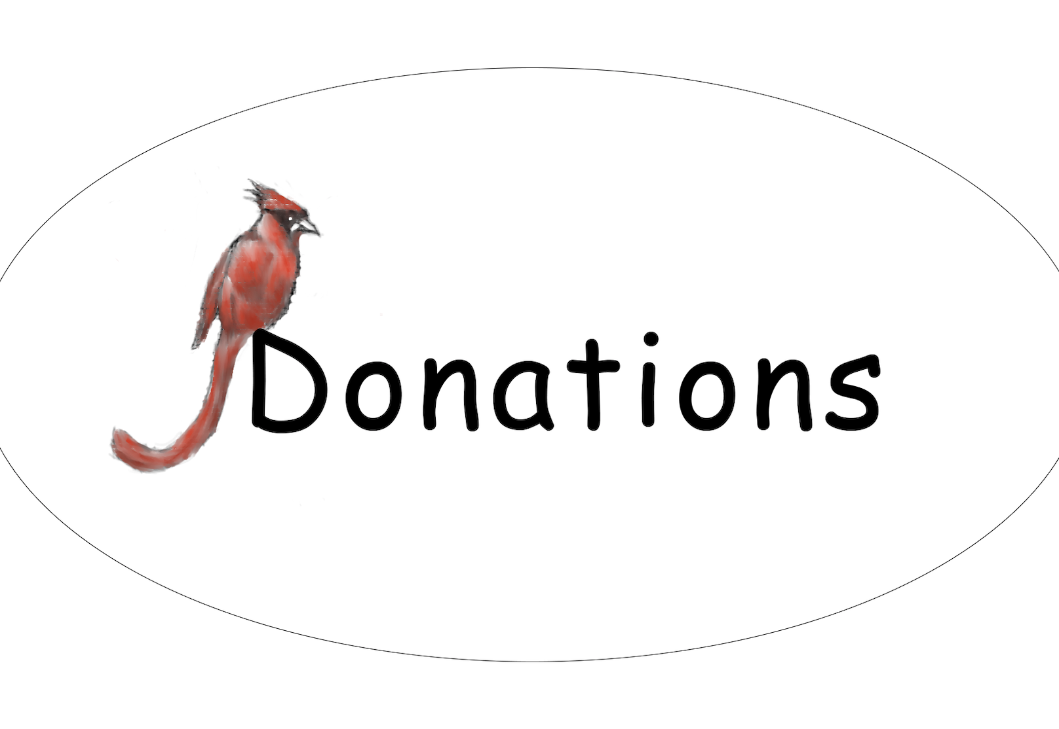
REDJay
Created By
Rahmel Hill
Jorge Quintero-Blancas
Darius Walker
Erick Villegas

Slide 2
Our Goal
This website can facilitate the transfer of old clothes from people who no longer want or need them to people who do and not only that but will help reduce the amount of clothes that end up in landfills.
By evaluating the donated clothes through our approval process, we can ensure that the recipients will be receiving clothes that are in good, wearable condition and offer a consistent viable option for them to have access to quality clothing.

Slide 3
Overview
Offers users the opportunity to donate articles of clothing and include features such as style, brand, and size to describe the type of clothing they are donating.
Once an item is donated, it is cataloged for approval by an admin.
Upon approval it will be available for pick up at a donation center location.
To locate donation centers, users can use the geolocation tab.

Slide 4
Technologies
Entity Framework
LINQ
REST.API
Angular
Azure DataBase
Microsoft SQL Server

Slide 5
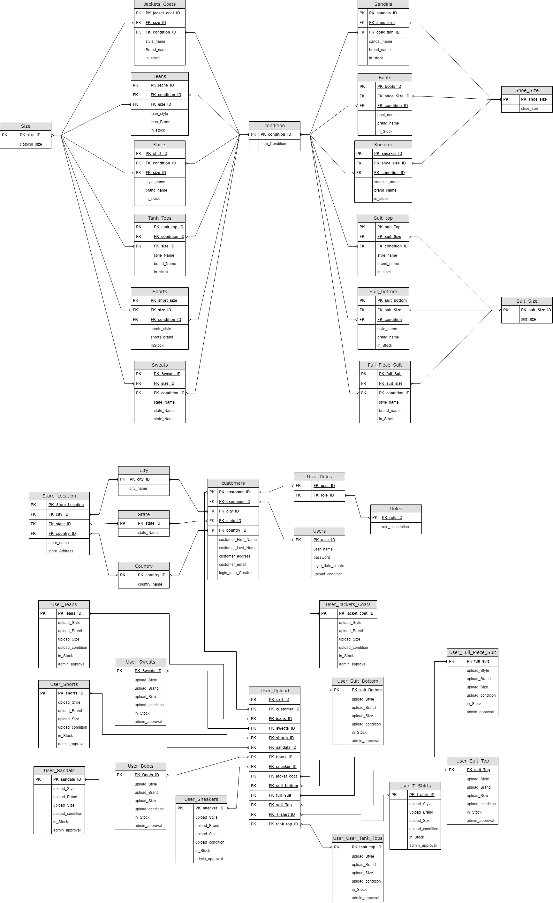
Clothing ER Diagram

Slide 6
User ER Diagram

Slide 7
Future Plans
• Expand our options of donated articles to also include items such as toys, small furniture, dishes, books, and electronics.
• Improve our UI to offer higher quality user interaction.
• Improve backend to run SQL queries in stored procedures
• Add user upload features, having users upload their items for donation, with images
• Implement search function

