Slide 1
PRESENTATION OF A WEB APPLICATION THAT PROVIDES ANSWERS TO PaSt EXAM QUESTIONS IN CUIB
BY BRAINTECH

Slide 2
INTRODUCTION
BRAINTECH IS A WEB BASE APPLICATION DEVELOPED USING PYTHON AND DJANGO WITH AIMS TO PROVIDE PAST EXAM QUESTIONS AND ANSWER TO ASSIT STUDENT ON CAMPUS TO PREPARE FOR EXAMS.

Slide 3
TECHNOLOGICAL REVIEW
To Carry-out Our Project , We Used The Following Technologies :
Visual Studio Code is a code editor for building and debugging web applications.
Python is an object-oriented, high-level programming language for web and app development.
Django is a python framework that is used to build web applications
HTML is the standard markup language for Web pages
CSS is a styling sheet language used to beautify a website.
Bootstrap is a free and open-source web development framework

Slide 4
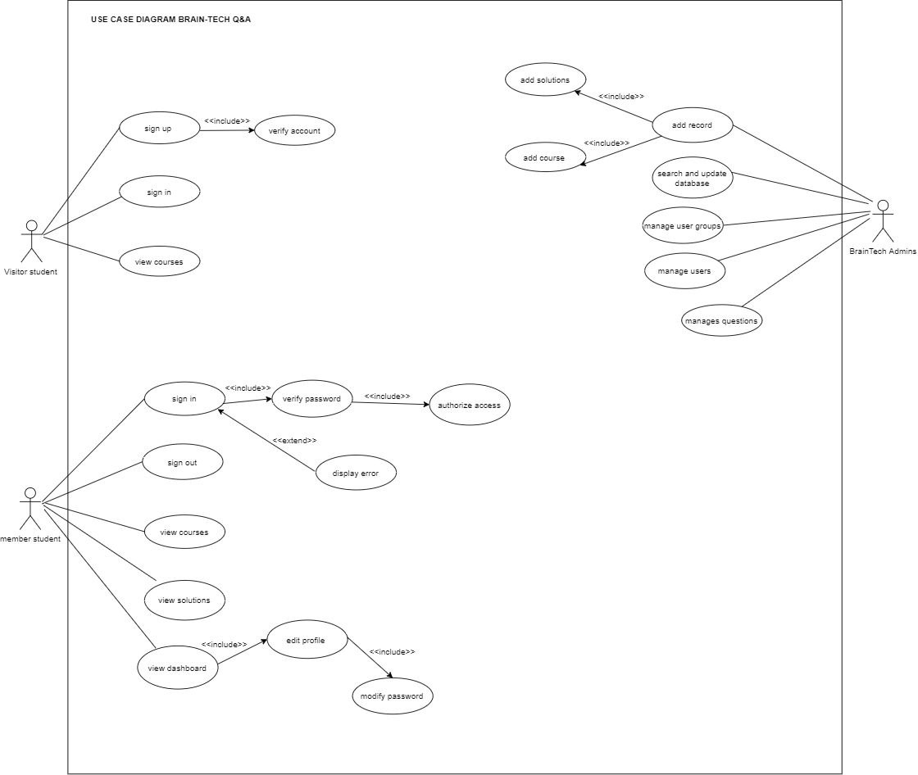
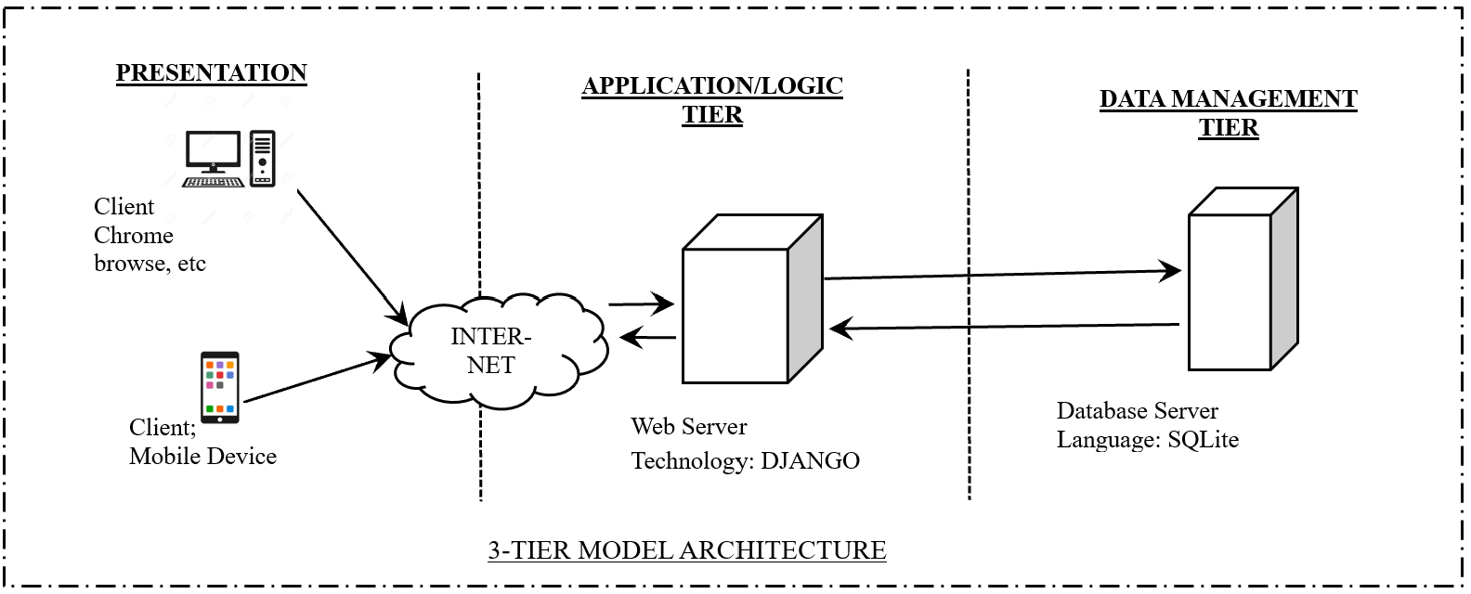
ACTIVITIES CARRIED OUT
USE CASE DIAGRAM
A use case diagram is a graphical description of a user's possible interactions with a system
SYSTEM DESIGN
System design defines the elements of a system such as the architecture and the components so as to meet application expectations.

Slide 5
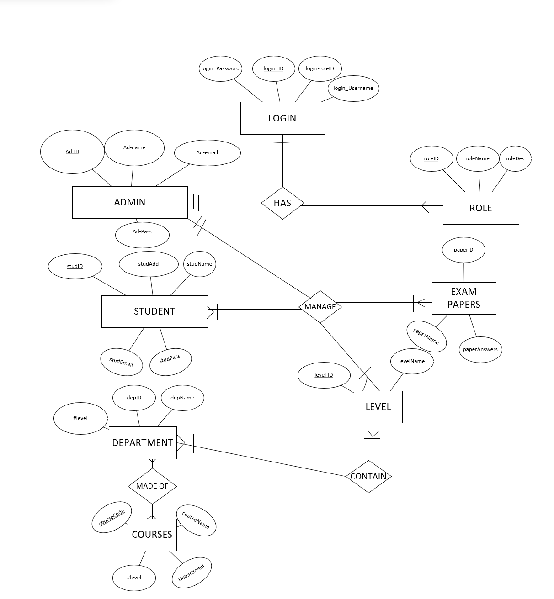
ACTIVITIES CARRIED OUT

Slide 6
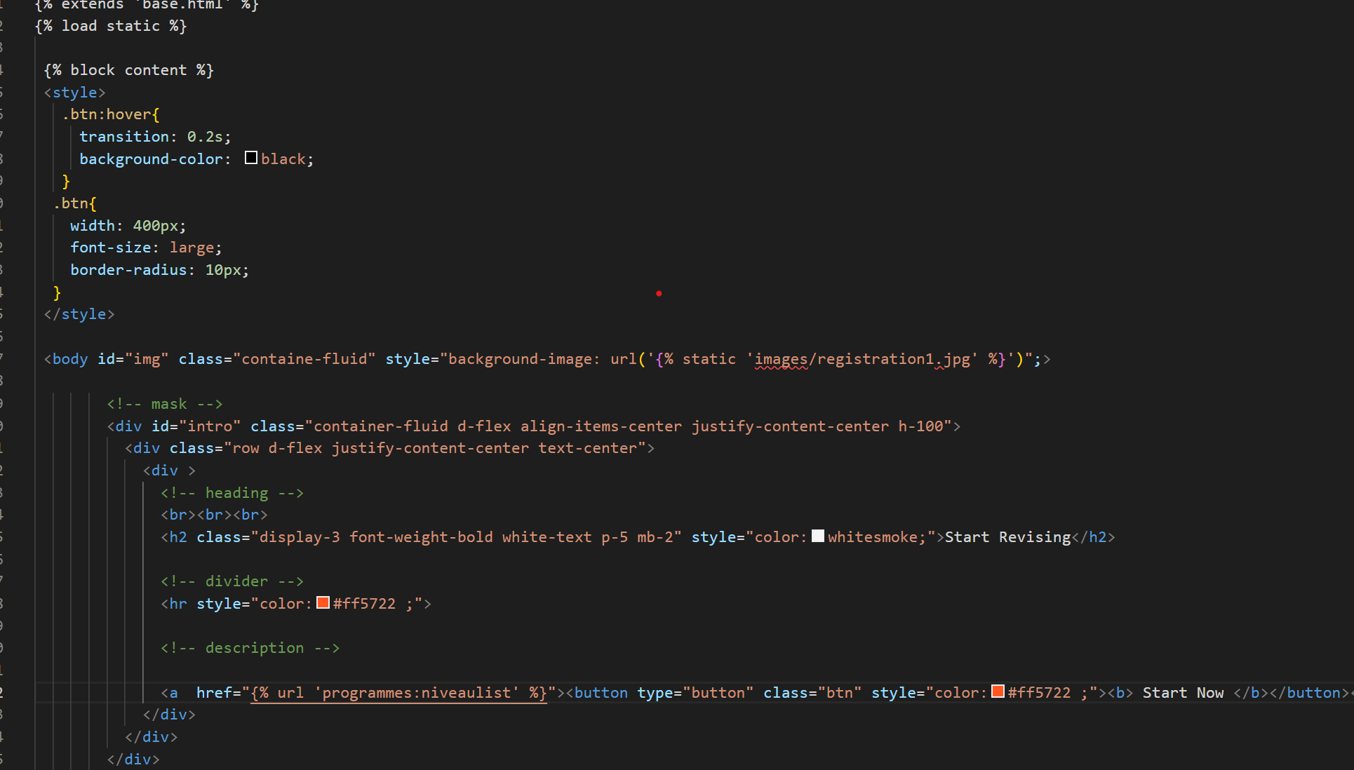
ACTIVITIES CARRIED OUT
FRONT-END
Front-end web development is the development of the graphical user interface of a website, through the use of HTML, CSS, so that users can view and interact with that website.
HOME PAGE

Slide 7


Slide 8
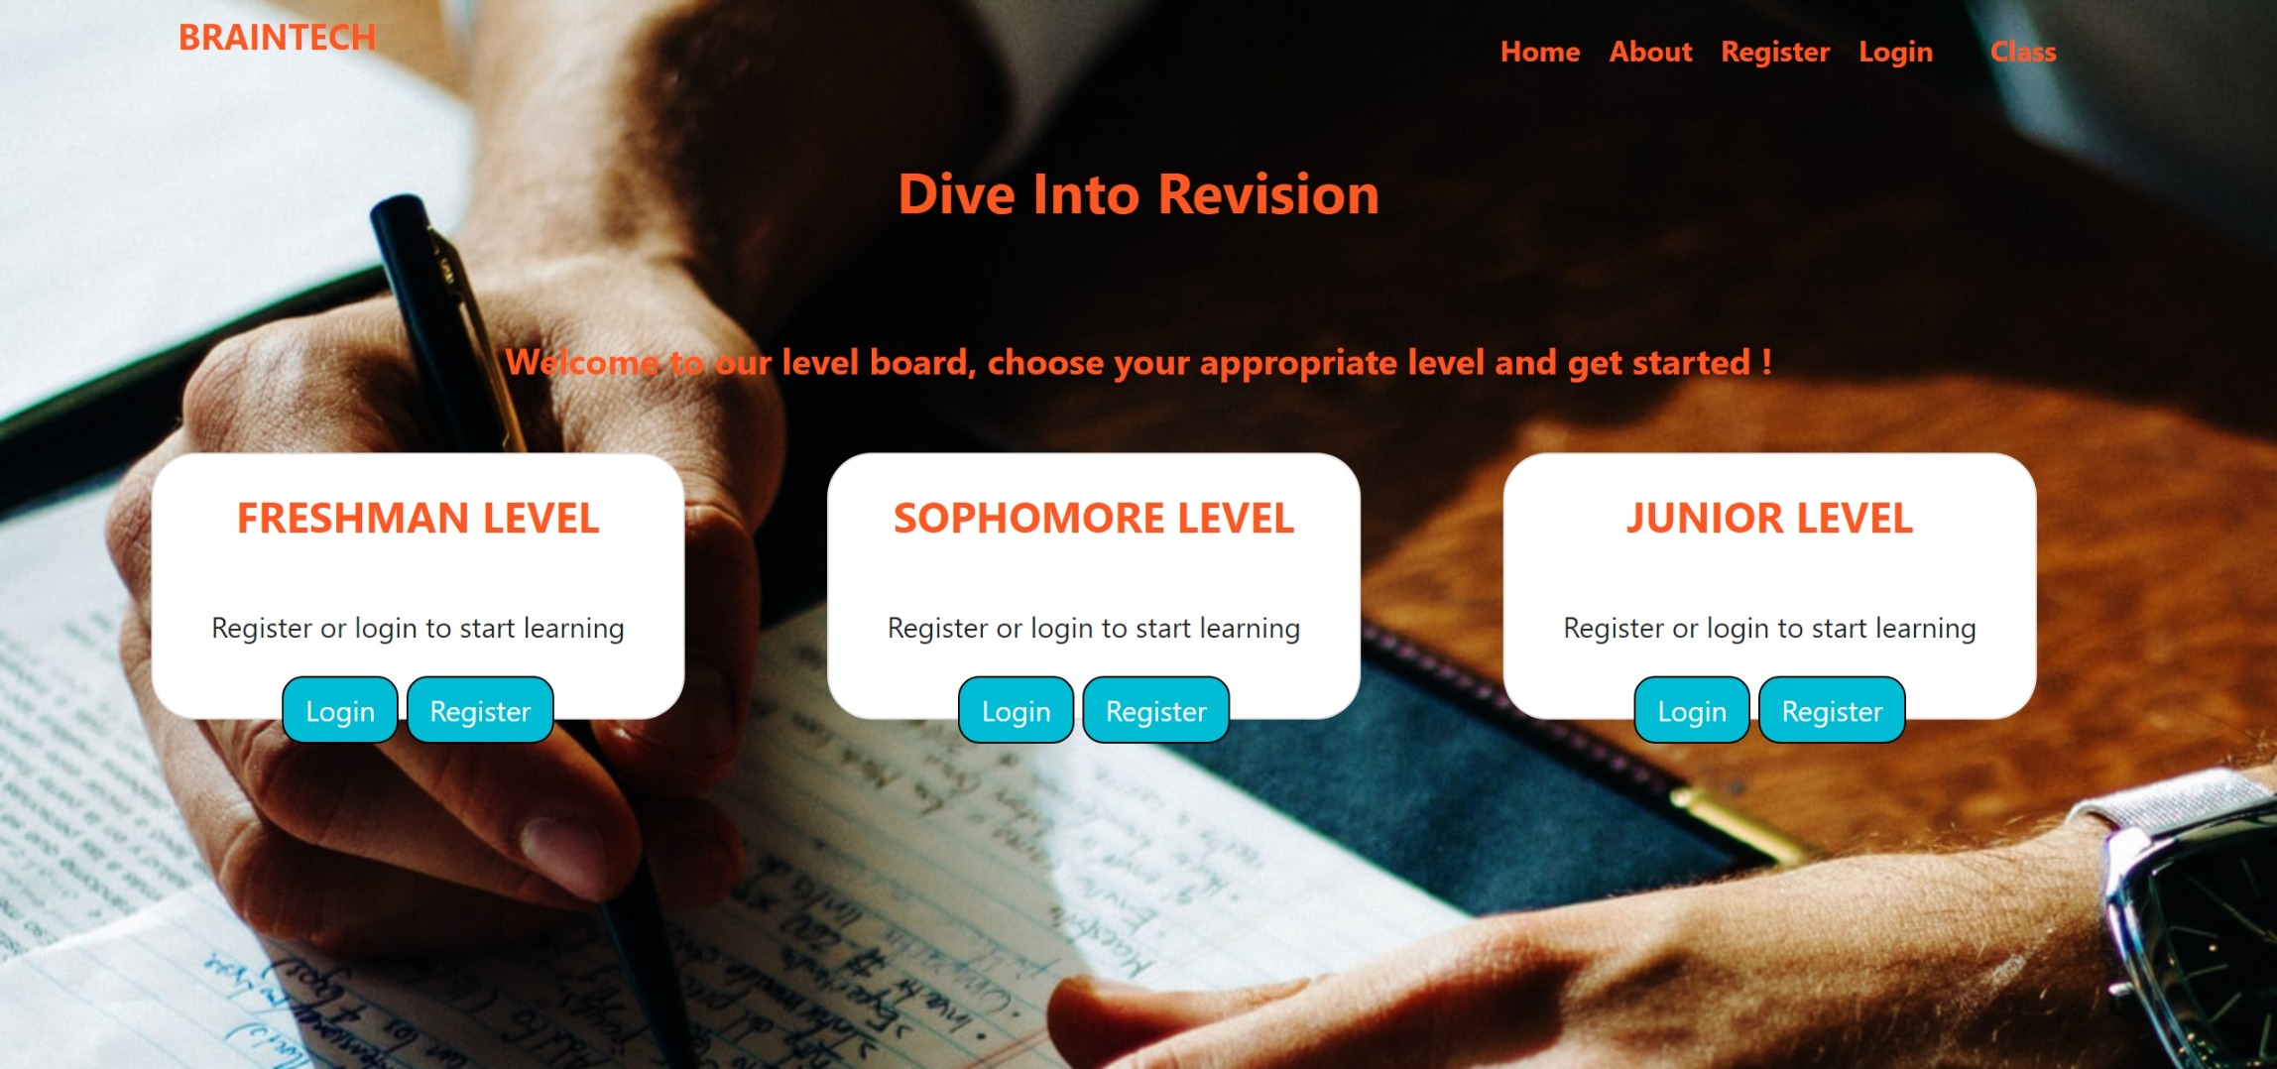

Slide 9
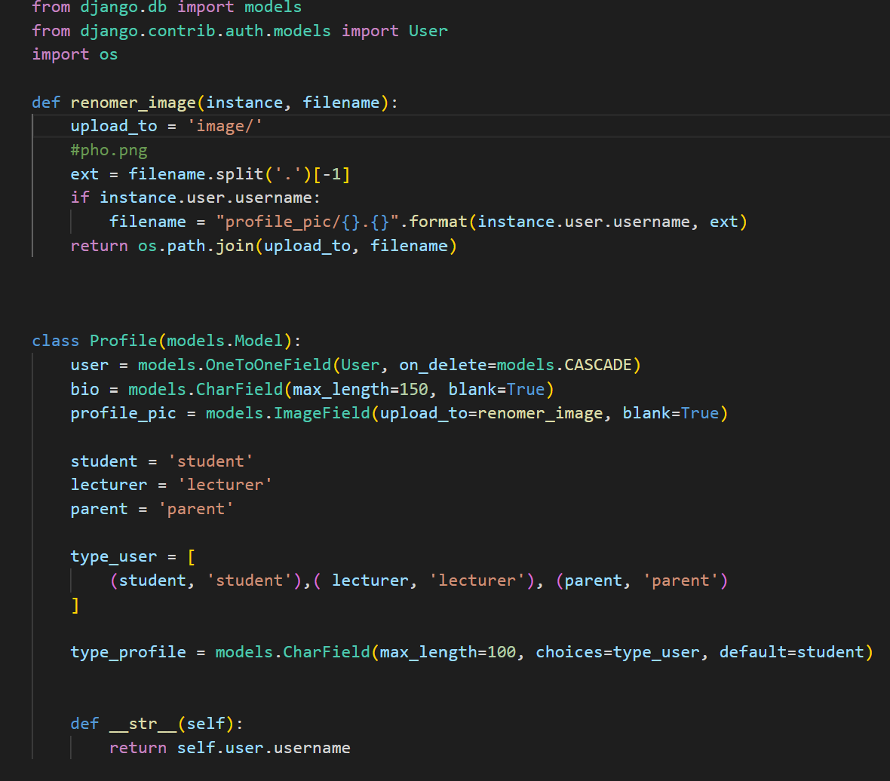
ACTIVITIES CARRIED OUT
BACK-END
Back-end Development focuses on databases, scripting, website architecture. It contains behind-the-scene activities that occur when performing any action on a website.
MODEL.PY

Slide 10
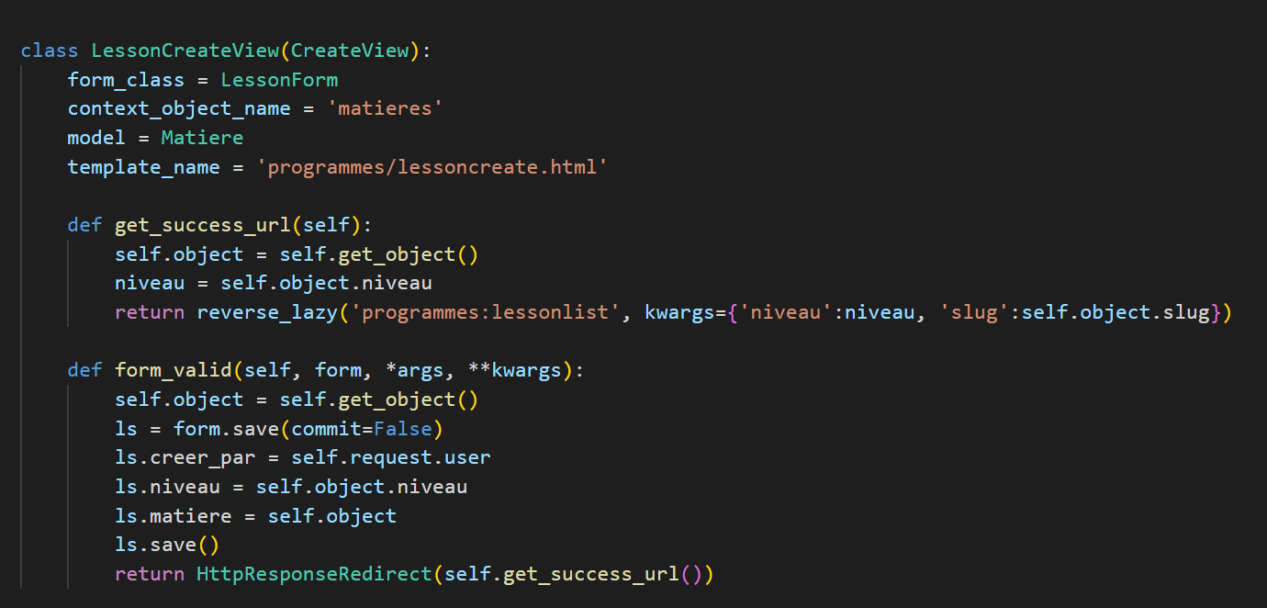
Bellow is the code for create , papers and answers

Slide 11
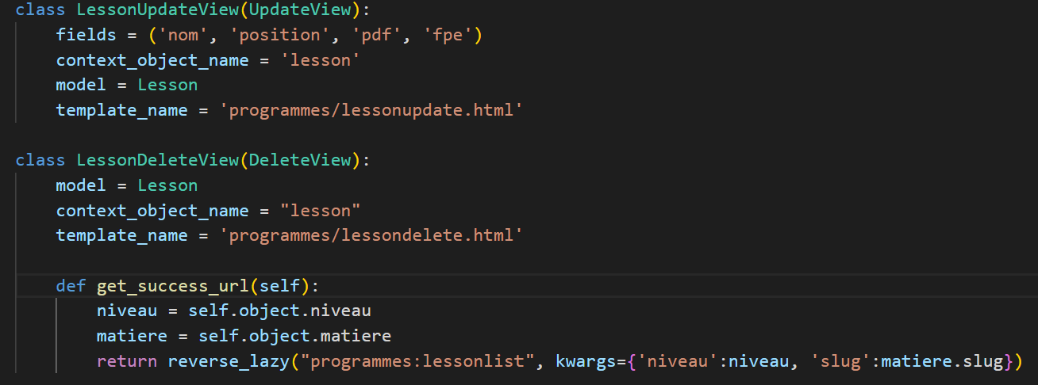
CODES FOR DELETTING AND UPDATING CONTENTS

Slide 12
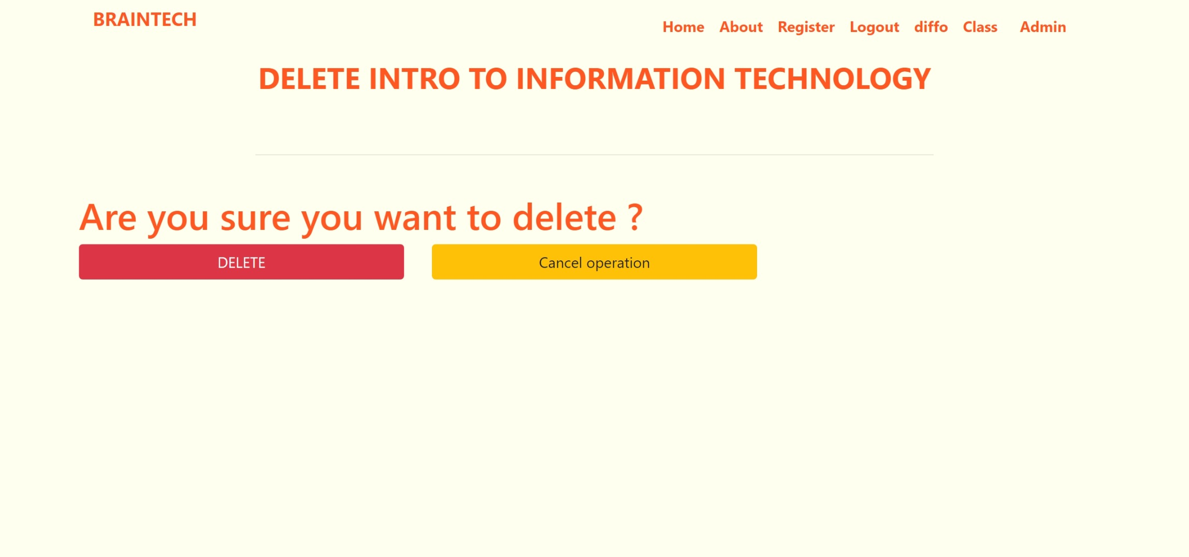
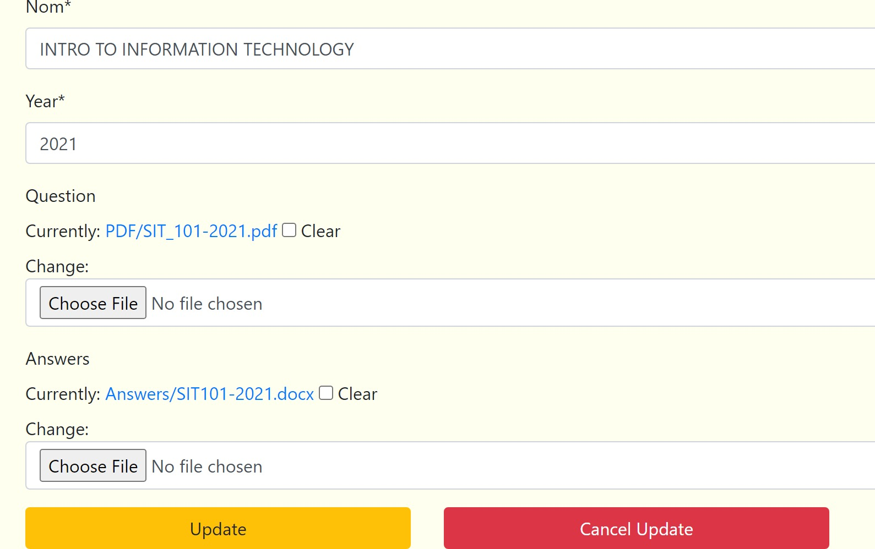
UPDATE AND DELETE VIEW

Slide 13
CONCLUSION & RECOMMENDATIONS

Slide 14
THANK you FOR LISTENING

