Slide 1
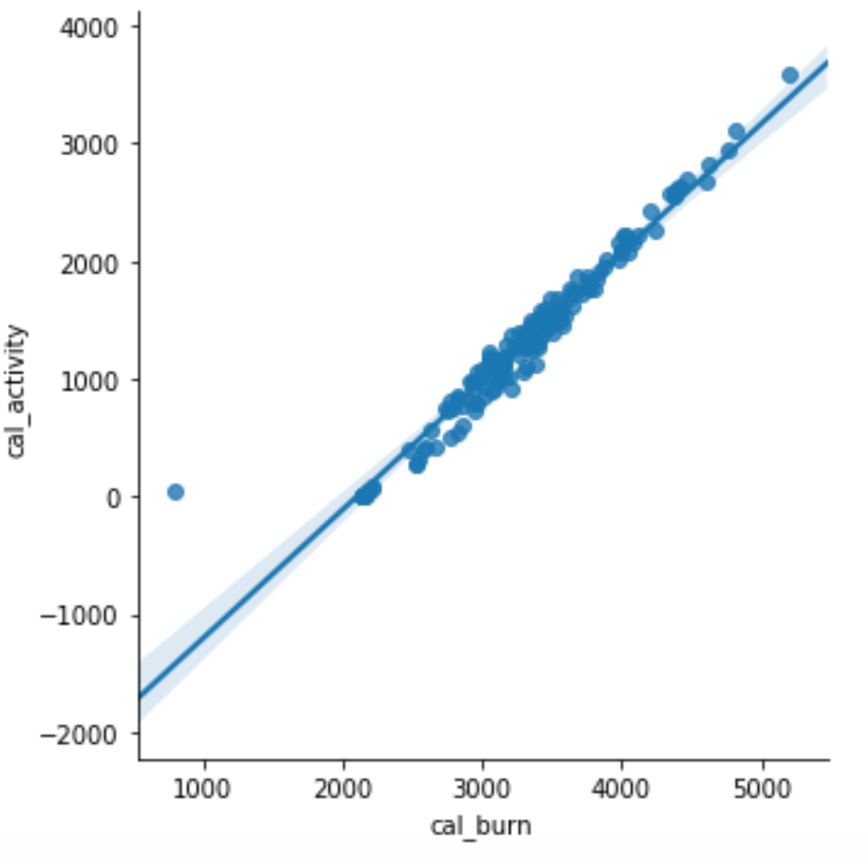
This could be used to explain how we performed imputation
Of cal_activity

Slide 2
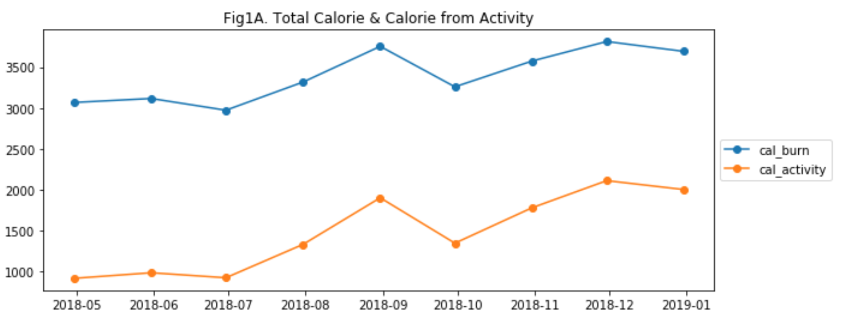
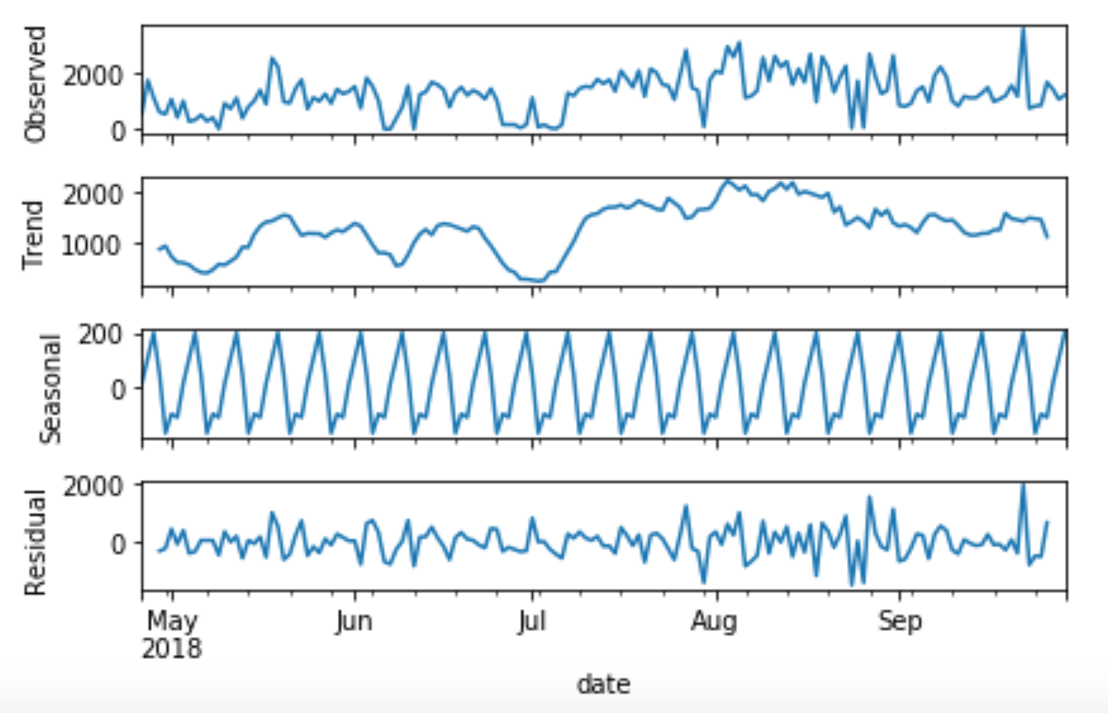
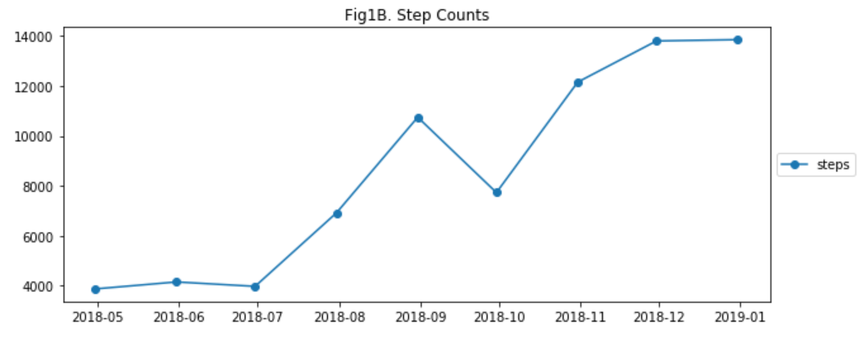
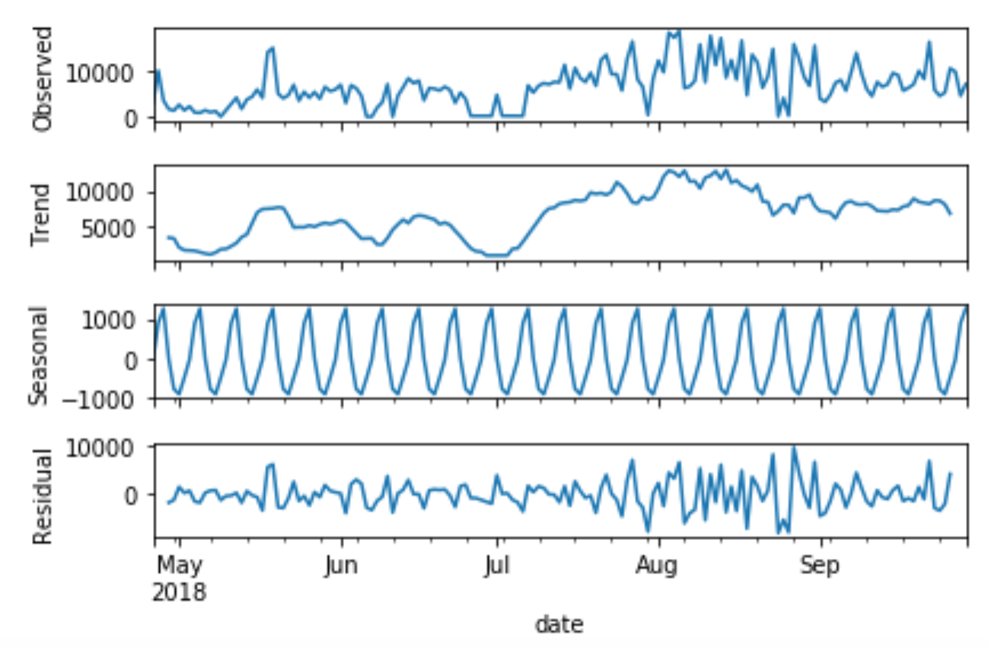
cal_activity
step count
These show how Armstrong trending toward
a more active person toward end of the year,
And the seasonality of his step count &
calorie burned from doing activity

Slide 3
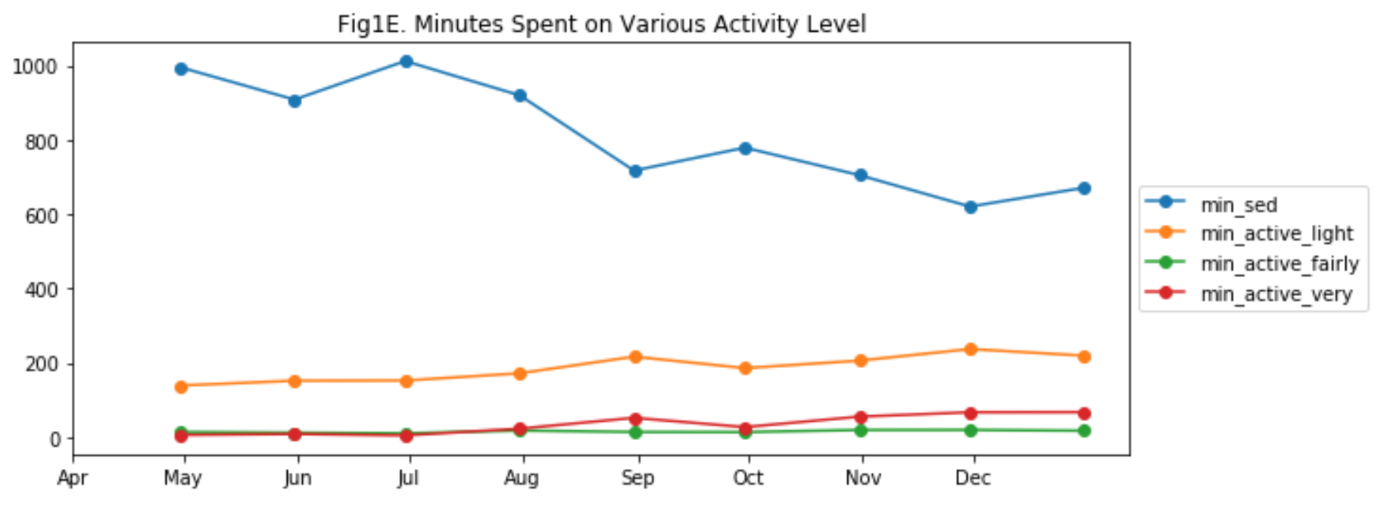
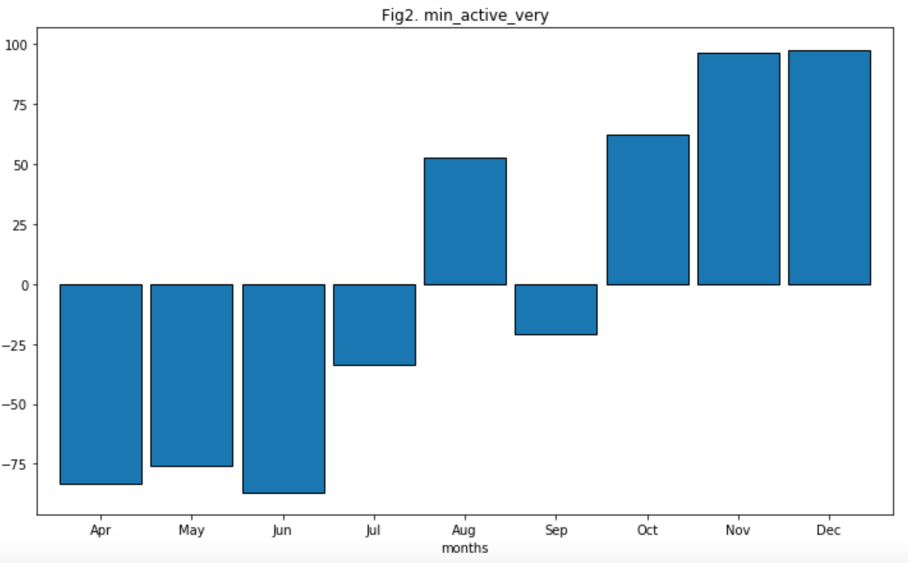
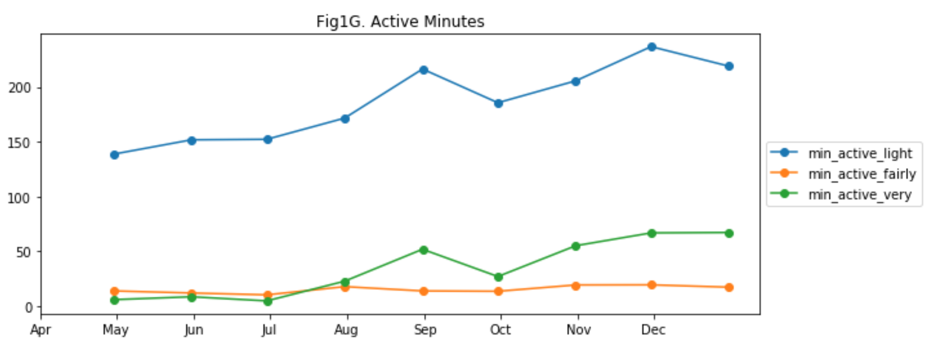
These show how Armstrong trending toward
a more active person toward end of the year,
The fig2 min_activity_very tells us the increase in
His intense activity (compare with average intense
Min). So his life style definitely changing

