Slide 1


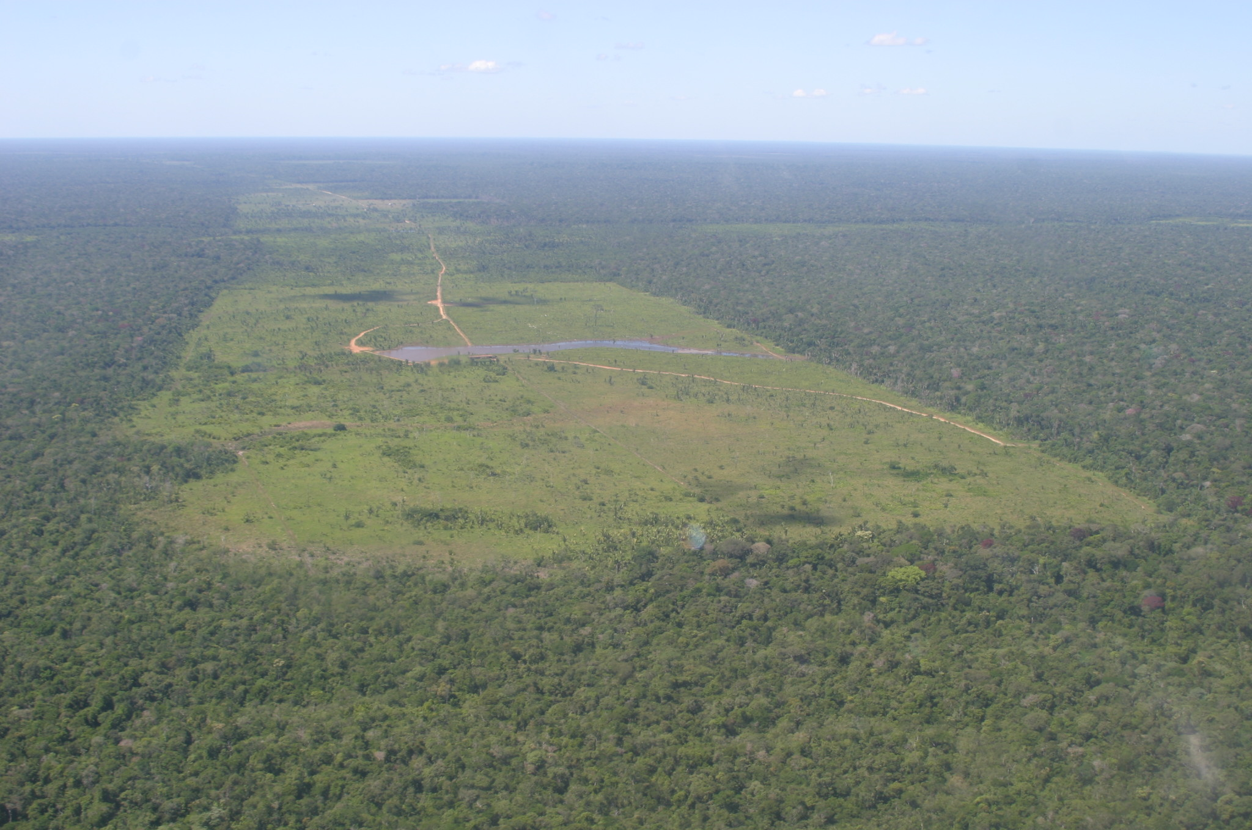
Regional Climate Change Over Eastern Amazonia Caused by Pasture and Soybean Cropland Expansion
Gilvan Sampaio^{1*}, Carlos Nobre¹, Marcos H. Costa², Prakki Satyamurty¹, Britaldo S. Soares-Filho³ and Manoel F. Cardoso¹
¹ CPTEC/INPE
² UFV
³ UFMG
* sampaio@cptec.inpe.br
LBA-ECO 11th Science Team Meeting
Salvador-BA / 2007 September

Slide 2
In the last years, several studies have shown the importance of the tropical rainforests for the Earth’s climate.
Field observations (Gash and Nobre, 1997) and numerical studies (e.g. Dickinson and Henderson-Sellers, 1988; Nobre et al., 1991; Hahmann and Dickinson, 1997; Costa and Foley, 2000) reveal that large scale deforestation in Amazonia could alter the regional climate significantly. Evapotranspiration is reduced and surface temperature is increased for pastures.
Many AGCM modeling studies have considered the sensitivity of the climate system to a complete conversion of Amazonian rainforest to pasture (Dickinson and Henderson-Sellers, 1988; Nobre et al., 1991, Henderson-Sellers et al., 1993).

Slide 3
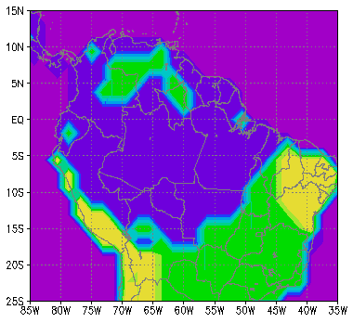
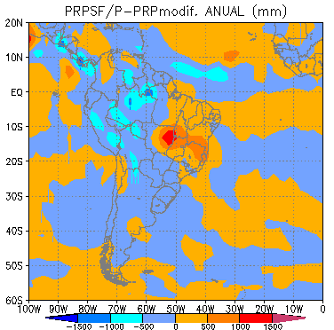
EFFECTS OF LARGE SCALE DEFORESTTION
P pasture - P forest ( annual, in mm)
Oceano
Atlântico
Cerrado
Forest → Pasture
Caatinga
Pacífic
Ocean
Cerrado
Rocha, 2001.
Numerical Simulations of deforestation
1 to 2.5 C surface temperature increase
15% to 30% evapotranspiration decrease
5% to 20% rainfall decrease

Slide 4
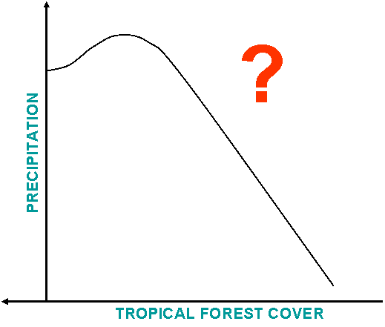
What is the relationship between precipitation and Amazonia forest cover ?

Slide 5
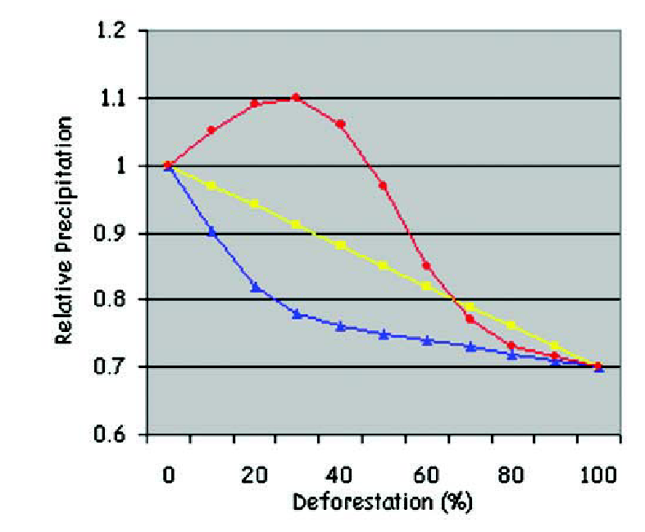
Conceptual models of regional deforestation in Amazonia
“An alternative pattern could represent first an increase of precipitation as a result of partial deforestation, maybe due to the mesoescale circulations, ... followed by a catastrophic decrease passing some threshold value.”
“Increase of the deforested areas
Linear decrease of P”
“Relatively small deforestation could cause a major decrease of precipitation, with a progressing deforestation not having further significant impact”
Avissar et al., 2002

Slide 6
In order to assess the effects of Amazonian deforestation on the regional climate, we used the CPTEC-INPE AGCM driven by land cover maps under a business-as-usual scenario of future deforestation.
Previous studies [Nobre et al., 1991; Lean and Rowntree, 1993, Costa and Foley, 2000; Berbet and Costa, 2003; among others], in general, have considered a single scenario of degraded pasture.
Here, the rainforest is gradually replaced by degraded pasture or by soybean cropland.

Slide 7
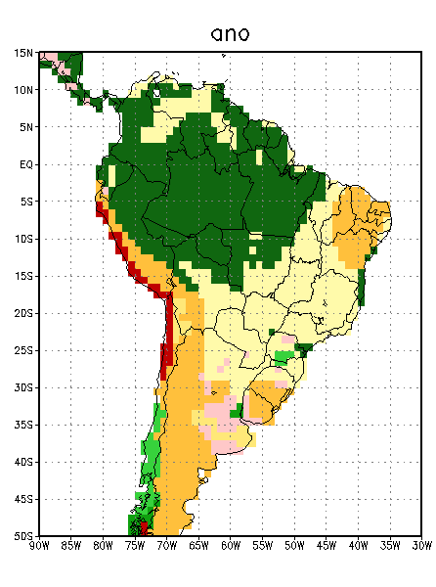
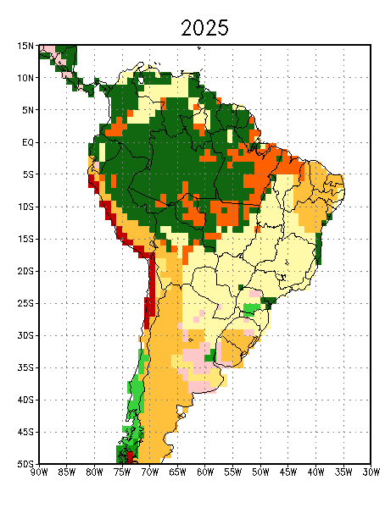
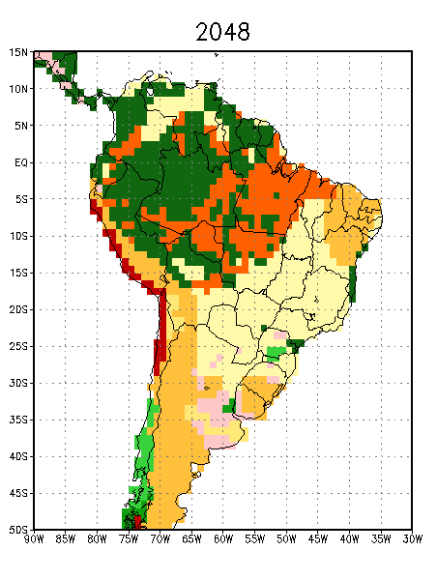
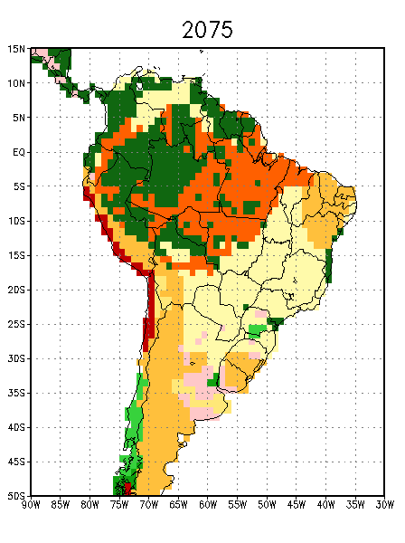
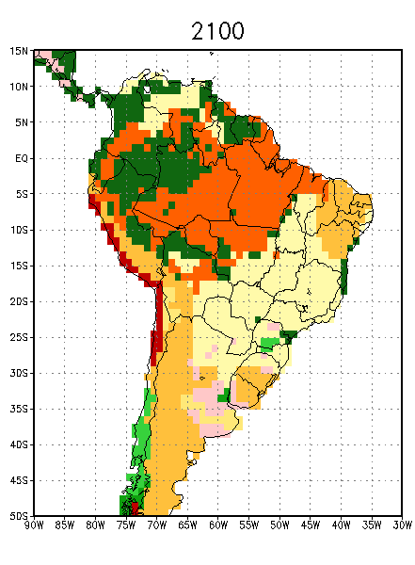
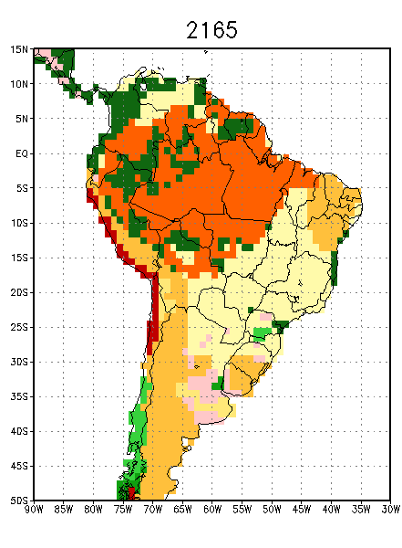
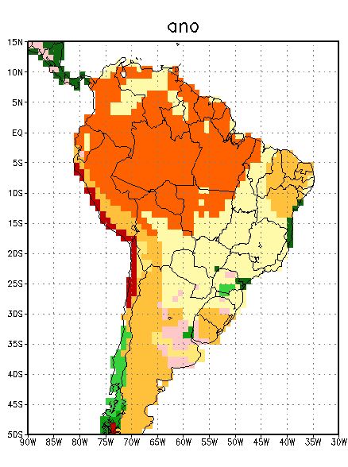
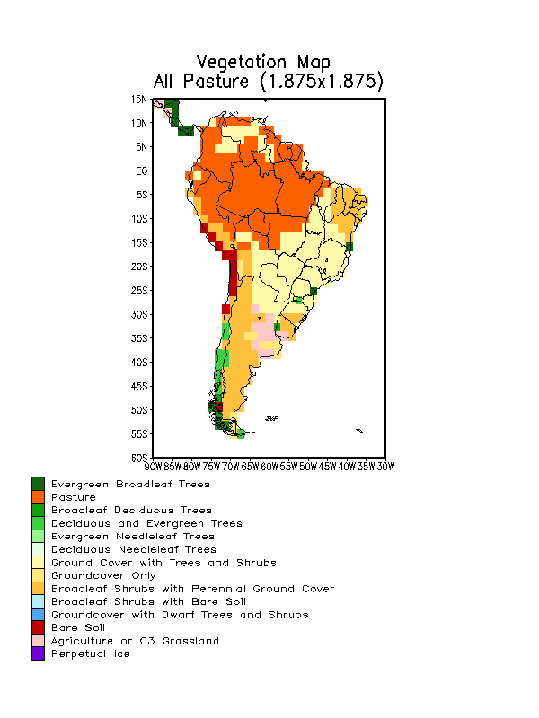
PROJECTED SCENARIOS
Control
20%
40%
50%
60%
80%
100%
or Soybean
Vegetation classification
Dorman and Sellers (1989)
Source: Soares-Filho et al., 2006 and Amazon Scenarios Project, LBA
Sampaio et al., 2007

Slide 8
The land cover change scenarios with deforested areas smaller than 40% are from Soares-Filho et al. [2006].
Their model produces annual maps of simulated future deforestation under user-defined scenarios of highway paving, protected areas networks, protected areas effectiveness, deforestation rates and deforested land ceilings.
The land cover change scenarios with deforested areas greater than 40% are obtained using the same methodology extending further into the future the simulation of deforestation under the business-as-usual scenario.

Slide 9
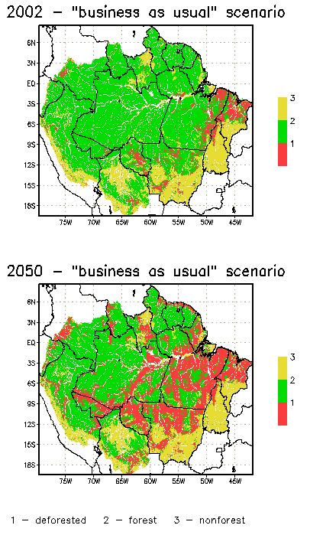
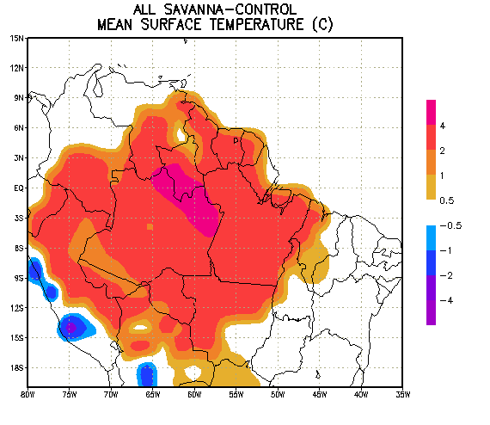
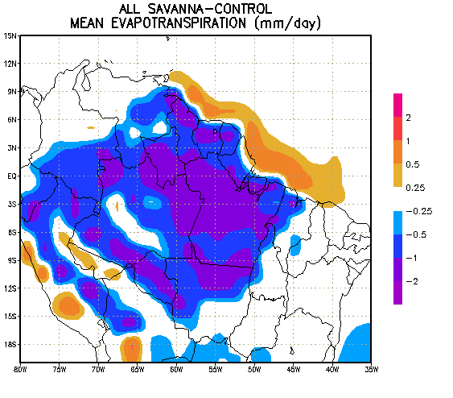
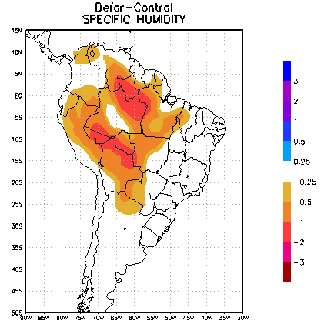
CPTEC
GLOBAL MODEL
RESULTS

Slide 10
MODEL DESCRIPTION AND EXPERIMENT DESIGN

Slide 11
Global Circulation Model – CPTEC/INPE 1.0
(Kinter et al. 1997, Bonatti, 1996, Cavalcanti et al., 2002)
Model horizontal resolution: T062 (~200km x 200 km)
Vertical levels: 42
Land surface scheme: Simplified Simple Biosphere Model (SSiB) – Xue et al., 1991
For each land grid point, a vegetation type (biome) is prescribed, and the vegetation classification follows Dorman and Sellers (1989). A set of physical, morphological, and physiological parameters is assigned to each biome.
Boundary conditions:
Monthly SST: climatological - NCEP-Reynolds e Smith, 1994
Initial climatological values: soil moisture, albedo and snow depth.
Sea ice: considered at grid points for which SST is below -2ºC.

Slide 12
Experiments:
The CPTEC model was integrated for each experiment and control for 87 months with five different initial conditions derived from five consecutive days of NCEP analyses. The results are the mean of the last 60 months (experiment – control).
1) Control case: Today land cover scenario.
2) PASTURE: Land cover change scenarios with deforested areas equal to 20%, 40%, 50%, 60%, 80% and 100% of the original extent of the Amazon forest.
3) SOYBEAN: Land cover change scenarios with deforested areas of 20%, 50%, 80% and 100%.
For each scenario a pseudo-equilibrium between the climate and vegetation was obtained.

Slide 13
Based on Nobre el al. [1991], Xue et al. [1996] and the ABRACOS experiment [Gash et al. 1996], we create a new vegetation type called degraded grass (pasture).
Based on Costa et al. [2007], we created another new vegetation type called soybean cropland (soybean), which has the physiology of a C3 plant.
The modeled soybean crop was planted on 4 February, and harvested on 15 June, and in the remainder of the year the land cover type was bare soil.

Slide 14
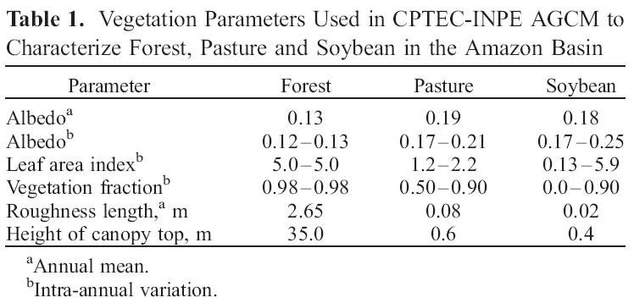
These differences arise mainly because the soybean crop was grown only during the first half of the year, becoming bare soil during the remainder of the year.
Sampaio et al., 2007
Geophys. Res. Lett., 34

Slide 15
AGCM
RESULTS

Slide 16
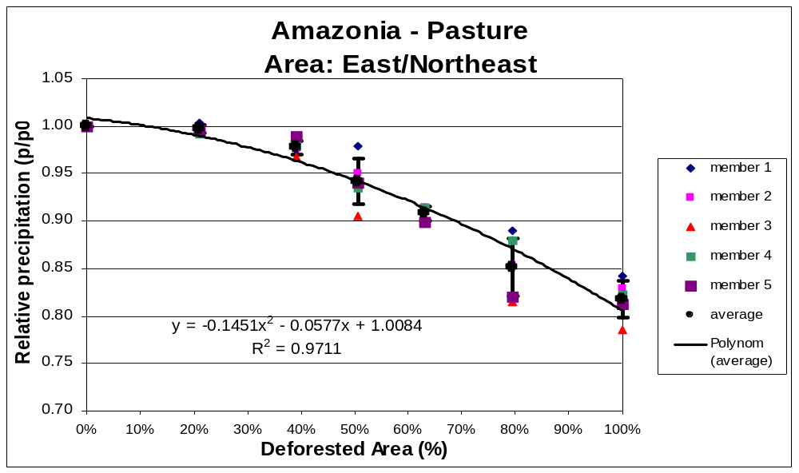
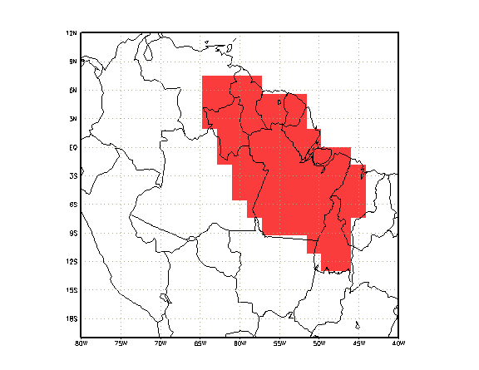
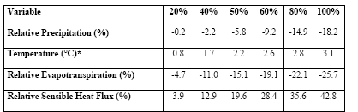
Amazonia - PASTURE
decrease in precipitation associated with pasture expansion
Sampaio et al., 2007
Geophys. Res. Lett., 34

Slide 17
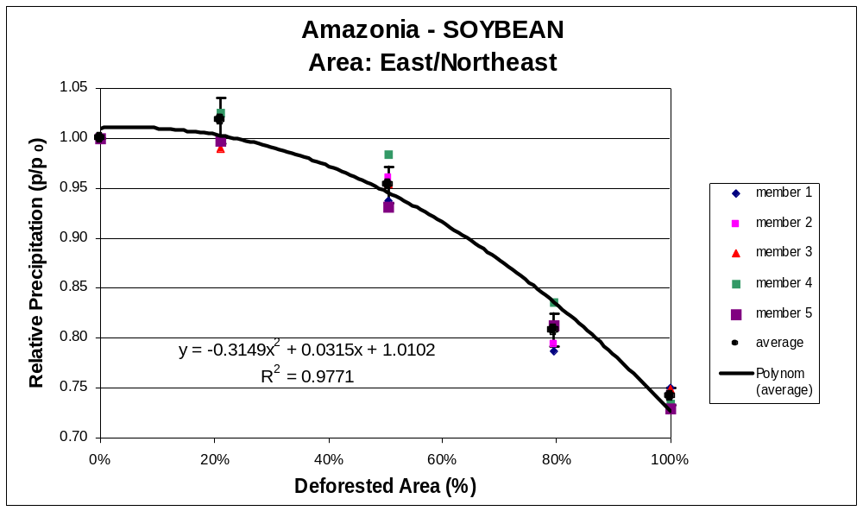
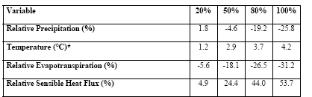
Amazonia - SOYBEAN
the magnitude of precipitation decrease is higher over soybean than over pasture
Sampaio et al., 2007
Geophys. Res. Lett., 34

Slide 18
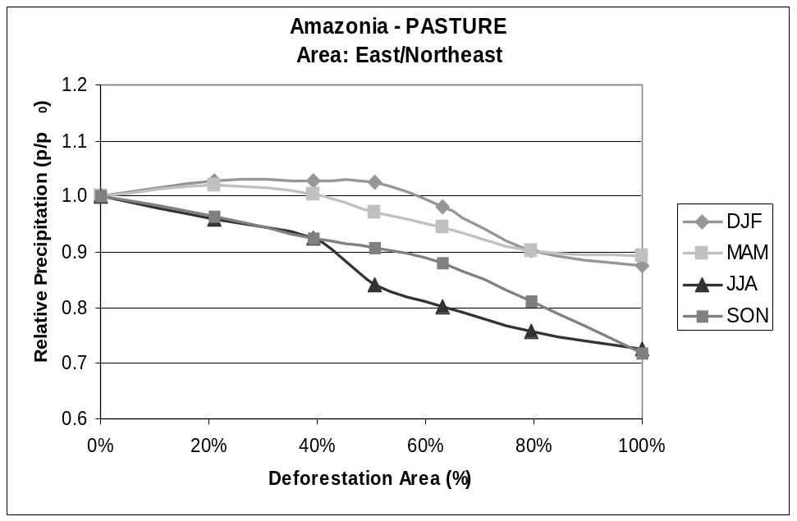
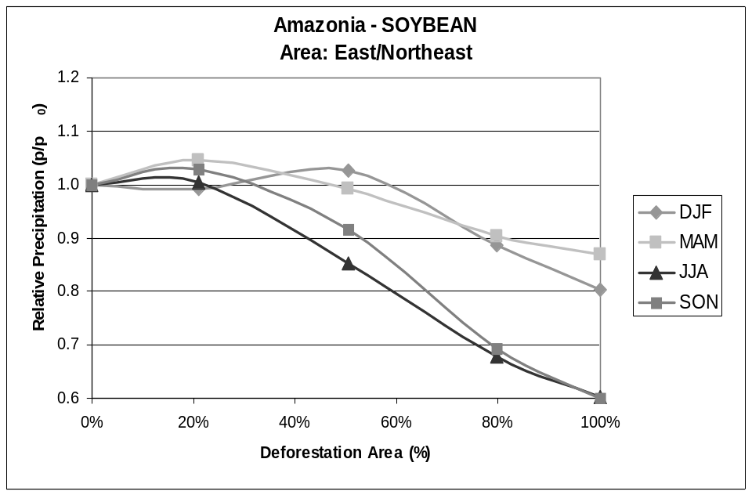
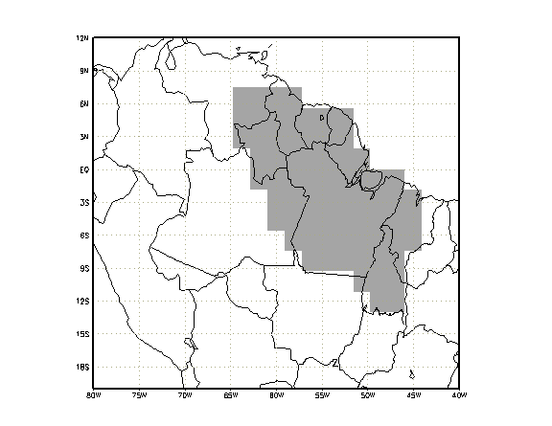
Precipitation
PASTURE
SOYBEAN
Relative Precipitation
Season | All Pasture | All Soybean
JJA | -27.5% | -39.8%
SON | -28.1% | -39.9%
The reduction in precipitation occurs mainly during the dry season, and is more evident when the deforested area is larger than 40% !
Season | All Pasture | All Soybean
JJA | -15.7% | -24.0%
all Amazonia
Sampaio et al., 2007
Geophys. Res. Lett., 34

Slide 19
CONCLUSIONS
The results for eastern Amazonia show increase in surface temperature and decrease in evapotranspiration and precipitation. The precipitation change after deforestation over eastern Amazonia is associated with increase in albedo and reduction of evapotranspiration associated with the lower surface aerodynamic roughness, the lower leaf area, and the shallower rooting depth of pasture and soybean cropland compared with forest.
The relationship between simulated precipitation and deforestation shows an accelerating decrease of rainfall for increasing deforestation for both classes of land use conversions. The reduction in precipitation in this region is more evident when deforestation exceeds 40% of the original forest cover, and this reduction in precipitation occurs mainly during the dry season.
The reduction in precipitation can create favorable conditions to potentially alter the structure of the forests, and lead to a process of savannization, as suggested by some studies [e.g. Nobre et al., 1991; Oyama and Nobre, 2003; Hutyra et al., 2005].

