Slide 1


Analysis of the Veterans Affairs
Through DCHV as a Sample set

Slide 2
DCHV program analysis

Slide 3
Per my obligations; here is my Due Diligence as well as Due care.
This is not an investigation at this point. Purely just an observation.
VA employees are systematically targeting specific veterans attacking them using passive aggressive techniques

Slide 4


Slide 5
State of homeless key factors
Food insecurities
Lack of nutritious food
Lack of access to grocers
Starvation
Stable shelter insecurities
Lack Secure place to function
Communal living
Adruped relocation
Secure from external elements
Exposure to dispirted living regulation
Mental insecurities
Constant demoralization
Societal isolation(cast away)
Mental wellbeing
Stigma due to folly
Predatory infrastructure
Lack of assistance
Starvation
Stabilization insecurities
Ability to increase monetization
Fulfilling job placement
Reliable transportation

Slide 6
Effective communication
Vocational Rehab
Occupational therapy
Mission Nutrition
The ‘DCHV check-in’ is performed in all the courses. Leaving no actual response time. Forcing us to share sensitive information with those whom may misuse it, as well as showing no compassion to the issue.
Recreational Therapy
Spirituality
Criminal mind and addictive thinking
Anger Mangement
DCHV check in
Mindfulness
Emotional honesty
Recreational Therapy
Healthy Living
Whole Health
Marked in red are courses with inappropriate and unethical conversations.
Mindfulness
Essential for recovery
Reflection point
Marked in blue are class that do not occur
Marked in yellow class with little relevency
Marked in green are acceptable class

Slide 7
Lack of therapeutic time
Loud knocking every two hours called ‘Health and safety’ checks ( from 8am to 10pm).
‘Room inspections’ done on off hour.
Unable to leave building similar to CT6.
After 10pm check seem to be done every three throughout the night ( by nursing).
Intercoms are loudly continuously up to 10pm each day.
Lack of access to affordable hygiene materials.
One least than minutes interaction with case manager with no follow-up/through.
Program leads are alway unavailable to resolve issues or address concerns.
The are no Veterans Affairs programs for healthy adults under the age of 60.

Slide 8
Nutrition

Slide 9
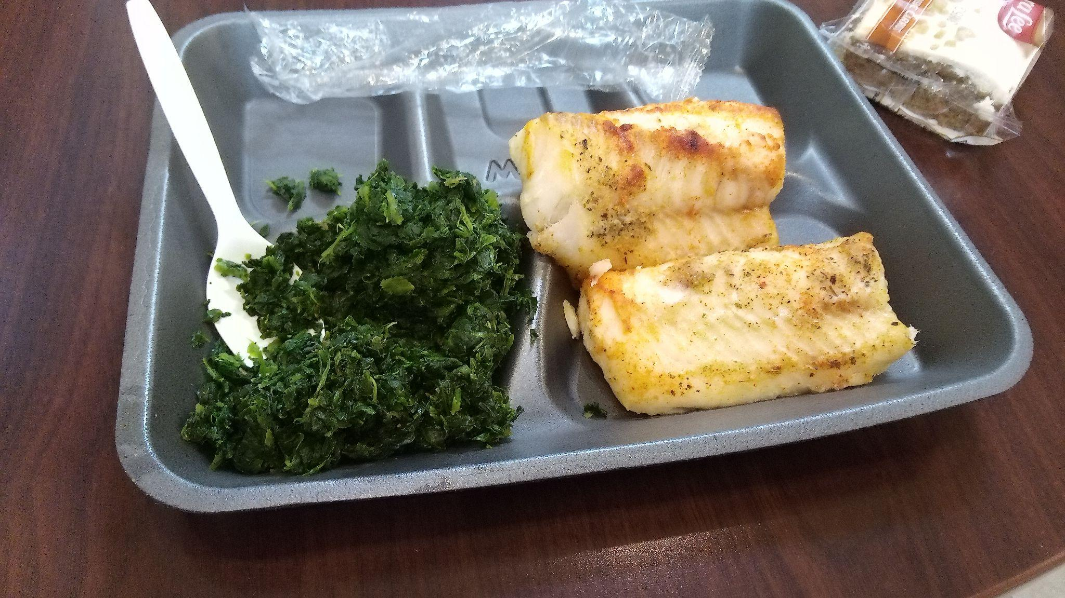
Best meal

Slide 10
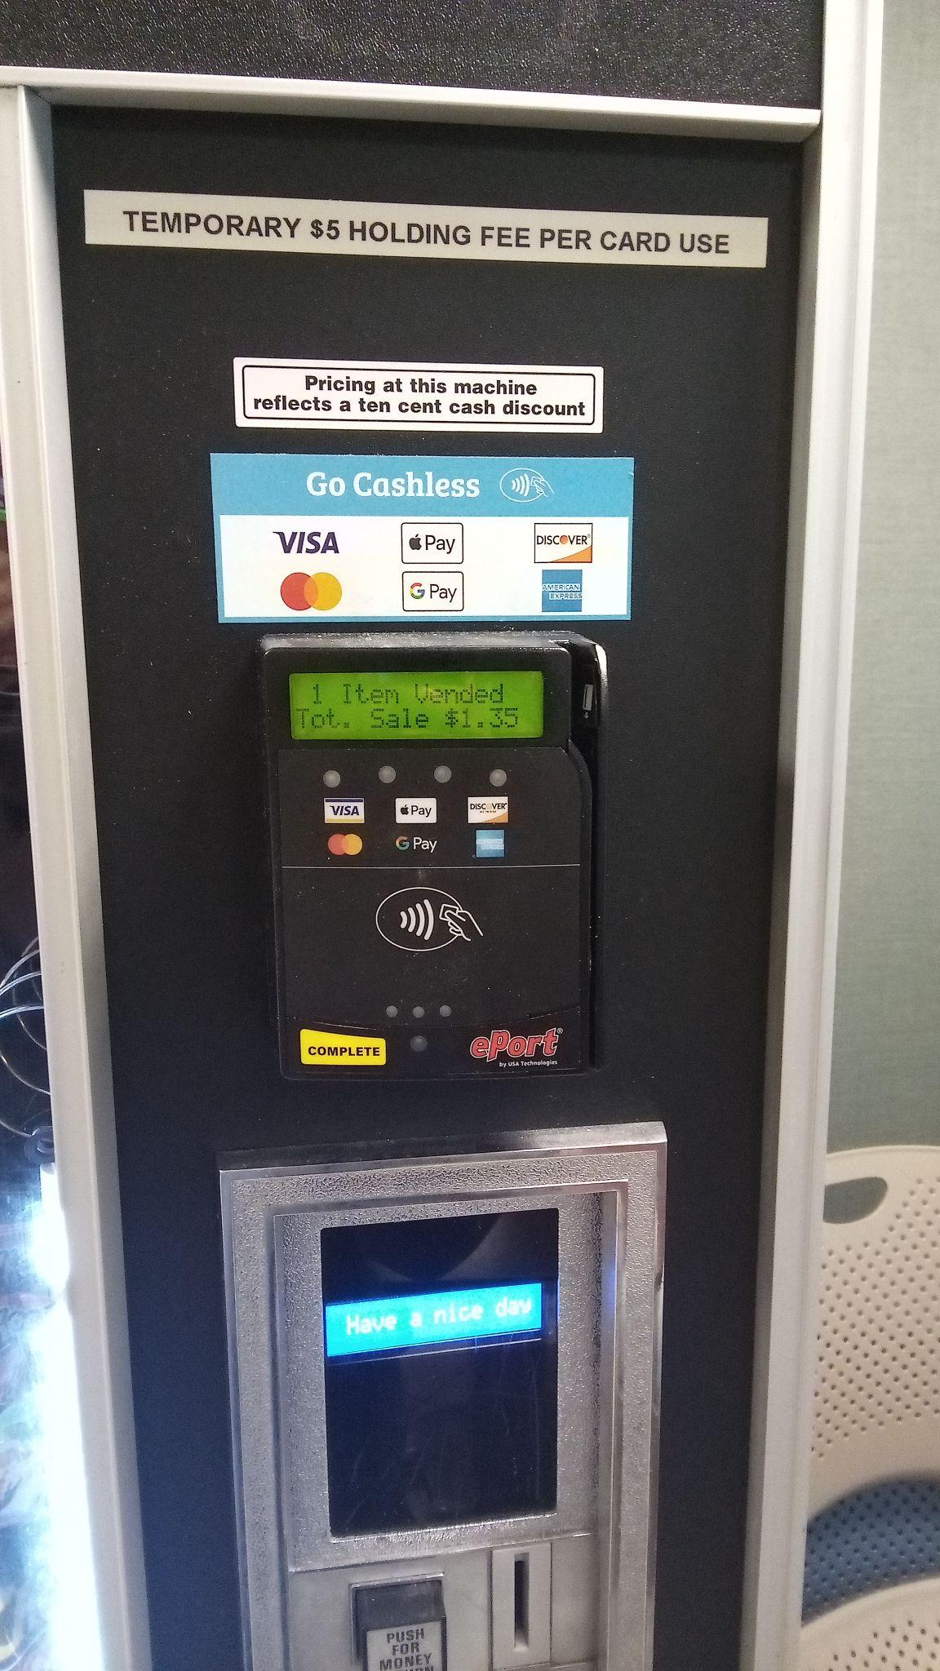

Lack of Healthy snack options
Also misleading. Claims 10 cent discount. But actual adds 10 cents to each purchase.

Slide 11
Progress Award (method the VA uses to evaluated)
‘ This certifies your active engagement toward achievement of your housing goals during your participation in the Mental Health Residential Rehabilitation Treatment Program’
P
Participation
Attends and participates in groups
Attends scheduled appointments with providers
R
Resources
Talks with VOA CM for transportation assistance and housing
Attends SA meeting in the community
Attends home groups, seeks sponsors, attends aftercare, etc.
O
Obtaining
Obtains ID documents
Obtains bank statement and income verification letter
Obtains DD214

Slide 12
Questions for consideration (no response needed)
What is the Veteran Affair’s definition/standard of a therapeutic environment?
How do the VA address those with Battle Field fatigue(special operation and combat focus personnel)?
How does this current process/track curve or prevent chronic homelessness among Veterans?
When was the last time the tracks have been evaluated on their effectiveness?
Do the instructors/social workers have any conflict of interest that weaken the fidelity of this establishment?
Are Veteran not attending programs due to their perceive irrelevancy?
Should signing a legally binding document that is partially filled out be forced upon us?
Who/Whom at the DOM is actually looking out for the veterans best interest?
Notes:
PTSD- quantitatively skwed the data. Preventing if not masking the effects of war on the human body, with those whom carried drama from earlier periods in their life path.

Slide 13
CIA Triad
Confidentiality: Ensures that sensitive data is restricted to authorized individuals only, preventing unauthorized viewing, theft, and sharing.
Foundational principle for information security
Confidentiality
Availability
Integrity

Slide 14
Dom confidentiality definition
What happens in group stays in group

Slide 15
Synapse of mental health track
My evaluation of the mental health program here at the DOM, is similar to that of the homeless program. This program focuses heavily, if not solely, on drug addiction. Alienating those who aim to better garner/understand their condition. Since every class is filibustered with the same stories and a desensitized instructor the risk of unwantedness is heightened. Forcing a profile approach highlights the lack of understanding among the staff. In conclusion, the staff focus only on what they find most comfortable/easiest and drown out individuals seeking clarity and connection.

Slide 16
Safety,Security, Risk, and Concerns
Bad news: seems only one is working on it
Good news: your not the only one
Current and overall Veterans Affairs environment

Slide 17

Advance Persistent Threat

Slide 18
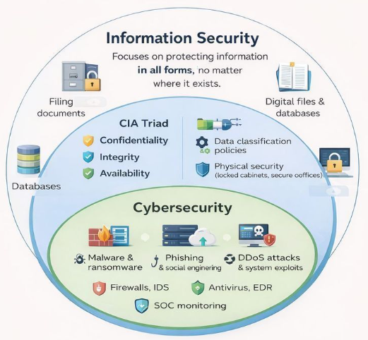

Slide 19
APT definition
An adversary with sophisticated levels of expertise and significant resources, allowing it through the use of multiple different attack vectors (e.g., cyber, physical, and deception), to generate opportunities to achieve its objectives which are typically to establish and extend its presence - from NIST SP 800-39
An Advanced Persistent Threat (APT) is a sophisticated, prolonged cyberattack where intruders establish an undetected, long-term presence in a network to steal sensitive data or sabotage systems.

Slide 20
APT to consider
Potential groups types
Motives
1
Financially Motivated APT
Unquestionable revenue source
Consistent/reliable revenue source
The amount of potential revenue (100% = over $50,000 for one single veteran; (1 VA program = mutl- million dollars)
2
Nation-state sponsored APT
Weaken public perception of military
Reduce the amount of new recruits
Undetectable foothold (positioning decision makers, access to other Organizations, etc.)
3
Corporate-sponsored APT
To privatized specific program/services.
Reduce patients/customer.
Weaken public trust in quality of service.
gain/siphon research data through partnership.(skewing data and misleading research)
Notable mention
Local groups/communties(goonies)
Prominent Families

Slide 21
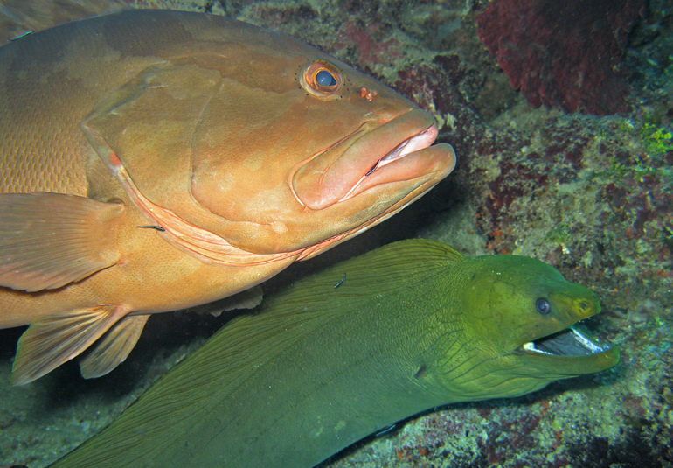
Both internal and external hunting together
Targeting directors
Blocking those actual in need of services
Taking over full programs

Slide 22
CIA Triad
Confidentiality – preserving authorized restrictions on information access and disclosure, including means for protecting personal privacy and proprietary information
Integrity – guarding against improper information modification or destruction and ensuring information non-repudiation and authenticity
Availability – ensuring timely and reliable access to and use of information
NIST SP 800-12 rev1
Confidentiality
Availability
Integrity

Slide 23
Thank you

Slide 24

Minority representation

Slide 25

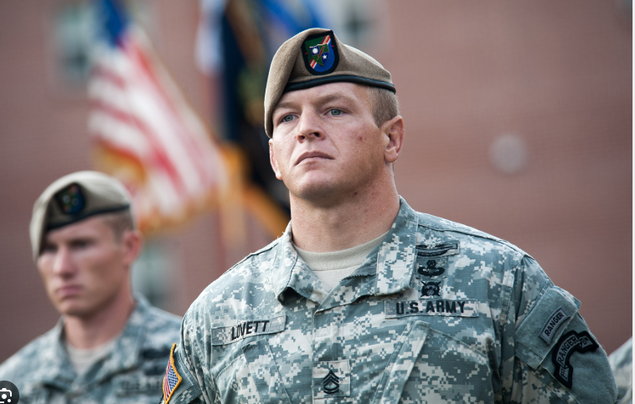
No the Differences lives depend on it.
De Oppresso Liber
To Free the Oppressed

Slide 26
Combat veteran point of view from staff interaction
Rambo jail https://youtu.be/2-aDz23CId8?si=JB6MuvuR14YIIygG
Rambo - https://youtu.be/eJk4JNM7vas?si=1ZFmMbWtl37gHhGI
Ranger RRC - https://youtu.be/yqpPogpji84?si=VVqOUDksSOz49eGV
What you subject us to - Cell https://youtu.be/MreNB4cH3Rk?si=kCobL646b04ZANSx

Slide 27
Army values
Loyalty Devote yourself to the U.S Constitution
Duty Fulfill your responsibilities and accomplish tasks as part of a team, without taking shortcuts.
Respect Treat others with dignity and respect while expecting others to do the same
Selfless service Commit to going a furtherm enduring longer, and adding to the effort in your own way
Honor Develop honorable habits and live up to our values in every choice you make
Integrity Stand up for what is right, legally and morally, without doing or saying anything that deceives others
Personal courage Face moral fear or adversity, while standing up for and acting upon the things you know are honorable

Slide 28
Escalation of force
Used to prevent miltary and law enforcement personnel from causing harm to enemy combatants who are surrendering or wounded and out of combat threat.

Slide 29
Rule of Engagment
Directives that delineate the circumstances and limitations under which U.S forces will inititate and/or continue combat engagement.

Slide 30
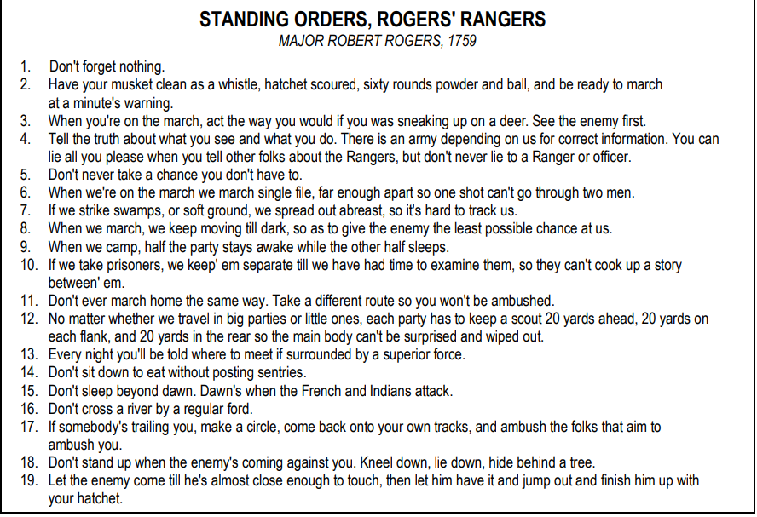
Mindset of a combat soldier

Slide 31
Creeds in which they live by
Recognizing that I volunteered as a Ranger, fully knowing the hazards of my chosen profession. I willl always endeavor to uphold the prestige, honor and high esprit-de-corps of my Ranger Regiment.
Acknowledging the fact that a Ranger is a more elite Soldier who arrives at the cutting edge of battle by land, sea, or air, I accept the fact that as a Ranger my country expects me to move further, faster and fight harder than any other soldier
Never shall I fail my comrades. I will always keep myself mentally, alert, physically strong, and morally straight and I will shoulder more than my share of the task, whatever it may be, one hundred percent and then some.
Gallantly will I show the world that I am a specially selected and well-trained Soldier. My courtesy to superior officers, neatness of dress, and care of equipment shall set the example for others to follow.
Energetically will I meet the enemies of my country. I shall defeat them on the field of battle for I am better trained and will fight with all my might. Surrender is not a Ranger word. I will never leave a fallen comrade to fall into the hands of the enemy and under no circumstances will I ever embarrass my country.
Readily will I display the intestinal fortitude required fo fight on to the Ranger objective and complete the mission, though I be the lone survivor.

Slide 32
Questions for your consideration
Would to it feel to have your nation and Gobal trust in you and principles, to now being served/condemned by those who lack both mental and moral constitutions?
Knowing how each failure, set-backs, and ‘try’( instead of commiting to succeeding) impact a society. How does it feel to have administrator who barely care for their own well-being, being in charge of yours?
Time being the most valuable asset, having it wasted by administrators folly that hide behind false empathy whom hold sociopathic tendencies ( delusional people, who work on those they brand as delusional)
Can you point to a program, function, or department within the Veteran’s Affairs who specializes in supporting this minority group and have the ability to comprehend their point of views and concerns?

Slide 33
Xie Xie
Zfieryeye
email:Zfieryeye@technolust.org
Chat : technolust.org

