Slide 1
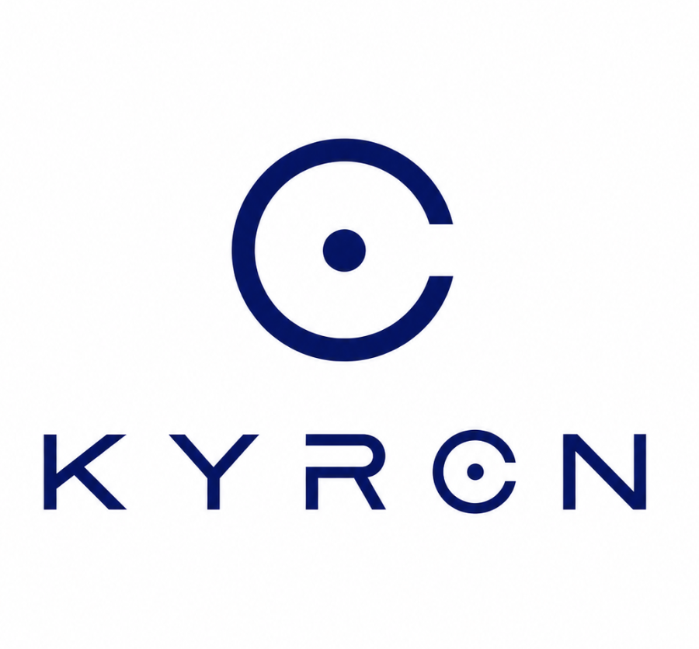
The solution
Kyron verifies real users through one secure digital flow
One journey
from signup to trusted return
Document proofing, liveness, face matching, fraud checks, and Face ID reuse work together to create a trusted onboarding journey.
Document
Liveness
Face match
Decision
Face ID
Passport or Lao ID proofing
Face actions and gesture challenge
Selfie matched to document portrait
Explainable pass, reject, and reason codes
Reuse for login or payment approval
Kyron eKYC
Solution

Slide 2
How the solution works
Kyron combines verification steps that answer three questions: is the document real, is the person live, and does the face match?
Document proofing
Liveness defense
Face matching
Decision + reuse
Checks OCR/MRZ fields, expiry, quality, tamper signs, and fraud risk.
Uses face movement, hand gestures, and passive anti-spoof checks.
Compares the live selfie with the document portrait to confirm ownership.
Returns explainable results, then enables Face ID for future login or payment.
Result: faster onboarding, stronger fraud protection, and a reusable trusted identity.
Kyron eKYC
Solution

