Slide 1
Pelajaran Yang Dipetik Dari
Hosting Server Pengembangan Distro
Andika Triwidada
<andika@gmail.com>
hostmaster yeyen.blankonlinux.or.id
BlanKonf 2009

Slide 2

Yeyen
24 Oktober 2007
1U, 19” → rack mounted
CPU Intel dual core, 1.8 GHz
RAM 2 GB
HD SATA 2x320 GB, upgrade ke 4x320 GB
Floppy drive & CDROM drive pensiun
Ubuntu 8.04 HH LTS i386

Slide 3
Services
http
rsync
torrent
AoE
ssh

Slide 4
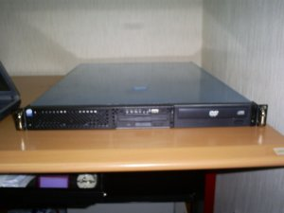
Virtual Hosts
blankonlinux.or.id
  arsip, security
  bzr
  cdimage
  cecunguk
  dev, dev2
  irgsh
  konf
  serambi
  tempayan
  wiki

Slide 5
Resource Usage Stats
CPU: masalah beberapa cron job
RAM: cukup
Disk: cukup
Network: IIX 50 - Mbps, intl. - terbatas

Slide 6
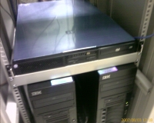
Disk Usage Statistics
$ df -h
Filesystem Size Used Avail Use% Mounted on
/dev/mapper/yeyen-root 9.9G 4.3G 5.1G 46% /
/dev/mapper/yeyen-home 567G 384G 155G 72% /home
/dev/mapper/yeyen-var 9.9G 2.5G 6.9G 27% /var
/dev/sdb1 294G 188G 92G 68% /mnt/sdb1
/dev/sdd1 296G 2.2G 279G 1% /mnt/sdd1

Slide 7
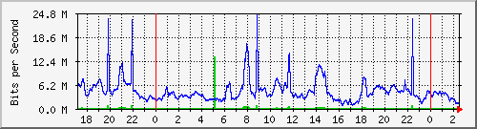
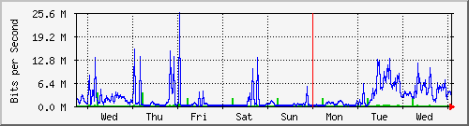
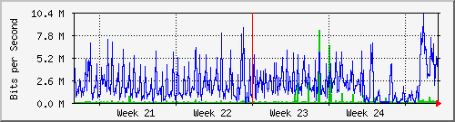
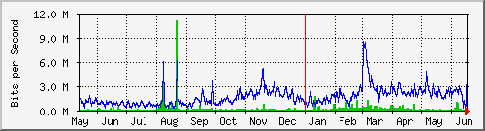
Network Usage Statistics
mrtg
webalizer

Slide 8
Network Usage Breakdown
HTTP (jul 2008 – jun 2009)
  Cdimage: 19.794 GB
  Cecunguk: 406 GB
  Arsip: 46 GB
  Dev: 13 GB
rsync (okt 2007 – jun 2009): 1.716 GB
Lainnya (total, termasuk HTTP + rsync)
  In 214.0 kb/s, Out 1646.6 kb/s

Slide 9
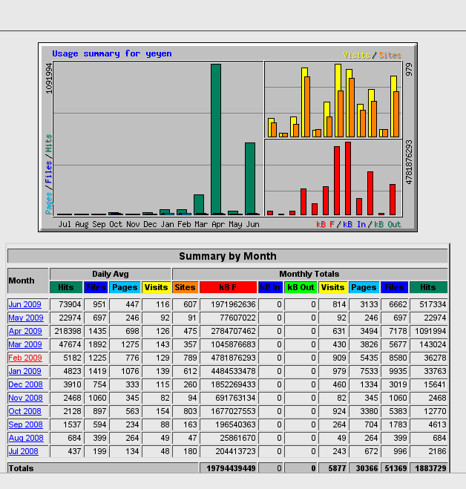
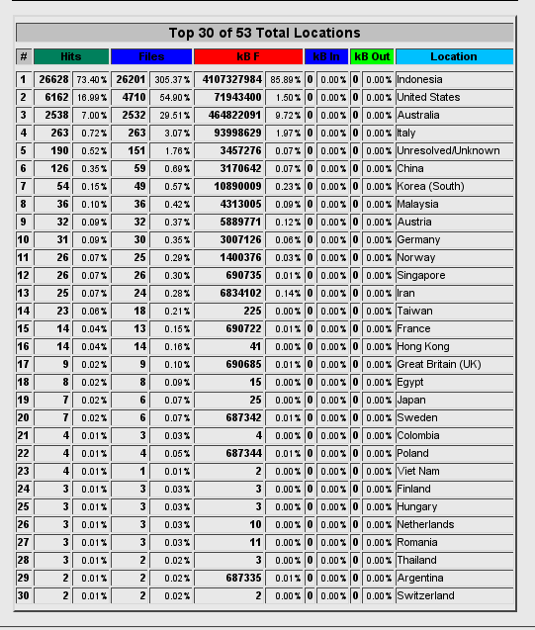

Slide 10
Masalah
Download accelerator
  limitipconn; cdimage: MaxConnPerIP 5
CPU hungry cron job
International traffic
  untung ada cermin di sebelah

Slide 11
Rencana
AMD64 build
  jedough, tukar CPU vs space → masalah RAM

Slide 12
Kondisi Ideal
RAM 4+ GB
  Host amd64 → amd64 build
  Guest i386 RAM 1 GB → i386 build
  Guest amd64 → ISO test
  Guest i386 → ISO test
Disk 2x 1 TB
  Versi DVD? Repo Blankon? :D
Link internasional 256 kbps dedicated

Slide 13
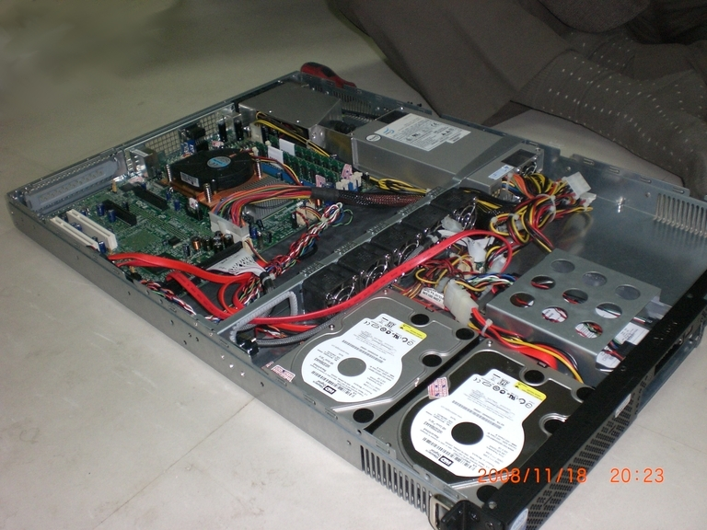
Donatur
Mesin – Unesco
Colo, bandwidth – Padi.net
Disk – invaleed, kruik

Slide 14
Satpam
mdamt, imtheface, iang, resza, timut, somat, invaleed, udienz, andika

