Slide 1
Chapter 6: Project Schedule Management
Information Technology Project Management, Ninth Edition
Note: See the text itself for full citations

Slide 2
Learning Objectives (1 of 2)
Illustrate the importance that project schedules and good project schedule management can have in helping to make projects successful
Discuss the process of planning schedule management
Define activities as the basis for developing project schedules
Describe how project managers use network diagrams and dependencies to assist in activity sequencing
Explain how various tools and techniques help project managers perform activity duration estimates
Use a Gantt chart for planning and tracking schedule information, find the critical path for a project, and describe how critical chain scheduling and the Program Evaluation and Review Technique (PERT) affect schedule development

Slide 3
Learning Objectives (2 of 2)
Compare how schedule management is addressed using Agile vs. more predictive project approaches
Discuss how reality checks and discipline are involved in controlling and managing changes to the project schedule
Describe how project management software can assist in project schedule management and review words of caution before using this software
Discuss considerations for agile/adaptive environments

Slide 4
The Importance of Project Schedules (1 of 3)
Managers often cite delivering projects on time as one of their biggest challenges
Time has the least amount of flexibility; it passes no matter what happens on a project
Individual work styles and cultural differences may also cause schedule conflicts
Different cultures and even entire countries have different attitudes about schedules

Slide 5
Media Snapshot
In contrast to the 2002 Salt Lake City Winter Olympic Games (see Chapter 4’s Media Snapshot), planning and scheduling was very different for the 2004 Athens Summer Olympic Games and the 2014 Sochi Winter Olympic Games
Many articles were written before the opening ceremonies in Athens predicting that the facilities would not be ready in time
The Greeks even made fun of critics by having construction workers pretend to still be working as the ceremonies began, but the games cost more than twice the planned budget
The 2014 Winter Olympic Games in Sochi, Russia, suffered even greater financial loss
Originally budgeted at $12 billion, final costs reached over $51 billion, making it the most expensive games in history

Slide 6
The Importance of Project Schedules (2 of 3)
Project time management processes
Planning schedule management
Defining activities
Sequencing activities
Estimating activity resources
Estimating activity durations
Developing the schedule
Controlling the schedule

Slide 7
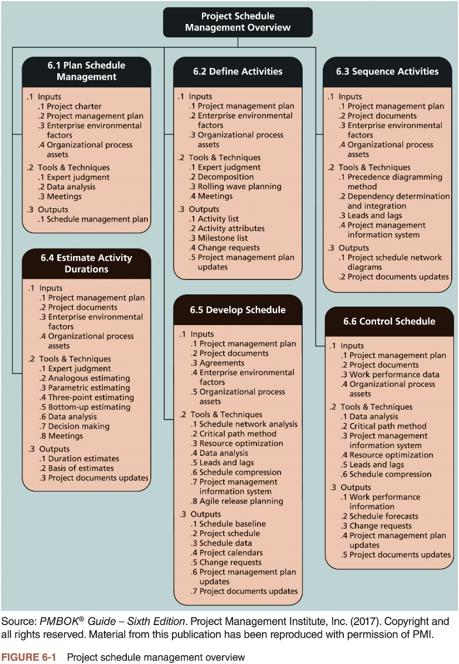
The Importance of Project Schedules (3 of 3)

Slide 8
Planning Schedule Management
Elements of a schedule management plan
Project schedule model development
Scheduling methodology
Level of accuracy and units of measure
Control thresholds
Rules of performance measurement
Reporting formats
Process descriptions

Slide 9
Defining Activities (1 of 2)
Defining activities involves identifying the specific actions that will produce the project deliverables in enough detail to determine resource and schedule estimates
Activity list: a tabulation of activities to be included on a project schedule
Activity name, activity identifier or number, and brief description of the activity
Activity attributes provide more information
Predecessors, successors, logical relationships, leads and lags, resource requirements, constraints, imposed dates, and assumptions related to the activity

Slide 10
Defining Activities (2 of 2)
A milestone is a significant event that normally has no duration
It often takes several activities and a lot of work to complete a milestone
They’re useful tools for setting schedule goals and monitoring progress
Examples: obtaining customer sign-off on key documents or completion of specific products

Slide 11
What Went Wrong?
At the U.S. Federal Bureau of Investigation (FBI), poor time management was one of the reasons behind the failure of Trilogy
System was supposed to integrate intelligence within the Bureau
In May 2006, the Government Accounting Agency said that the Trilogy project failed at its core mission of improving the FBI’s investigative abilities and was plagued with missed milestones and escalating costs
Sentinel replaced Trilogy in 2007
During a test exercise in 2011, Sentinel experienced two outages, and the FBI determined that the current hardware structure was inadequate
In 2014, the system still wasn’t working well

Slide 12
Sequencing Activities (1 of 6)
Sequencing process involves evaluating the reasons for dependencies and the different types of dependencies
A dependency or relationship is the sequencing of project activities or tasks
Mandatory dependencies: inherent in the nature of the work being performed on a project, sometimes referred to as hard logic
Discretionary dependencies: defined by the project team, sometimes referred to as soft logic. and should be used with care since they may limit later scheduling options
External dependencies: involve relationships between project and non-project activities

Slide 13
Sequencing Activities (2 of 6)
Network diagrams are the preferred technique for showing activity sequencing
Schematic display of the logical relationships among, or sequencing of, project activities
Two main formats are the arrow and precedence diagramming methods

Slide 14
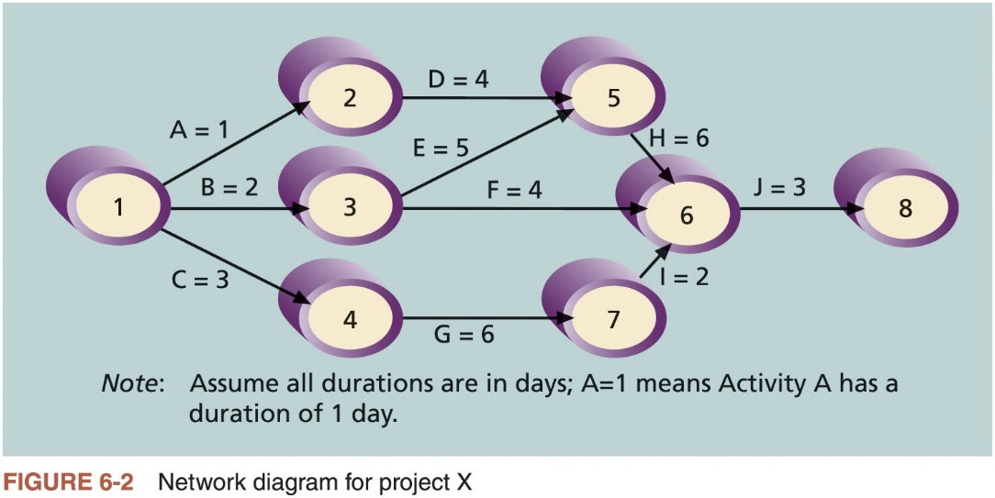
Sequencing Activities (3 of 6)

Slide 15
Sequencing Activities (4 of 6)
Arrow diagramming method (ADM) (i.e., activity-on-arrow network diagrams)
Activities are represented by arrows
Nodes or circles are the starting and ending points of activities
Only show finish-to-start dependencies
Refer to the text for the step-by-step process of creating AOA diagrams
Precedence diagramming method (PDM)
Network diagramming technique in which boxes represent activities
Types of dependencies or relationships between activities
Finish-to-start
Start-to-start
Finish-to-finish
Start-to-finish

Slide 16
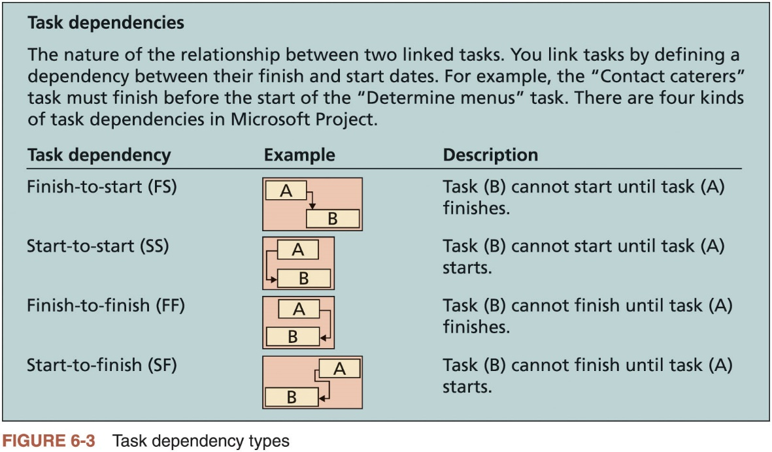
Sequencing Activities (5 of 6)

Slide 17
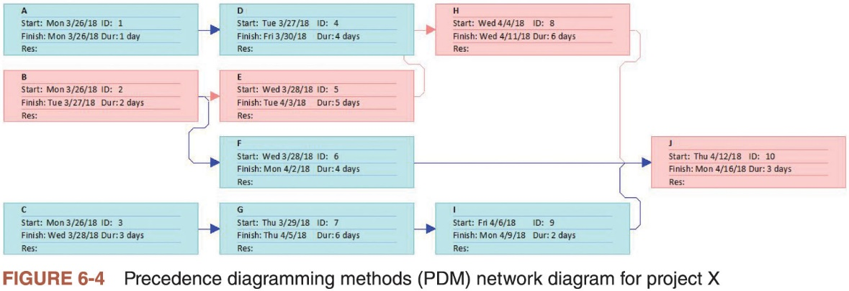
Sequencing Activities (6 of 6)

Slide 18
Estimating Activity Durations
Duration includes the actual amount of time worked on an activity plus elapsed time
Effort is the number of workdays or work hours required to complete a task and does not normally equal duration
People doing the work should help create estimates
An expert should review them
A three-point estimate is an estimate that includes an optimistic, most likely, and pessimistic estimate
Three-point estimates are needed for PERT and Monte Carlo simulations

Slide 19
Advice for Young Professionals
Some people find estimating to be challenging, especially for their own work
It is very important to develop this skill
Practice estimating how long it takes you to do different activities and then take actual measurements
Define the activity in detail to help make better estimates
If you realize that an activity estimate might not be a good one, let your team know as soon as possible so that adjustments can be made early in the project

Slide 20
Developing the Schedule
Uses results of the other time management processes to determine the start and end date of the project
Ultimate goal is to create a realistic project schedule that provides a basis for monitoring project progress for the time dimension of the project
Important tools and techniques
Gantt charts
Critical path analysis
Critical chain scheduling
PERT analysis

Slide 21
Gantt Charts (1 of 5)
Provide a standard format for displaying project schedule information by listing project activities and corresponding start and finish dates in a calendar form
Symbols
Black diamond: milestones
Thick black bars: summary tasks
Light gray horizontal bars: durations of tasks
Arrows: dependencies between tasks

Slide 22
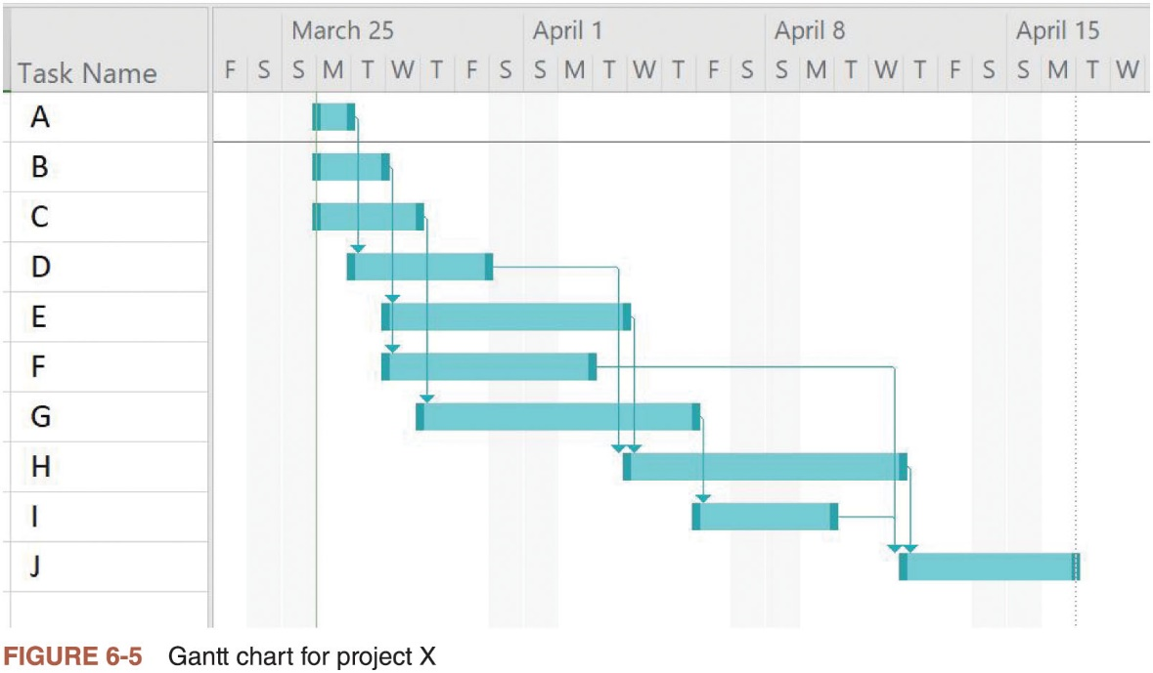
Gantt Charts (2 of 5)

Slide 23
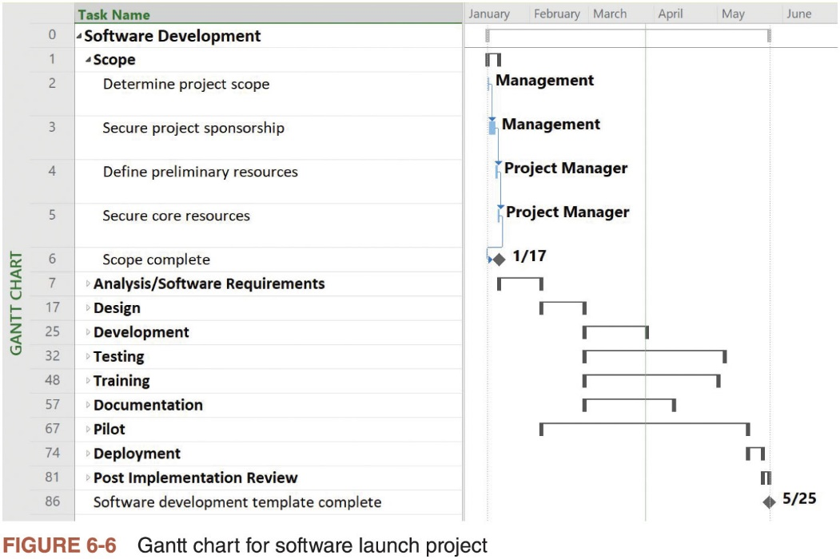
Gantt Charts (3 of 5)

Slide 24
Gantt Charts (4 of 5)
Adding milestones to Gantt charts
Many people like to focus on meeting milestones, especially for large projects
Milestones emphasize important events or accomplishments on projects
SMART Criteria for milestones
Specific
Measurable
Assignable
Realistic
Time-framed

Slide 25
Best Practice
Shawn Anchor suggests the 20-second rule in his book, The Happiness Advantage
People prefer the path of least resistance
For example, if you have to wait in line 20 seconds to get a second scoop of ice cream, you might resist it
Anchor recommends making it more difficult for yourself to be distracted at work by keeping email or websites closed while you are working
Save time by adding time to the distracting behaviors at work

Slide 26
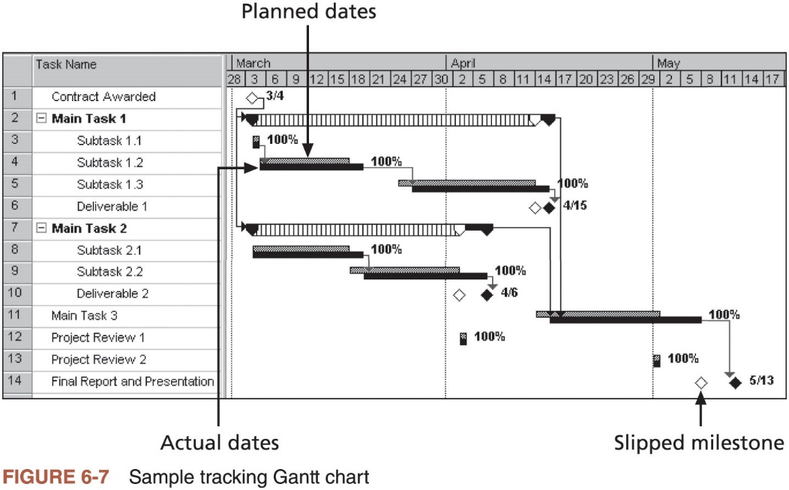
Gantt Charts (5 of 5)

Slide 27
Critical Path Method (CPM) (1 of 2)
Network diagramming technique used to predict total project duration
Critical path: series of activities that determine the earliest time by which the project can be completed
The longest path through the network diagram and has the least amount of slack or float; amount of time an activity may be delayed without delaying a succeeding activity or the project finish date
Calculating the critical path
Develop a good network diagram and add the duration estimates for all activities on each path through the network diagram
Longest path is the critical path
If one or more of the activities on the critical path takes longer than planned, the whole project schedule will slip unless the project manager takes corrective action

Slide 28
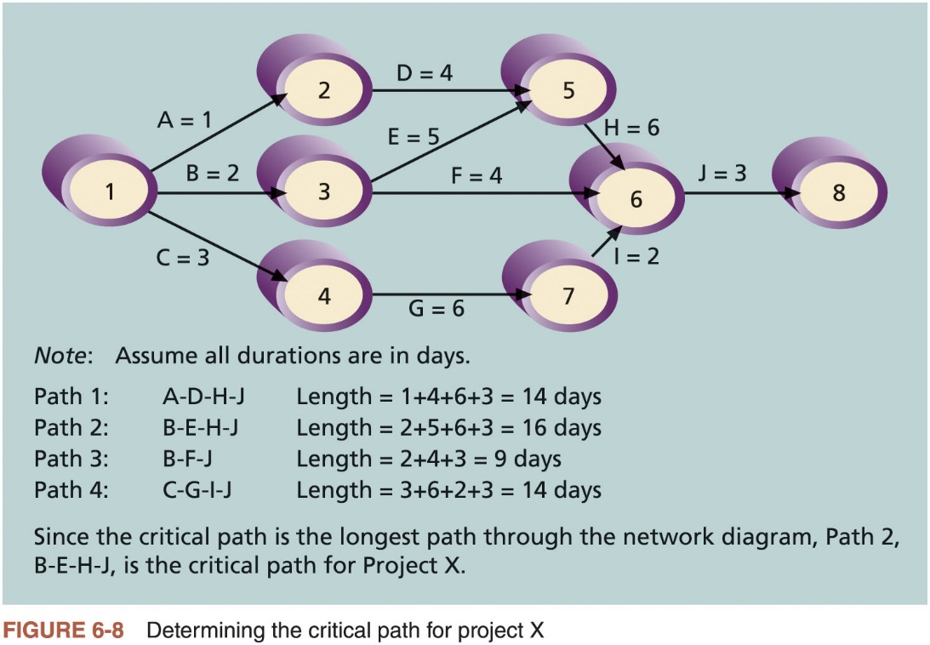
Critical Path Method (CPM) (2 of 2)

Slide 29
Growing Grass Can Be on the Critical Path
The fact that its name includes the word critical does not mean that it includes all critical activities
Only accounts for time
Example: growing grass for Disney’s Animal Kingdom
There can be more than one critical path if the lengths of two or more paths are the same
Project managers should closely monitor performance of activities on the critical path to avoid late project completion
Critical path can change as the project progresses

Slide 30
Using Critical Path Analysis to Make Schedule Trade-Offs (1 of 3)
Free slack or free float
Amount of time an activity can be delayed without delaying the early start of any immediately following activities
Total slack or total float
Amount of time an activity may be delayed from its early start without delaying the planned project finish date
Forward pass
Determines the early start and finish dates
Backward pass
Determines the late start and finish dates

Slide 31
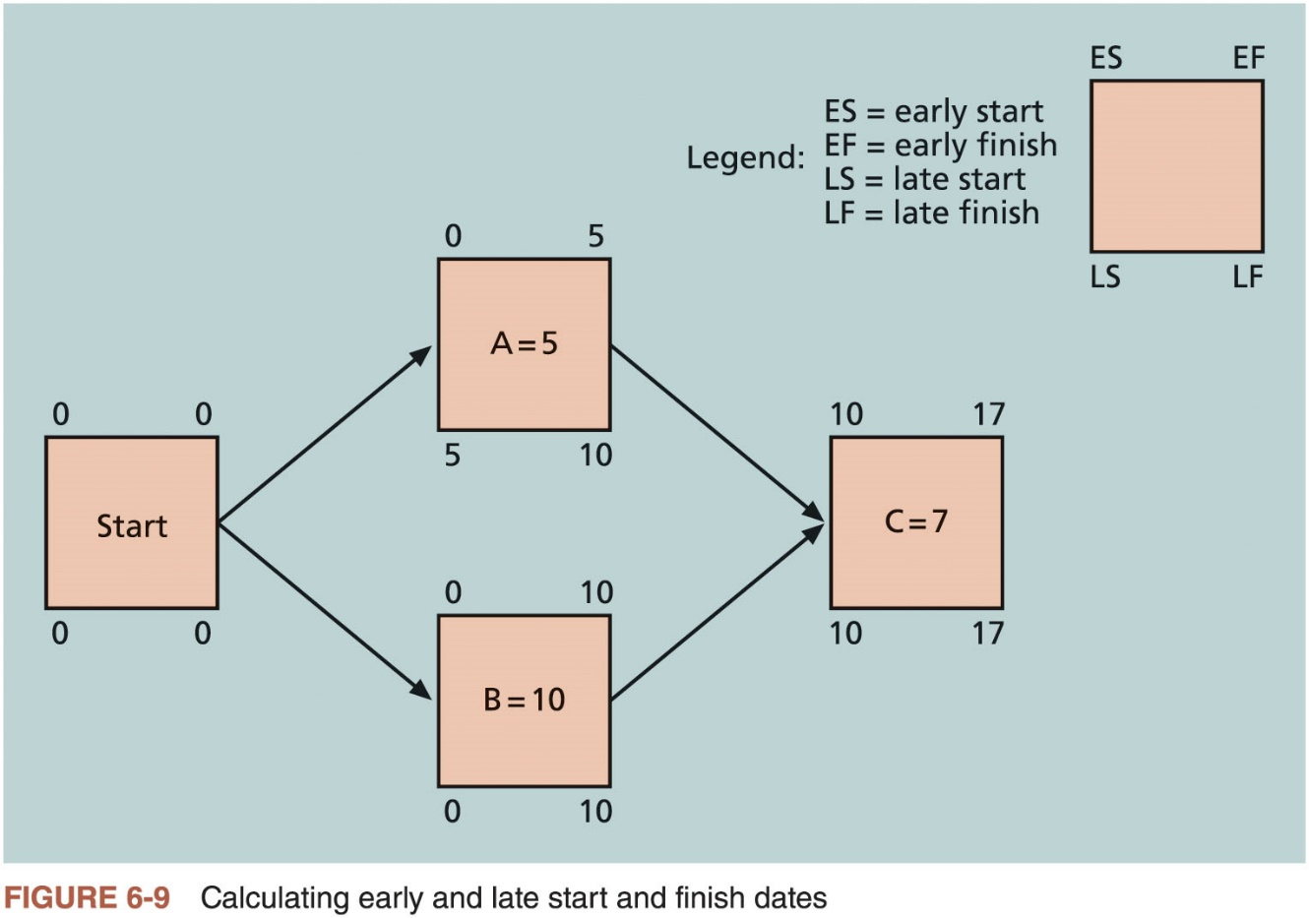
Using Critical Path Analysis to Make Schedule Trade-Offs (2 of 3)

Slide 32
Using Critical Path Analysis to Make Schedule Trade-Offs (3 of 3)
Task Name | Start | Finish | Late Start | Late Finish | Free Slack | Total Slack
A | 8/3/15 | 8/3/15 | 8/5/15 | 8/5/15 | 0d | 2d
B | 8/3/15 | 8/4/15 | 8/3/15 | 8/4/15 | 0d | 0d
C | 8/3/15 | 8/5/15 | 8/5/15 | 8/7/15 | 0d | 2d
D | 8/4/15 | 8/7/15 | 8/6/15 | 8/11/15 | 2d | 2d
E | 8/5/15 | 8/11/15 | 8/5/15 | 8/11/15 | 0d | 0d
F | 8/5/15 | 8/10/15 | 8/14/15 | 8/17/15 | 7d | 7d
G | 8/6/15 | 8/13/15 | 8/10/15 | 8/17/15 | 0d | 2d
H | 8/12/15 | 8/19/15 | 8/12/15 | 8/19/15 | 0d | 0d
I | 8/14/15 | 8/17/15 | 8/18/15 | 8/19/15 | 2d | 2d
J | 8/20/15 | 8/24/15 | 8/20/15 | 8/24/15 | 0d | 0d
Table 6-1 Free and Total Float or Slack for Project X

Slide 33
Using the Critical Path to Shorten a Project Schedule
Main techniques for shortening schedules
Shortening durations of critical activities/tasks by adding more resources or changing their scope
Crashing activities by obtaining the greatest amount of schedule compression for the least incremental cost
Fast tracking activities by doing them in parallel or overlapping them

Slide 34
Importance of Updating Critical Path Data
It is important to update the schedule with actual data
Note actual activity durations as they are completed
Revise estimates for activities in progress
Monitor changes to make informed decisions

Slide 35
Critical Chain Scheduling (1 of 4)
Considers limited resources when creating a project schedule and includes buffers to protect the project completion date
Uses the Theory of Constraints (TOC): management philosophy developed by Eliyahu M. Goldratt; attempts to minimize multitasking when a resource works on more than one task at a time

Slide 36
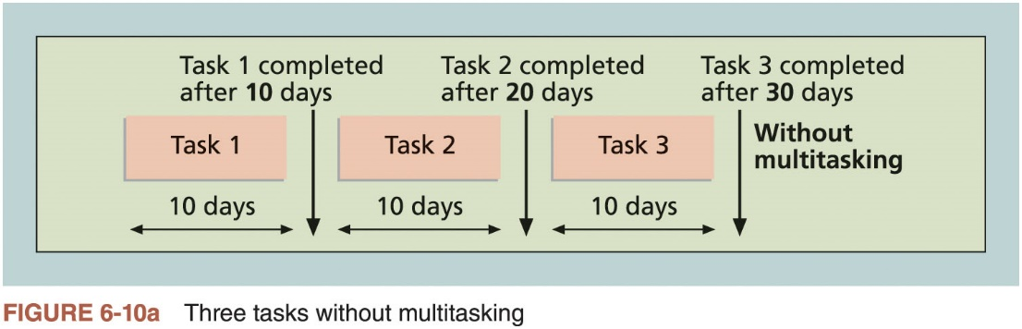
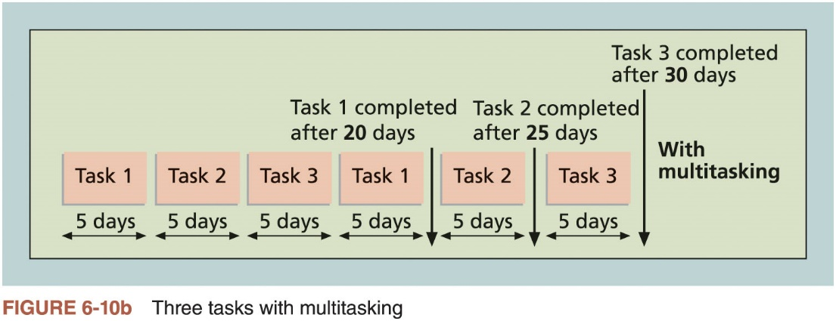
Critical Chain Scheduling (2 of 4)

Slide 37
Critical Chain Scheduling (3 of 4)
Additional concepts
Buffer: additional time to complete a task
Murphy’s Law: if something can go wrong, it will
Parkinson’s Law: work expands to fill the time allowed
Project buffer: additional time added before the project’s due date
Feeding buffers: additional time added before tasks on the critical path

Slide 38
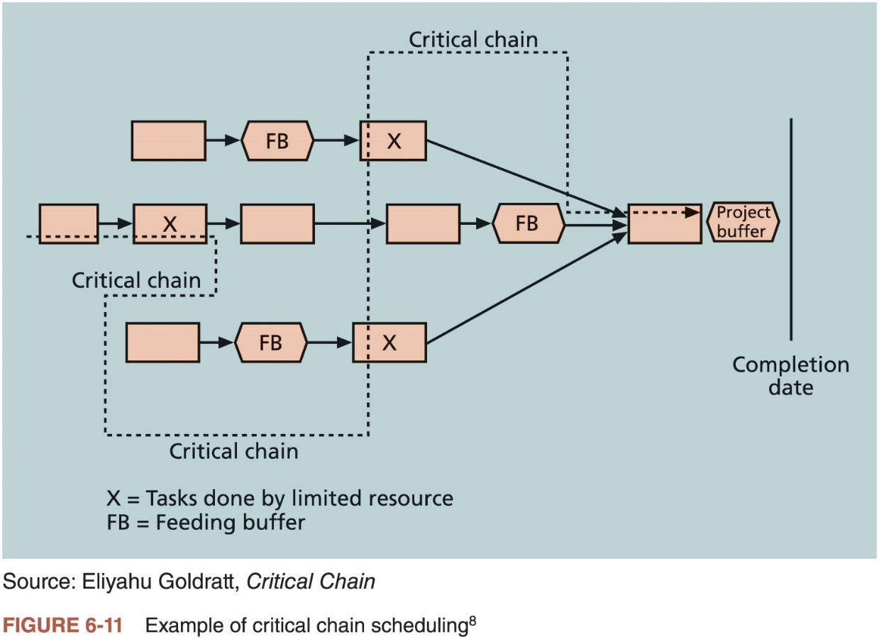
Critical Chain Scheduling (4 of 4)

Slide 39
What Went Right?
Scheduling at healthcare clinic’s can be more efficient by using critical chain scheduling
National University Hospital in Singapore decreased patient admission times by more than 50 percent
Improved scheduling lowered average wait times, which went from six to eight hours to less than three hours
63 percent of patients were admitted in less than 1.5 hours

Slide 40
Program Evaluation and Review Technique (PERT)
Network analysis technique used to estimate project duration when there is a high degree of uncertainty about the individual activity duration estimates
Uses probabilistic time estimates: duration estimates based on using optimistic, most likely, and pessimistic estimates of activity durations
By using the PERT weighted average for each activity duration estimate, total project duration estimate takes into account the risk or uncertainty in the individual activity estimates

Slide 41
Agile and Schedule Management
Core values of the Manifesto for Agile Software Development
Customer collaboration over contract negotiation
Responding to change over following a plan
Example: product owner defines and prioritizes the work to be done within a sprint
Collaboration and time management are designed into the process

Slide 42
Controlling the Schedule
Goals of schedule control
Know the status of the schedule
Influence the factors that cause schedule changes
Determine that the schedule has changed
Manage changes when they occur
Main inputs to schedule control
Project management plan
Project documents
Work performance data
Organizational process assets

Slide 43
Reality Checks on Scheduling and the Need for Discipline
Important activities
Review the draft schedule or estimated completion date in the project charter
Prepare a more detailed schedule with the project team
Make sure the schedule is realistic and followed
Alert top management well in advance if there are schedule problems

Slide 44
Using Software to Assist in Project Schedule Management
Software for facilitating communications helps people exchange schedule-related information
Decision support models help analyze trade-offs that can be made to address schedule issues
Project management software can help in various time management areas

Slide 45
Global Issues
Microsoft tells the customer story of Mexico’s Secretary of Economy, who wanted to ensure that IT initiatives aligned with business goals and improved project management efficiency
After implementing new software, their IT team could handle four times the number of concurrent projects without adding more staff

Slide 46
Words of Caution on Using Project Management Software
Many people misuse project management software because they don’t understand important concepts and have not had training
Example: dependencies must be entered to have dates adjust automatically and to determine the critical path
Many project management software programs come with templates or sample files
It is very easy to use these files without considering unique project needs
Project managers and their teams should be careful not to rely too much on templates or sample files and ignore the unique concerns of their particular projects

Slide 47
Considerations for Agile/Adaptive Environments
Schedule management is radically different using Agile and Scrum
Projects that rely heavily on the critical path method consider meeting the project’s estimated completion date as a crucial component of success
Agile projects may not even need to estimate activity durations or project schedules at all; overall project completion time is not important

Slide 48
Chapter Summary
Project time management is often cited as the main source of conflict on projects
Most IT projects exceed time estimates
Main processes
Plan schedule management
Define activities
Sequence activities
Estimate activity resources
Estimate activity durations
Develop schedule
Control schedule

