Slide 1
Chapter 8: Project Quality Management
Information Technology Project Management, Ninth Edition
Note: See the text itself for full citations

Slide 2
Learning Objectives (1 of 2)
Develop a justification for project quality management and its importance in achieving project success for information technology (IT) products and services
Define project quality management and understand how quality relates to various aspects of IT projects
Describe quality management planning and how quality and scope management are related
Discuss the importance of managing quality and quality assurance
Explain the main outputs of the quality control process

Slide 3
Learning Objectives (2 of 2)
List and describe the tools and techniques for quality control, such as the Basic Tools of Quality, statistical sampling, Six Sigma, and testing
Summarize the contributions of noteworthy quality experts to modern quality management
Describe how leadership, the cost of quality, organizational influences, expectations, cultural differences, and maturity models relate to improving quality in IT projects
Discuss how software can assist in project quality management
Discuss considerations for agile/adaptive environments

Slide 4
The Importance of Project Quality Management
Many people joke about the poor quality of IT products (see cars and computers joke)
Most people simply accept poor quality
Quality is very important

Slide 5
What Went Wrong?
1981: small timing difference caused by a computer program change created a 1-in-67 chance that the space shuttle’s five onboard computers would not synchronize
Error caused a launch abort
1986: two hospital patients died after receiving fatal doses of radiation from a Therac 25 machine
Software problem caused the machine to ignore calibration data
Wells Fargo bank were forced to cease any business expansion until they proved they cleaned up their act
Lost millions of dollars in docked pay
2018: Facebook data break

Slide 6
What Is Project Quality Management? (1 of 3)
International Organization for Standardization (ISO) definition of quality
“Totality of characteristics of an entity that bear on its ability to satisfy stated or implied needs” (ISO8042:1994)
“The degree to which a set of inherent characteristics fulfils requirements” (ISO9000:2000)
Other definitions of quality
Conformance to requirements
Project’s processes and products meet written specifications
Fitness for use
Product can be used as it was intended

Slide 7
What Is Project Quality Management? (2 of 3)
Project quality management ensures the project will satisfy the needs for which it was undertaken
Project quality management processes
Planning quality management: identifying which quality standards are relevant to the project and how to satisfy them; a metric is a standard of measurement
Managing quality: translating the quality management plan into executable quality activities
Controlling quality: monitoring specific project results to ensure they comply with the relevant quality standards

Slide 8
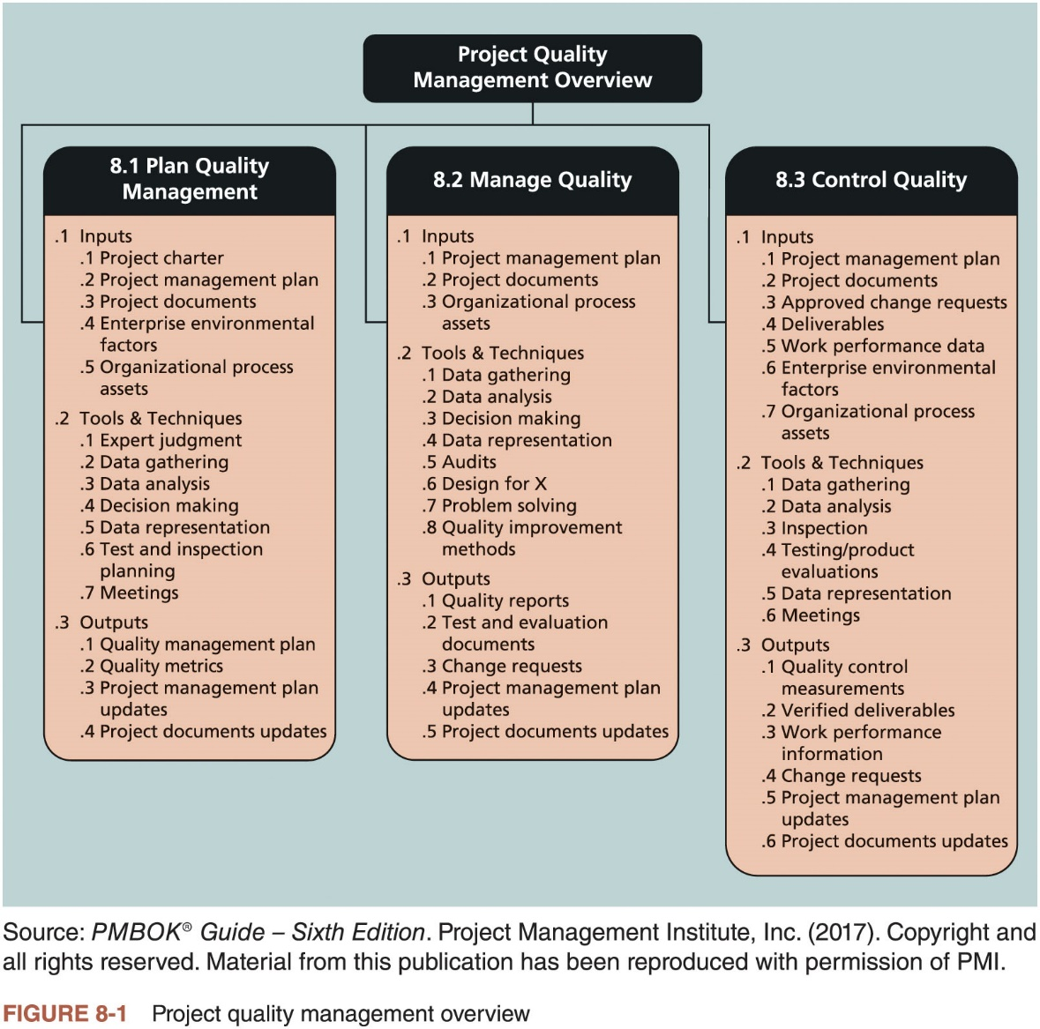
What Is Project Quality Management? (3 of 3)

Slide 9
Planning Quality Management (1 of 2)
Implies the ability to anticipate situations and prepare actions to bring about the desired outcome
Defect prevention methods
Selecting proper materials
Training and indoctrinating people in quality
Planning a process that ensures the appropriate outcome

Slide 10
Planning Quality Management (2 of 2)
Scope aspects of IT projects
Functionality: degree to which a system performs its intended function
Features: system’s special characteristics that appeal to users
System outputs: screens and reports the system generates
Performance addresses: how well a product or service performs the customer’s intended use
Reliability: ability of a product or service to perform as expected under normal conditions
Maintainability: ease of performing maintenance on a product
All project stakeholders must work together to balance the quality, scope, time, and cost dimensions of the project
Project managers are ultimately responsible for quality management on their projects

Slide 11
Managing Quality
Quality assurance includes all the activities related to satisfying the relevant quality standards for a project
Another goal is continuous quality improvement
Kaizen is the Japanese word for improvement or change for the better
Lean involves evaluating processes to maximize customer value while minimizing waste
Benchmarking generates ideas for quality improvements by comparing specific project practices or product characteristics to those of other projects or products within or outside the performing organization
A quality audit is a structured review of specific quality management activities that help identify lessons learned that could improve performance on current or future projects

Slide 12
What Went Right?
Kanban uses five core properties
Visual workflow
Limit work-in-process
Measure and manage flow
Make process policies explicit
Use models to recognize improvement opportunities
Application of Kanban is different for every team

Slide 13
Controlling Quality
Main outputs of quality control
Acceptance decisions
Rework
Process adjustments

Slide 14
Tools and Techniques for Quality Control (1 of 9)
Basic tools of quality that help in performing quality control
Cause-and-effect diagrams
Control chart
Checksheet
Scatter diagram
Histogram
Pareto chart
Flowcharts/run charts

Slide 15
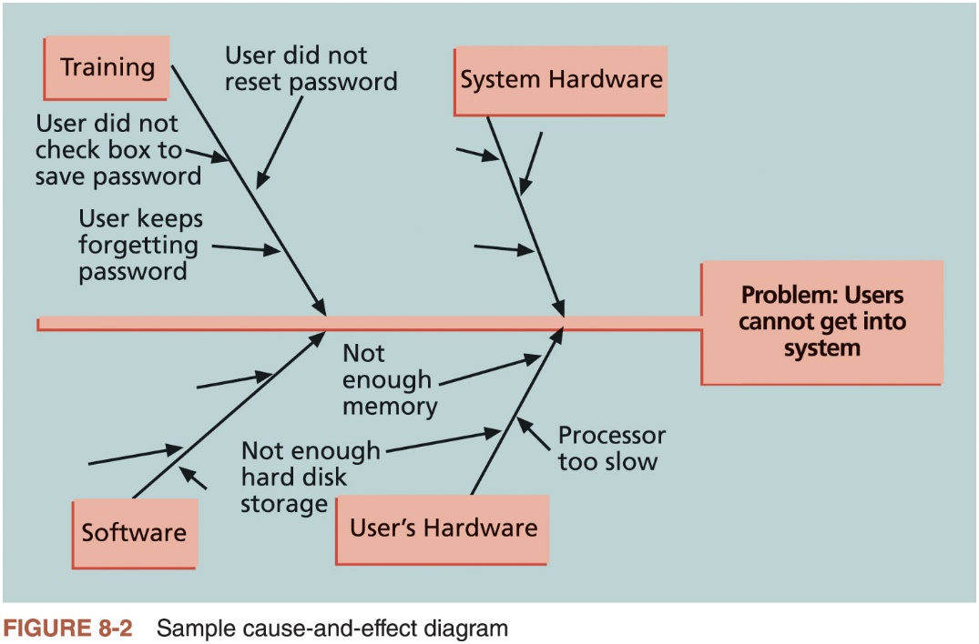
Tools and Techniques for Quality Control (2 of 9)

Slide 16
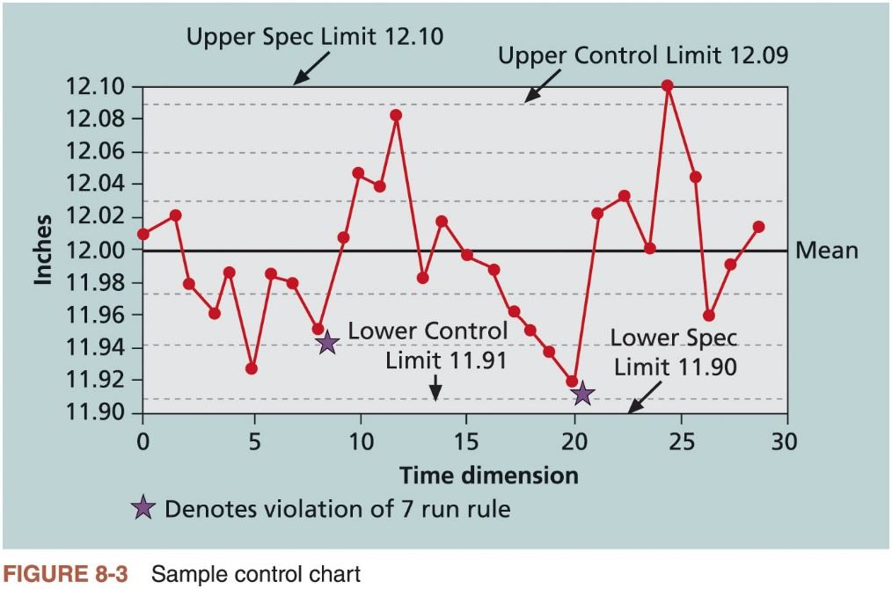
Tools and Techniques for Quality Control (3 of 9)

Slide 17
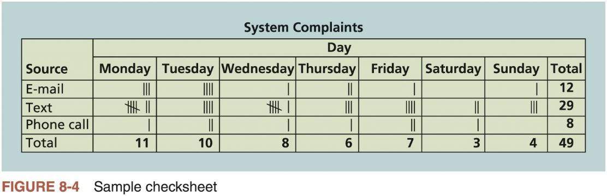
Tools and Techniques for Quality Control (4 of 9)

Slide 18
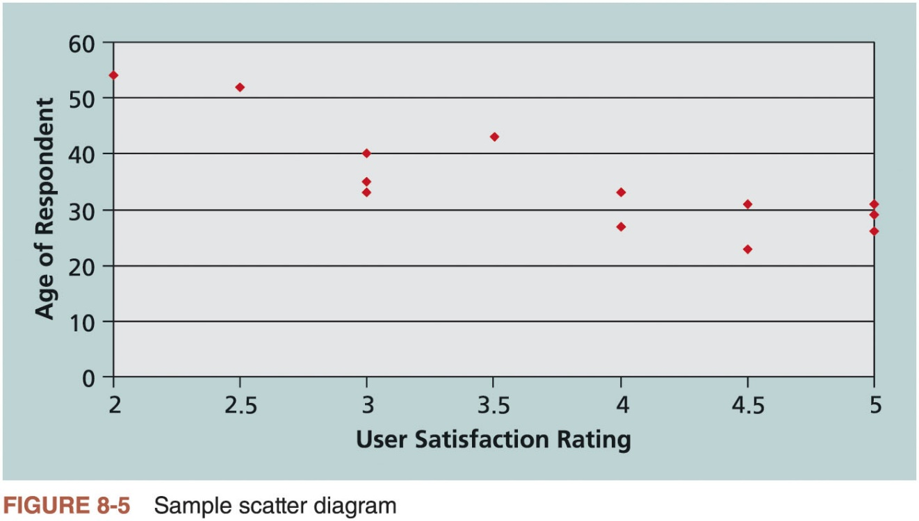
Tools and Techniques for Quality Control (5 of 9)

Slide 19
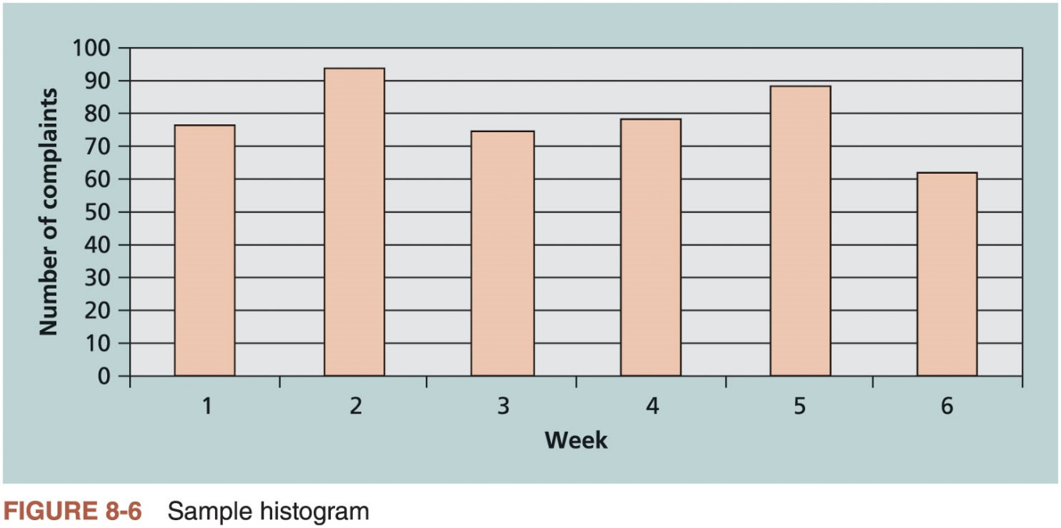
Tools and Techniques for Quality Control (6 of 9)

Slide 20
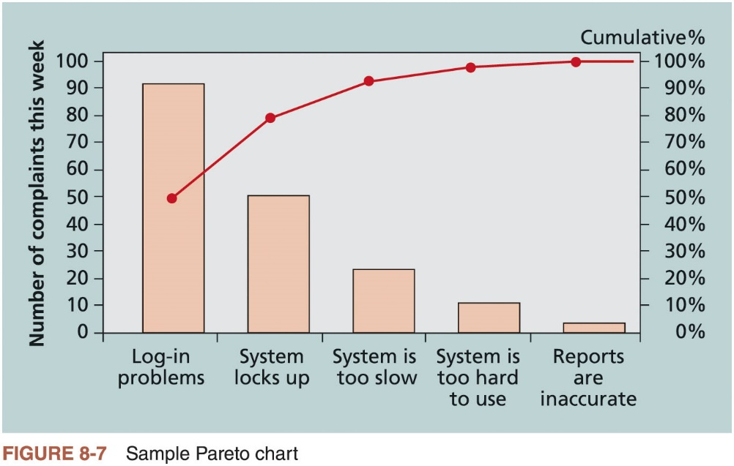
Tools and Techniques for Quality Control (7 of 9)

Slide 21
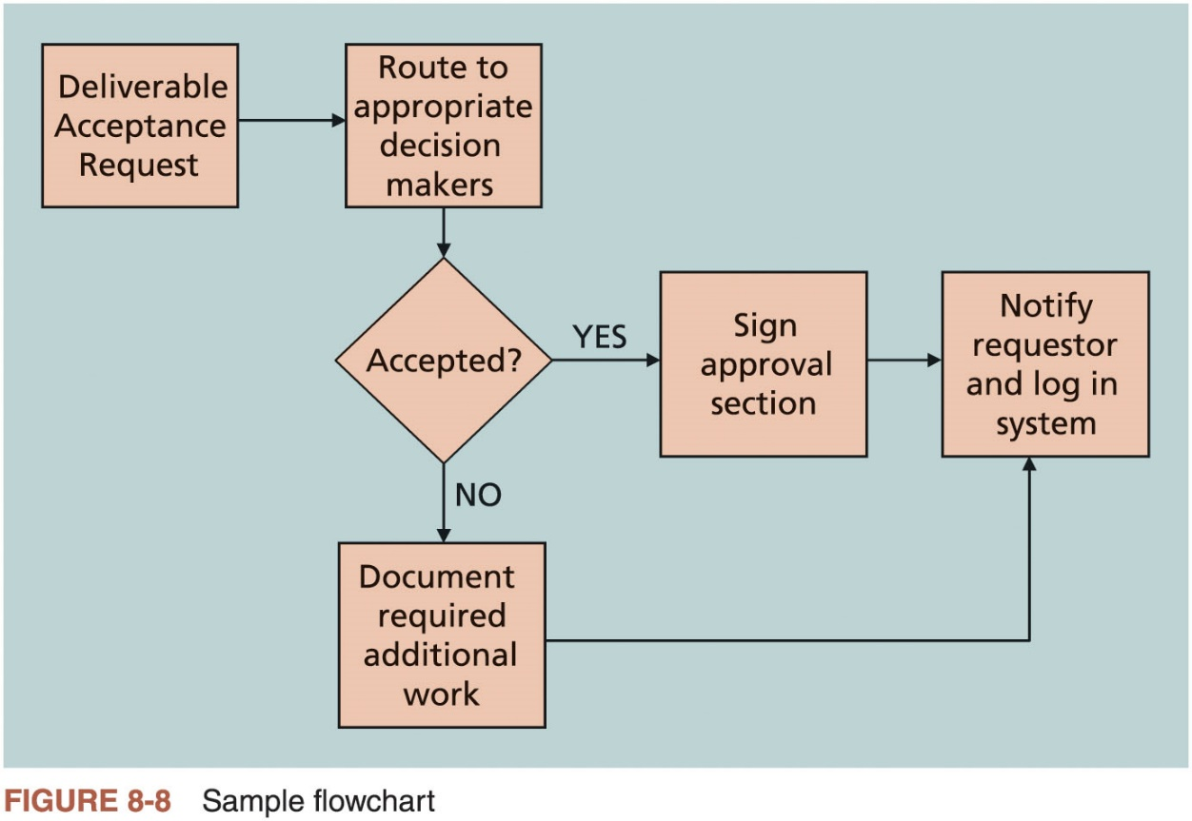
Tools and Techniques for Quality Control (8 of 9)

Slide 22
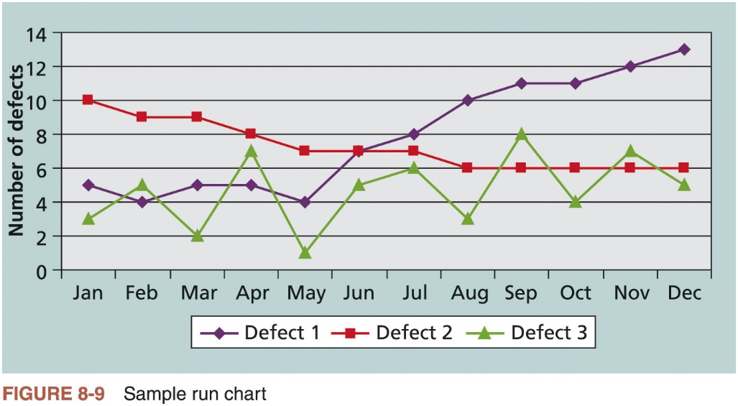
Tools and Techniques for Quality Control (9 of 9)

Slide 23
Statistical Sampling (1 of 2)
Choosing part of a population of interest for inspection
Size of a sample depends on how representative you want the sample to be
Sample size formula
Sample size = .25 x (certainty factor/acceptable error)²

Slide 24
Statistical Sampling (2 of 2)
Desired Certainty | Certainty Factor
95% | 1.960
90% | 1.645
80% | 1.281
Table 8-1 Commonly used certainty factors

Slide 25
Six Sigma (1 of 2)
The Six Sigma Way authors, Peter Pande, Robert Neuman, and Roland Cavanagh, define Six Sigma
A comprehensive and flexible system for achieving, sustaining, and maximizing business success. Six Sigma is uniquely driven by close understanding of customer needs, disciplined use of facts, data, and statistical analysis, and diligent attention to managing, improving, and reinventing business processes.”

Slide 26
Six Sigma (2 of 2)
DMAIC is a systematic, closed-loop process for continued improvement that is scientific and fact based
Define: define the problem/opportunity, process, and customer requirements
Measure: define measures, then collect, compile, and display data
Analyze: scrutinize process details to find improvement opportunities
Improve: generate solutions and ideas for improving the problem
Control: track and verify the stability of the improvements and the predictability of the solution

Slide 27
How is Six Sigma Quality Control Unique?
Six Sigma principles that help organizations improve their competitiveness and bottom-line results
Requires an organization-wide commitment
Training follows the “belt” system
Organizations have the ability and willingness to adopt contrary objectives, such as reducing errors and getting things done faster
An operating philosophy that is customer focused and strives to drive out waste, raise levels of quality, and improve financial performance at breakthrough levels

Slide 28
Six Sigma and Project Selection and Management
What makes a project a potential Six Sigma project?
Must be a quality problem or gap between the current and desired performance
Project should not have a clearly understood problem
Solution should not be predetermined, and an optimal solution should not be apparent

Slide 29
Six Sigma and Statistics (1 of 5)
Sigma means standard deviation
Standard deviation measures how much variation exists in a distribution of data; a key factor in determining the acceptable number of defective units found in a population
Six Sigma projects strive for no more than 3.4 defects per million opportunities

Slide 30
Six Sigma and Statistics (2 of 5)
Six Sigma uses a conversion table
Yield represents the number of units handled correctly through the process steps
A defect is any instance where the product or service fails to meet customer requirements
There can be several opportunities to have a defect
Six nines of quality is a measure of quality control equal to one fault in one million opportunities
In the telecommunications industry, it means 99.9999 percent service availability or 30 seconds of down time a year

Slide 31
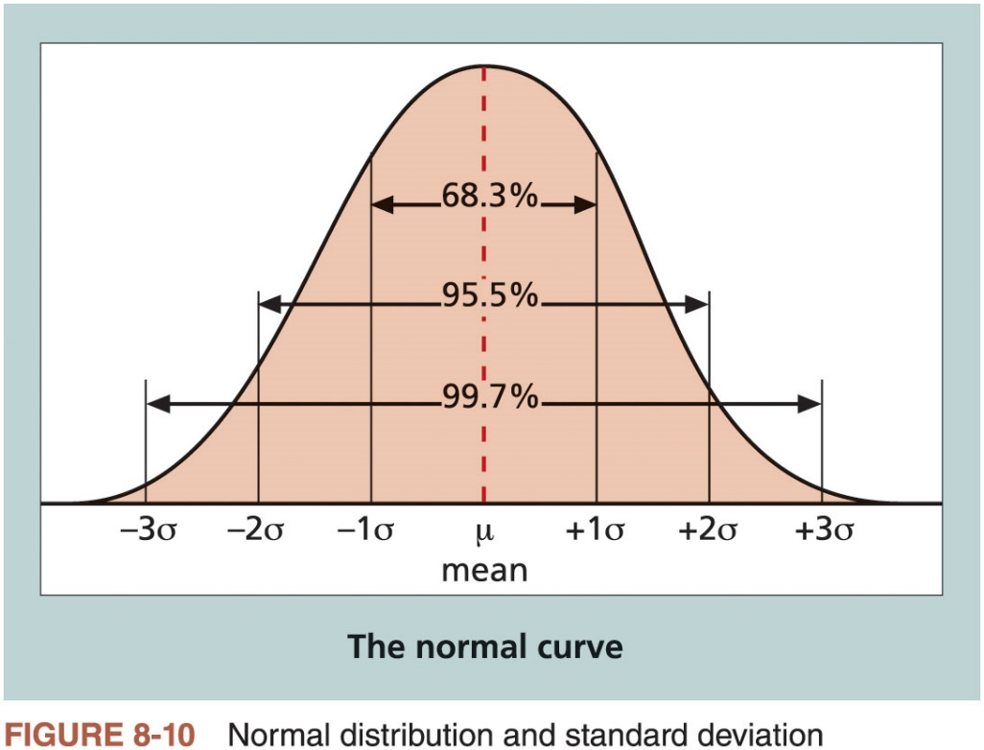
Six Sigma and Statistics (3 of 5)

Slide 32
Six Sigma and Statistics (4 of 5)
Specification Range (in ± Sigmas) | Percent of Population within Range | Defective Units per Billion
1 | 68.27 | 317,300,000
2 | 95.45 | 45,400,000
3 | 99.73 | 2,700,000
4 | 99.9937 | 63,000
5 | 99.999943 | 57
6 | 99.9999998 | 2
Table 8-2 Sigma and defective units

Slide 33
Six Sigma and Statistics (5 of 5)
Sigma | Yield | Defects per Million Opportunities (DPMO)
1 | 31.0% | 690,000
2 | 69.2% | 308,000
3 | 93.3% | 66,800
4 | 99.4% | 6,210
5 | 99.97% | 230
6 | 99.99966% | 3.4
Table 8-3 Six Sigma conversion table

Slide 34
Testing (1 of 4)
Many IT professionals think of testing as a stage that comes near the end of IT product development
Testing needs to be done during almost every phase of the systems development life cycle, not just before the organization ships or hands over a product to the customer

Slide 35
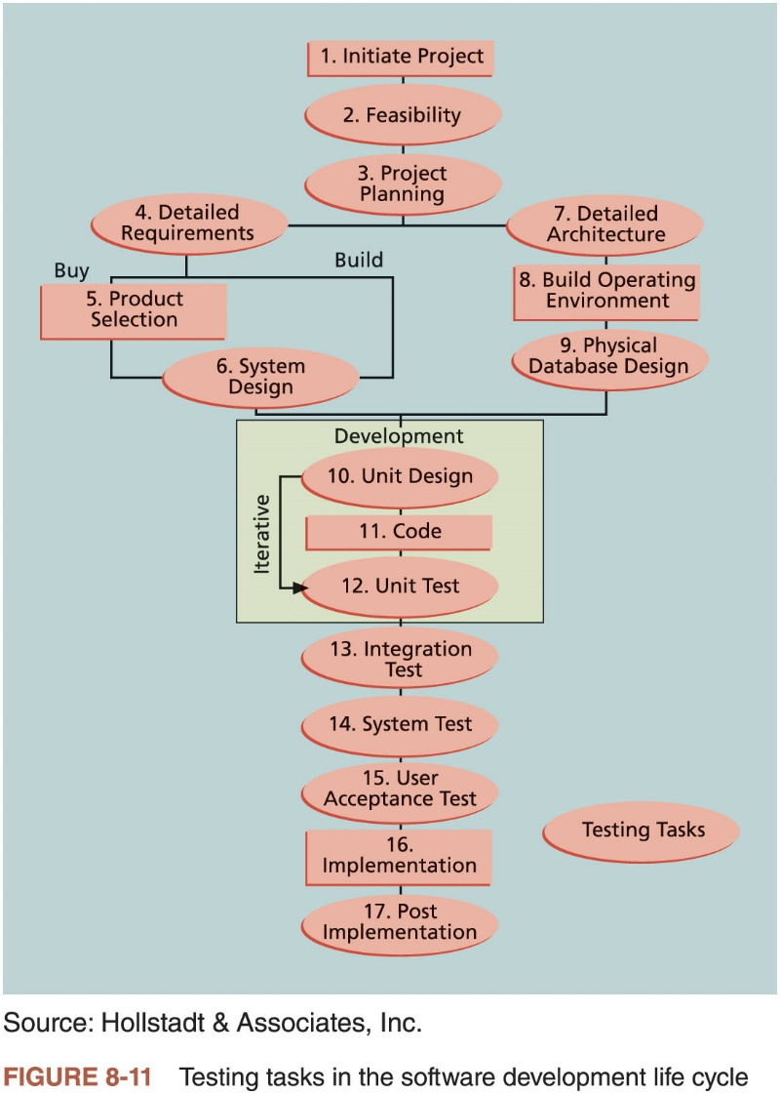
Testing (2 of 4)

Slide 36
Testing (3 of 4)
Types of tests
Unit testing tests each individual component (often a program) to ensure it is as defect-free as possible
Integration testing occurs between unit and system testing to test functionally grouped components
System testing tests the entire system as one entity
User acceptance testing is an independent test performed by end users prior to accepting the delivered system

Slide 37
Testing (4 of 4)
Testing alone is not enough
Watts S. Humphrey, a renowned expert on software quality, defines a software defect as anything that must be changed before delivery of the program
Testing does not sufficiently prevent software defects
The number of ways to test a complex system is huge
Users will continue to invent new ways to use a system that its developers never considered
Humphrey suggests that people rethink the software development process to provide no potential defects when you enter system testing
Developers must be responsible for providing error-free code at each stage of testing

Slide 38
Modern Quality Management (1 of 4)
Modern quality management:
Requires customer satisfaction
Prefers prevention to inspection
Recognizes management responsibility for quality
Noteworthy quality experts:
Deming, Juran, Crosby, Ishikawa, Taguchi, and Feigenbaum

Slide 39
Modern Quality Management (2 of 4)
Quality experts
Deming was famous for his work in rebuilding Japan and his 14 Points for Management
Juran wrote the Quality Control Handbook and ten steps to quality improvement
Crosby wrote Quality is Free and suggested that organizations strive for zero defects
Ishikawa developed the concepts of quality circles and pioneered the use of cause-and-effect diagrams
Taguchi developed methods for optimizing the process of engineering experimentation
Feigenbaum developed the concept of total quality control

Slide 40
Modern Quality Management (3 of 4)
Malcolm Baldrige National Quality Award
Originated in 1987 to recognize companies that have achieved a level of world-class competition through quality management
Given by the President of the United States to U.S. businesses
Three awards each year in different categories
Manufacturing
Service
Small business
Education and health care

Slide 41
Modern Quality Management (4 of 4)
ISO standards
ISO 9000: a three-part, continuous cycle of planning, controlling, and documenting quality in an organization
Provide minimum requirements needed for an organization to meet its quality certification standards
Help ensure that projects create products or services that meet customer needs and expectations

Slide 42
Global Issues
In 2015,15 electric cars were introduced throughout the world
Driverless cars are also being tested
In March of 2018, a woman was killed by a self-driving car operated by an Uber driver

Slide 43
Improving IT Project Quality
Suggestions for improving quality for IT projects
Establish leadership that promotes quality
Understand the cost of quality
Provide a good workplace to enhance quality
Work toward improving the organization’s overall maturity level in software development and project management

Slide 44
Leadership
A large percentage of quality problems are associated with management, not technical issues
Top management must take responsibility for creating, supporting, and promoting quality programs
Leadership provides an environment conducive to producing quality
When every employee insists on producing high-quality products, then top management has done a good job of promoting the importance of quality

Slide 45
The Cost of Quality (1 of 2)
Cost of conformance plus the cost of nonconformance
Conformance means delivering products that meet requirements and fitness for use
Cost of nonconformance means taking responsibility for failures or not meeting quality expectations

Slide 46
The Cost of Quality (2 of 2)
Cost categories related to quality
Prevention cost: cost of planning and executing a project so it is error-free or within an acceptable error range
Appraisal cost: cost of evaluating processes and their outputs to ensure quality
Internal failure cost: cost incurred to correct an identified defect before the customer receives the product
External failure cost: cost that relates to all errors not detected and corrected before delivery to the customer
Measurement and test equipment costs: capital cost of equipment used to perform prevention and appraisal activities

Slide 47
Media Snapshot
Computer viruses and malware software have been a quality concern for years
Consumers are now being warned that e-cigarettes can be bad for computers
Anything can infect your computer if it can be inserted into a USB port
Other consumer products like smart TVs can invade privacy

Slide 48
The Impact of Organizational Influences, and Workplace Factors on Quality
Study by DeMarco and Lister showed that organizational issues had a much greater influence on programmer productivity than the technical environment or programming languages
Programmer productivity varied by a factor of one to ten across organizations, but only by 21 percent within the same organization
Study found no correlation between productivity and programming language, years of experience, or salary
A dedicated workspace and a quiet work environment were key factors to improving programmer productivity

Slide 49
Expectations and Cultural Differences in Quality
Project managers must understand and manage stakeholder expectations
Expectations vary
Organization’s culture
Geographic regions

Slide 50
Advice for Young Professionals
Managing expectations is a critical skill
It’s important to understand other people’s expectations as well as your own
Too many people, including experienced project managers, make assumptions about expectations and get surprised when they do not match those of their stakeholders
Never be afraid to ask what is expected of you

Slide 51
Maturity Models (1 of 3)
Frameworks for helping organizations improve their processes and systems
Software Quality Function Deployment Model focuses on defining user requirements and planning software projects
Capability Maturity Model Integration is a process improvement approach that provides organizations with the essential elements of effective processes

Slide 52
Maturity Models (2 of 3)
CMMI levels
Incomplete
Performed
Managed
Defined
Quantitatively Managed
Optimizing

Slide 53
Maturity Models (3 of 3)
PMI released the Organizational Project Management Maturity Model (OPM3) in December 2003
Model is based on market research surveys sent to more than 30,000 project management professionals and incorporates 180 best practices and more than 2,400 capabilities, outcomes, and key performance indicators
Addresses standards for excellence in project, program, and portfolio management best practices and explains the capabilities necessary to achieve those best practices

Slide 54
Best Practice
OPM3® example to illustrate a best practice, capability, outcome, and key performance indicator:
Best practice: establish internal project management communities
Capability: facilitate project management activities
Outcome: establish local initiatives
Key performance indicator: community addresses local issues

Slide 55
Using Software to Assist in Project Quality Management
Software can be used to assist with tools and techniques
Spreadsheet and charting software helps create diagrams
Statistical software packages help perform statistical analysis
Specialized software products help manage Six Sigma projects or create quality control charts

Slide 56
Considerations For Agile/Adaptive Environments
Agile methods can be used on all types of projects, not just software development
Several projects use a hybrid approach where some deliverables are created using more traditional approaches
Quality is a very broad topic, and it is only one of the ten project management knowledge areas
Project managers must focus on defining how quality relates to their specific projects and ensure that those projects satisfy the needs for which they were undertaken

Slide 57
Chapter Summary
Quality is a serious issue
Project quality management includes planning quality management, performing quality assurance, and controlling quality
Many tools and techniques are related to project quality management
Many people made significant contributions to the development of modern quality management
There is much room for improvement in IT project quality
Several types of software are available to assist in project quality management

