Slide 1
Chapter 9: Project Resource Management
Information Technology Project Management, Ninth Edition
Note: See the text itself for full citations

Slide 2
Learning Objectives (1 of 2)
Explain the importance of good resource management on projects, including the current state of the global IT workforce and future implications for IT
Define project resource management and understand its processes
Summarize key concepts for managing people by understanding theories of motivation, influence, and power; how people and teams can become more effective; emotional intelligence; and leadership
Discuss resource management planning and be able to create a human resource plan, project organizational chart, responsibility assignment matrix, and resource histogram
Describe the process of estimating activity resources

Slide 3
Learning Objectives (2 of 2)
Discuss issues that are typically involved in resource acquisition, particularly as they involve resource assignments, resource loading, and resource leveling
Assist in team development with training, team-building activities, and reward systems
Explain and apply several tools and techniques to help manage a project team and summarize general advice on managing teams
Summarize the process of controlling resources
Describe how project management software can assist in project resource management
Discuss considerations for agile/adaptive environments

Slide 4
The Importance of Resource Management
People determine the success and failure of organizations and projects
Most project managers agree that managing human resources effectively is one of the toughest challenges they face
Managing people is a vital component of project resource management

Slide 5
The Global IT Workforce
Although there have been ups and downs in the IT labor market, there will always be a need for good IT workers
By June of 2017, there were almost 4.3 billion mobile-broadband subscriptions
By 2020, ICT spending is projected to grow to nearly $5.5 trillion
Jobs available to IT professionals are expected to increase by 12 percent by 2024
Project management is number three on Computerworld’s hottest tech list

Slide 6
Implications for the Future of IT Human Resource Management
Proactive organizations are addressing human resource needs
Improving benefits
Redefining work hours and incentives
Finding future workers

Slide 7
Global Issues
In 2013, Yahoo’s CEO issued a memo stating that employees could no longer work from home, causing quite a stir throughout the world
Diebold’s CEO took the opposite approach and started recruiting employees who wanted to work from home, luring the best and brightest workers from Yahoo and other companies cutting back on telecommuting
The Huffington Post believes that telecommuting has won, and even Yahoo has softened its stance

Slide 8
What Went Wrong?
CompTIA found a gap between skills that employers wanted and what they actually found in the IT workforce
68 percent of IT firms report having a very challenging time finding new staff
52 percent of organizations report having job openings, and 33 percent say they are understaffed, while 42 percent say they are fully staffed but want to hire more people in order to expand
58 percent of businesses are concerned about the quality and quantity of IT talent available for hire
Top technology priorities in this survey included security, data storage, and network infrastructure
The number one strategy to handle understaffing is requiring workers to put in more hours
94 percent of IT professionals plan to pursue more training

Slide 9
What is Project Resource Management? (1 of 2)
Making the most effective use of the human and physical resources involved with a project
Planning resource management
Estimating activity resources
Acquiring resources
Developing the project team
Managing the project team
Controlling resources

Slide 10
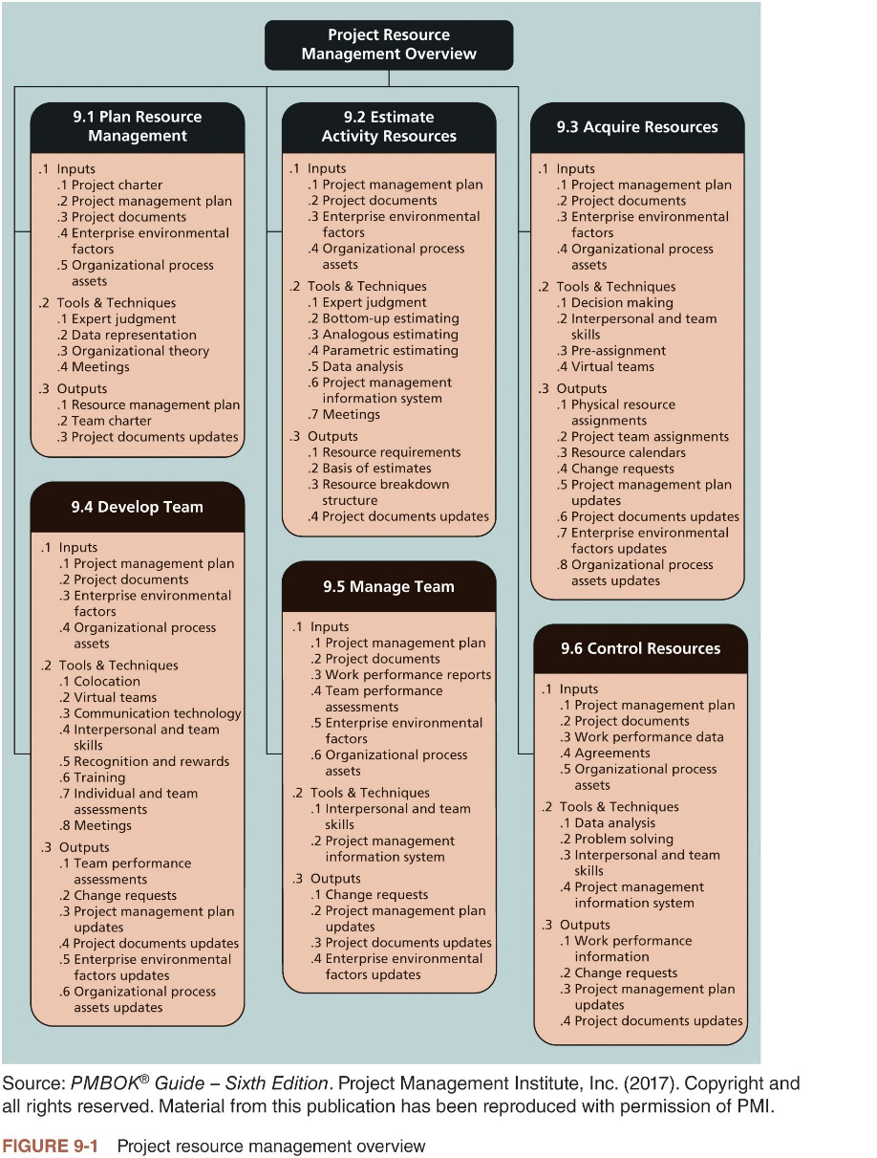
What is Project Resource Management? (2 of 2)

Slide 11
Keys to Managing and Leading People
Psychologists and management theorists have devoted much research and thought to the field leading people at work
Motivation theories
Influence and power
Effectiveness
Emotional intelligence
Leadership

Slide 12
Motivation Theories
Intrinsic motivation causes people to participate in an activity for their own enjoyment
Example: some people love to read, write, or play an instrument because it makes them feel good
Extrinsic motivation causes people to do something for a reward or to avoid a penalty
Example: some young children would prefer not to play an instrument, but they do because they receive a reward or avoid a punishment for doing so

Slide 13
Maslow’s Hierarchy of Needs (1 of 2)
Abraham Maslow argued that humans possess unique qualities that enable them to make independent choices, thus giving them control of their destiny
Developed a hierarchy of needs; states that people’s behaviors are guided or motivated by a sequence of needs

Slide 14
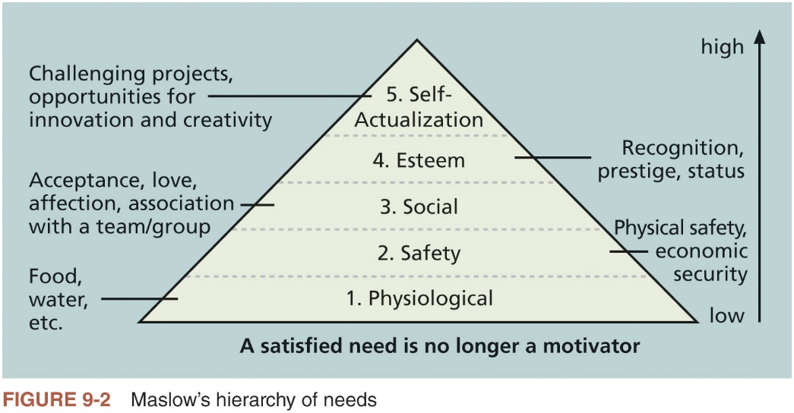
Maslow’s Hierarchy of Needs (2 of 2)

Slide 15
Herzberg’s Motivational-Hygiene Theory (1 of 2)
Frederick Herzberg distinguished between motivational factors and hygiene factors
Motivational factors: factors that cause job satisfaction
Hygiene factors: could cause job dissatisfaction

Slide 16
Herzberg’s Motivational-Hygiene Theory (2 of 2)
Hygiene Factors | Motivators
Larger salaries | Achievement
More supervision | Recognition
More attractive work environment | Work itself
Computer or other required equipment | Responsibility
Health benefits | Advancement
Training | Growth
Table 9-1 Examples of Herzberg’s hygiene factors and
motivators

Slide 17
Media Snapshot
RSA Animate used a whiteboard drawing technique to summarize key points from Pink’s book in a YouTube video called “Drive: The surprising truth about what motivates us”
Pink suggests that managers focus on motivators
Autonomy
Mastery
Purpose

Slide 18
McClelland’s Acquired-Needs Theory
Specific needs are acquired or learned over time and shaped by life experiences
Achievement (nAch): achievers like challenging projects with achievable goals and regular feedback
Affiliation (nAff): people with high nAff desire harmonious relationships and need to feel accepted by others, so managers should try to create a cooperative work environment for them
Power: (nPow): people with a need for power desire either personal power (not good) or institutional power (good for the organization)

Slide 19
McGregor’s Theory X and Y
Douglas McGregor popularized the human relations approach to management in the 1960s
Theory X: assumes workers dislike and avoid work, so managers must use coercion, threats and various control schemes to get workers to meet objectives
Theory Y: assumes individuals consider work as natural as play or rest and enjoy the satisfaction of esteem and self-actualization needs
Theory Z: introduced in 1981 by William Ouchi and is based on the Japanese approach to motivating workers, emphasizing trust, quality, collective decision making, and cultural values

Slide 20
Influence and Power (1 of 3)
Thamhain and Wilemon: ways to have influence on projects
Authority: legitimate hierarchical right to issue orders
Assignment: ability to influence a worker's later work assignments
Budget: ability to authorize others' use of discretionary funds
Promotion: ability to improve a worker's position
Money: ability to increase a worker's pay and benefits
Penalty: ability to cause punishment
Work challenge: ability to assign work that capitalizes on a worker's enjoyment of doing a particular task
Expertise: perceived special knowledge that others deem important
Friendship: ability to establish friendly personal relationships between the project manager and others

Slide 21
Influence and Power (2 of 3)
Ways to influence
Project managers who use work challenges and expertise to influence people projects are more likely to succeed
Projects are more likely to fail when project managers rely too heavily on authority, money, or penalty

Slide 22
Influence and Power (3 of 3)
Power is the potential ability to influence behavior to get people to do things they would not otherwise do
Power is much stronger than influence, because it is often used to force people to change their behavior
Types of power
Coercive
Legitimate
Expert
Reward
Referent

Slide 23
Covey and Improving Effectiveness (1 of 2)
Project managers can apply Covey’s seven habits to improve effectiveness on projects
Be proactive
Begin with the end in mind
Put first things first
Think win/win
Seek first to understand, then to be understood
Synergize
Sharpen the saw

Slide 24
Covey and Improving Effectiveness (2 of 2)
Good project managers are empathic listeners
They listen with the intent to understand
Before you can communicate with others, you have to have rapport
Relation of harmony, conformity, accord, or affinity
Mirroring is the matching of certain behaviors of the other person
A technique to help establish rapport
IT professionals need to develop empathic listening and other people skills to improve relationships with users and other stakeholders

Slide 25
Advice for Young Professionals
Start using empathy more effectively
Put aside your viewpoint
Validate the other person’s perspective
Examine your attitude
Listen to the entire message that the other person is trying to communicate
Ask what the other person would do

Slide 26
Emotional Intelligence
Howard Gardner’s book Frames of Mind: The Theory of Multiple Intelligences introduced the concept of using more than one way to think of and measure human intelligence
Gardner suggested the need to develop both interpersonal intelligence (capacity to understand the motivations, intentions, and desires of others) and intrapersonal intelligence (capacity to understand oneself, one’s feelings, and motivations)
Emotional intelligence (EI) is knowing and managing one’s own emotions and understanding the emotions of others for improved performance

Slide 27
Leadership
There is no one best way to be a leader
Most experts agree that the best leaders are able to adapt their style to needs of the situation
It is important to understand and pay attention to concepts of motivation, influence, power, effectiveness, emotional intelligence, and leadership in all project processes

Slide 28
What Went Right?
PMI introduced the PMI Talent Triangle® in 2015 to emphasize the need for more than technical skills for project managers
The Talent Triangle® includes:
Technical project management
Strategic and business management
Leadership

Slide 29
Developing the Resource Management Plan and Team Charter (1 of 6)
Involves identifying and documenting project resources, roles, responsibilities, skills, and reporting relationships
Can be separated into a human resource management plan and a physical resource management plan
Contents include:
Project organizational charts
Responsibility assignment matrixes
Staffing management plan and resource histograms
Team charters

Slide 30
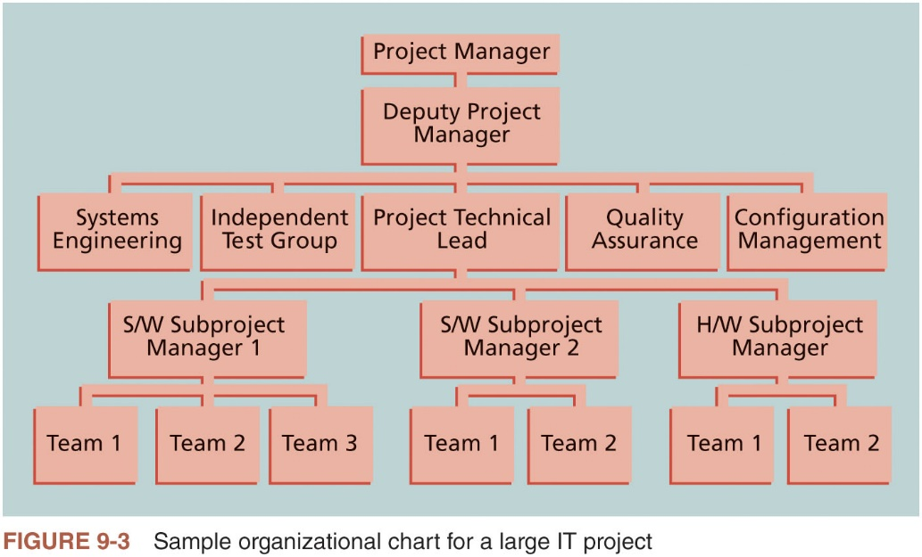
Developing the Resource Management Plan and Team Charter (2 of 6)

Slide 31
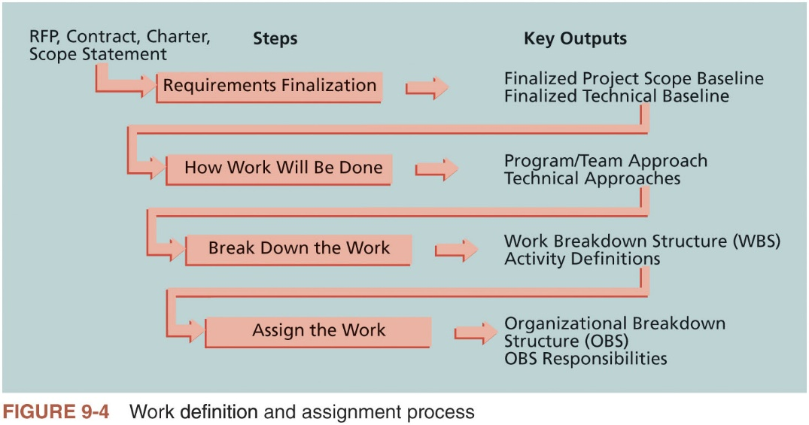
Developing the Resource Management Plan and Team Charter (3 of 6)

Slide 32
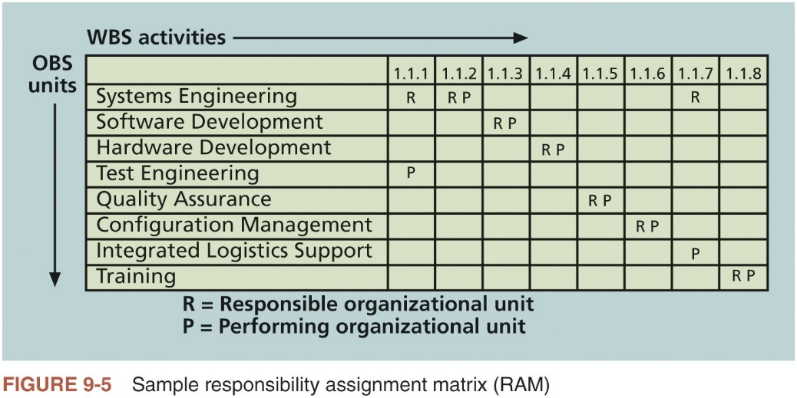
Developing the Resource Management Plan and Team Charter (4 of 6)

Slide 33
Developing the Resource Management Plan and Team Charter (5 of 6)
 | Car Owner | Shop Owner | Mechanic | Parts Supplier
Pay for parts and services | A, R | C
Determine parts and services needed | C |  | A, R | C
Supply parts |  | C | C | A, R
Install parts | I | A | R
Table 9-2 Sample RACI chart

Slide 34
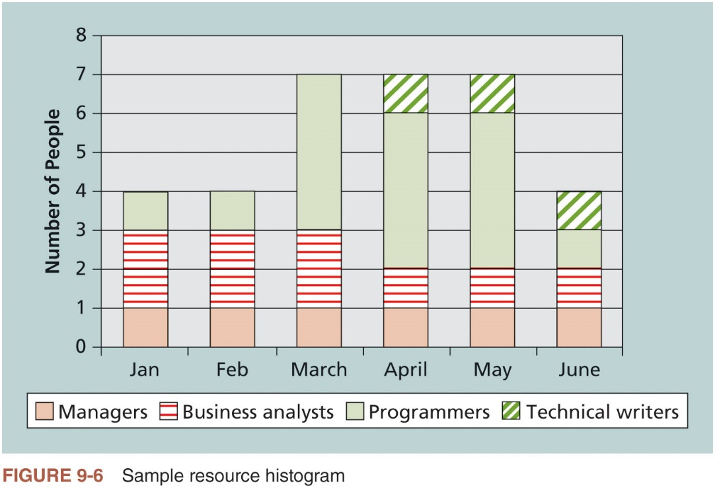
Developing the Resource Management Plan and Team Charter (6 of 6)

Slide 35
Estimating Activity Resources
Tools that can assist in resource estimating
Expert judgment
Various estimating approaches
Data analysis
Project management software
Meetings

Slide 36
Acquiring Resources
During the late 1990s, the IT job market became extremely competitive
Today, many organizations again face a shortage of IT staff
Regardless of the current job market, acquiring qualified IT professionals is critical

Slide 37
Resource Assignment
After developing resource requirements, project managers must work with other people in their organizations to assign them to their projects or to acquire additional human or physical resources needed for the project
Organizations that do a good job of staff acquisition have good staffing plans
It is very important to consider the needs of individuals and the organization when making recruiting and retention decisions

Slide 38
Best Practice
Best practices can be applied to include the best places for people to work
Fortune Magazine lists the “100 Best Companies to Work For” in the United States every year, with Google taking the honors for the eighth time in 2017
Working Mothers Magazine lists the best companies in the U.S. for women based on benefits for working families
The Times online provides the Sunday Times list of the “100 Best Companies to Work For,” a key benchmark against which U.K. companies can judge their performance as employers

Slide 39
Resource Loading (1 of 2)
Resource loading refers to the amount of individual resources an existing schedule requires during specific time periods
Helps project managers develop a general understanding of the demands a project will make on the organization’s resources and individual people’s schedules
Overallocation means more resources than available are assigned to perform work at a given time

Slide 40
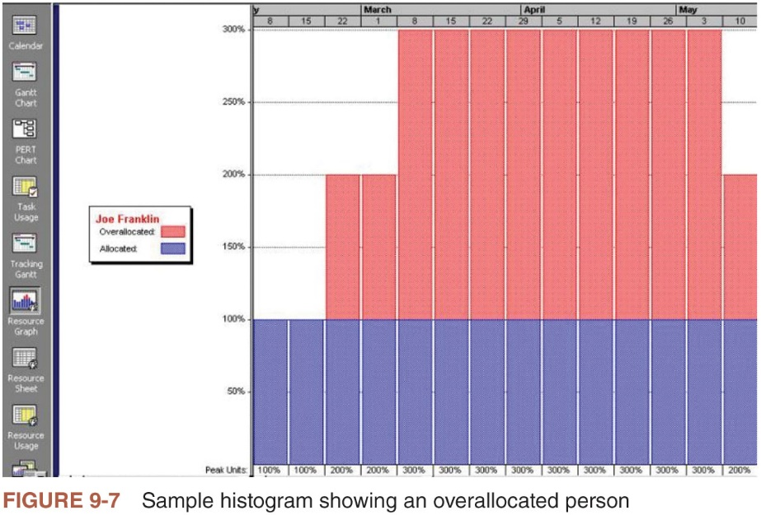
Resource Loading (2 of 2)

Slide 41
Resource Leveling (1 of 2)
Resource leveling is a technique for resolving resource conflicts by delaying tasks
Main purpose is to create a smoother distribution of resource usage
Benefits of resource leveling
When resources are used on a more constant basis, they require less management
May enable project managers to use a just-in-time inventory type of policy for using subcontractors or other expensive resources
Results in fewer problems for project personnel and accounting department
Often improves morale

Slide 42
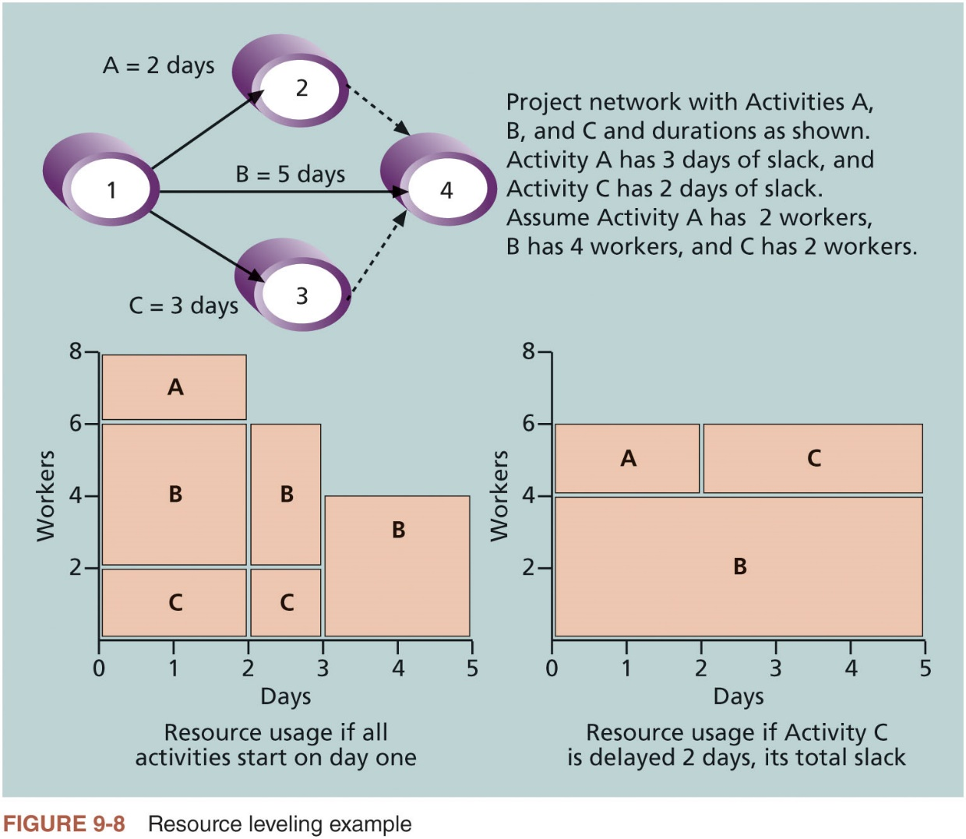
Resource Leveling (2 of 2)

Slide 43
Developing the Project Team (1 of 2)
The main goal of team development is to help people work together more effectively to improve project performance
It takes teamwork to successfully complete most projects
Tuckman model describes five stages of team development
Forming
Storming
Norming
Performing
Adjourning

Slide 44
Developing the Project Team (2 of 2)
Training
Project managers often recommend that people take specific training courses to improve individual and team development
Team-building activities
Physical challenges
Psychological preference indicator tools

Slide 45
The Meyers-Briggs Type Indicator
Popular tool for determining personality preferences and helping teammates understand each other
Four dimensions
Extrovert/Introvert (E/I)
Sensation/Intuition (S/N)
Thinking/Feeling (T/F)
Judgment/Perception (J/P)
Intuitive/Thinking types (i.e., NTs or rationals) are attracted to technology fields

Slide 46
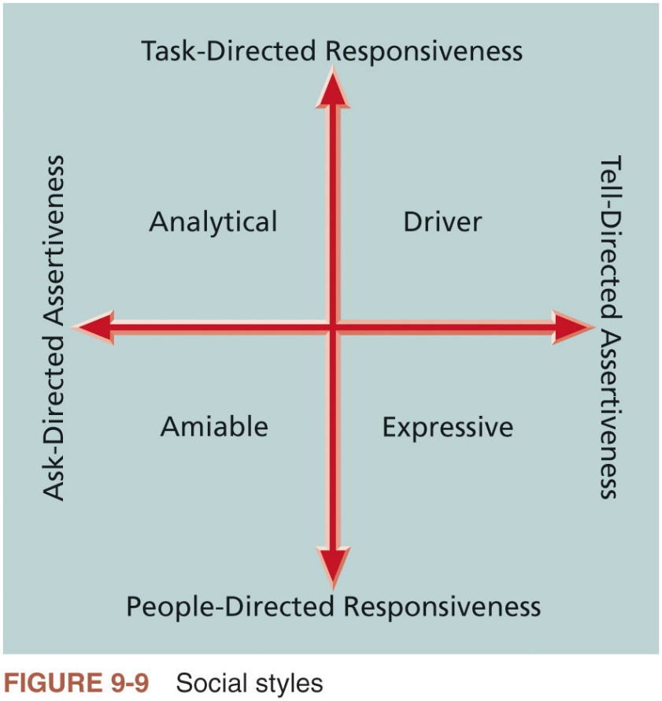
The Social Styles Profile
People are perceived as behaving primarily in one of four zones, based on their assertiveness and responsiveness
Drivers
Expressives
Analyticals
Amiables

Slide 47
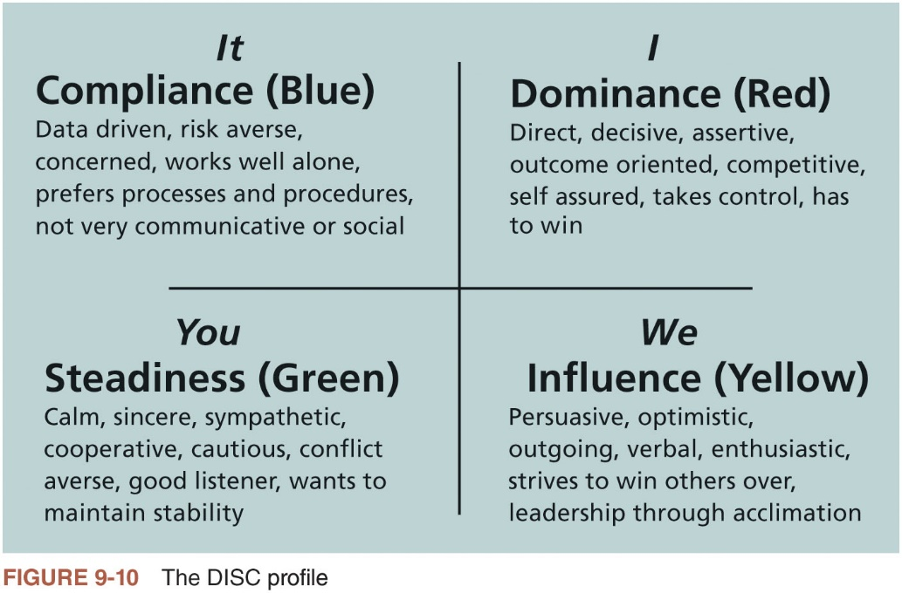
DISC Profile
Four-dimensional model of normal behavior
Dominance
Influence
Steadiness
Compliance

Slide 48
Reward and Recognition Systems
Team-based reward and recognition systems can promote teamwork
Focus on rewarding teams for achieving specific goals
If management rewards teamwork, they will promote or reinforce the philosophy that people work more effectively in teams
Project managers must continually assess their team’s performance
When they find areas in which individuals or the entire team can improve, it’s their job to find the best way to develop their people and improve performance

Slide 49
Managing the Project Team
Project managers must lead their teams in performing various project activities
After assessing team performance and related information, the project manager must make several decisions
Changes to be requested
Corrective or preventive actions
Updates needed

Slide 50
Tools and Techniques for Managing Project Teams (1 of 4)
Several tools and techniques are available to assist in managing project teams
Interpersonal and team skills
Project management information systems
Conflict management

Slide 51
Tools and Techniques for Managing Project Teams (2 of 4)
Conflict handling modes
Confrontation: directly face a conflict using a problem-solving approach
Compromise: use a give-and-take approach
Smoothing: de-emphasize areas of difference and emphasize areas of agreement
Forcing: win-lose approach
Withdrawal: retreat or withdraw from an actual or potential disagreement
Collaborating: decision makers incorporate different viewpoints and insights to develop consensus and commitment

Slide 52
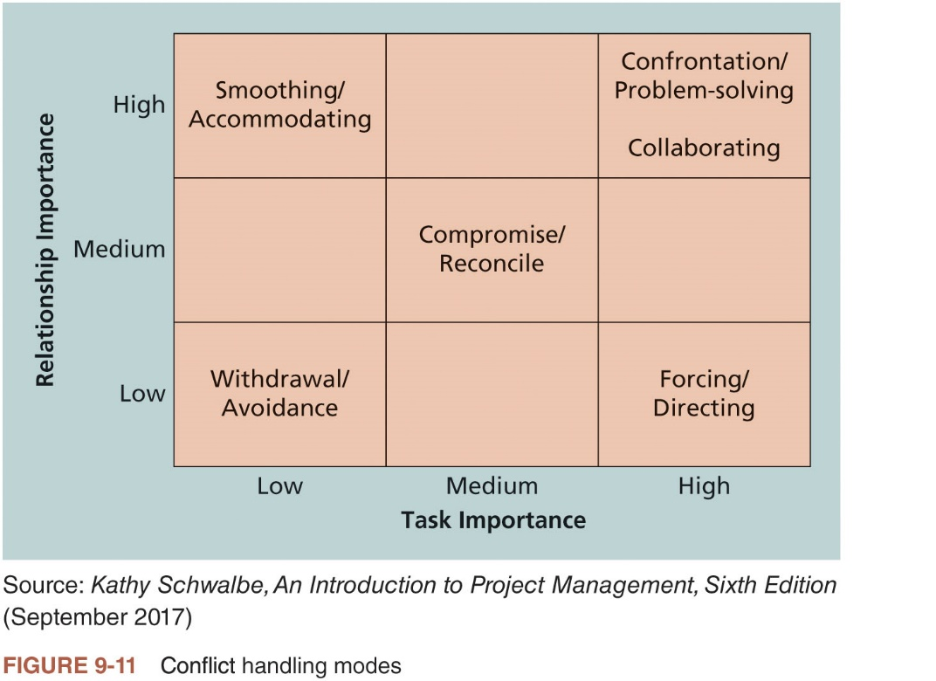
Tools and Techniques for Managing Project Teams (3 of 4)

Slide 53
Tools and Techniques for Managing Project Teams (4 of 4)
Conflict can be good
Conflict often produces important results, such as new ideas, better alternatives, and motivation to work harder and more collaboratively
Groupthink: conformance to the values or ethical standards of a group; can develop if there are no conflicting viewpoints
Research suggests that task-related conflict often improves team performance, but emotional conflict often depresses team performance

Slide 54
General Advice on Managing Teams (1 of 2)
Five dysfunctions of teams
Absence of trust
Fear of conflict
Lack of commitment
Avoidance of accountability
Inattention to results

Slide 55
General Advice on Managing Teams (2 of 2)
General advice
Be patient and kind with your team
Fix the problem instead of blaming people
Establish regular, effective meetings
Allow time for teams to go through the basic team-building stages
Limit the size of work teams to three to seven members
Plan some social activities to help project team members and other stakeholders get to know each other better
Stress team identity
Nurture team members and encourage them to help each other
Acknowledge individual and group accomplishments
Take additional actions to work with virtual team members

Slide 56
Controlling Resources
Ensuring physical resources assigned to the project are available as planned
Also involves monitoring the planned versus actual resources utilization and taking corrective actions as needed

Slide 57
Using Software to Assist in Resource Management
Software can help in producing a simple responsibility assignment matrix or resource histograms
Software includes several features related to human resource management
Assigning and tracking resources
Leveling resources
Resource usage reports
Overallocated resource reports
To-do lists

Slide 58
Considerations for Agile/Adaptive Environments
Teams are important on all types of projects, as is collaboration, problem solving, and knowledge sharing
On agile projects, team members are usually fully dedicated to a single team
Relationships are based on trust, and collaboration is continuously improved using regular feedback

Slide 59
Chapter Summary
Project resource management includes the processes required to make the most effective use of the people involved with a project
Planning resources
Estimating activity resources
Acquiring resources
Developing the team
Managing the team
Controlling resources

