Slide 1
Chapter 12: Project Procurement Management
Information Technology Project Management, Ninth Edition
Note: See the text itself for full citations

Slide 2
Learning Objectives (1 of 2)
Explain the importance of project procurement management and the increasing use of outsourcing for information technology (IT) projects
Describe the work involved in planning procurements for projects, including determining the proper type of contract to use and preparing a procurement management plan, statement of work, source selection criteria, and make-or-buy analysis
Discuss how to conduct procurements and strategies for obtaining seller responses, selecting sellers, and awarding contracts
Describe the process of controlling procurements by managing procurement relationships and monitoring contract performance

Slide 3
Learning Objectives (2 of 2)
Discuss types of software that are available to assist in project procurement management
Discuss considerations for agile/adaptive environments

Slide 4
Importance of Project Procurement Management (1 of 4)
Procurement means acquiring goods and/or services from an outside source
Other terms include purchasing and outsourcing
Garner estimated the value of the global IT industry in 2017 at $3.7 trillion
According to a study by Deloitte, the outsourcing market continues to grow
Debates on outsourcing
Some companies, such as Wal-Mart, prefer to do no outsourcing at all, while others do a lot of outsourcing
GM recently announced plans to switch from outsourcing 90% of IT service to only 10%

Slide 5
Global Issues
Urban onshoring: recent approach to bring IT jobs back to the U.S., especially for functions like software testing
Urban Development Center model develops the infrastructure, resources, and jobs in low-income urban neighborhoods to provide technology education, training, and job placement services for over 4,500 unemployed and low-income adults in New York City

Slide 6
What Went Right?
Retailer Zulily develops software in-house to meet their needs for speed and innovation
Proprietary algorithms track customers and make adjustments to meet changing consumer preferences
They send customers e-mails containing deals targeted to what they’ve bought from the site and to their page viewing patterns

Slide 7
Importance of Project Procurement Management (2 of 4)
Why outsource?
Access skills and technologies
Reduce both fixed and recurrent costs
Allow the client organization to focus on its core business
Provide flexibility
Increase accountability

Slide 8
What Went Wrong?
In 2011, New York City’s mayor, Michael Bloomberg, acknowledged that City Hall had mismanaged its major IT projects and vowed to improve their oversight
Prosecutors said the $700 million price tag for the CityTime payroll system was inflated by fraud, and the mayor demanded $600 million back from the main contractor
The automated personnel system, Nycaps, suffered significant delays and cost overruns due to leadership issues, increasing from an original estimate of $66 million to over $363 million

Slide 9
Importance of Project Procurement Management (3 of 4)
Project procurement management
Acquiring goods and services for a project from outside the performing organization
Main processes
Planning procurement management: determining what to procure and when and how to do it
Conducting procurements: obtaining seller responses, selecting sellers, and awarding contracts
Controlling procurements: managing relationships with sellers, monitoring contract performance, making changes as needed, and closing out contracts

Slide 10
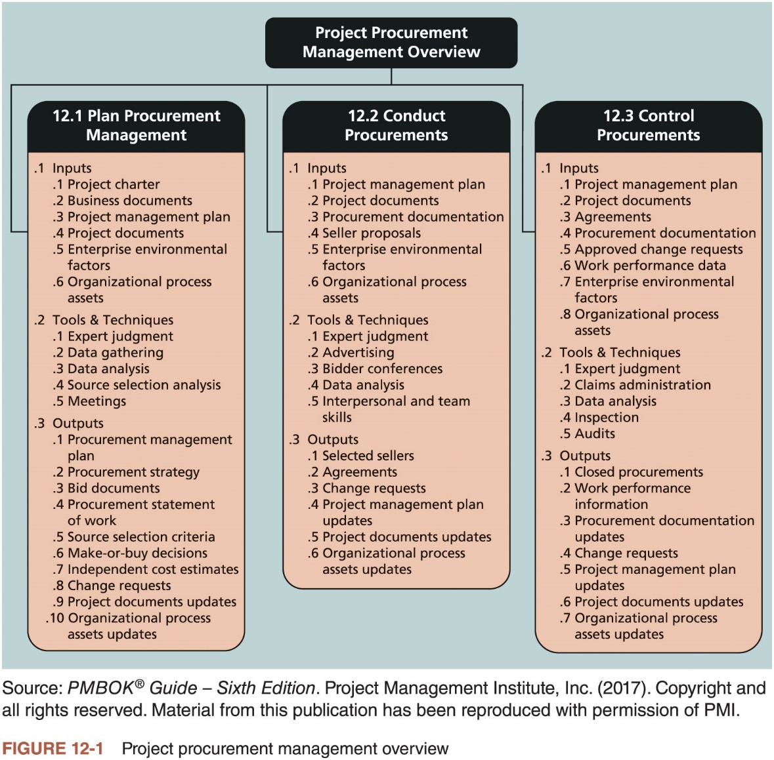
Importance of Project Procurement Management (4 of 4)

Slide 11
Planning Procurement Management
Identifying which project needs can best be met by using products or services outside the organization
Involves deciding whether to procure, how to procure, what to procure, how much to procure, and when to procure
An important output of this process is the make-or-buy decision
If there is no need to buy any products or services from outside the organization, then there is no need to perform any of the other procurement management processes

Slide 12
Types of Contracts (1 of 3)
Different types of contracts can be used in different situations
Fixed price or lump sum contracts: involve a fixed total price for a well-defined product or service
Point of Total Assumption (PTA): cost at which the contractor assumes total responsibility for each additional dollar of contract cost
Cost-reimbursable contracts: involve payment to the seller for direct and indirect costs
Cost plus incentive fee, cost plus fixed fee, and cost plus percentage of costs
Time and material contracts: hybrid of both fixed price and cost reimbursable contracts
Unit price contracts: require the buyer to pay the seller a predetermined amount per unit of service

Slide 13
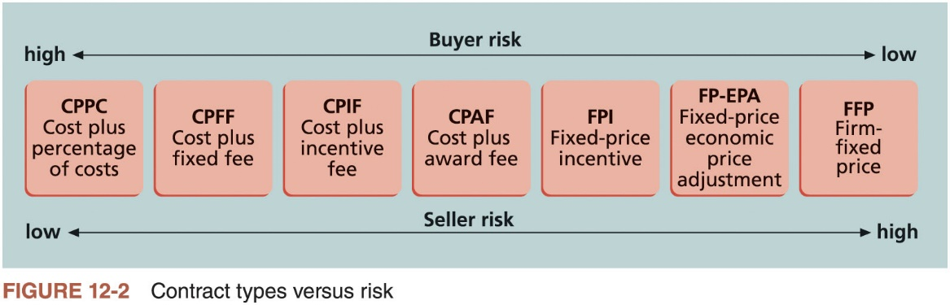
Types of Contracts (2 of 3)

Slide 14
Media Snapshot
Contract incentives can be extremely effective
On August 1, 2007, tragedy struck Minneapolis, Minnesota, when a bridge on I-35W collapsed, killing 13 motorists, injuring 150 people, and leaving a mass of concrete and steel in the river and on its banks
Peter Sanderson, project manager for the joint venture of Flatiron-Manson led his team in completing the project
The contractors earned $25 million in incentive fees on top of their $234 million contract for completing the bridge three months ahead of schedule
MnDOT justified the incentive payment by saying that each day the bridge was closed it cost road users more than $400,000

Slide 15
Types of Contracts (3 of 3)
Contracts should include specific clauses to take into account issues unique to the project
Time and material contracts and unit-price contracts can be high or low risk, depending on the nature of the project and other contract clauses
A termination clause allows the buyer or supplier to end the contract

Slide 16
Tools and Techniques for Planning Procurement Management
Several tools and techniques are available to help project managers and their teams in planning procurement management
Make-or-buy analysis
General management technique used to determine whether an organization should make or perform a particular product or service inside the organization or buy from someone else
Expert judgment
Experts both from inside and outside an organization can provide excellent advice in planning purchases and acquisitions
Market research
Many potential suppliers are often available for goods and services, so the project team must choose suppliers carefully

Slide 17
Procurement Management Plan
Describes how the procurement processes will be managed, from developing documentation for making outside purchases or acquisitions to contract closure
Contents varies based on project needs

Slide 18
Statement of Work (1 of 2)
A statement of work (SOW) is a description of the work required for the procurement
If a SOW is used as part of a contract to describe only the work required for that particular contract, it is called a contract statement of work
A contract SOW is a type of scope statement
A good SOW gives bidders a better understanding of the buyer’s expectations

Slide 19
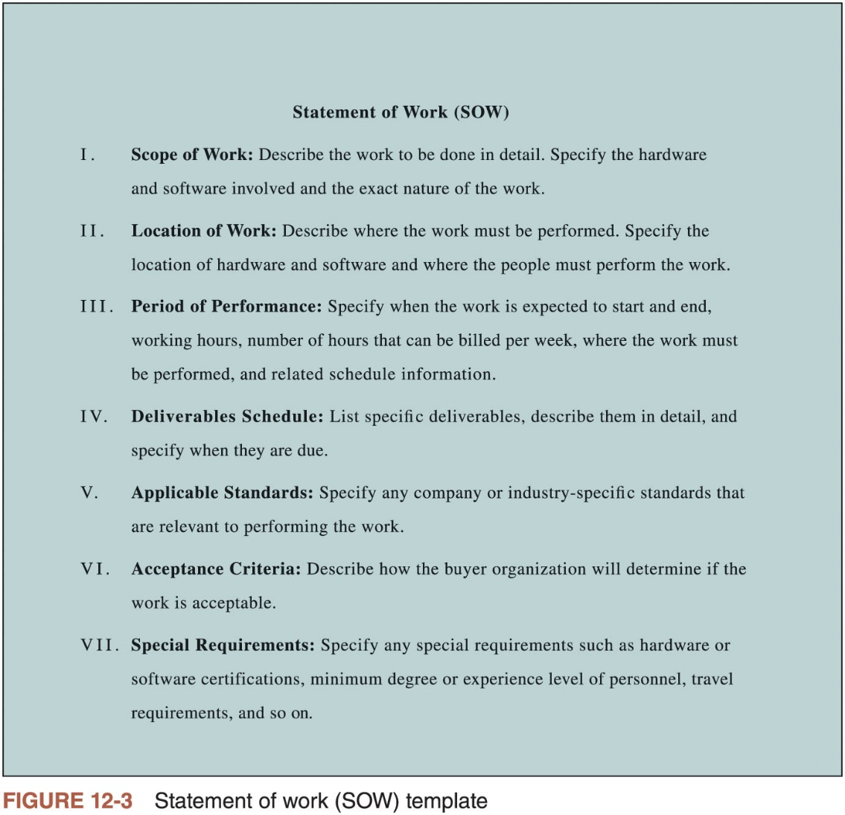
Statement of Work (2 of 2)

Slide 20
Procurement or Bid Documents
Request for Proposals: used to solicit proposals from prospective sellers
A proposal is a document prepared by a seller when there are different approaches for meeting buyer needs
Requests for Quotes: used to solicit quotes or bids from prospective suppliers
A bid, also called a tender or quote (short for quotation), is a document prepared by sellers providing pricing for standard items that have been clearly defined by the buyer

Slide 21
Examples from a Real RFP
Government agencies are often required to make procurement information open to the public
Refer to Table 12-1 and 12-2 for an example
It’s very important for buyers to clarify what they want so that sellers can respond appropriately

Slide 22
Source Selection Criteria
It’s important to prepare some form of evaluation criteria, preferably before issuing a formal RFP or RFQ
Organizations use criteria to rate or score proposals, and they often assign a weight to each criterion to indicate its importance
Beware of proposals that look good on paper
Be sure to evaluate factors, such as past performance and management approach
Some IT projects also require potential sellers to deliver a technical presentation as part of their proposal
The proposed project manager should lead the potential seller’s presentation team

Slide 23
Conducting Procurements (1 of 4)
Steps after planning for procurement management
Decide whom to ask to do the work
Send appropriate documentation to potential sellers
Obtain proposals or bids
Select a seller
Award a contract

Slide 24
Conducting Procurements (2 of 4)
Approaches for procurement
Organizations can advertise to procure goods and services in several ways
Approaching the preferred supplier
Approaching several potential suppliers and taking bids
A bidders’ conference can help clarify expectations
Meeting with prospective sellers prior to preparation of their proposals or bids

Slide 25
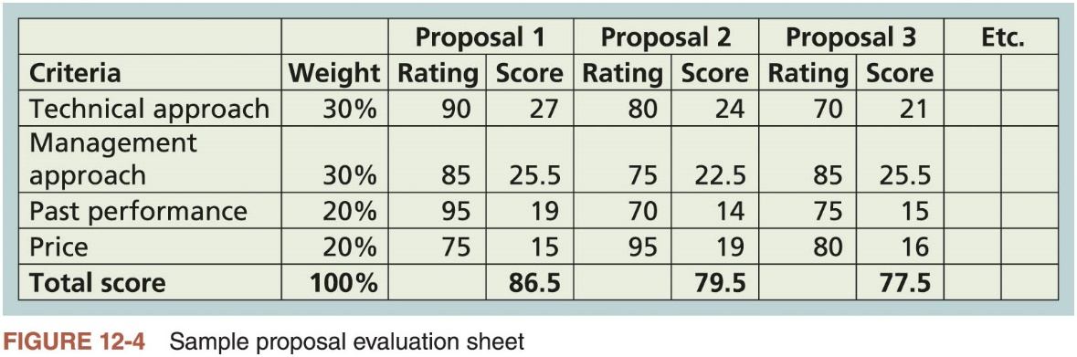
Conducting Procurements (3 of 4)

Slide 26
Conducting Procurements (4 of 4)
Seller selection
After developing a short list of possible sellers, organizations often follow a more detailed proposal evaluation process
It is customary to have contract negotiations during the source selection process
Sellers on the short list often prepare a best and final offer (BAFO)
Final output is a contract signed by the buyer and the selected seller

Slide 27
Controlling Procurements (1 of 4)
Ensures the seller’s performance meets contractual requirements
Contracts are legal relationships, so it is important that legal and contracting professionals be involved in writing and administering contracts
Project team members must be aware of potential legal problems they might cause by not understanding a contract
It is critical that project managers and team members watch for constructive change orders
Oral or written acts or omissions by someone with actual or apparent authority that can be construed to have the same effect as a written change order

Slide 28
Controlling Procurements (2 of 4)
Suggestions for change control in contracts
Changes to any part of the project need to be reviewed, approved, and documented by the same people in the same way that the original part of the plan was approved
Evaluation of any change should include an impact analysis
Changes must be documented in writing
Project managers and teams should stay closely involved to make sure the new system will meet business needs and work in an operational environment
Have backup plans
Use tools and techniques, such as a contract change control system, buyer-conducted performance reviews, inspections and audits, etc.

Slide 29
Controlling Procurements (3 of 4)
Closing procurements
Involves completing and settling contracts and resolving any open items
The project team should determine if all work was completed correctly and satisfactorily, update records to reflect final results, and archive information for future use
The contract itself should include requirements for formal acceptance and closure

Slide 30
Best Practice
Procurement can be more intelligent
Data scientists build predictive models to analyze big date related to finance, marketing, etc.
Why not model procurement processes?
Behavioral economists know that people do not act rationally
Why no apply irrationality to your advantage in negotiations?
Quality control/assurance departments encourage employees to suggest quality improvements all the time
Why not enable your workers to be on the lookout for additional new and innovative suppliers?
Crowdsourcing solicits ideas from a large group of people
Can it apply to some of your organization’s procurements?

Slide 31
Controlling Procurements (4 of 4)
Tools to assist in contract closure
Procurement audits identify lessons learned in the procurement process
A records management system provides the ability to easily organize, find, and archive procurement-related documents
Ideally, all procurements should end in a negotiated settlement between the buyer and the seller; if negotiation is not possible, then some type of alternate dispute resolution such as mediation or arbitration can be used
Archiving information for future use is particularly important

Slide 32
Using Software to Assist in Project Procurement Management (1 of 2)
Word-processing software: write proposals and contracts
Spreadsheet software: create proposal evaluation worksheets
Databases: track suppliers
Presentation software: present procurement-related information
E-procurement software: electronic procurement functions

Slide 33
Using Software to Assist in Project Procurement Management (2 of 2)
Procure-to-pay suite: provides support for indirect procurements
E-purchasing functionality
Catalog management capabilities
E-invoicing
Accounts Payable Invoice Automation

Slide 34
Considerations for Agile/Adaptive Environments
Agile Manifesto values customer collaboration over contract negotiation, setting an important tone for procurement relationships on agile projects
The buyer and seller should work together to create the required products and services throughout the entire procurement process
Another goal of agile/adaptive environments is speed
Several procurements, however, take time
Processes of project procurement management follow a clear, logical sequence
Project managers and their teams must follow good project procurement management

Slide 35
Chapter Summary
Procurement, purchasing, or outsourcing is the acquisition of goods and services from an outside source
Project procurement management includes planning procurement management and then conducting and controlling procurements
Involves deciding what to procure or outsource, what type of contract to use, and how to describe the effort in a statement of work
Several types of software can assist in project procurement management

