Slide 1
Chapter 13: Project Stakeholder Management
Information Technology Project Management, Ninth Edition
Note: See the text itself for full citations

Slide 2
Learning Objectives
Explain the importance of project stakeholder management throughout the life of a project
Discuss the process of identifying stakeholders, how to create a stakeholder register, and how to perform a stakeholder analysis
Describe the contents of a stakeholder engagement plan
Describe the process of managing stakeholder engagement
Explain methods for monitoring stakeholder engagement
Discuss types of software available to assist in project stakeholder management
Discuss considerations for agile/adaptive environments

Slide 3
Importance of Project Stakeholder Management (1 of 4)
Because stakeholder management is so important to project success, the Project Management Institute decided to create an entire knowledge area devoted to it in 2013
The purpose of project stakeholder management is to identify all people or organizations affected by a project, to analyze stakeholder expectations, and to effectively engage stakeholders

Slide 4
Importance of Project Stakeholder Management (2 of 4)
Projects often cause changes in organizations, and some people may lose their jobs when a project is completed
Project managers might be viewed as enemies
By contrast, they could be viewed as allies if they lead a project that helps increase profits, produce new jobs, or increase pay for certain stakeholders
In any case, project managers must learn to identify, understand, and work with a variety of stakeholders

Slide 5
What Went Wrong?
Changing the way work is done can send a shock wave through an organization, leaving many people afraid and even thinking about ways to stop or sabotage a project
Donald White, founder and program manager at Defense Systems Leaders in Washington, D.C., described situations that can lead to project sabotage:
Buy-in blues
Short-term profits
Overachieving
Lack of respect

Slide 6
Importance of Project Stakeholder Management (3 of 4)
Project stakeholder management processes
Identifying stakeholders: identifying everyone involved in the project or affected by it, and determining the best ways to manage relationships with them
Planning stakeholder management: determining strategies to effectively engage stakeholders
Managing stakeholder engagement: communicating and working with project stakeholders to satisfy their needs and expectations, resolving issues, and fostering engagement in project decisions and activities
Monitoring stakeholder engagement: monitoring stakeholder relationships and adjusting plans and strategies for engaging stakeholders as needed

Slide 7
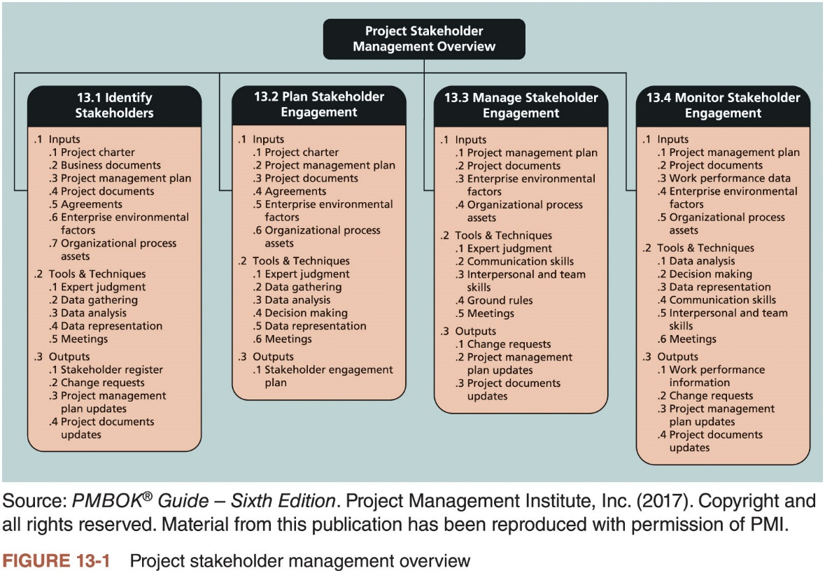
Importance of Project Stakeholder Management (4 of 4)

Slide 8
Identifying Stakeholders (1 of 7)
Internal project stakeholders generally include the project sponsor, project team, support staff, and internal customers for the project
Other internal stakeholders include top management, other functional managers, and other project managers because organizations have limited resources
External project stakeholders include the project’s customers (if they are external to the organization), competitors, suppliers, and other external groups that are potentially involved in the project or affected by it, such as government officials and concerned citizens

Slide 9
Identifying Stakeholders (2 of 7)
Peter Gilliland, a project management tutor and skills coach in the United Kingdom, offers an even more detailed list of potential stakeholders for a project, including:
Program director and manager
Project manager and family
Sponsors
Customers
Labor unions
Potential customers
Competitors
It is also necessary to focus on stakeholders with the most direct ties to a project
Example: only key suppliers

Slide 10
Identifying Stakeholders (3 of 7)
A stakeholder register includes basic information on stakeholders
Identification information: stakeholders’ names, positions, locations, roles in the project, and contact information
Assessment information: stakeholders’ major requirements and expectations, potential influences, and phases of the project in which stakeholders have the most interest
Stakeholder classification: is the stakeholder internal or external to the organization? Is the stakeholder a supporter of the project or resistant to it?

Slide 11
Identifying Stakeholders (4 of 7)
Name | Position | Internal/ External | Project Role | Contact Information
Stephen | VP of Operations | Internal | Project sponsor | stephen@globaloil.com
Betsy | CFO | Internal | Senior manager, approves funds | betsy@globaloil.com
Chien | CIO | Internal | Senior manager, PM’s boss | chien@globaloil.com
Ryan | IT analyst | Internal | Team member | ryan@globaloil.com
Lori | Director, Accounting | Internal | Senior manager | lori@globaloil.com
Sanjay | Director, Refineries | Internal | Senior manager of largest refinery | sanjay@globaloil.com
Debra | Consultant | External | Project manager | debra@gmail.com
Suppliers | Suppliers | External | Supply software | suppliers@gmail.com
Table 13-1 Sample stakeholder register

Slide 12
Identifying Stakeholders (5 of 7)
After identifying key project stakeholders, you can use different classification models to determine an approach for managing stakeholder relationships
A power/interest grid can be used to group stakeholders based on their level of authority (power) and their level of concern (interest) for project outcomes

Slide 13
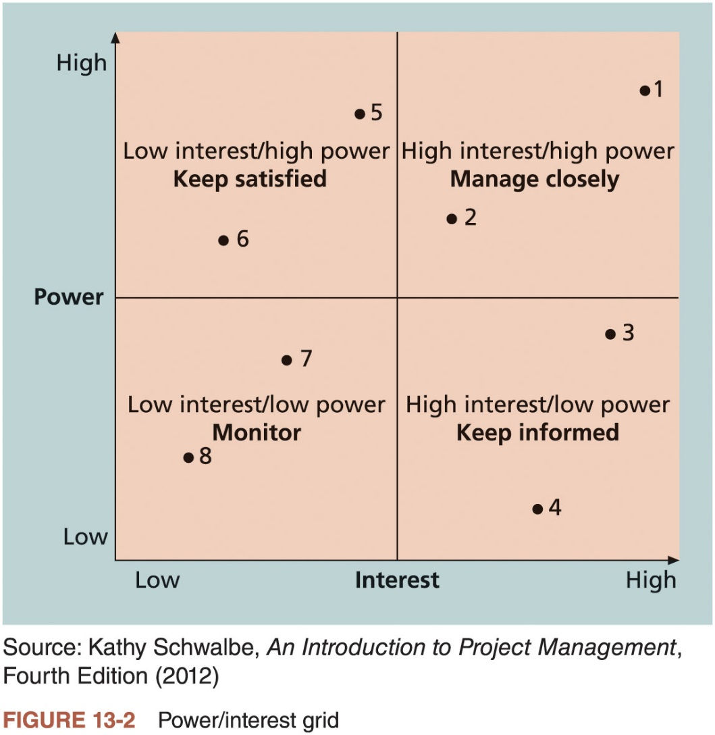
Identifying Stakeholders (6 of 7)

Slide 14
Identifying Stakeholders (7 of 7)
Stakeholder engagement levels
Unaware: unaware of the project and its potential impacts on them
Resistant: aware of the project yet resistant to change
Neutral: aware of the project yet neither supportive nor resistant
Supportive: aware of the project and supportive of change
Leading: aware of the project and its potential impacts and actively engaged in helping it succeed

Slide 15
What Went Right?
Instead of just saying “no” when your project sponsor asks for something unreasonable, it is better to explain what is wrong with the request and then present a realistic way to solve the problem at hand
Christa Ferguson, a PMP® and independent program manager in San Francisco, described how she handled a request from a project sponsor to deliver a new tablet device in two months when she knew she would need more time
Based on her experience, she knew the RFQ for the effort alone would take almost a month
Christa quickly researched the facts to propose a realistic delivery schedule
The project sponsor reset expectations once he learned what it took to produce the tablets

Slide 16
Planning Stakeholder Management (1 of 2)
After identifying and analyzing stakeholders, project teams should develop a plan for management them
May be formal or informal, based on the needs of the project
The stakeholder management plan can include:
Current and desired engagement levels
Interrelationships between stakeholders
Communication requirements
Potential management strategies for each stakeholders
Methods for updating the stakeholder management plan

Slide 17
Planning Stakeholder Management (2 of 2)
Because a stakeholder management plan often includes sensitive information, it should not be part of the official project documents, which are normally available for all stakeholders to review
In many cases, only project managers and a few other team members should prepare the stakeholder management plan
Parts of the stakeholder management plan are not written down, and if they are, distribution is strictly limited

Slide 18
Managing Stakeholder Engagement (1 of 4)
Project success is often measured in terms of customer/sponsor satisfaction
Project sponsors often rank scope, time, and cost goals in order of importance and provide guidelines on how to balance the triple constraint
This ranking can be shown in an expectations management matrix to help clarify expectations

Slide 19
Managing Stakeholder Engagement (2 of 4)
Measure of Success | Priority | Expectations | Guidelines
Scope | 1 | The scope statement clearly defines mandatory requirements and optional requirements. | Focus on meeting mandatory requirements before considering optional ones. In this case, following corporate IT standards is optional.
Time | 1 | There is little give in the project completion date. The schedule is very realistic. | The project sponsor must be alerted if any issues might affect meeting schedule goals.
Cost | 3 | This project is crucial to the organization. If you can clearly justify the need for more funds, they can be made available. | There are strict rules for project expenditures and escalation procedures. Cost is very important, but it takes a back seat to meeting schedule and then scope goals.
Technology/ standards | 2 | There are several potential solutions available, but only one that meets all of the sponsor’s technical requirements, especially for accounting. | While corporate IT standards are important, an exception makes sense in this case.
Table 13-3 Expectations management matrix

Slide 20
Managing Stakeholder Engagement (3 of 4)
Understanding the stakeholders’ expectations can help in managing issues
Issues should be documented in an issue log, a tool used to document, monitor, and track issues that need resolution
Unresolved issues can be a major source of conflict and result in stakeholder expectations not being met
Issue logs can address other knowledge areas as well

Slide 21
Managing Stakeholder Engagement (4 of 4)
Issue # | Description | Impact | Date Reported | Reported By | Assigned to | Priority (H/M/L) | Due Date | Status | Comments
1 | Need requirements categorized as mandatory and optional | Cannot do much without it | Feb. 4 | Ryan | Stephen | H | Feb. 8 | Closed | Requirements clearly labeled
2 | Need shorter list of potential suppliers —no more than 10 | Will delay evaluation without it | Feb. 6 | Debra | Ryan | H | Feb. 12 | Open | Almost finished; needed requirements categorized first
Etc.
Table 13-4 Sample issue log

Slide 22
Best Practice
Project managers are often faced with challenges, especially in managing stakeholders
Sometimes they simply cannot meet requests from important stakeholders
Suggestions for handling these situations
Be clear from the start
Explain the consequences
Have a contingency plan
Avoid surprises
Take a stand

Slide 23
Monitoring Stakeholder Engagement (1 of 2)
You cannot control stakeholders, but you can control their level of engagement
Engagement involves a dialogue in which people seek understanding and solutions to issues of mutual concern
Many teachers are familiar with various techniques for engaging students
It is important to set the proper tone at the start of a class or project

Slide 24
Monitoring Stakeholder Engagement (2 of 2)
If a teacher does nothing but lecture on the first day of class or criticizes the first person who offers a comment, students will quickly decide that their best strategy is to keep quiet and maybe not even attend the class
On the other hand, if the teacher uses a lot of activities to get all participants to speak or use technology to participate, they will expect to be active participants in future classes

Slide 25
Media Snapshot
Many students today like to interact via text messages
Ellen DeGeneres, a popular comedian with her own television show, likes to poke fun at text messages in a segment based on amusing errors caused by cell phone auto-correct features
In addition to watching out for auto-correct errors when messaging, users must also be careful who they reply to and what they say in reply

Slide 26
Using Software to Assist in Project Stakeholder Management (1 of 2)
Productivity software like word processors, spreadsheets, and presentation software can aid in creating various documents related to stakeholder management
Communications software like e-mail, blogs, websites, texts, and tweets can aid in stakeholder communications
Collaboration tools like Google docs, wikis, and virtual meeting software can also promote stakeholder engagement in projects

Slide 27
Using Software to Assist in Project Stakeholder Management (2 of 2)
Social media can also help engage stakeholders
LinkedIn has thousands of groups for project management professionals
Some project management software includes functionality like Facebook’s to encourage relationship building on projects, like giving high fives for a job well done
It is crucial that project managers and their teams focus on monitoring stakeholder engagement to meet their needs and expectations, not to show off the latest technology
A lot of stakeholder engagement requires old-fashioned techniques like talking to someone

Slide 28
Global Issues
Not all software implementations go well, and managing stakeholders is a major challenge
The U.K. government scrapped its £11.4 billion national healthcare IT initiative in September 2011 after it failed to deliver the promised benefits
Unfortunately, this project was just one in a series of high-profile failures in the U.K.
In response, the government decided to send its project managers back to school
They partnered with the University of Oxford and the Deloitte consulting firm to establish the Major Projects Leadership Academy in Oxford, England
Currently, 300 people are categorized as major project leaders in the British government
The academy enrolls over 100 major project leaders each year

Slide 29
Considerations For Agile/Adaptive Environments
It is important to understand and involve key stakeholders on all projects
The nature of agile/adaptive projects, however, does often require more stakeholder involvement and faster decision making
Product owners create the backlog for each iteration, thereby ensuring that their priorities are clear
Posting project artifacts in a public space can be done on agile and non-agile projects
Based on the sensitivity of the information and type of project

Slide 30
Chapter Summary
Managing stakeholders is now the tenth knowledge area in the PMBOK® Guide
Processes include:
Identifying stakeholders
Planning stakeholder engagement
Managing stakeholder engagement
Monitoring stakeholder engagement
Several types of software can assist in project stakeholder management
Social media can also help in developing relationships with stakeholders

