Slide 1


Characterizing and Modeling the Impact of Wireless Signal Strength on Smartphone Battery Drain
Ning Ding
Xiaomeng Chen
Abhinav Pathak
Y. Charlie Hu
Daniel Wagner
Andrew Rice

Slide 2
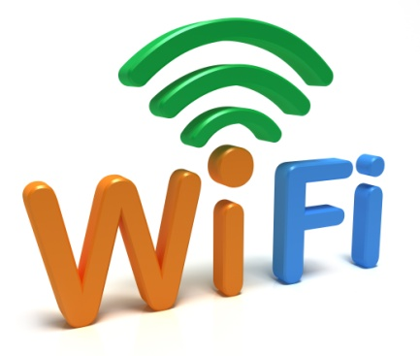



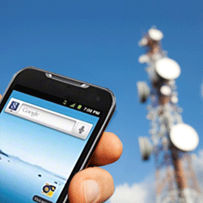

Mobile Networks Connect the World

Slide 3
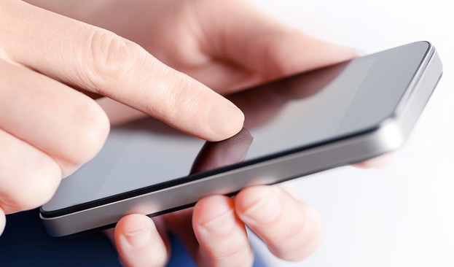







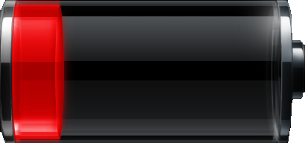
Signal Strength Affects User Experience
Ideally
Reality…

Slide 4


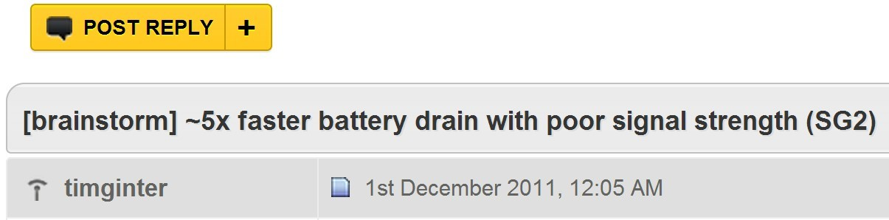

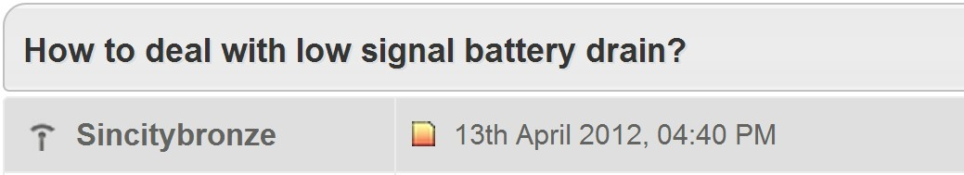
Complaints about Poor Signal

Slide 5
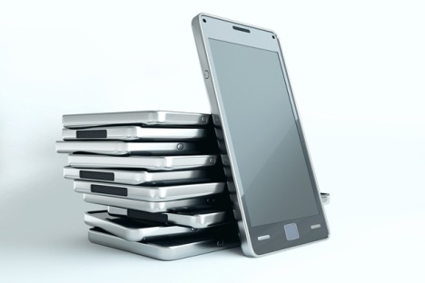

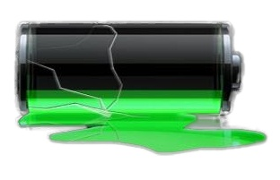

Key Questions about the Impact of Signal Strength
How often are users experiencing poor signal?
How much is the impact on battery drain?
How do we model the extra energy drain?

Slide 6
Key Questions about the Impact of Signal Strength
How often are users experiencing poor signal?
How much is the impact on battery drain?
How do we model the extra energy drain?

Slide 7


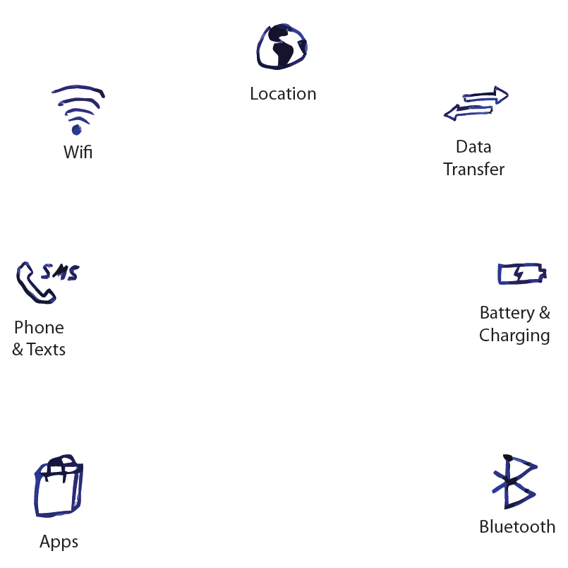

Signal Strength Trace Collection
Your phone changes network cell 213 times per day
You transfer 3.7MB per day with WiFi, and 1.5MB per day with 3G
62% of your phone calls are less than 30s
Your average charging time is 42min
If the user permits, the app will upload anonymous
signal strength and location data

Slide 8
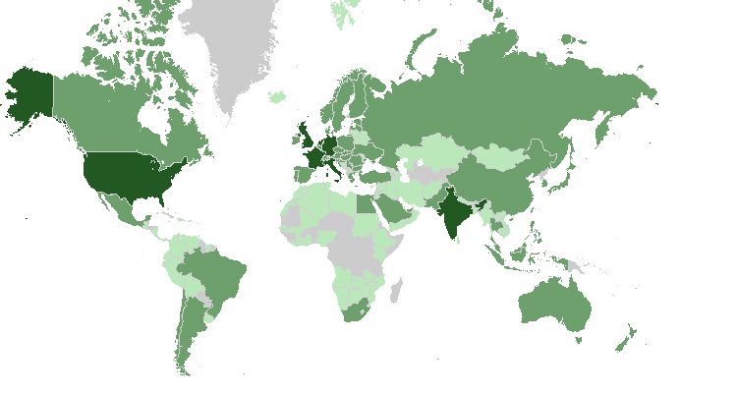
Data Contributors
Contributors:
■ 1-10
■ 11-100
■ 101-1000
Traces (> 1 month) from 3785 users,
145 countries, 896 mobile operators

Slide 9
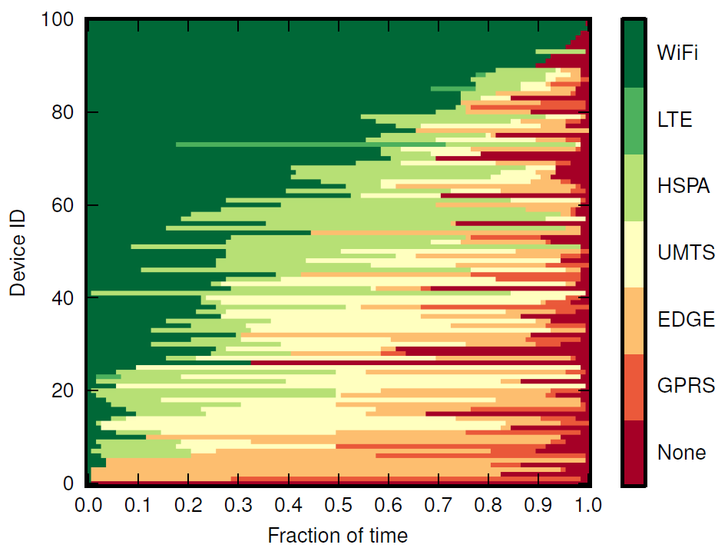
Distribution of Wireless Technologies
100 sampled devices
WiFi 40%
HSPA 42%
UMTS 8%
None 8%
EDGE 2%

Slide 10
Distribution of Wireless Technologies
WiFi and 3G (HSPA, UMTS) are the dominant wireless technologies

Slide 11
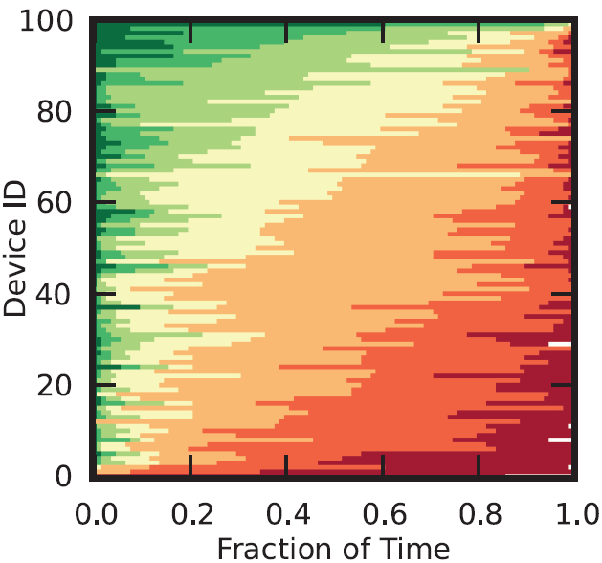
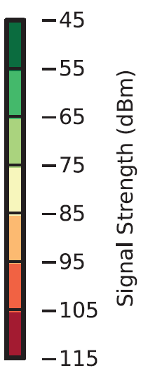
3G Signal Strength Distribution
Poor signal
≤ -91.7dBm [defined by Ofcom]
Empty bar
≤ -109dBm
Full bar
≥ -89dBm
On average users saw poor 3G signal 47% of the time

Slide 12
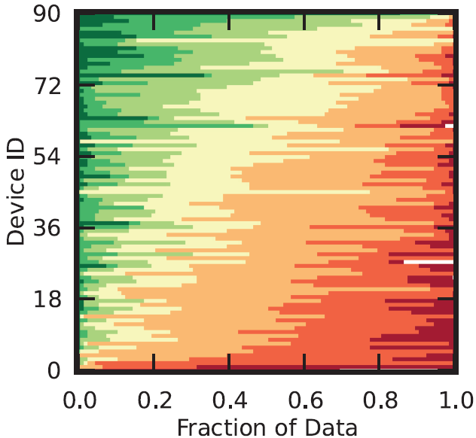
Data Transferred under 3G
43% of 3G data are transferred at poor signal

Slide 13
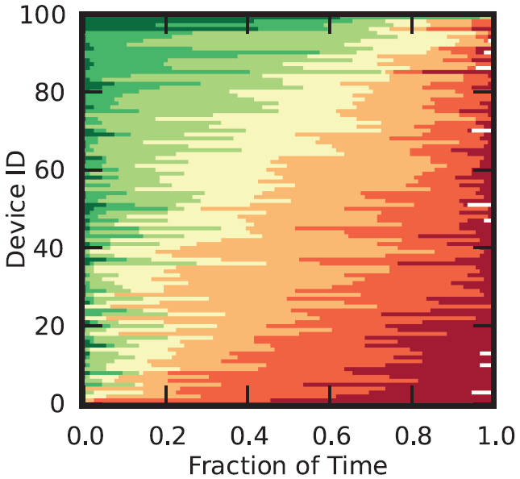
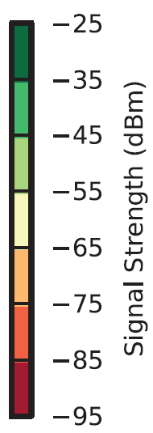
WiFi Signal Strength Distribution
Full bar
≥ -55dBm
Poor signal
≤ -80dBm
Empty bar
≤ -100dBm
On average users saw poor WiFi signal 23% of the time

Slide 14
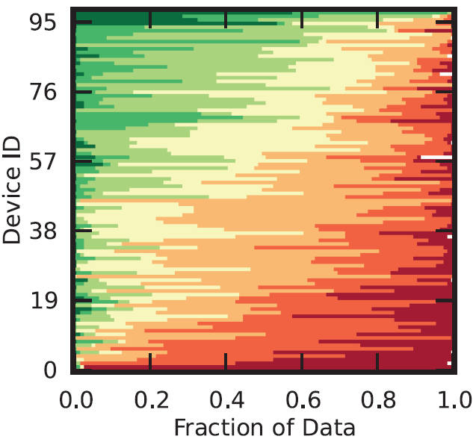
Data Transferred under WiFi
21% of WiFi data are transferred at poor signal

Slide 15
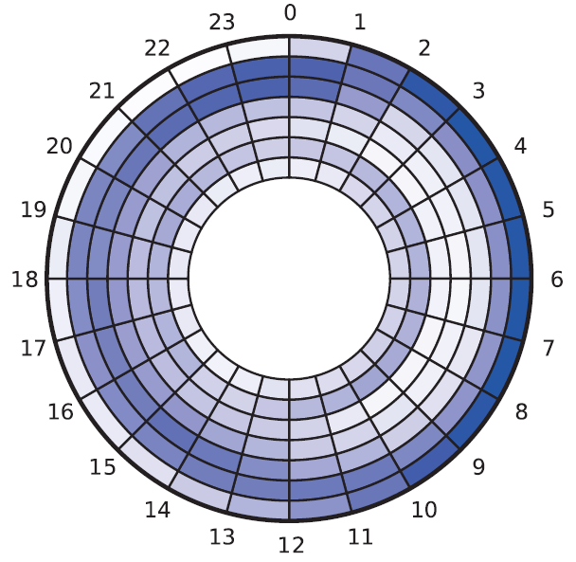
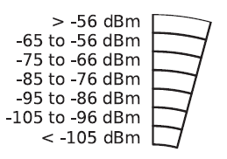
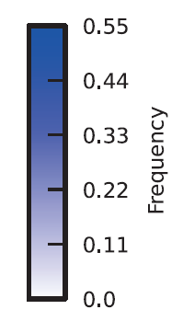
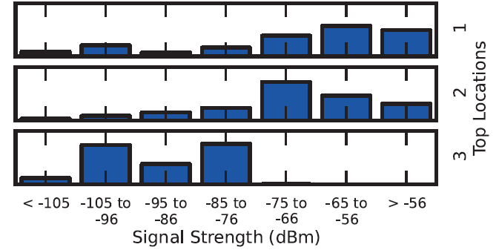
Possible Reasons for Signal Strength Variations
A user with good 3G signal

Slide 16
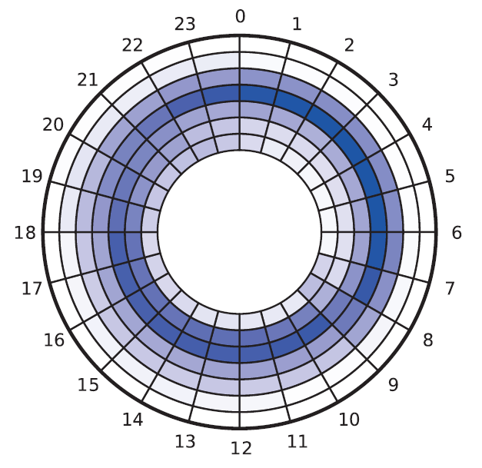
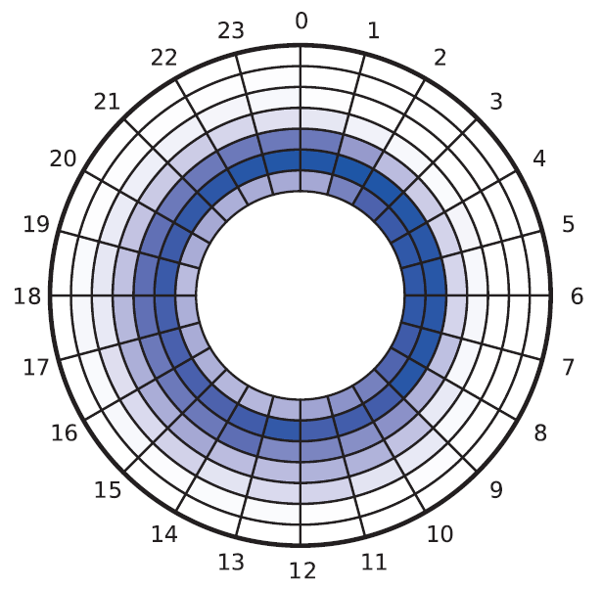

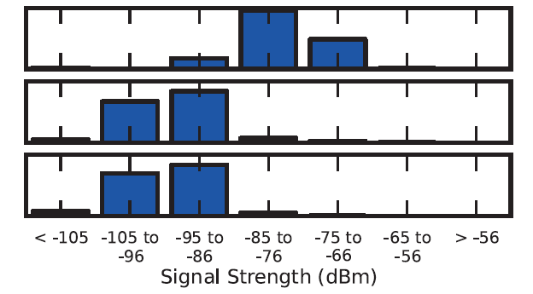
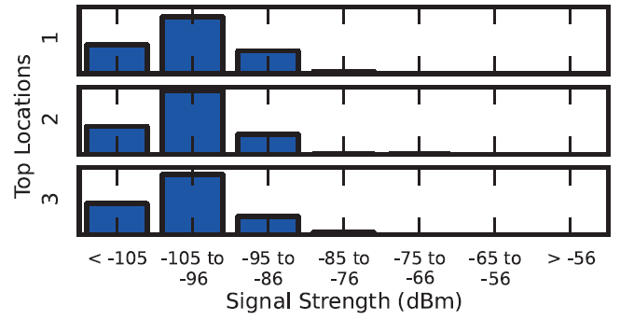
Possible Reasons for Signal Strength Variations
A user with medium 3G signal
A user with poor 3G signal

Slide 17
Summary of Signal Strength Distribution
Users spend significant amount of time in poor signal strength
47% of time in 3G
23% of time in WiFi
A large fraction of data are transferred under poor signal strength
43% of data in 3G
21% of data in WiFi

Slide 18
Key Questions about the Impact of Signal Strength
How often are users experiencing poor signal?
How much is the impact on battery drain?
How do we model the extra energy drain?

Slide 19
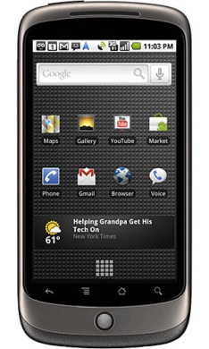
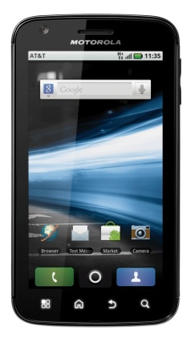
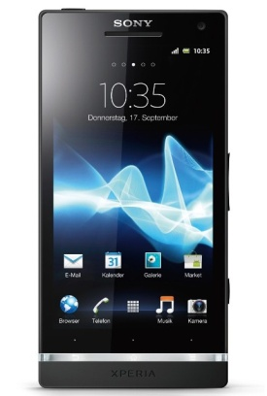
Smartphones Used in Experiments
HTC Nexus One
802.11b/g
T-Mobile 3G
Motorola Atrix 4G
802.11b/g
AT&T 3G
Sony Xperia S
802.11b/g
AT&T 3G
Results shown are for Nexus One phone

Slide 20
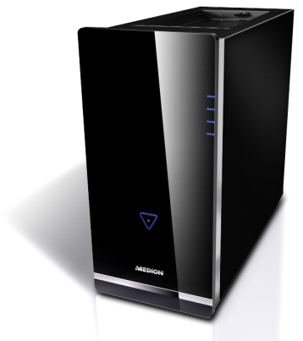
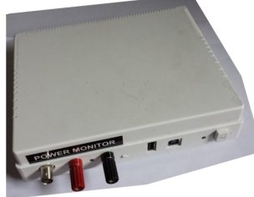
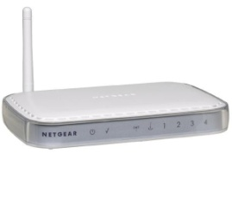
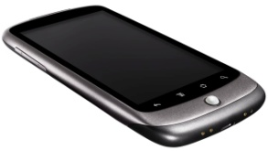


WiFi Experiment Setup
Local server: runs socket server, emulates RTT using tc
Control signal strength by adjusting the distance
Powermeter
Wireless router: connects to server with 100Mbps LAN
Phone: performs 100KB socket downloading
Laptop2: monitor mode, captures all MAC frames
Laptop1: monitor mode, captures all MAC frames

Slide 21
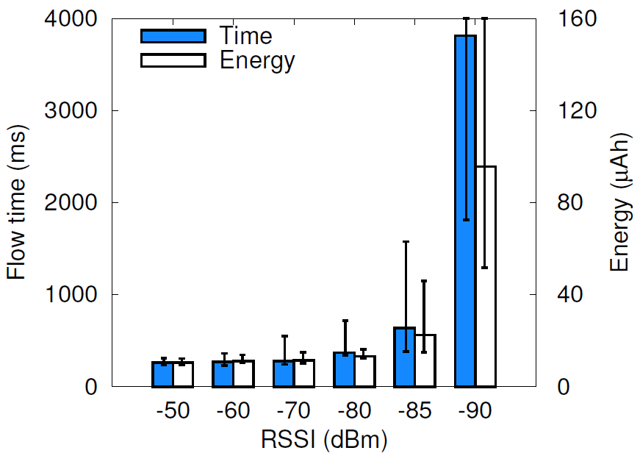
WiFi Experiment Results
-90dBm: 13x longer flow time, 8x more energy, compared to -50dBm
Flow time and energy for 100KB download with 30ms server RTT

Slide 22
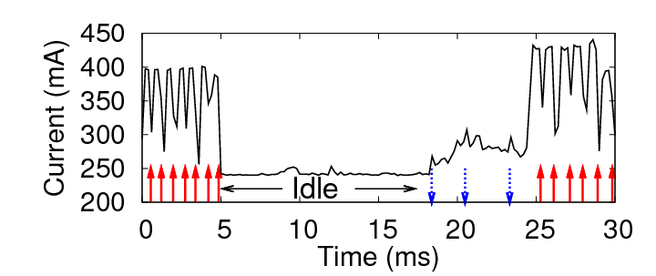
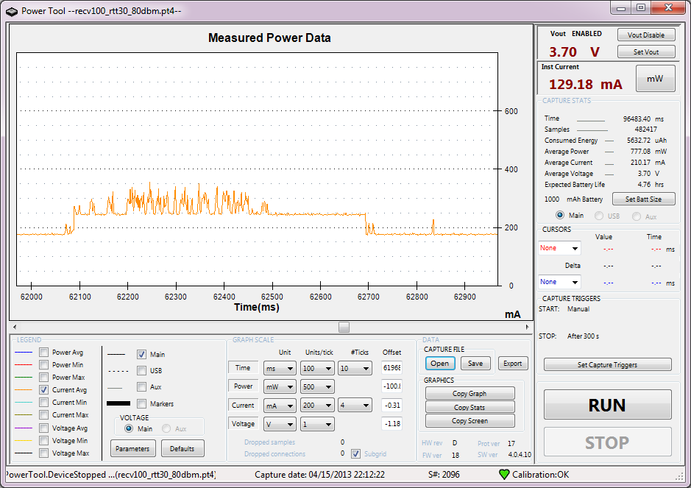



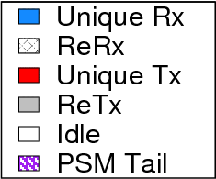
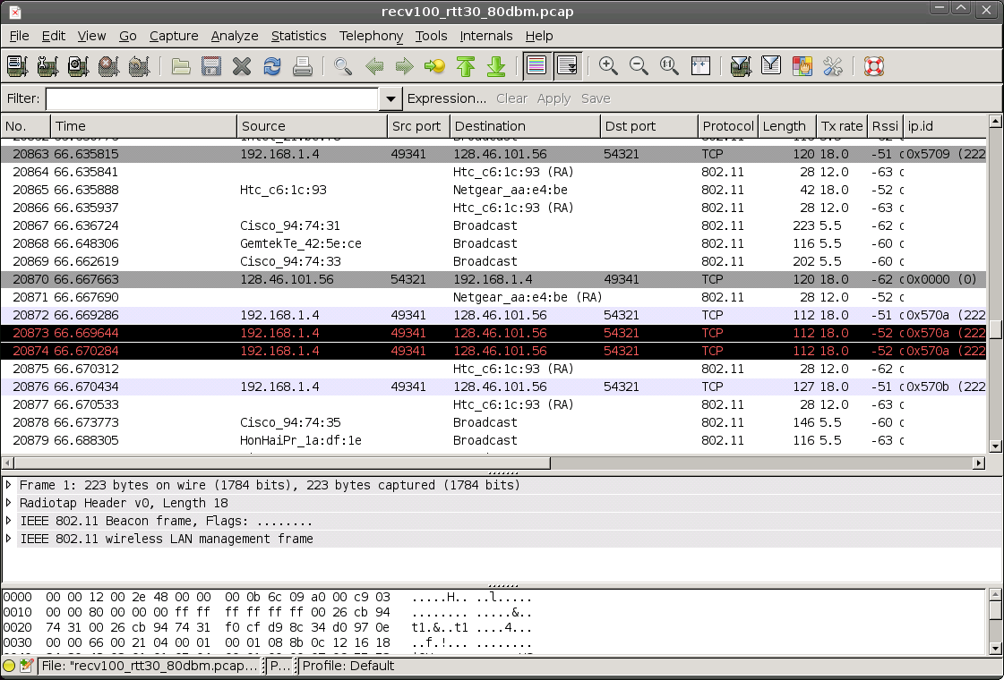
WiFi Energy Breakdown Methodology
Packet send
Packet recv
Power profile from powermeter
A snapshot of synchronized power profile and packet trace
Packet traces from laptops

Slide 23
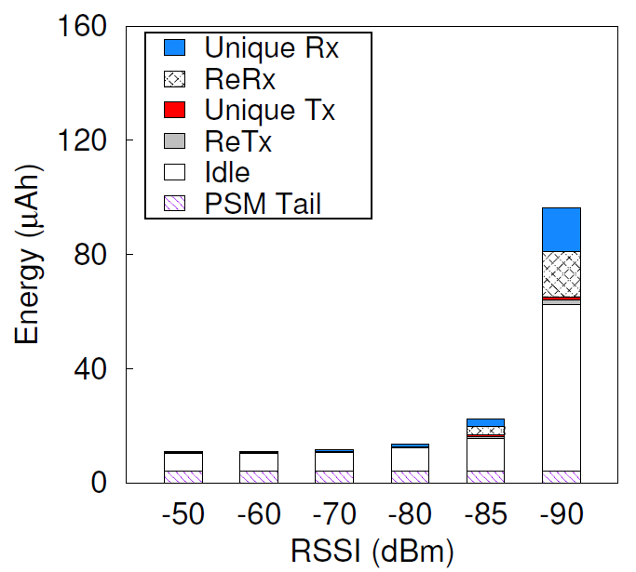
WiFi Energy Breakdown
Energy breakdown

Slide 24
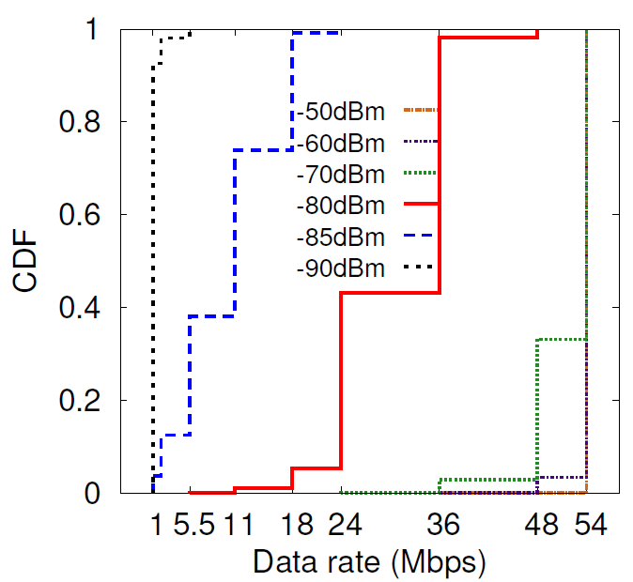
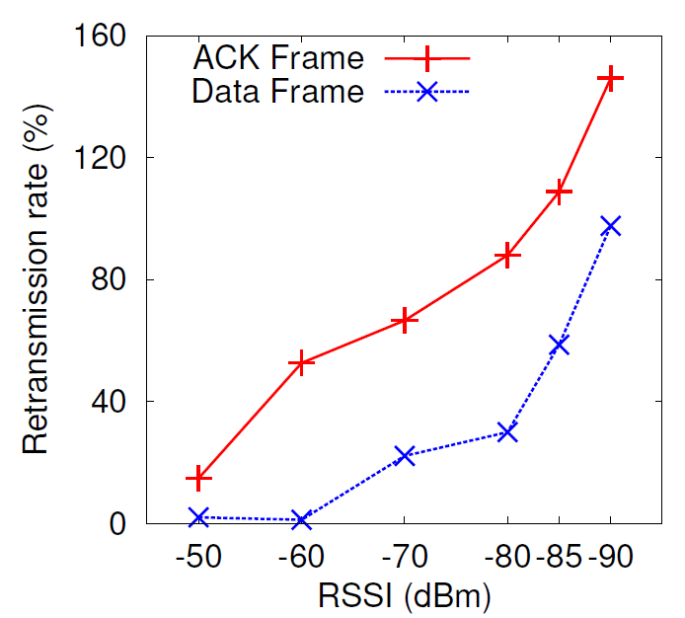
WiFi Energy Breakdown Analysis
Data rate
Retransmission rate
Leads to higher Rx energy
Leads to higher reRx and idle energy

Slide 25
3G Experiment Setup
Local server: runs socket server, emulates RTT using tc, run TCPDump to capture packets
Powermeter
Control signal strength by changing location of the phone
Phone: performs 100KB socket downloading, run TCPDump to capture packets

Slide 26
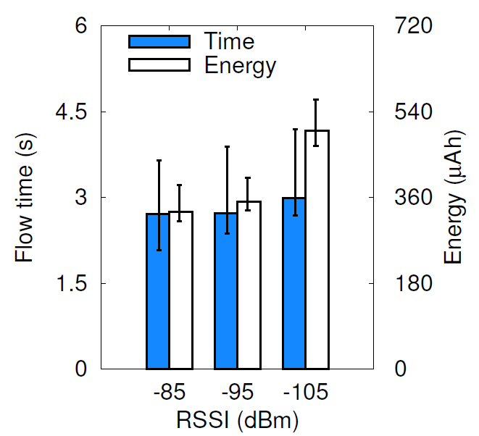
3G Experiment Results
-105dBm: 52% more energy, compared to -85dBm
Flow time and energy for 100KB download with 30ms server RTT

Slide 27
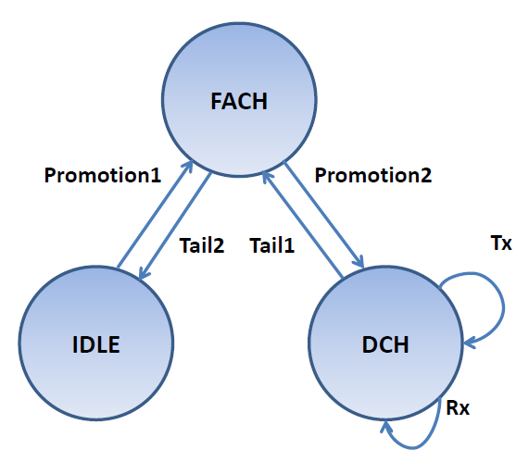
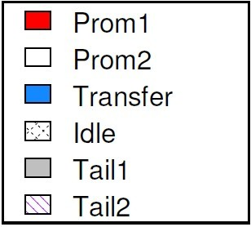

3G Energy Breakdown Methodology
T-Mobile 3G state machine

Slide 28
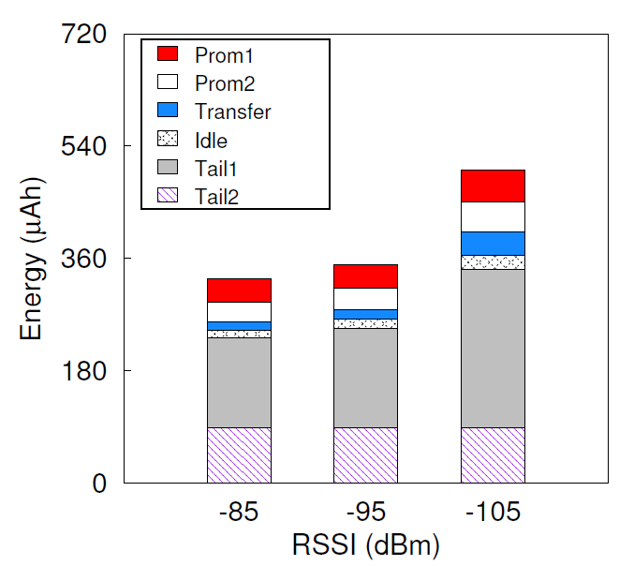
3G Energy Breakdown
-105dBm: 184% more energy on Transfer, 76% more energy on Tail1, compared to -85dBm
Energy breakdown

Slide 29
Key Questions about the Impact of Signal Strength
How often are users experiencing poor signal?
How much is the impact on battery drain?
How do we model the extra energy drain?

Slide 30

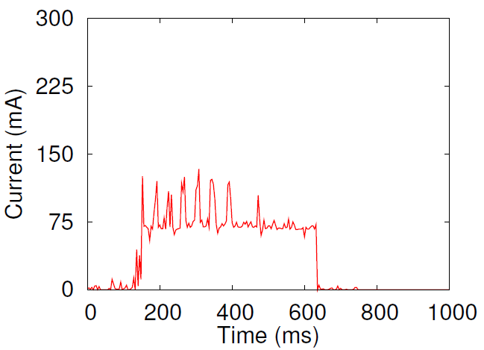
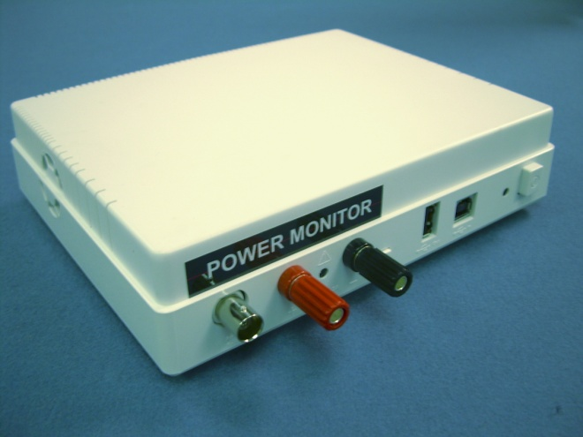
Smartphone Energy Study Requires Power Models
Smartphone
Powermeter
Power Output
Not convenient to use
Cannot do energy accounting

Slide 31

Train Power Models
Correlation between the triggers and energy consumption
Triggers
Power Model

Slide 32
Use Power Models
Power Model
Triggers
Predicted power
Eliminates the need for powermeter
Enables energy accounting

Slide 33


Three Generations of Smartphone Network Power Models
Power Model | Trigger | Network states | Subroutine-level energy accounting | Overhead
Utilization-based
Bytes sent/received
Low
Packet-driven
Packets
High
System-call
driven
System calls
Low
Incorporate the impact of signal strength

Slide 34
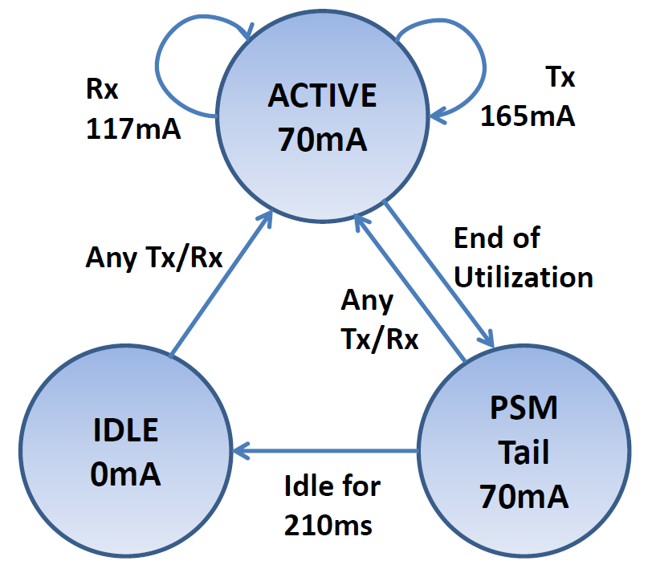
Refine WiFi Packet-driven Power Model
Refine the model by deriving state machine parameters under different WiFi signal strength
WiFi power state machine
under good signal strength

Slide 35
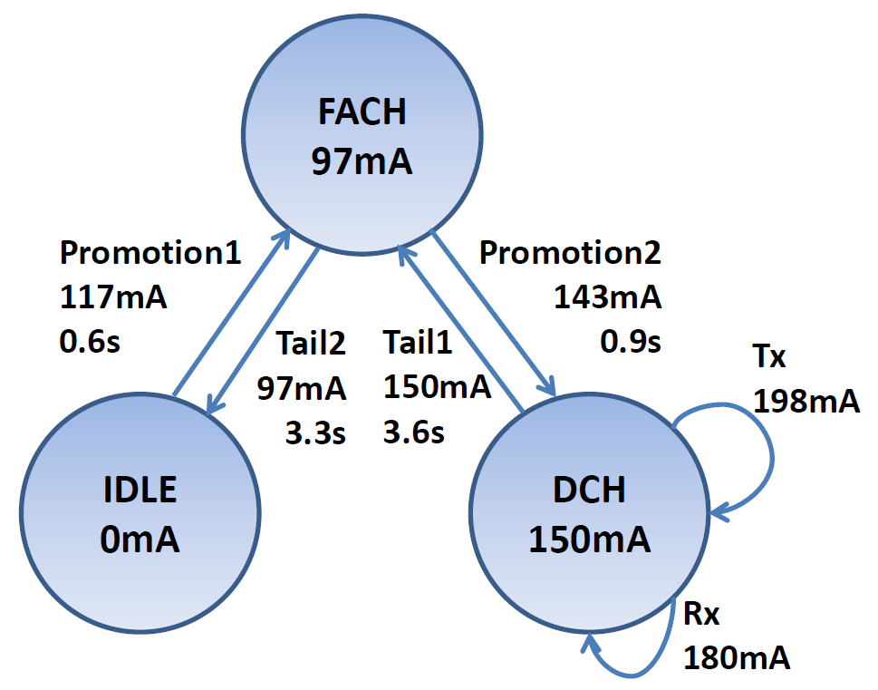
Refine 3G Packet-driven Power Model
Refine the model by deriving state machine parameters under different 3G signal strength
3G power state machine
under good signal strength

Slide 36
Refine System-call-driven Power Models
Incorporate impact of signal strength on
State machine parameters
Effective transfer rate
Details are in the paper

Slide 37
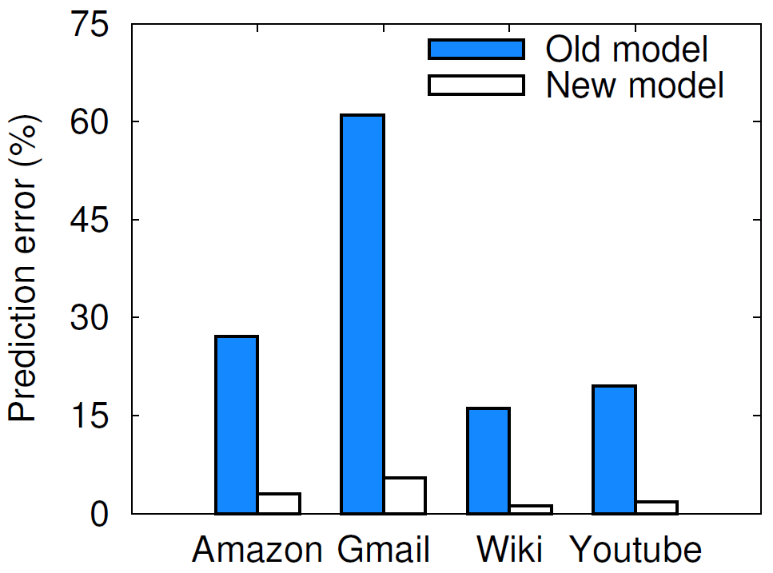
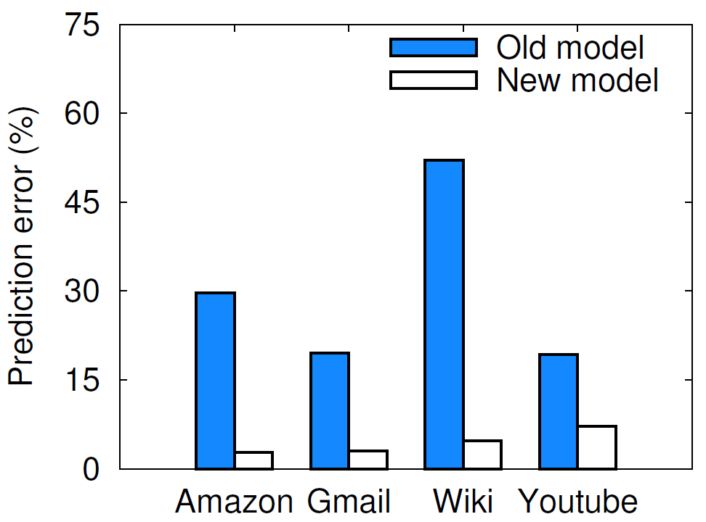
Evaluation of New System-call-driven Power Models
61.0%
52.1%
5.4%
7.2%
Model accuracy under WiFi poor signal (below -80dbm)
Model accuracy under 3G poor signal (below -95dbm)

Slide 38
Conclusion
The first large scale measurement study of WiFi and 3G signal strength
Time under poor signal: 47% for 3G, 23% for WiFi
Data under poor signal: 43% for 3G, 21% for WiFi
Controlled experiments to quantify the energy impact of signal strength
WiFi: 8x more energy under poor signal (-90dBm)
3G: 52% more energy under poor signal (-105dBm)
Refined power models that improve the accuracy under poor signal strength
WiFi: reduce error rate from up to 61.0% to up to 5.4%
3G: reduce error rate decreases from up to 52.1% to up to 7.2%

