Slide 1
The Parameterized Poker Squares EAAI NSG Challenge

Slide 2
What is the EAAI NSG Challenge?
Goal: a fun way to encourage good, faculty-mentored undergraduate research experiences that includes an option for peer-reviewed paper publication and presentation at a major CS conference.
Students may work independently or in teams with a faculty mentor to meet the challenge.
Challenge submissions and associated papers would be submitted at the following EAAI paper submission deadline (late-summer, one month before AAAI submission deadline).
At the next EAAI (February 2016): challenge results, accepted paper presentations, announcement of next NSG Challenge
EAAI 2016 NSG Challenge: Parameterized Poker Squares

Slide 3
Poker Squares (Original)
Materials:
shuffled standard (French) 52-card card deck,
paper with 5-by-5 grid, and
pencil
Each turn, a player draws a card and writes the card rank and suit in an empty grid position.
After 25 turns, the grid is full and the player scores each grid row and column as a 5-card poker hand according to a given point system.

Slide 4
American Point System
Poker Hand | Points | Description | Example
Royal Flush | 100 | A 10-J-Q-K-A sequence all of the same suit | 10♣, J♣, Q♣, K♣, A♣
Straight Flush | 75 | Five cards in sequence all of the same suit | A♦, 2♦, 3♦, 4♦, 5♦
Four of a Kind | 50 | Four cards of the same rank | 9♣, 9♦, 9♥, 9♠, 6♥
Full House | 25 | Three cards of one rank with two cards of another rank | 7♠, 7♣, 7♦, 8♥, 8♠
Flush | 20 | Five cards all of the same suit | A♥, 2♥, 3♥, 5♥, 8♥
Straight | 15 | Five cards in sequence; Aces may be high or low but not both | 8♣, 9♠, 10♥, J♦, Q♣
Three of a Kind | 10 | Three cards of the same rank | 2♠, 2♥, 2♦, 5♣, 7♠
Two Pair | 5 | Two cards of one rank with two cards of another rank | 3♥, 3♦, 4♣, 4♠, A♣
One Pair | 2 | Two cards of one rank | 5♦, 5♥, 9♣, Q♠, A♥
High Card | 0 | None of the above | 2♦, 3♣, 5♠, 8♥, Q♦

Slide 5
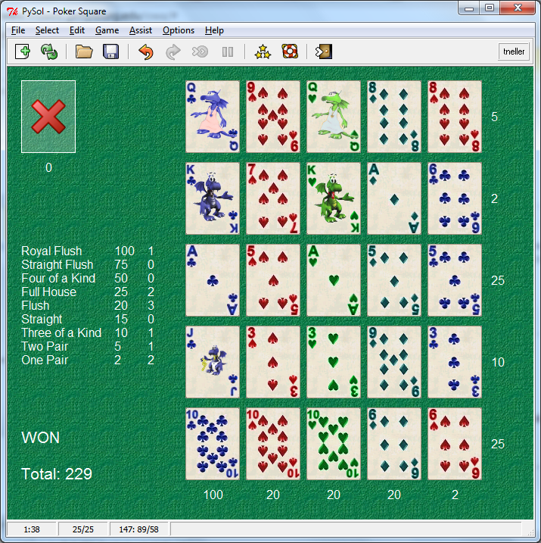
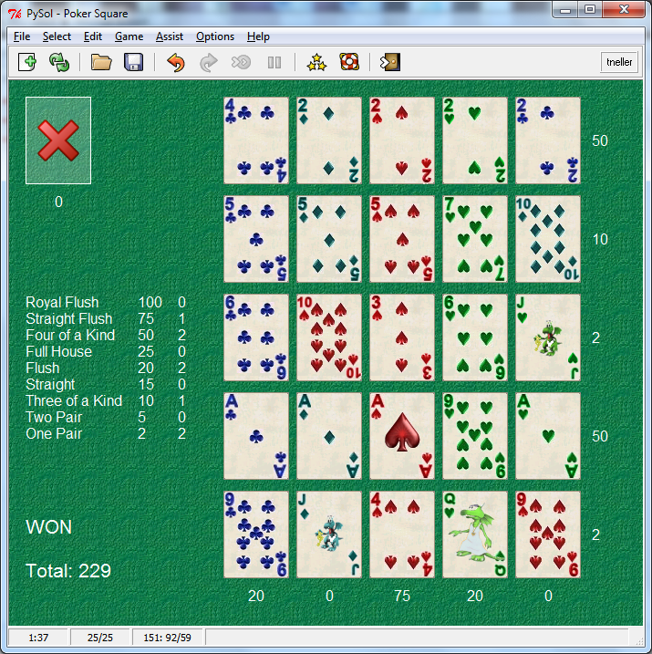
Scoring Examples

Slide 6
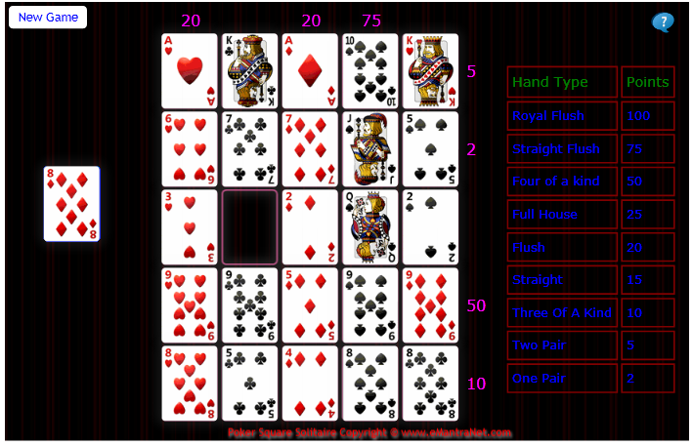
Let’s Play
Web: http://games.emantranet.com/PokerSquare.aspx
Other platforms: See http://tinyurl.com/pokersqrs

Slide 7
Parameterization of Poker Squares
The American Point System (0, 2, 5, 10, 15, 20, 25, 50, 75, 100) is based on hand rank in Poker.
The British Point System (1, 3, 6, 12, 5, 10, 16, 30, 30) is based on the difficulty of forming the hands in Poker Squares. (a.k.a. English Point System)
For our challenge, AI players will be given the scoring system at play time with points in the range [-128, 127]. Examples:
Ameritish point systems: random variations on American and British systems
Single Hand: 1 point for one hand type, 0 points otherwise
Hypercorners: all 1 or -1 score values
Random: random score system in range [-128, 127]

Slide 8
Player Interface
Java software supplied manages games, tournaments, scoring, partial scoring
The Java PokerSquaresPlayer interface is very simple:
void setPointSystem(PokerSquaresPointSystem system, long millis) – Player is given a point system and a given amount of milliseconds (300K) to form strategy from the point system
void init() – Player initializes before a game (e.g. clear board, game history)
int[] getPlay(Card card, long millisRemaining) – Given a drawn card and the number of ms remaining in the 30 second game, return the 0-based row and column the player chooses for the Card
String getName() – return the player name

Slide 9
Structure of the Game
The game is structured as an alternating sequence of chance nodes and player choice nodes.
Each card draw is a probabilistic event where any remaining card is drawn with equal probability.
Each player action is a commitment to a card placement.
chance
choice
chance
choice

Slide 10
Game Tree Size
How big is the Poker Squares game tree?
Root chance node: 52 possible cards
52 depth-1 choice nodes: 25 possible placements
52x25 depth-2 chance nodes: 51 possible cards
52x25x51 depth-3 choice nodes: 24 possible placements
…
52!/27! x 25! = 52!/(27x26) ≅ 1.15x10⁶⁵ nodes
Although:
Different draw/play sequences can lead to the same state.
Rows/columns may be reordered without affecting score.
Still, we will not be able to evaluate entire expectimax trees except for much smaller end-game situations.

Slide 11
Possible Approaches
Rule-based
Reinforcement Learning
Abstract each (partial) hand in play according to scoring potential
Learn expected hand score from simulated experience
Expectimax variations
E.g. Iterative-deepening, iterative-broadening
Monte Carlo Tree Search (MCTS)
???

Slide 12
Evaluation
Players will be evaluated using 4 to 6 point systems. For each point system:
Players will have 5 minutes to process the point system, forming strategy, etc.
Players will then play 100 games with 30 seconds of decision time per game.
Total scores will be linearly scaled between 0 (min. total score) and 1 (max. total score).
The player with the maximum sum of scaled total scores is the winner.

Slide 13
Supplied Code Classes
PokerSquares – manages tournaments, individual games, game sequences, etc.
Card – models playing card
PokerHand – classifies full/partial Poker hand
PokerSquaresPointSystem – generates point systems, scores hands and grids, prints grids
PokerSquaresPlayer – player interface
Sample PokerSquaresPlayer implementations

Slide 14
What’s Next?
Share Poker Squares with potential faculty mentors and undergraduate student researchers.
Form teams and contact the contest organizer (Todd Neller) to get on the contest mailing list for updates.
Download software and resources from http://tinyurl.com/ppokersqrs
Enjoy creating and experimenting with your Parameterized Poker Squares players.
Submit them for evaluation towards the end of the summer 2015.
Optional: Write up your research results with your faculty mentor and submit your paper to EAAI one month later.
If accepted, present your work at EAAI in February 2016.
Papers will appear with EAAI papers in the AAAI proceedings.

Slide 15
Resources and References
Organizer email: Todd Neller <tneller@gettysburg.edu>
Poker Squares Page: http://tinyurl.com/pokersqrs
References
Rules and play grids
Parameterized Poker Squares Page: http://tinyurl.com/ppokersqrs
Monte Carlo Tree Search (MCTS):
C. Browne et al. A Survey of Monte Carlo Tree Search Methods
L. Kocsis, C. Szepesvari. Bandit based Monte-Carlo Planning.
http://www.mcts.ai/?q=mcts
MCTS application to similar problem: R. Lorentz. An MCTS Program to Play EinStein Würfelt Nicht!

