Slide 1
Viola Jones – Face detection
Bulgaru Robert
Ioana George-Alexandru
Doru Blanzeanu

Slide 2
Introduction
In computer vision,a fundamental problem is represented by detecting objects from images/videos,in particular,faces.
This project's goal is to obtain better performance for real-time detection from images such as PNM

Slide 3
How the algorithm works?
Detection is done by using a trained cascade of shifted classifiers ;
These classifiers scan for Haar features within sliding windows of variable size through the entire image.

Slide 4

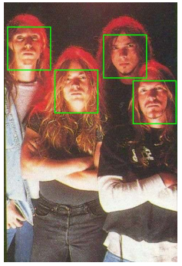
Results obtained after parallelization

Slide 5
Parallelization of the serial version
OpenMP and Cilk parallelized the outer loop spawning the sliding window;
Obtained a slight improvement of the execution time;
We observed that the parallel version was scalable
Tbb could not be successfully finished

Slide 6
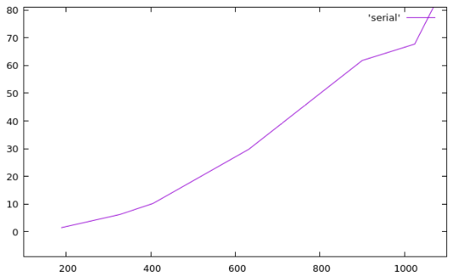
Results obtained for OpenMP

Slide 7
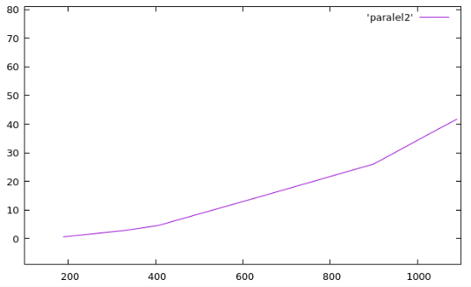
2 threads

Slide 8
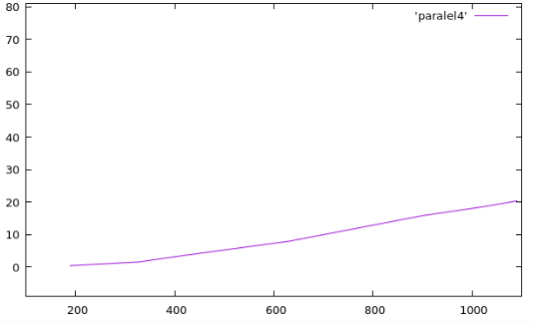
4 threads

Slide 9
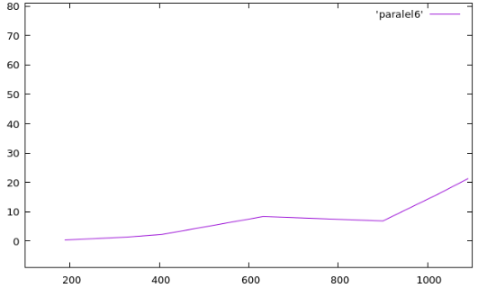
6 threads

Slide 10
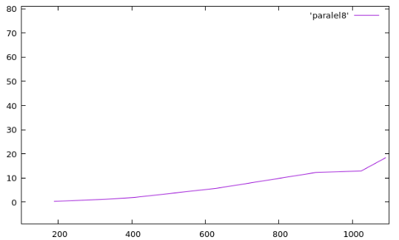
8 threads

Slide 11
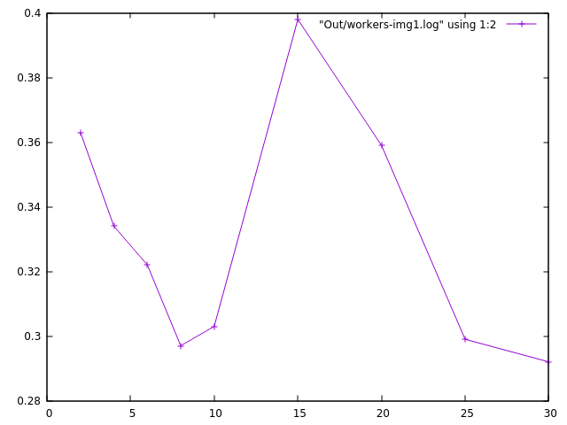
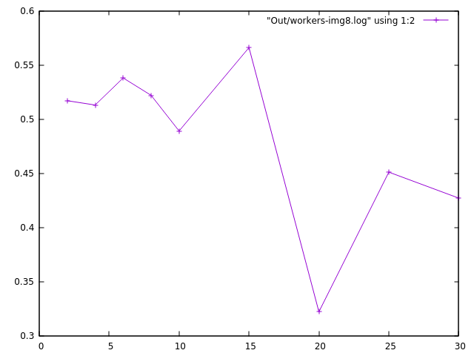
Results obtained for Cilk

Slide 12
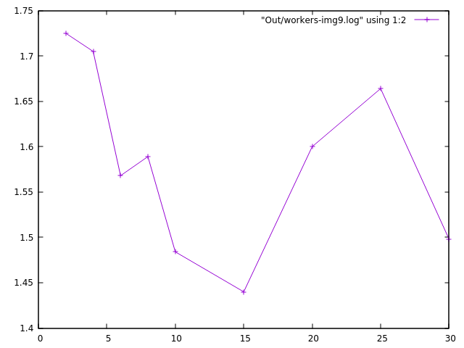
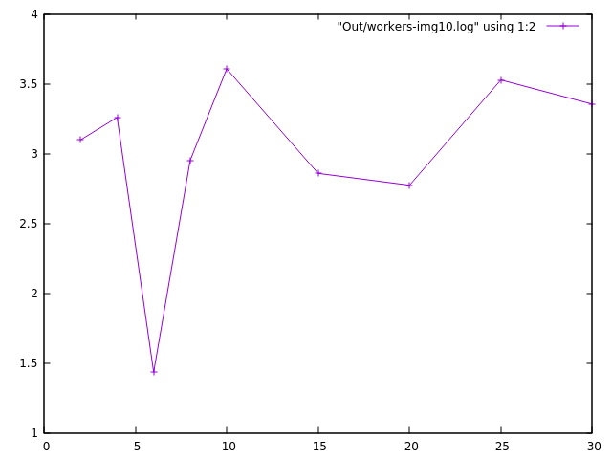
Results obtained for Cilk

Slide 13
Conclusions
The execution times was improved
Scalability was maintained

Slide 14
Bibliography
https://www.techleer.com/articles/277-an-insight-into-the-first-face-detection-algorithm-viola-jones/
https://en.wikipedia.org/wiki/Viola%E2%80%93Jones_object_detection_framework
http://iopscience.iop.org/article/10.1088/1742-6596/1007/1/012013/pdf
http://www.ipol.im/pub/art/2014/104/article.pdf
https://github.com/blanzeanudoru/pp

